Slide 1
Local Module Migration Support (MD 18)
Nicolas Rouquette
December 31, 2014

Slide 2
MagicDraw Projects & “Standard/System” Local Modules
Every MD project (local or teamwork) uses several locally-installed
“standard/system” modules
MD Project
MD UML
Standard Profile
MD
SysML
Profile
ISO
80K
Library
IMCE
Ontology
Profiles
DocGen
Profiles
CAESAR
Profile
…
MD’s standard/system modules change with the MD version changes
Other standard/system modules come from
JPL’s SECAE, JPL’s projects or (advanced) users
These may change more often than MD’s versions

Slide 3
Updating “Standard/System” Local Modules
Typically, additions do not induce migration problems:
Projects that used M(v1)
now use M(v2)
Typically, modifications induce migration problems:
Projects that used M(v2)
need migration to use M(v3)
MD Users use M in their MD projects (P, Q, …)
P
Q
P
Q
P
Q
…
…
…
✔
✔
✗
M
(v1)
M
(v1)
M
(v2)
M
(v3)
time
New Standard/System module M(v1) distributed
M(v2) = M(v1) + Additions
M(v3) = M(v2) +
Modifications
(deletions, changes)

Slide 4
Migration Workflow for Standard/System Modules
Incompatible changes made to a Standard/System module M from (v) => (v’)
The Project Usage Integrity Checker (PUIC) will detect problems when opening P with M(v’) installed
M(v)
M(v’)
P
P
Generate M(v) => M(v’)
ID migration map
✔
✗
M(v)
M(v’)
Open P with the OMG Tool Infrastructure wizard
User selects a module migration map: M(v)
Script forces MD to skip loading module: M(v)
P
P
P
✗
✗
✔
Remove module M(v) manually (no API) ( keep references! )
Invoke OMG Migration wizard on M(v)
User chooses M(v’)
Wizard mounts M(v’), converting references from M(v) => M(v’)
M(v)
M(v)
M(v’)

Slide 5
Organize Standard/System Modules For Migration
Examples of possible organization schemes
File-based Versioning
Directory-based Versioning)
profiles/, modelLibraries/ or samples/
profiles/, modelLibraries/ or samples/
<LibModule1-v1>.mdzip
<version1 date>
<LibModule1-v2>.mdzip
<LibModule1>.mdzip
<version2 date>
<LibModule1>.mdzip
Why?
Standard/System Modules may change several times within a given MD version
Allow a given MD installation to work with multiple versions of the “same” module

Slide 6
Solution Approach #1: Use MD’s Migration Capabilities
Migration APIs are “internal” (i.e. not documented)
Asked advice for using MD’s migration transformation APIs
See SSCAES-1157 (vendor issue: MDUMLCS-14911)
This capability seems designed for profile migration support
Migration seems limited to replacing types defined in a profile (e.g. stereotypes)
NoMagic provided a small example & code example
Example handles migration of “types”
Example not extensible for handling migration of arbitrary elements!
e.g: InstanceSpecifications, Slots, ValueSpecifications, Comments, etc…
This limitation is due, in part, to MD’s migration profile
Abandoned trying to use MD’s Migration Capabilities
This seemed a promising approach but MD’s capabilities seem to target a limited range of migration use cases

Slide 7
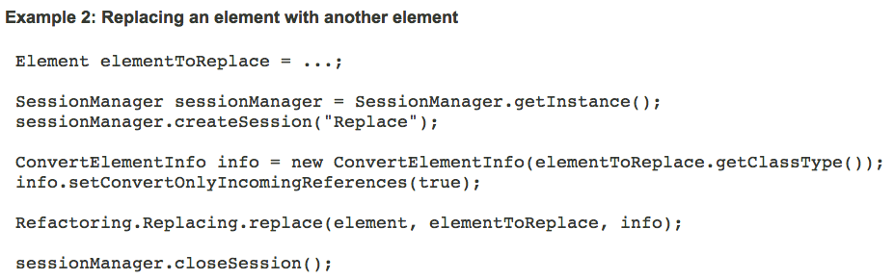
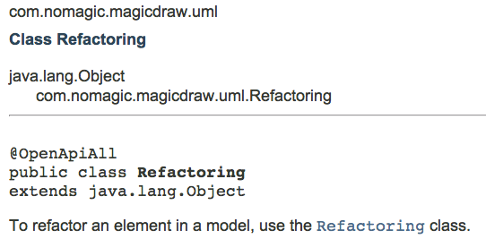
Solution Approach #2: Migration as MD Refactoring
MD Open API includes support for Refactoring
See SSCAES-1160
Initial experiments are encouraging
Plan:
Prototype a migration support capability
Evaluate its effectiveness with test cases

Slide 8
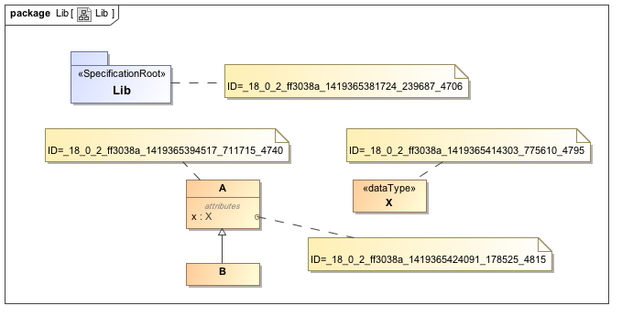
Example1: Old Module
M(v) = modelLibraries/20141231/Lib.mdzip

Slide 9
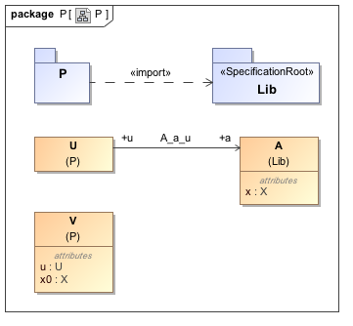
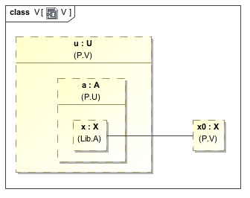
Example1: Old Project

Slide 10
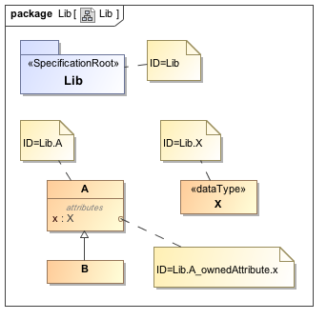
Example1: New Module
M(v’) = modelLibraries/20150101/Lib.mdzip
M(v’) =
M(v) except for canonical xmi:ids according to the OMG Tool Infrastructure algorithm

Slide 11
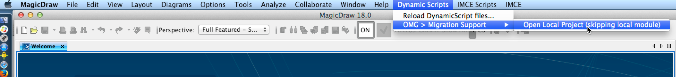
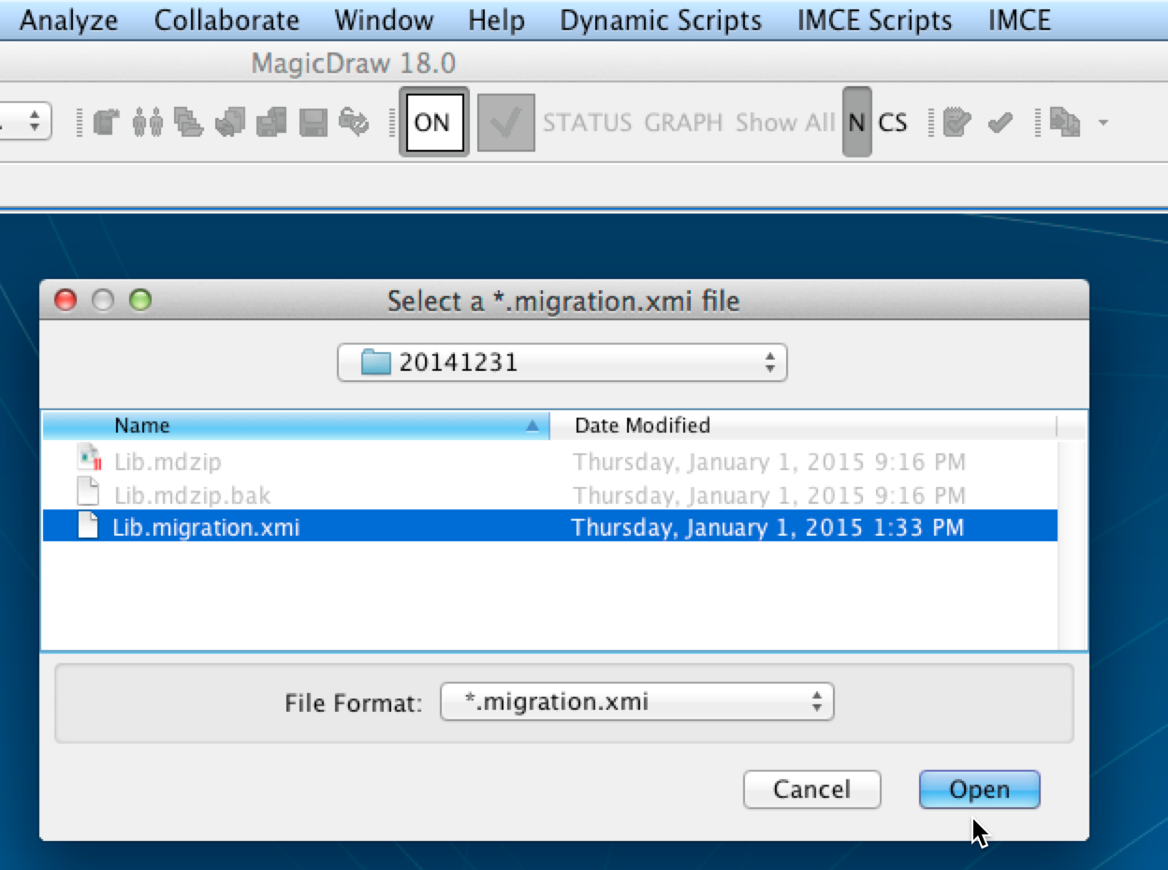
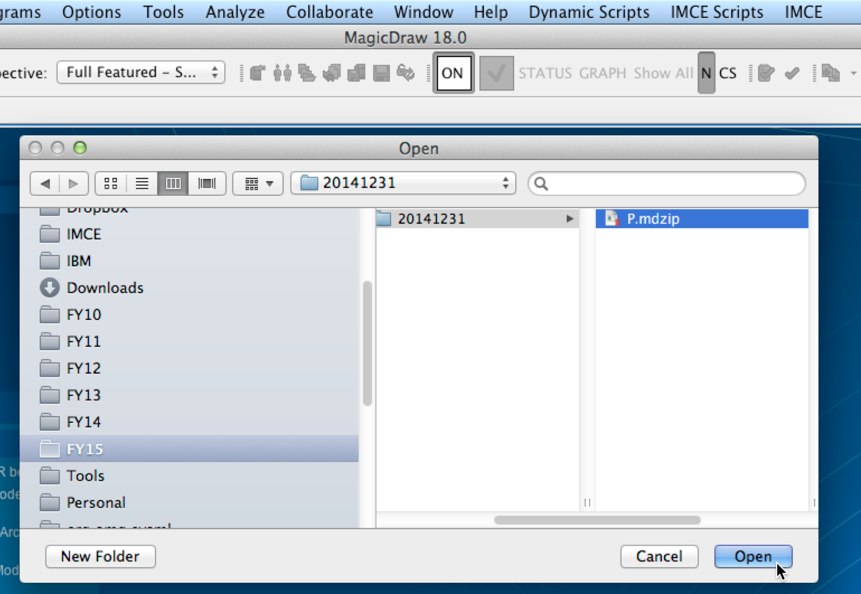
Example1: Migrating Old Project
1) Use the MagicDraw-specific OMG Migration Support dynamic scripts
2) Select the OMG migration metadata for the old module
3) Open the MagicDraw project file as usual

Slide 12
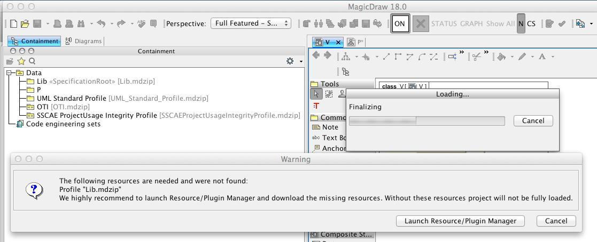
Example1: Skip Loading Old Module
4) The MagicDraw-specific OMG Migration wizard forced MagicDraw to skip loading the old module file
5) Click “Cancel” (this is OK)

Slide 13
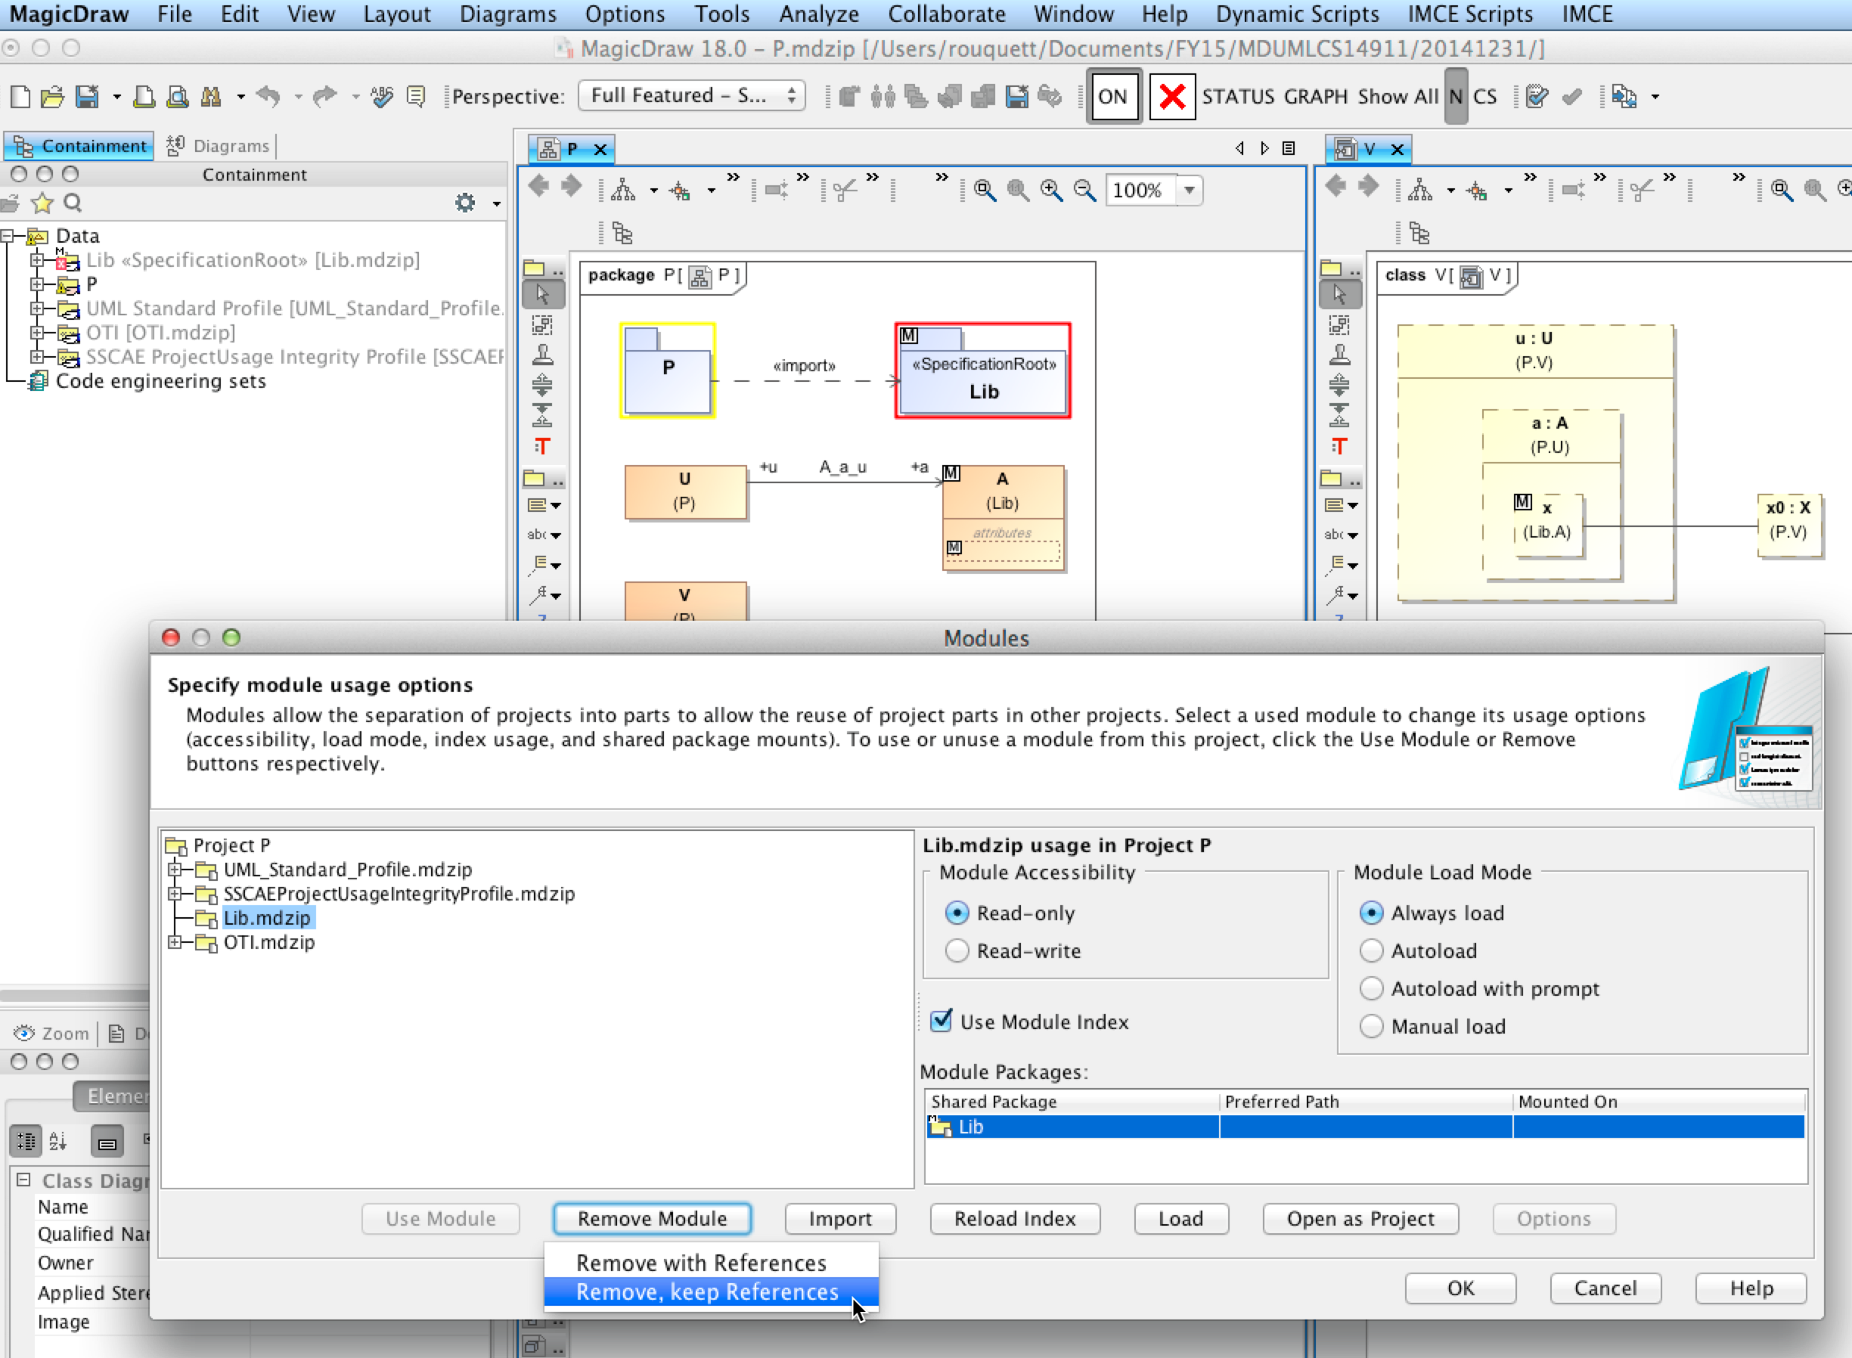
Example1: Remove Old Module
6) Use the “Options / Module” dialog to remove the old module (Keep References!)

Slide 14
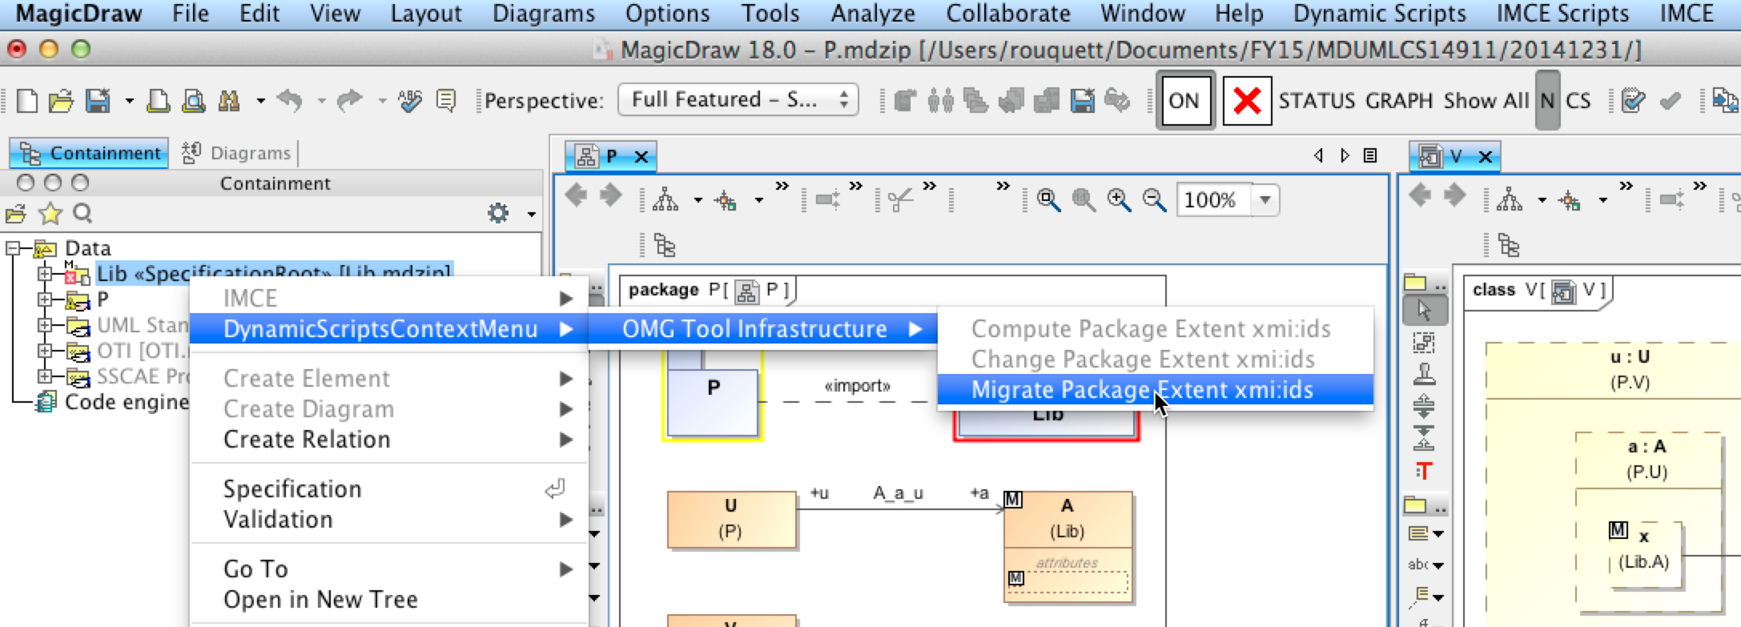
Example1: Migrate to New Module
7) Invoke the OMG Migration from the old module’s proxy package

Slide 15
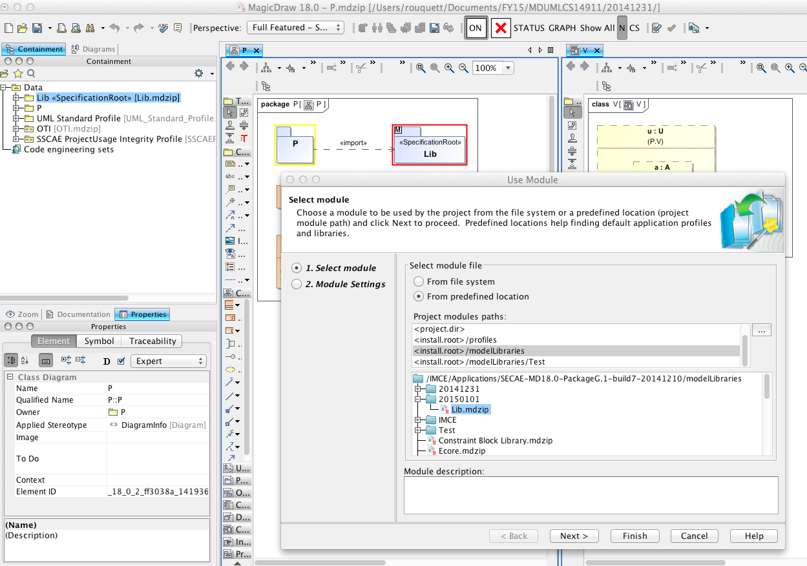
Example1: Mount the New Module
8) Select the new version of the module to mount (as migration from the old module)

Slide 16
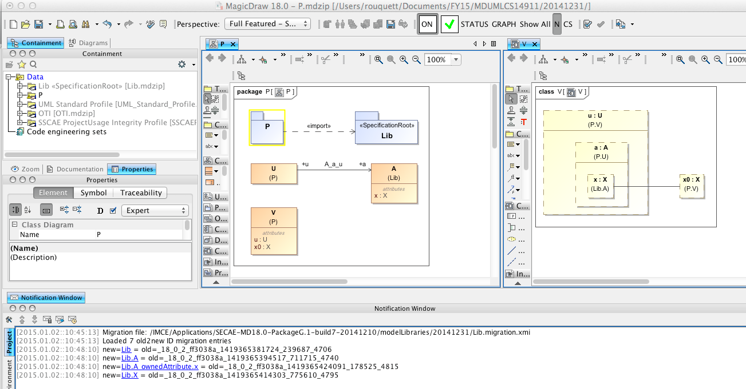
Example1: Migration Completed
9) Done!
References to the 20141231 version of “Lib” have been replaced with corresponding references to the 20150101 version of “Lib”

Slide 17
Applications of Migration Support
Incompatible changes to IMCE’s ontologies
IMCE ensures that backwards-compatible changes in ontologies result in backwards-compatible generated profiles
(this is done by resetting the “xmi:ids” for all elements in generated profiles according to a deterministic algorithm)
A solution is needed for incompatible changes made to IMCE ontologies (since the generated profiles will be incompatible)
ISO 80K libraries
This library evolved over the course of the SysML 1.4 RTF
Nerijus asked JPL for JPL’s version of ISO 80K for MD’s SysML plugin
For the official publication of SysML 1.4, the ISO 80K will be updated to correct production-related erratas
All “xmi:ids” will be reset according to a new OMG Tool Infrastructure algorithm
Nerijus & JPL users have asked for a “smaller” ISO 80K library with “SI units” only (this is called “coherence” in metrology)

