Slide 1
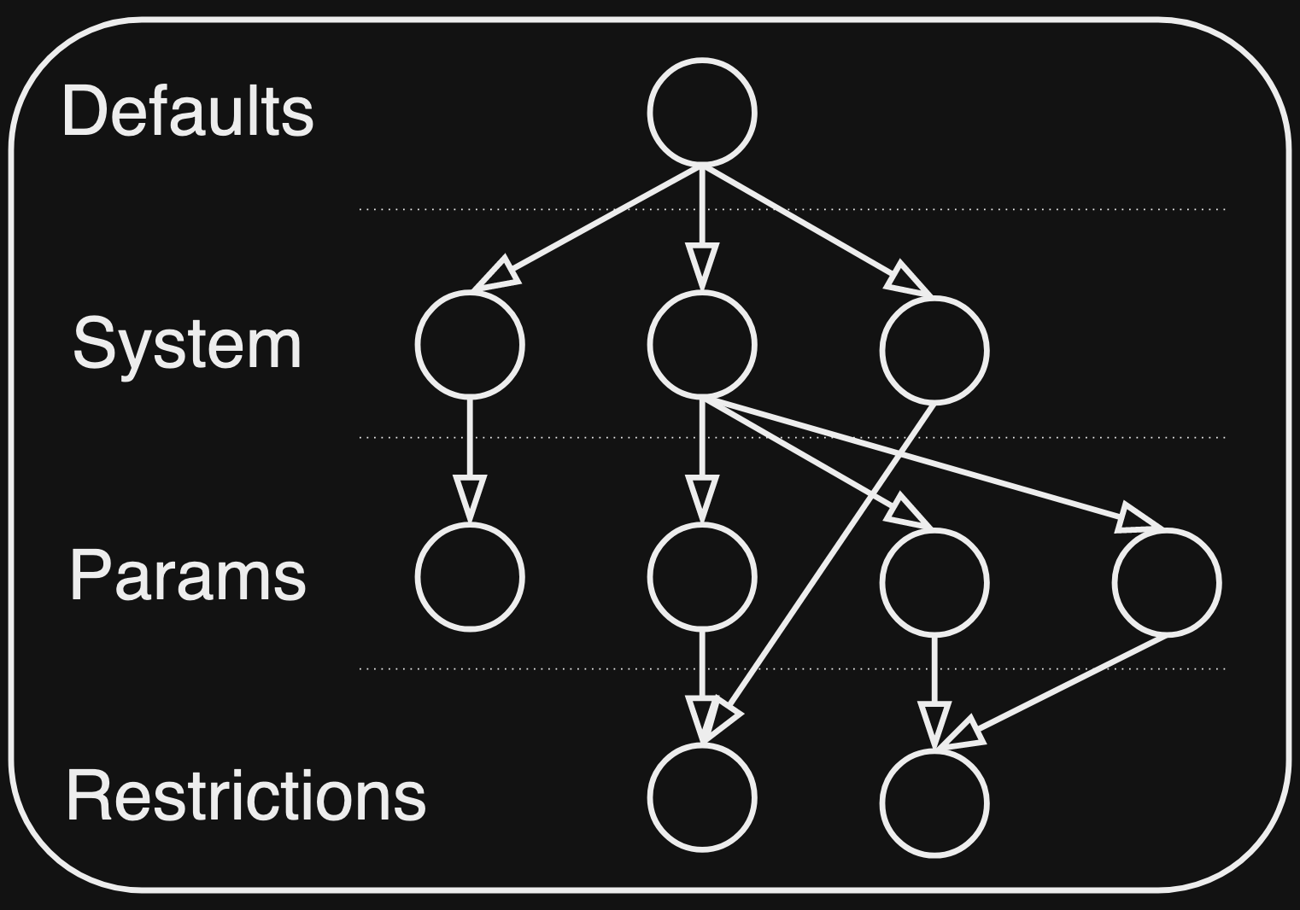
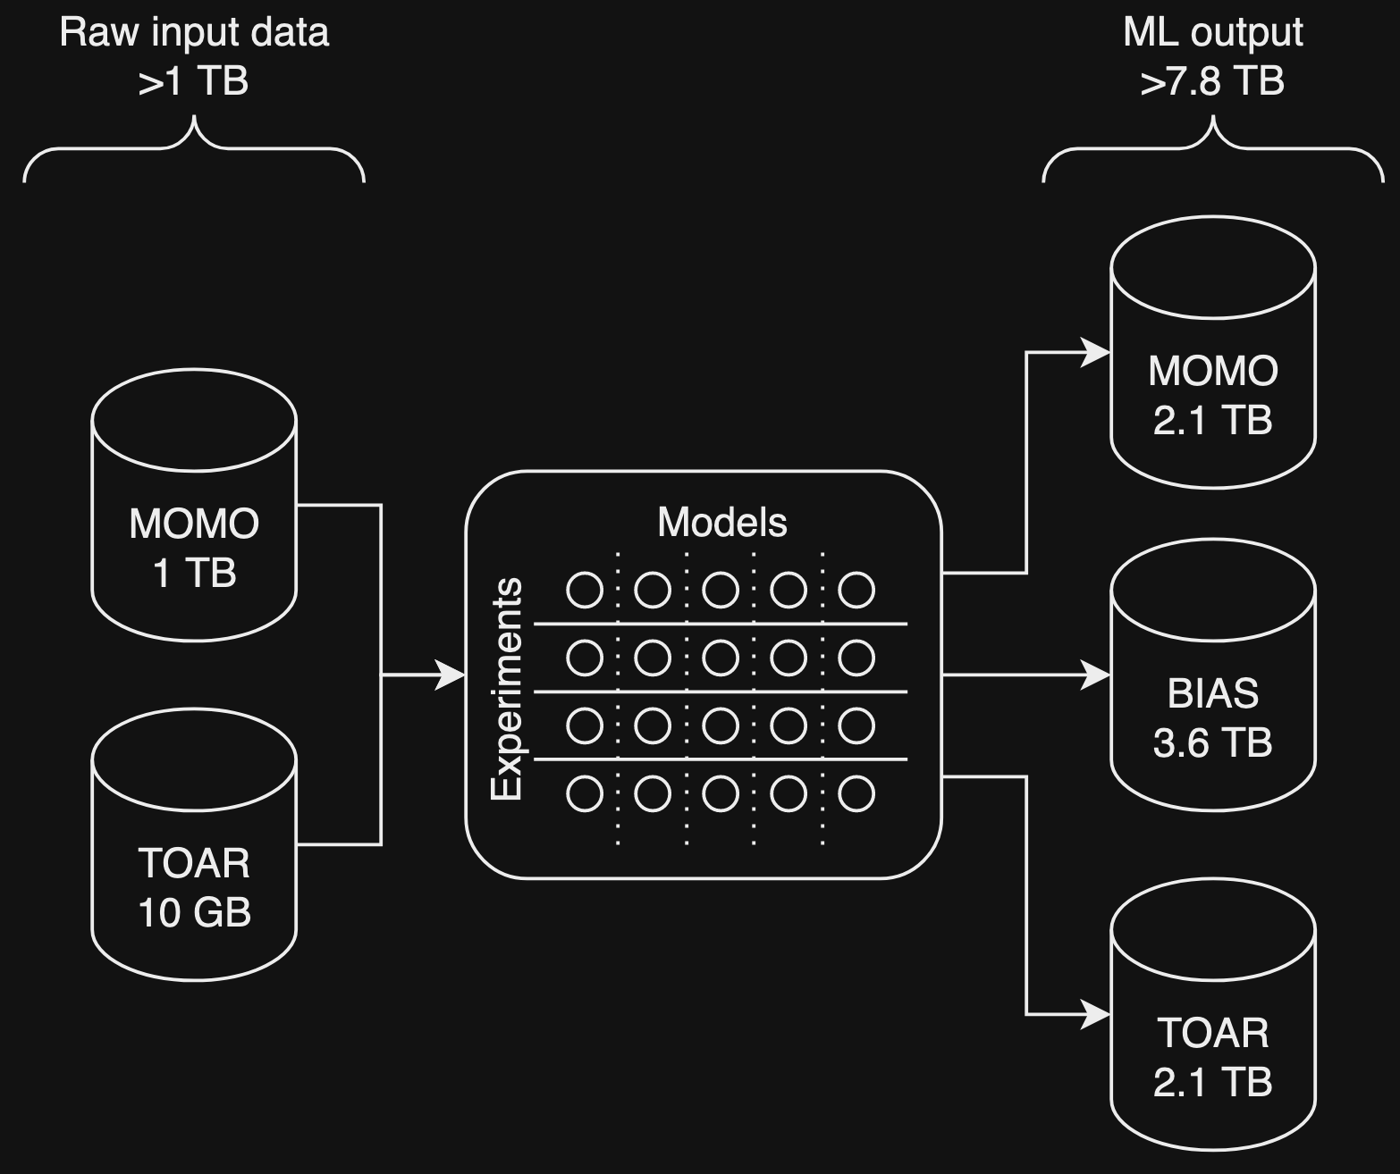
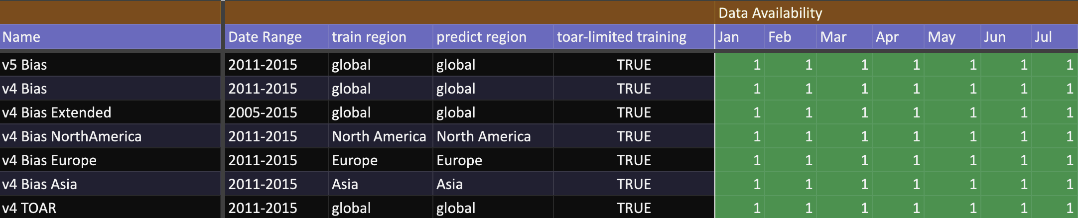
Experiment Traceability
mlky – Flexible research configurations
Open Sourced 07/2023
Notes:
We’ve had a significant number of back-end improvements in the recent months that normally go unnoticed. We’ve tackled large, less-exciting tasks such as improving our experiment traceability and evaluating our methods to ensure we are following best practices. We’re working with over a terabyte of input data, have processed it in many different ways, and have produced upwards of 8 terabytes of data. While not all science-yielding data, this is a lot to track and manage to ensure when we cross-compare experiments, we don’t make a mistake. A lot of effort has gone into solving this traceability problem - from doing manual tracking with spreadsheets to automated parameter logging - we’re hoping to share our knowledge on this front as we discover what does and does not work. A development to come out of this is a configuration software package called mlky. SUDS AQ has used this package extensively and it was essential in the rapid research and development growth of our project. In turn, SUDS AQ has furthered the development of this package, to the extent that it is now an independent package that is open source and publicly available.

Slide 2
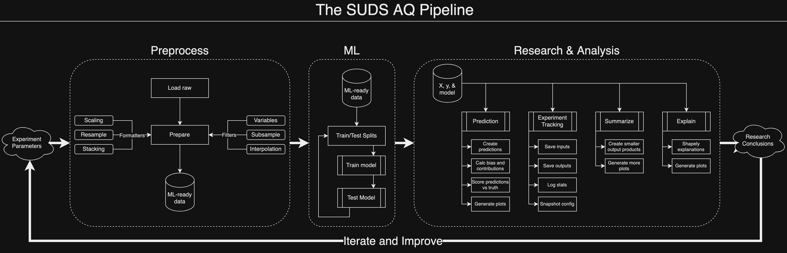
Mature and Stable
Active Development
Next Steps:
NTR and Open Source
Continue improving our outputs to increase science yield
Develop new tools to explore more ML explainability results
Notes:
Additionally, our research pipeline has now reached a level of maturity where direct development has slowed, freeing up time for us to explore more science-focused tasks such as improving our ML explainability methods. While we’ve always been science-focused, and now that a lot of the core pieces of the pipeline are set and stable, we can shift our development focus to be more about total science yield. In other words, we’re now working on utility tools better explore the vast amount of data we now have available as well as better understand ML explainability outputs.

