Slide 1
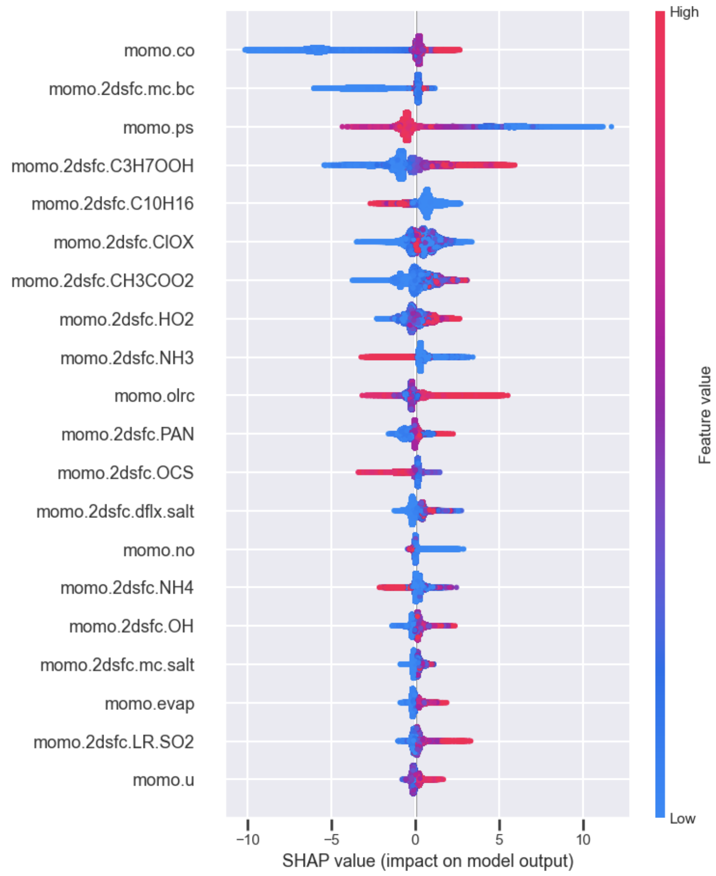
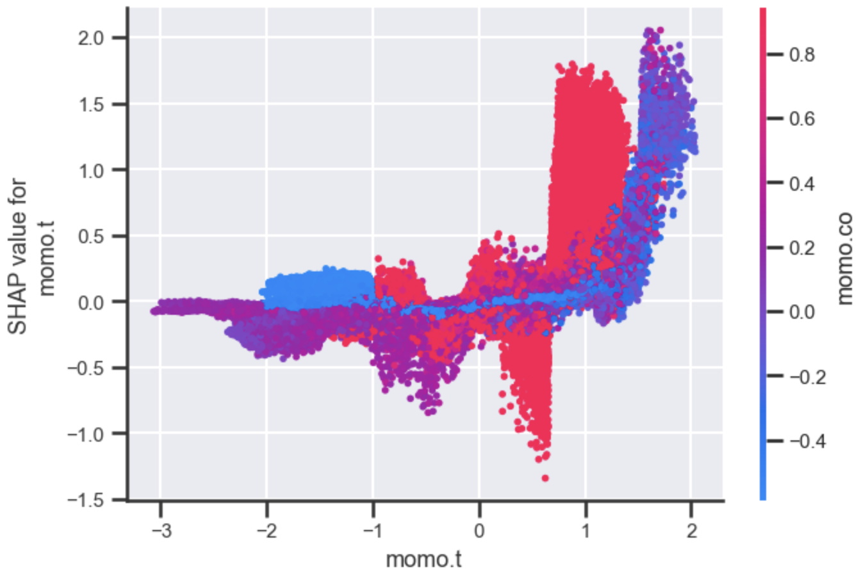
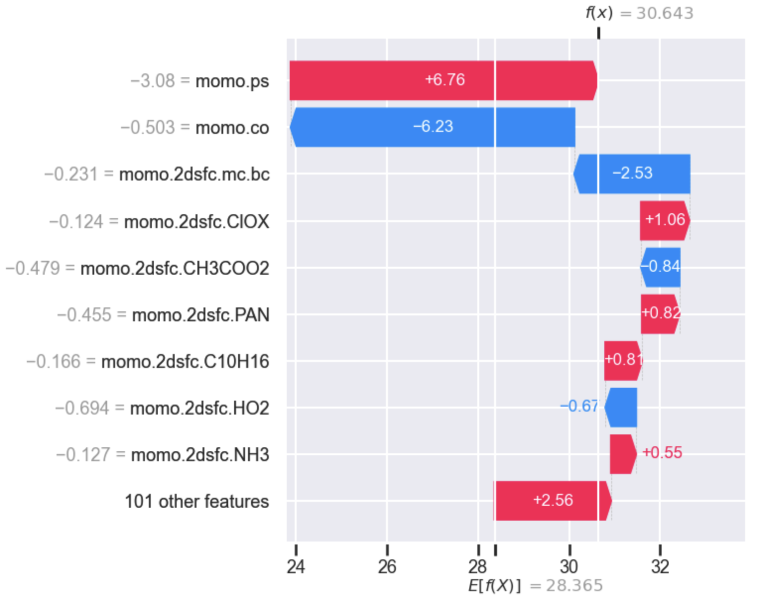
SHAP
SHapley Additive exPlanations
Low values of CO lower the predicted value!
SHAP allows us to ask new questions to gain knowledge on how features may impact the prediction quality of our models, such as:
Global insights
“What is the average impact on the prediction per feature?”
Feature insights (dependence)
“How does the impact on the model change with the feature’s values?”
Interactions between features
“How does the values of other features
change with the SHAP dependence of a
feature?”
Local prediction explanations
“How did the model arrive to a given
prediction value?”
Low values of PS == high altitude which matches expectations

