Slide 1
Data Science Working Group (DSWG) Pilot ML-Ready Annotation Capture at the Deep Space Network
Umaa Rebbapragada
Thurs, September 15, 2022

Slide 2
Acknowledgements
Umaa (PI, ML-ready data analysis of DRs)
James Montgomery (ML Experiments, Time-FED software engineer)
Gary Doran (Topic Modeling of DRs)
This work was made possible by

Slide 3
Differences from Ara’s Work
Augment information found in Ara’s report
https://wiki.jpl.nasa.gov/pages/viewpage.action?spaceKey=sec397&title=Situational+Awareness+and+Fault+Detection

Slide 4
Summary of Accomplishments
Conducted a comprehensive study of DRs and suitability for use in ML systems (Umaa)
Leveraged and furthered a time series prediction system to provide the most robust ML results to date (James)
Examined DR closure cause categories, and determined (Gary)

Slide 5
Desiderata
For DSN to include ML as part of its future automation strategy, DSN must:
Identify high impact use cases from user population
define performance metrics
Make available ML-ready data
Consistently sampled data
High quality annotations of the target variable
Supports Iteration
Incorporate user feedback
Respond to shifts in data

Slide 6
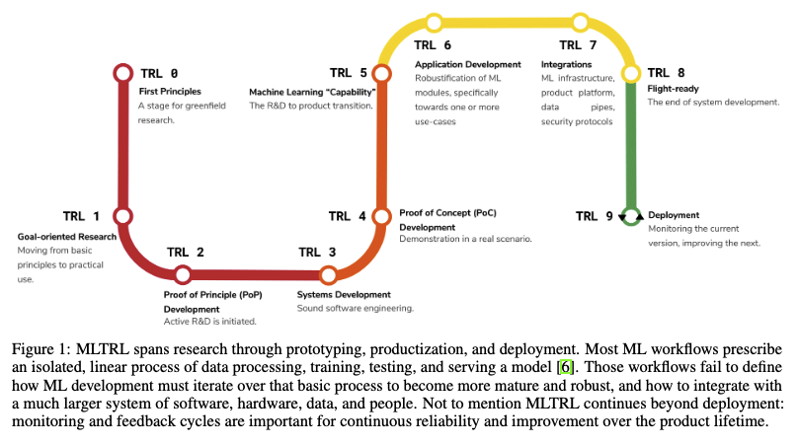
ML TRL levels
https://arxiv.org/pdf/2101.03989.pdf
ML development necessarily cycles between TRL levels

Slide 7
Conclusions
RFI is the only high impact use case that aligns with current closure cause
DR system doesn’t produce ML-ready annotations

Slide 8
But first, A Brief History of ML at the DSN

Slide 9
Timeline
Key: LE = Low Elevation, WE = Bad Weather, RFI/SC = Radio frequency and spacecraft interference
When | Task | Outcome | Funding | Who (Task Lead in bold)
Sept 2016 | DSN / ML Hackathon | Led to starter task | DSN | Rebbapragada, Verma, Doran, Mandrake
FY2017 | AIDAN: Diagnose LE, WE in VGR tracks Predict delays in lock acquisition (ETA) | Good results on small datasets started, but not finished | DSWG | Verma, Doran, Broschart
FY2018 – present | Use case added: RFI/SC on MMS; expanded data Started new experimental platform Continued ETA work Switched to unsupervised techniques (e.g., Track Comparisons, Feature ID) DRA | Poor results; need better features Unfinished Dormant after intern left Integration into CEP In progress | DSN | Verma, Rebbapragada, Yun, Montgomery, Klein (intern), Barraza
FY2021 | Predict optical turbulence at DSOC receiving station | Completed time series forecasting, evaluation platform (Time-FED) started at DSN | 9x (SCAN) | Piazzoli, Rebbapragada, Montgomery,
FY2022 | LE, WE, RFI/SC with Time-FED Open Source Time-FED Topic Modeling of unstructured text from DRs |  | DSWG ISI | Rebbapragada, Montgomery, Barraza, Verma, Doran

Slide 10
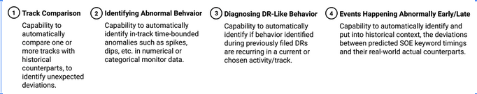
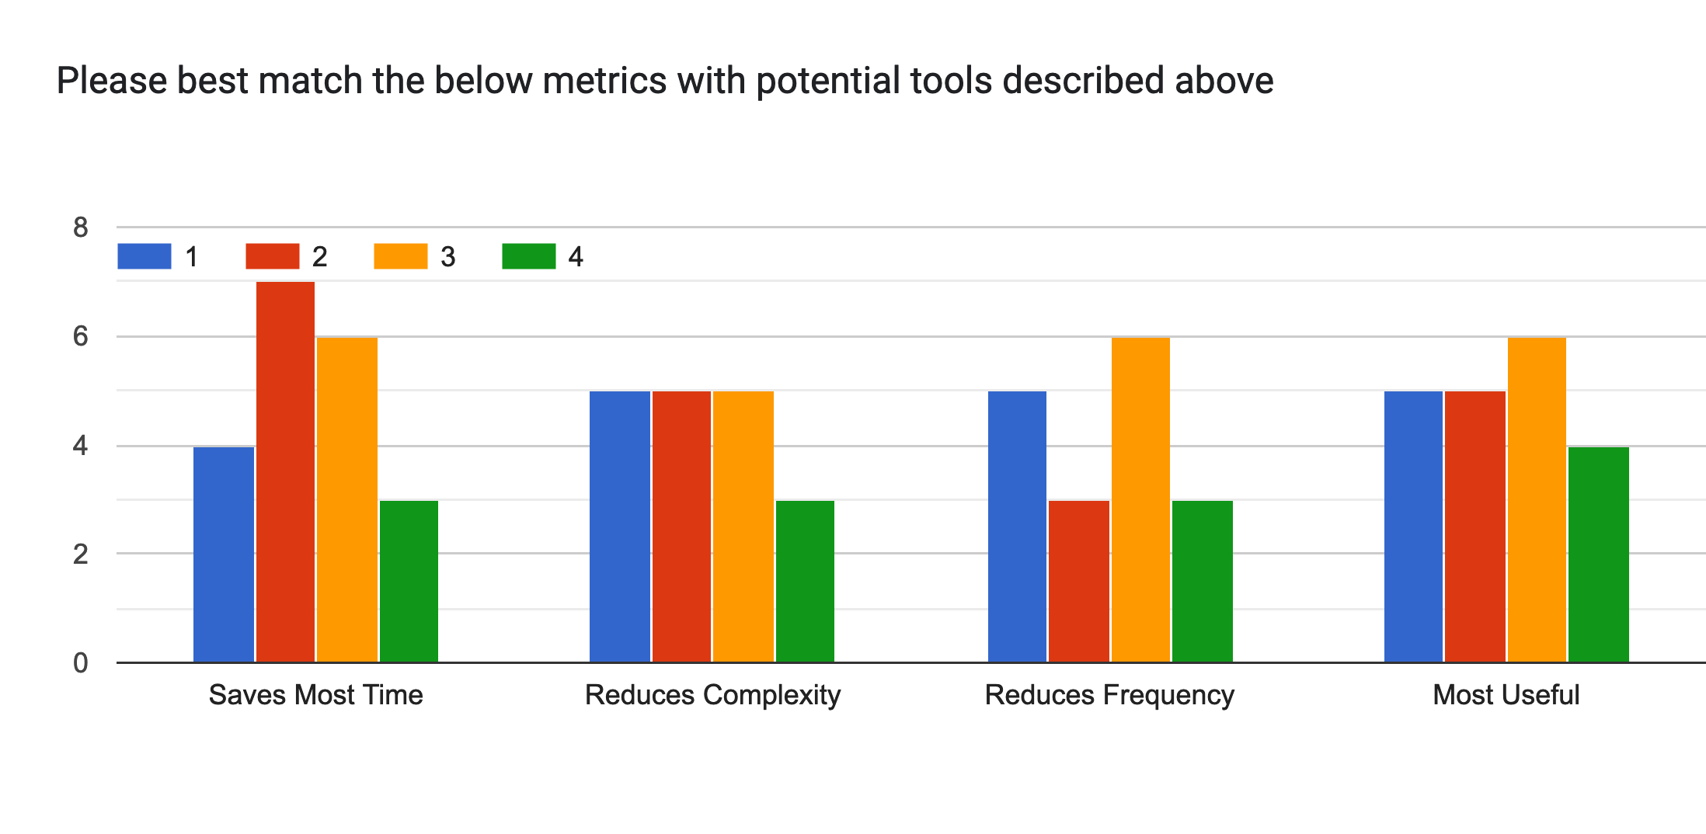
User Study 2022 – 21 LCO responses
Diagnosing DRs was rated most useful activity

Slide 11
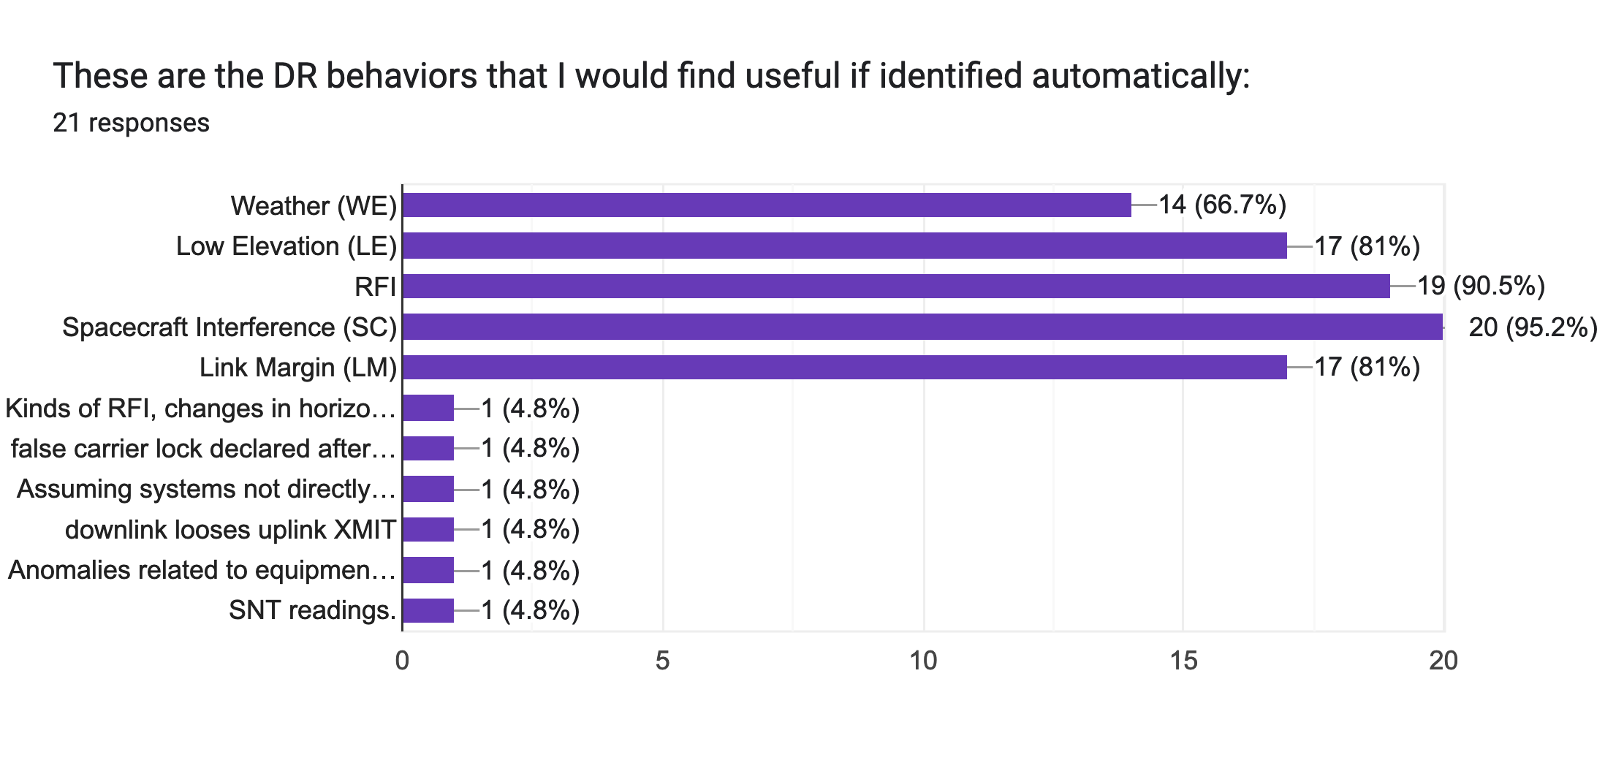
DSN-ML User Study 2022
21 LCO responses across 3 complexes

Slide 12
Goal 1 Study of ML-readiness of DR system

Slide 13
Methodology
Focus on RFI
Focus on MMS (which originally reported issues with RFI)
Focus on JWST (high quality DRs)

Slide 14
Data sources
SQA
Monitor data
DRs

Slide 15
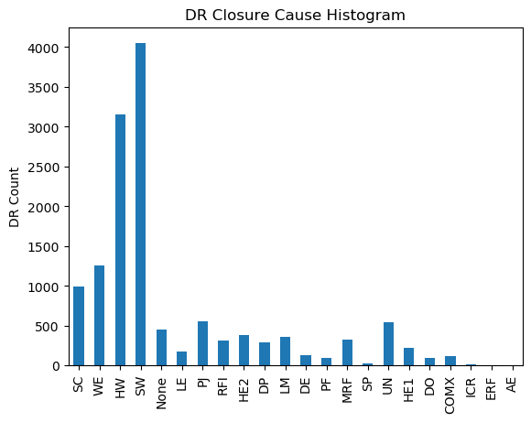
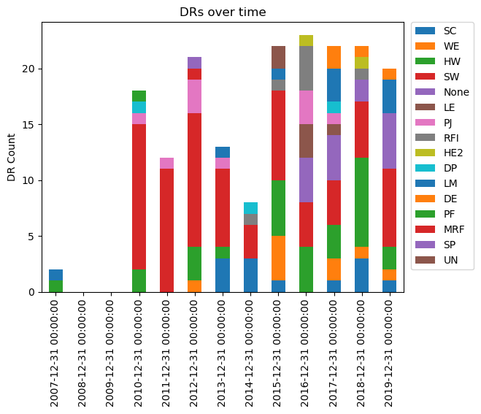
Breakdown of DRs by Closure Cause
Notes:
TODO: Pull recent data, sort by highest value

Slide 16
RFI/SC Analysis
563 RFI and SC DRs examined
Plotted DRs against relevant monitor data items
for RFI and SC, that’s AGC_VOLTAGE and CARRIER_SYSTEM_NOISE_TEMPERATURE
Looking at coincidence between:
DR start/ends
bad frame counts
out of lock status
signal in correlated monitor data items

Slide 17
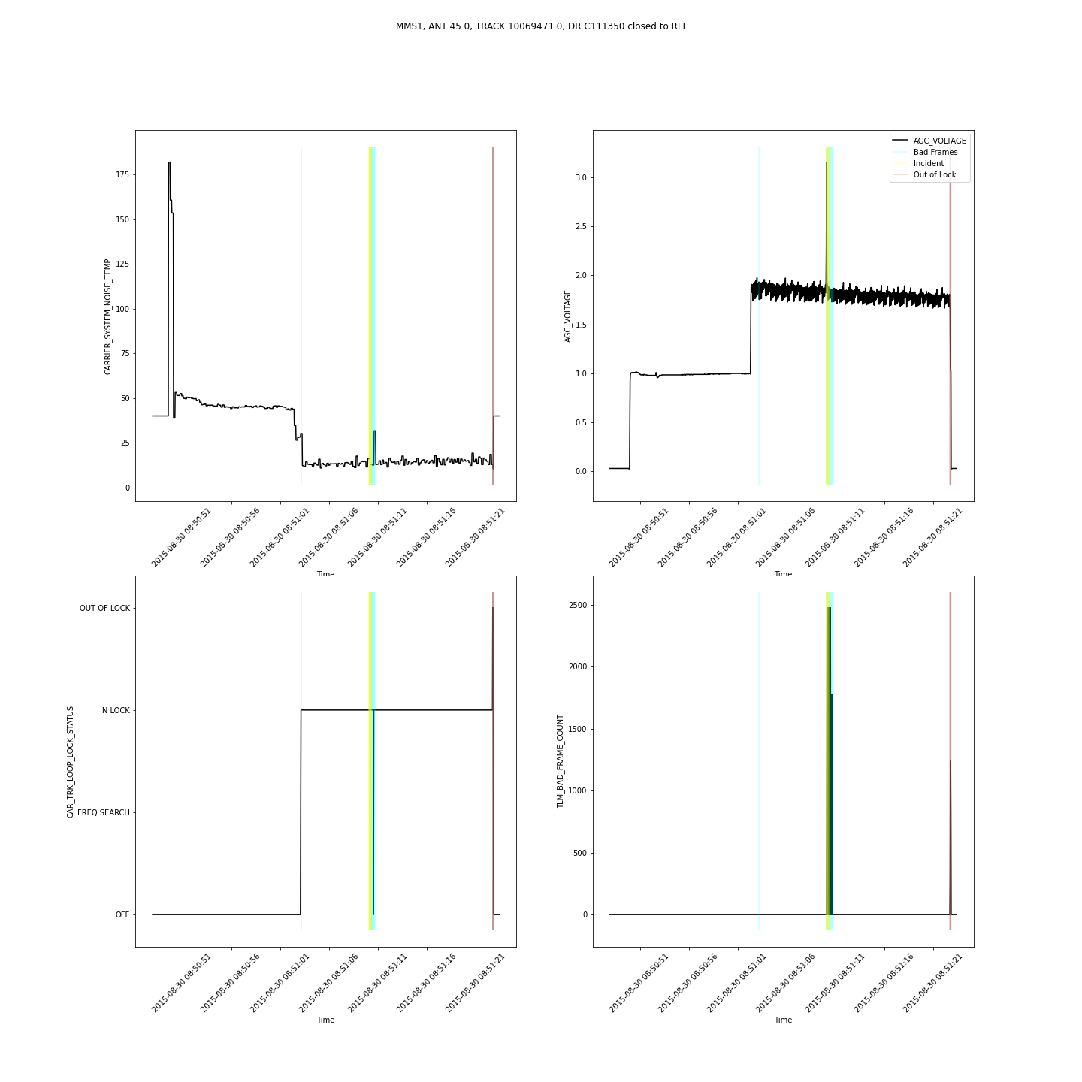
MMS1-10069471-C111350-RFI
Incident: Narrow
Pathologies: Present
Incident == Pathologies

Slide 18
MMS1-10069471-C111350-RFI
Incident: Narrow
Pathologies Present
Incident == Pathologies

Slide 19
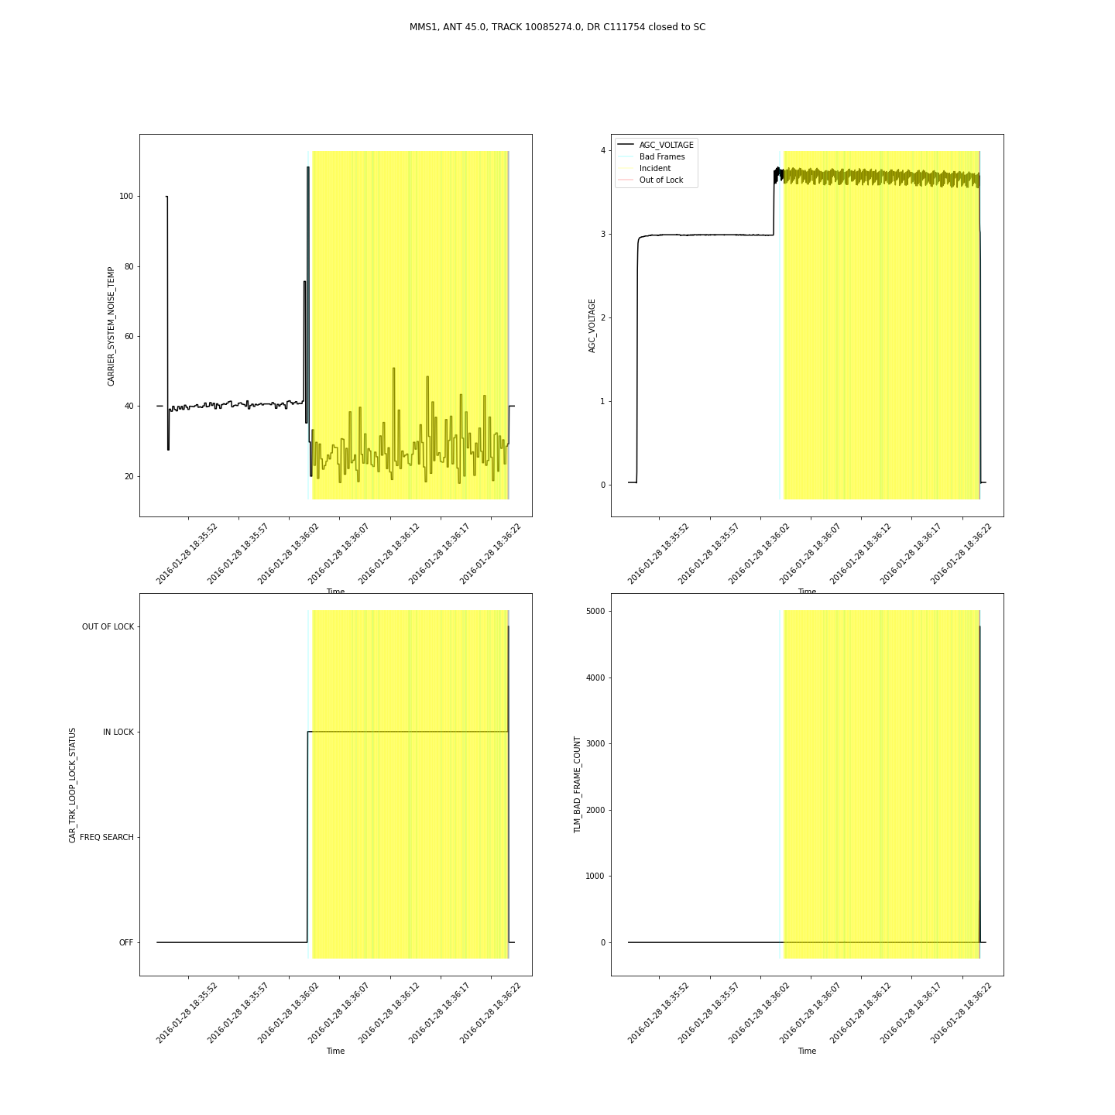
MMS1-10085274-C111754-SC
Incident: Wide
Pathologies: Present
Incident < Pathologies

Slide 20
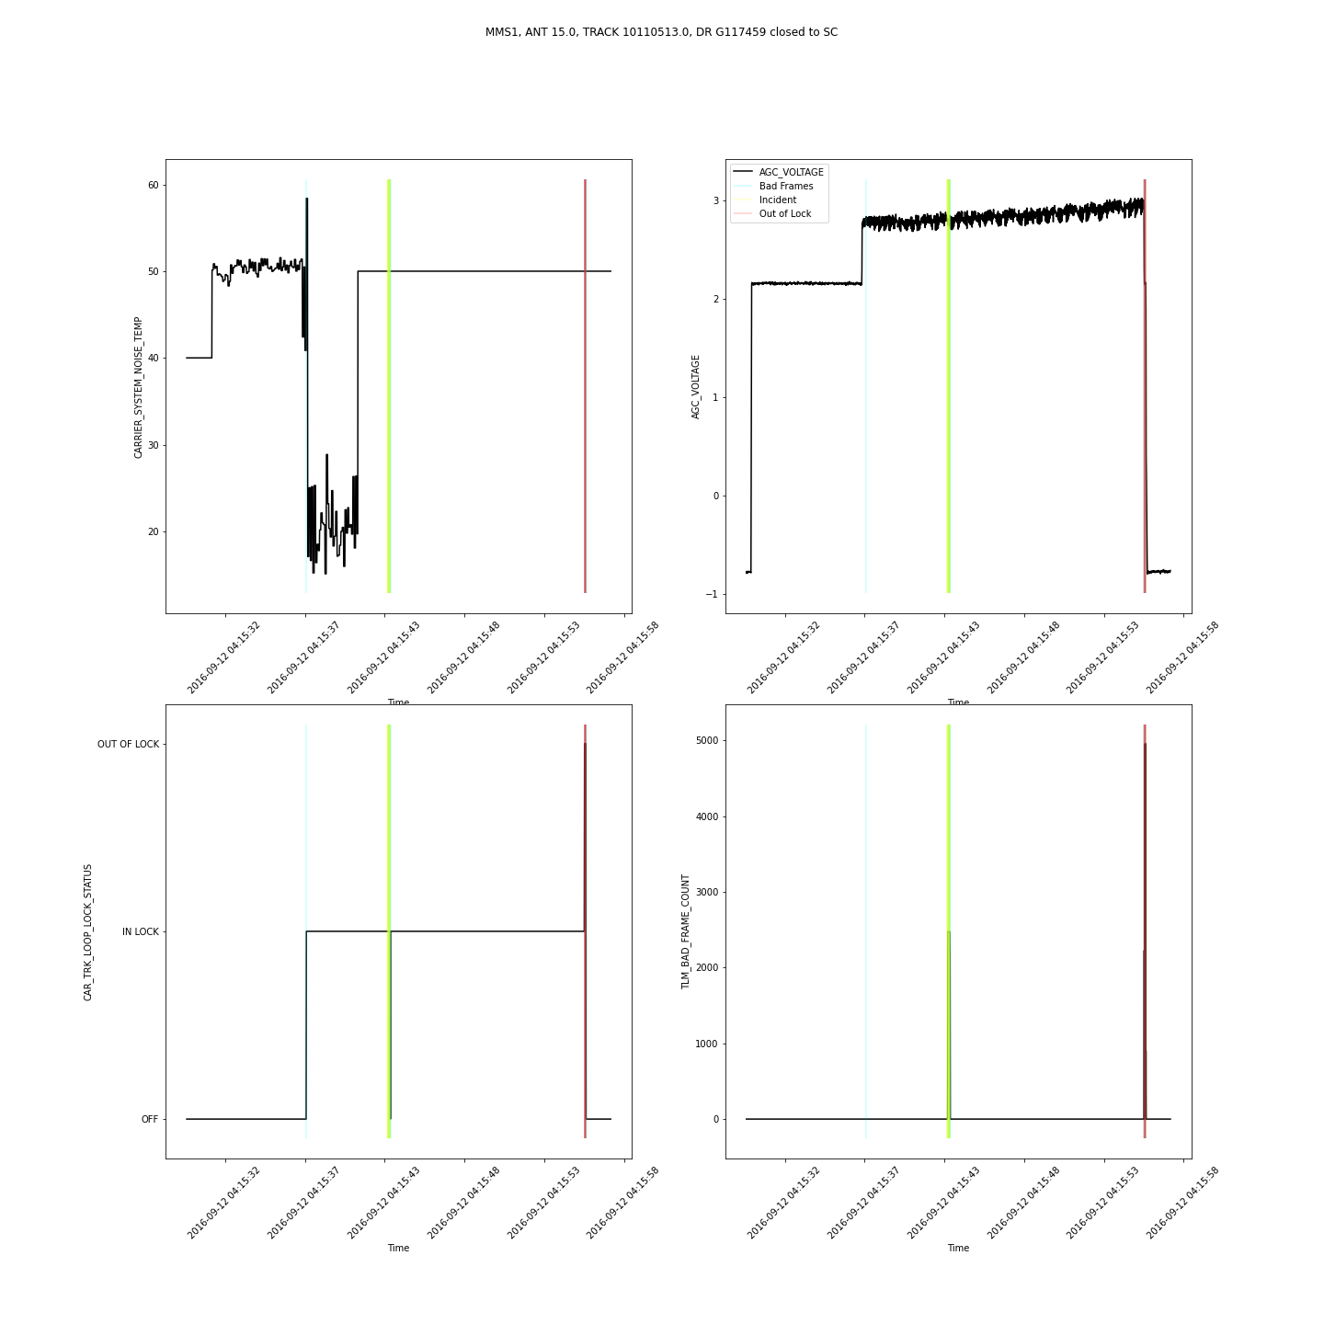
MMS1-10110513-G117459-SC
Incident: Narrow
Pathologies: No

Slide 21
Pathologies Present means that I can see pathological behavior in the monitor data
Incident Coverage:
= means the incident and pathologies fit each over
< means the incident time stamps exclude some of the pathologies in the monitor data
> means the incident covers all the pathologies but also includes what seems to be nominal behavior
Incident Size:
Narrow means the incident size covers a small amount of the track
Wide means the incident size covers a large portion of the track, but does not completely cover it
Full means the incident fully covers the track
 | MMS RFI/SC | JWST RFI/SC
Total DRs examined
Pathologies Present
Incident Coverage
Incident Size

Slide 22
Goal 2 ML Experiments and Software
James Montgomery

Slide 23
Updates to Platform
Lots of software engineering
Data extraction straight from the DSN SQA
Proper pre-processing
Label application straight from the DRs
Window extraction
Time series feature extraction
End-to-end platform
Generalized for classification and regression use cases
Unified configuration to easily define new and different runs

Slide 24
Configuration
Every step along the pipeline is highly configurable:
Preprocessing: 14 options
Extraction: 15 options
Feature Selection: 9 options
Classification: 5 options
+ model parameter options
Adaptable to a variety of use cases
Enabled faster research for multiple spacecrafts in parallel

Slide 25
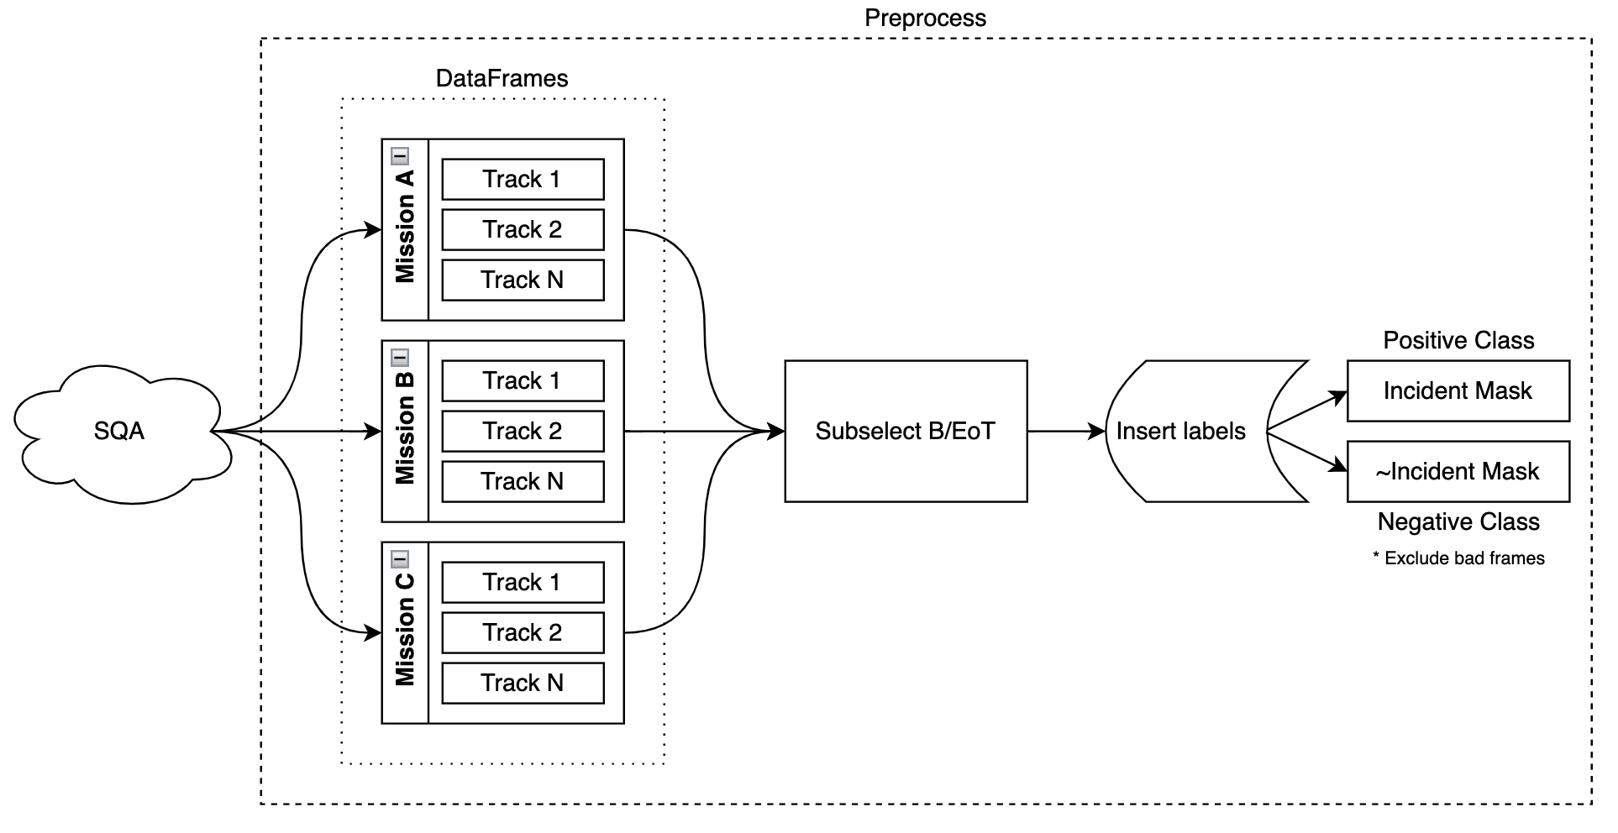
Platform: SQA
SQA is queried directly to pull track data down and processed through the preprocess module
Notes:
Refactor graphic for the new approach

Slide 26
Platform: API Refactor
Refactored half the pipeline to be API-oriented rather than pipeline-oriented
API: functions are provided to be used in scripts developed for the use case
Rolling window calculations
Tsfresh feature extraction
Pipeline: scripts are provided and the use case must conform to the expectations
A preprocess module specifically for the DSN data leverages this API
Enabled greater processing of the data

Slide 27
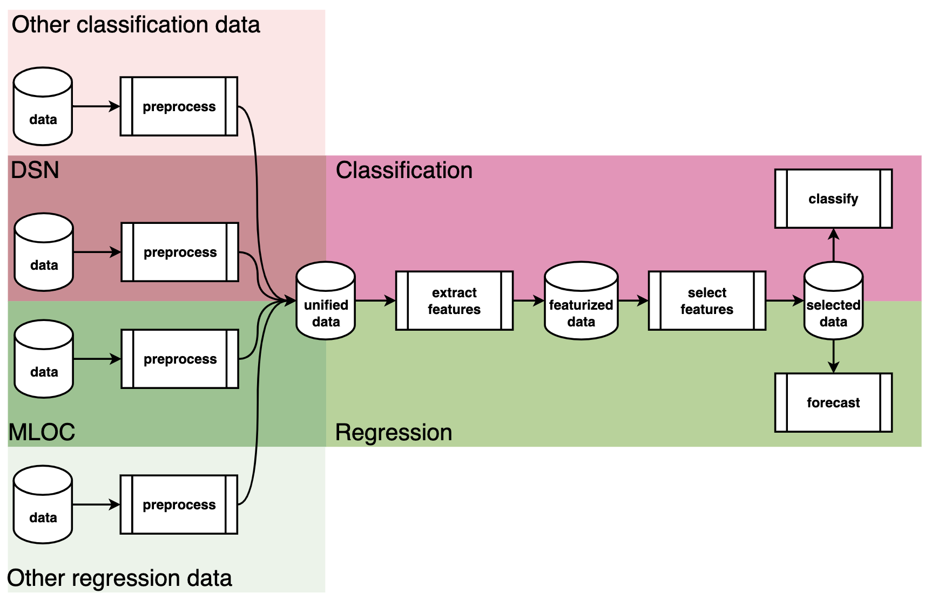
Platform: Classification
Expanded the pipeline to support classification and regression/forecasting

Slide 28
Methodology 1
Preprocess per track
Remove everything outside of Beginning/End of track
Any timestamp inside a DR’s bounds = positive
Everything else = negative
Remove TLM_BAD_FRAME_COUNT from the negative class (dropped)
Each track produces a set of windows
If any timestamp in that window is positive, window = positive. Otherwise negative
Gather all windows together, determine which to keep based on DR
Subsample the negative class to match the size of the positive class
Negative class is overwhelmingly larger in size than the positive class

Slide 29
Methodology 2
Due to a small amount of positive to negative windows, train/test split date is decided on the positive set
80% train, 20% test
Negative windows are sampled 1:1 to the positive before/after this calculated split date
Different window sizes were used depending on what produced more data to work with
Features used for the RFI case:
AGC Voltage
System Noise Temperature

Slide 30
Current Results
Results never surpassed 60% accuracy
Averaged around 55%
Could be a variety of reasons:
Not enough DRs to work with
Low quantity / too short in length
Low quality / track could not be accepted for reasons
Bad frames (removed from the negative class)
Required features were fully missing
AGC Voltage entirely NaN
Lack of funding to explore more analysis

Slide 31
Results: JWST
Parameter | Subparameter | Value
Window
 | Length | 2.5 minutes
 | Density | 100%
 | Step Size | 5 seconds
DRs |  | RFI
Train
 | Start | 2021-12-25
 | End | 2022-04-27
Test
 | Start | 2022-04-27
 | End | 2022-08-17
Metric | Score
Accuracy | 0.569585810742719
Precision | 0.558948984814878
Recall | 0.660217654171705
Truth
Number of Windows:
 | 0 | 1
0 | 4752 | 5170
1 | 3372 | 6552
Label | Train | Test
0 | 39696 | 9922
1 | 39694 | 9924
Predicted
Had significantly more windows than the other spacecraft
Higher quality tracks/data
More RFI cases in general
Results are comparable despite the greater training size
Notes:
Do not have window count for JWST at 2.5 minutes (deleted due to space for MMS)

Slide 32
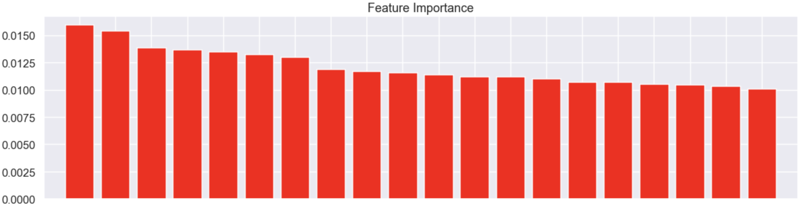
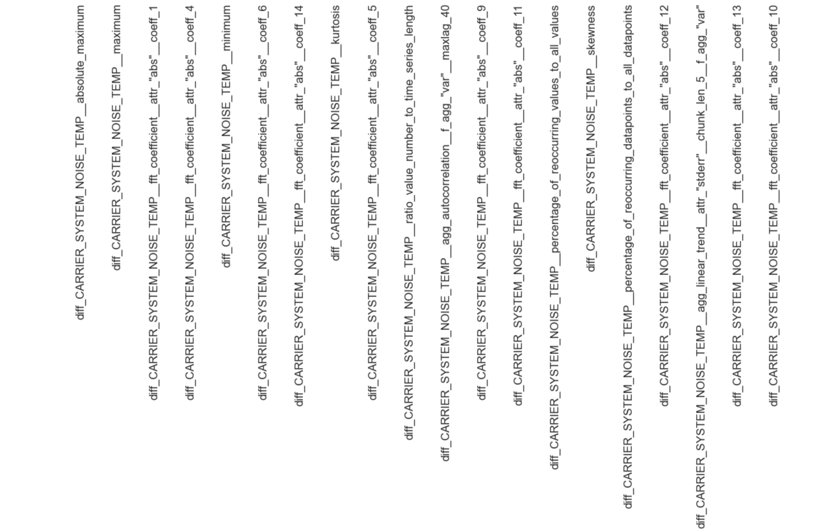
JWST Feature Importance
Note: There’s two images due to some issue with generating the plot

Slide 33
Results: MMS
Parameter | Subparameter | Value
Window
 | Length | 3 minutes
 | Density | 100%
 | Step Size | 5 seconds
DRs |  | RFI
Parameter | Subparameter | Value
Window
 | Length | 3 minutes
 | Density | 100%
 | Step Size | 5 seconds
DRs |  | RFI
Train
 | Start | 2018-02-18
 | End | 2018-10-16
Test
 | Start | 2018-10-16
 | End | 2018-10-17
Metric | Score
Accuracy | 0.5961538461538461
Precision | 1.0
Recall | 0.19230769230769232
Truth
Number of Windows:
 | 0 | 1
0 | 26 | 0
1 | 21 | 5
Label | Train | Test
0 | 101 | 26
1 | 101 | 26
Predicted
Window Size | Positive* | Negative
5 minutes | 5,437 | 145,098
3 minutes | 13,836 | 484,427
Why so few windows?
Length of RFI DRs were often short in time/samples
AGC Voltage variable wasn’t always available for a DR track
Window size may have been too large to avoid common issues with window calculations:
Requires full density, ie. no gaps/NaNs for all samples across all variables
*Across all DR kinds
RF was a very small subset

Slide 34
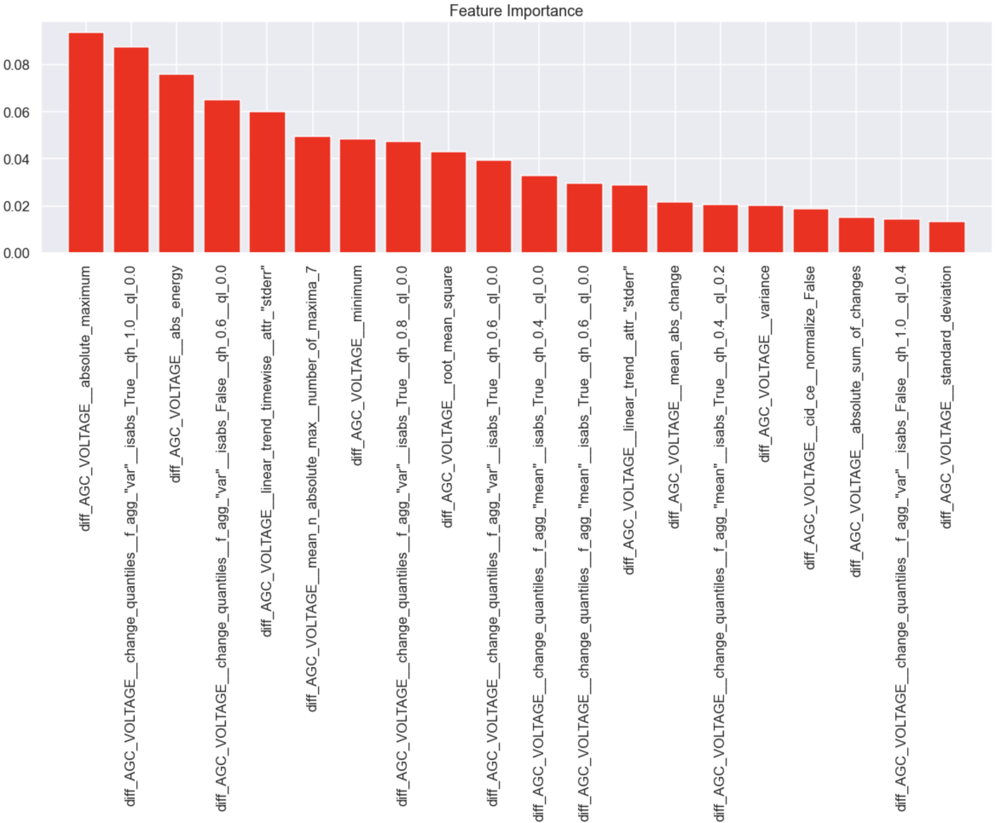
MMS Feature Importance

Slide 35
Problem Sources
Hyperparameters
Windows not long enough
Features not expressive enough
Not enough training data
Limited by the positive examples
Training data is not good

Slide 36
Topic Modeling of DRs
Gary Doran

Slide 37
Backup

Slide 38
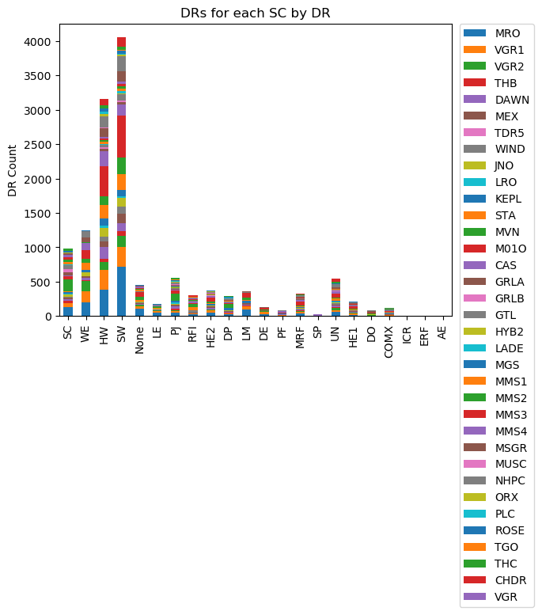
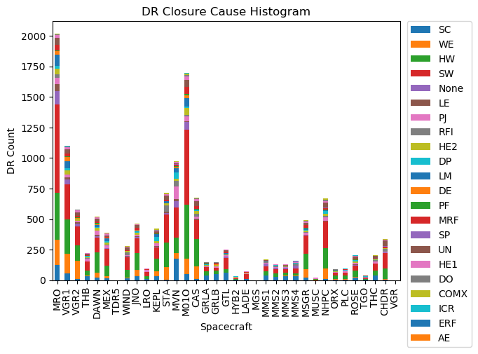
Mission DR Breakdown
Closure Cause’s Mission Breakdown

Slide 39
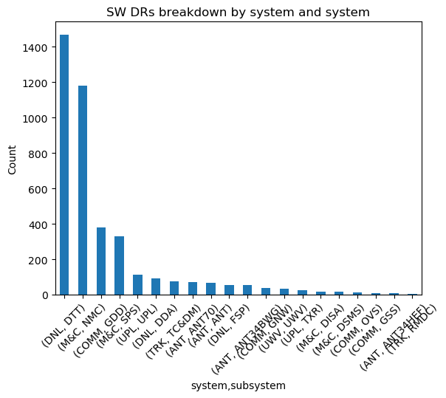
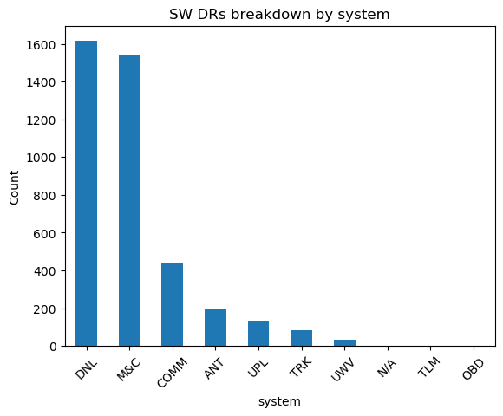
Software (SW)

Slide 40
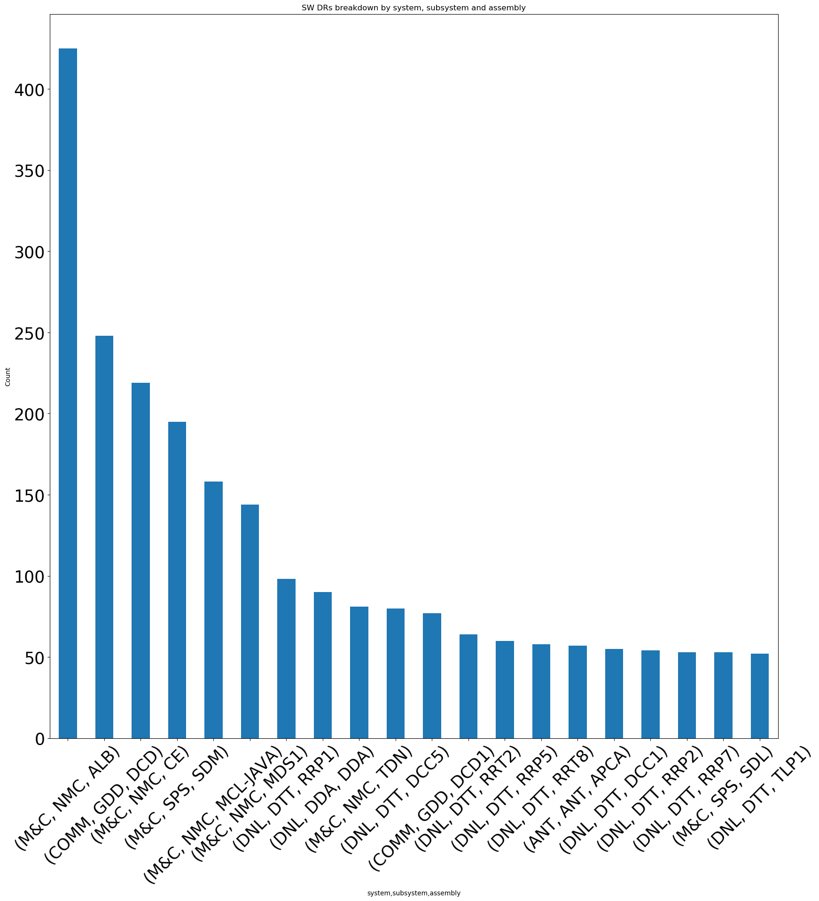
Software (SW)
Notes:
assembly is a divison of a sub-system
DTT: Downlink Tracking & Telemetry

Slide 41
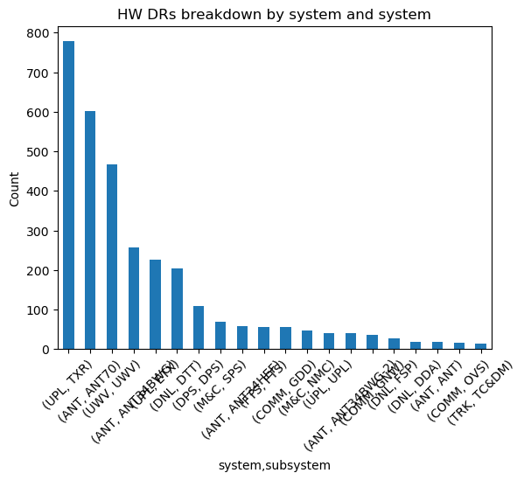
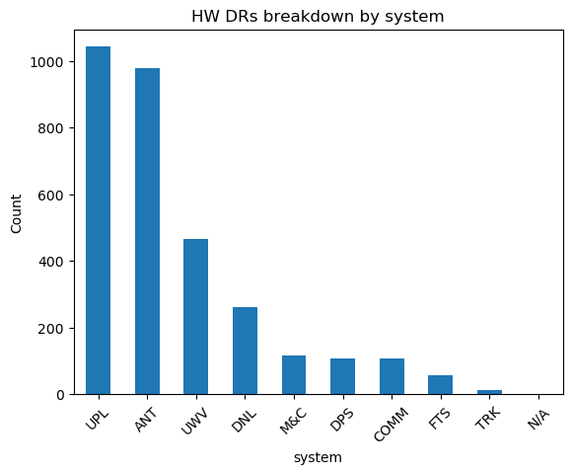
Hardware (HW)

Slide 42
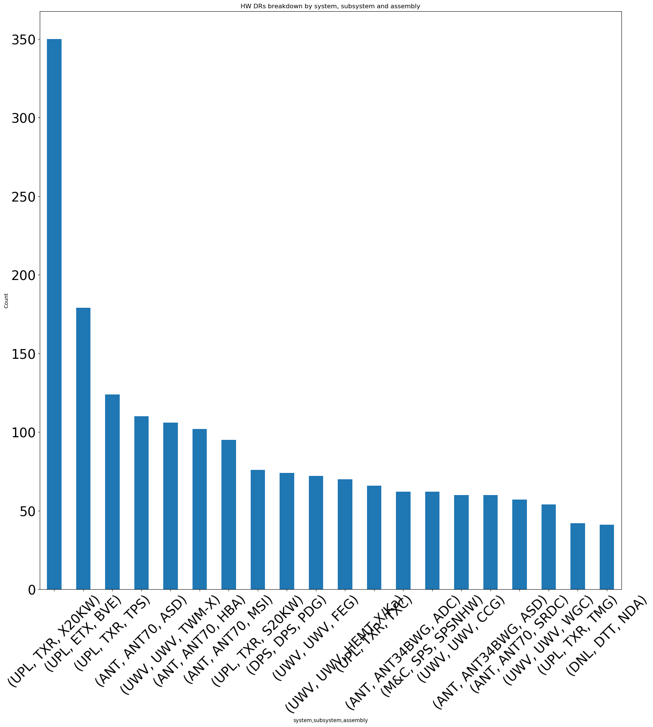
Hardware (HW)

Slide 43
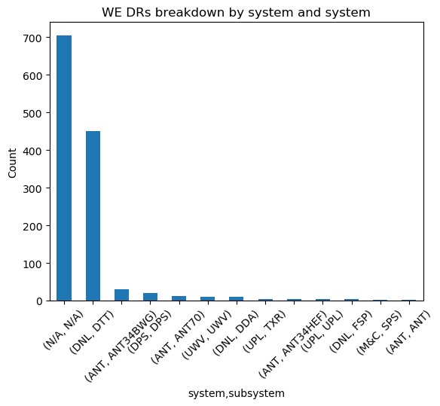
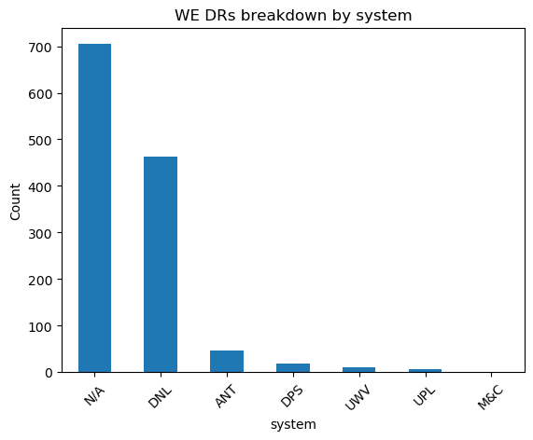
Weather (WE)

Slide 44
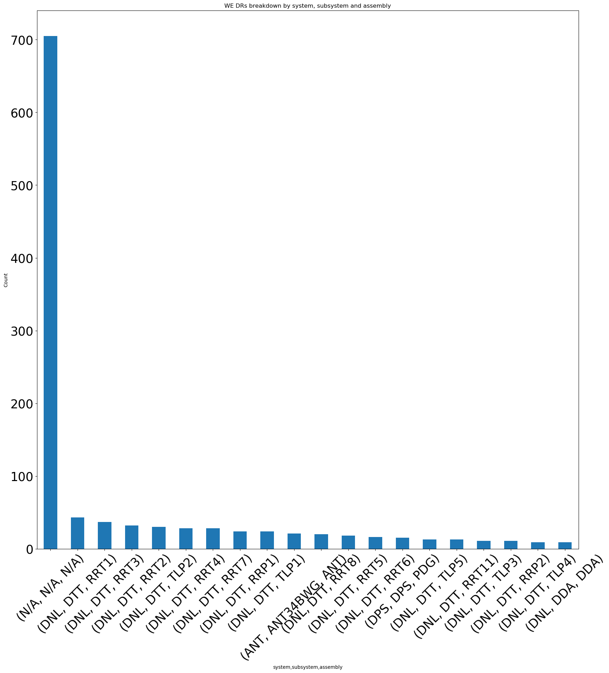
Weather (WE)

Slide 45
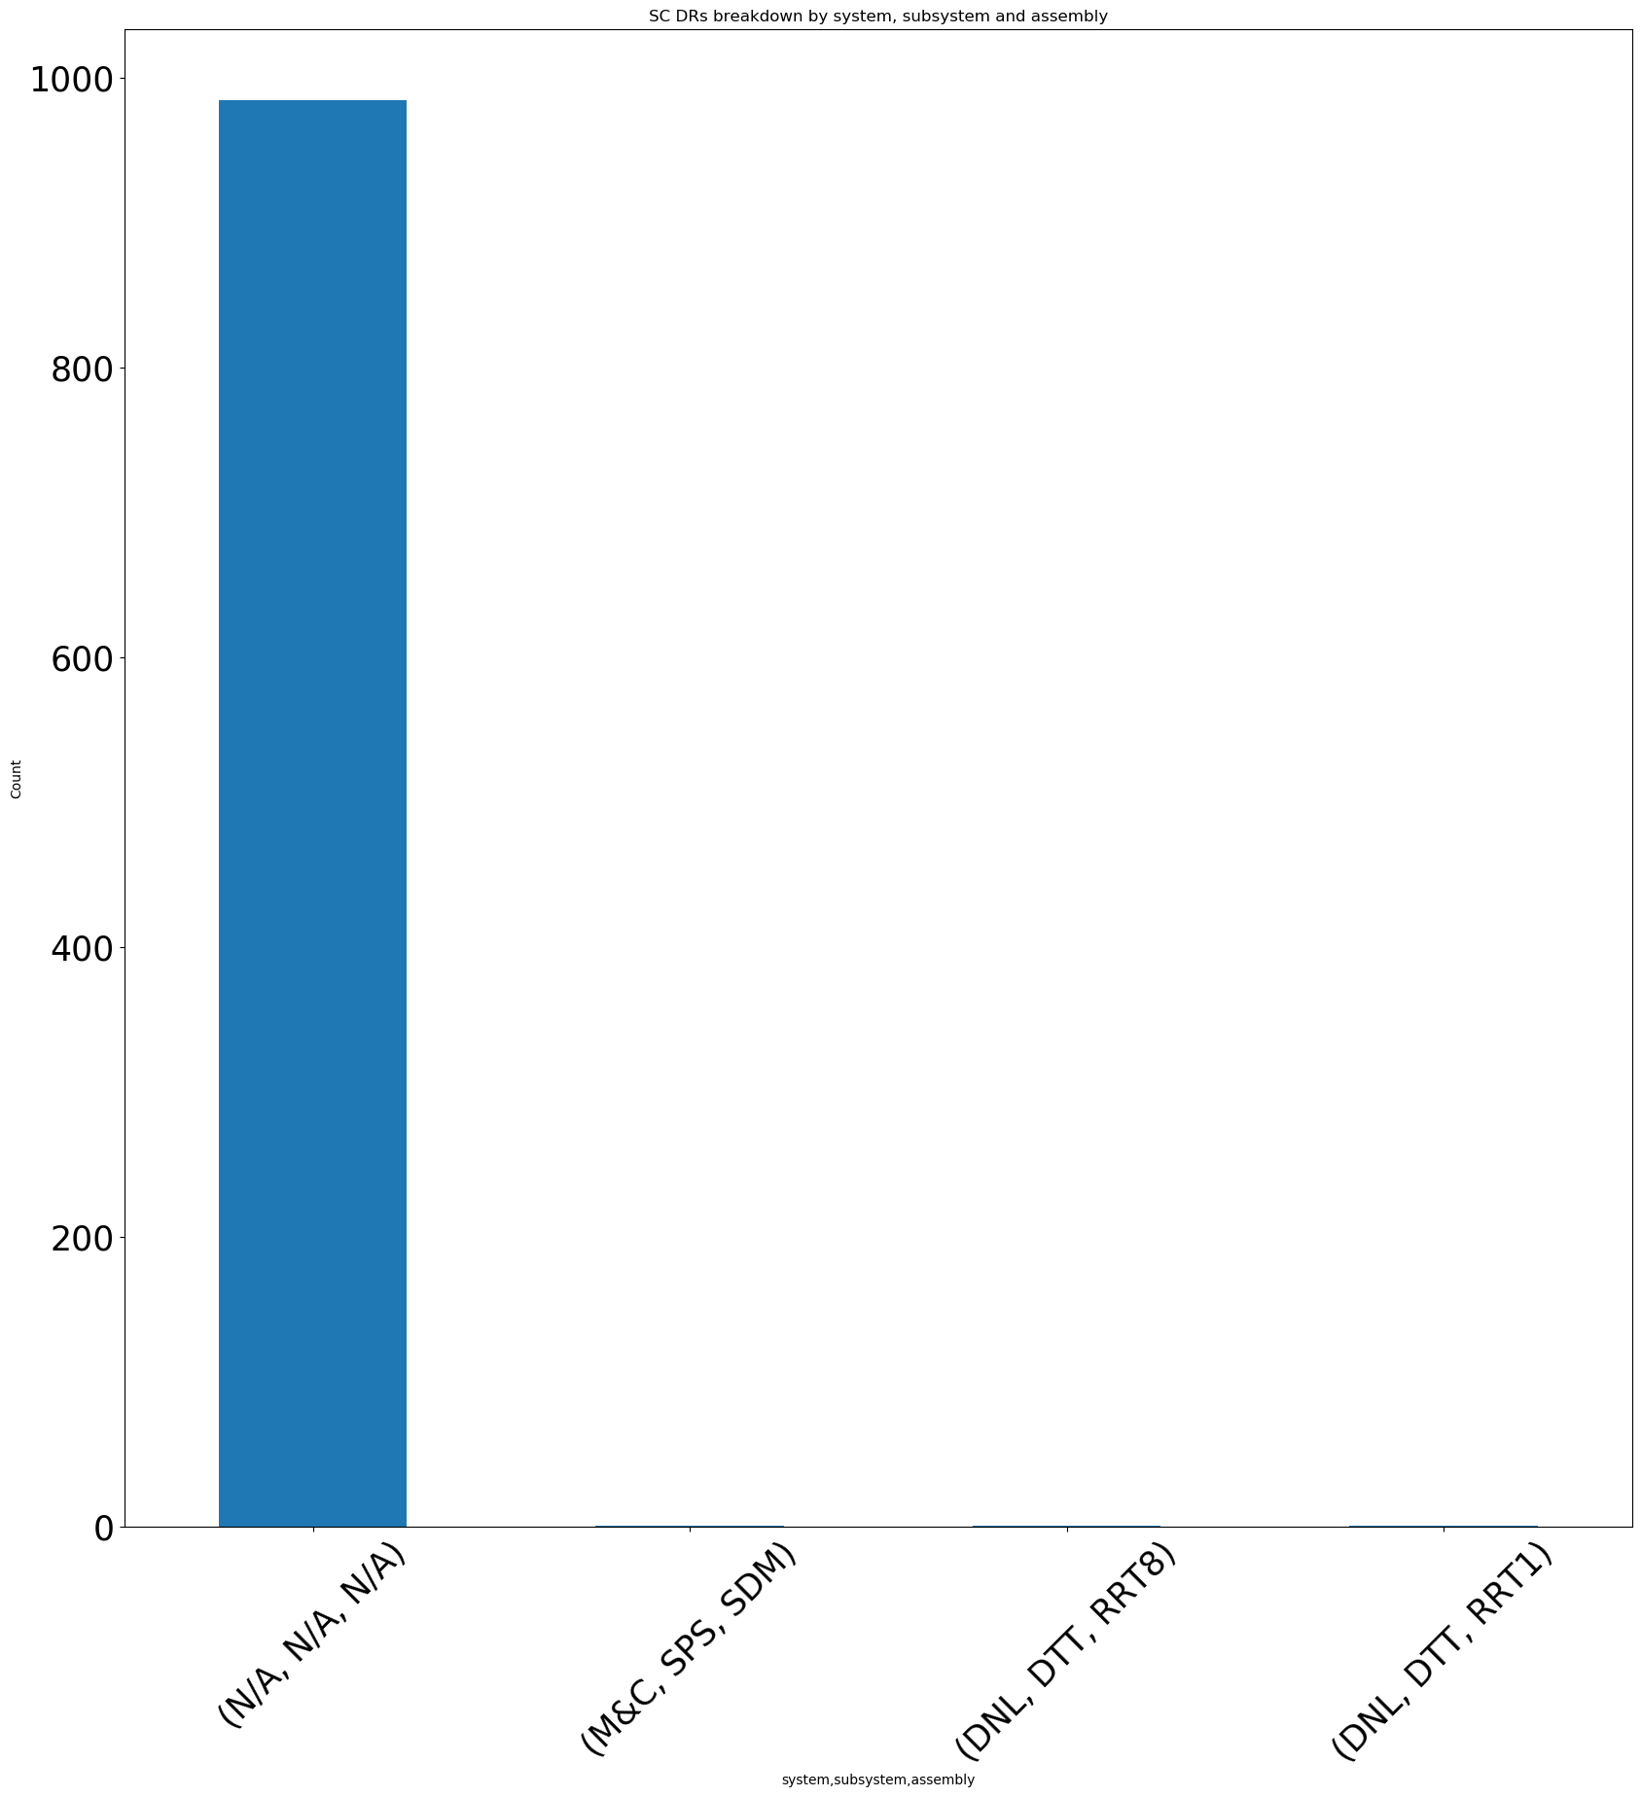
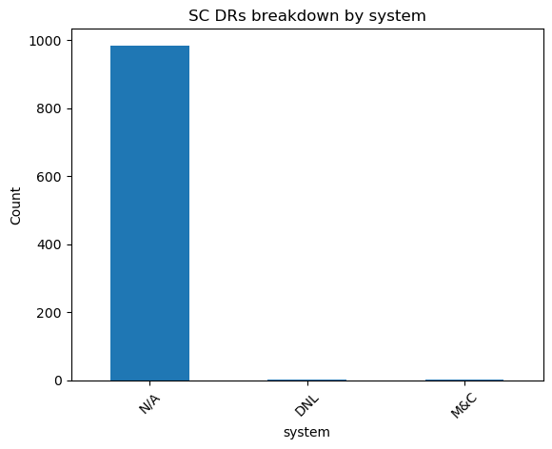
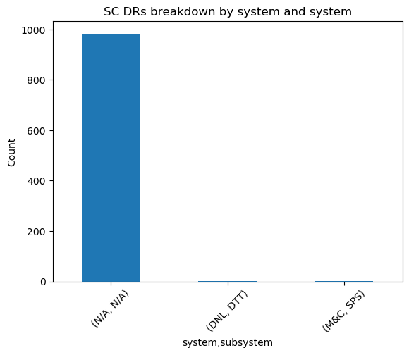
Spacecraft (SC)

Slide 46
DSWG Pilot Stated Goals
Re-label the RFI, Weather and Azimuth use case data, re-train and compare to previous results
Focused on RFI, and ran out of time to procure new labels.
Investigate new use cases possible using document topic modeling techniques from ML
Complete
Design an ML-ready annotation capture system in consultation with current operators
Put forth a proposal, but still to be reviewed by OEs
Present a cost-benefit analysis of our annotation capture scheme to our DSN stakeholders
Attempting to do that right now ☺

