Slide 1
TimeFED

Slide 2
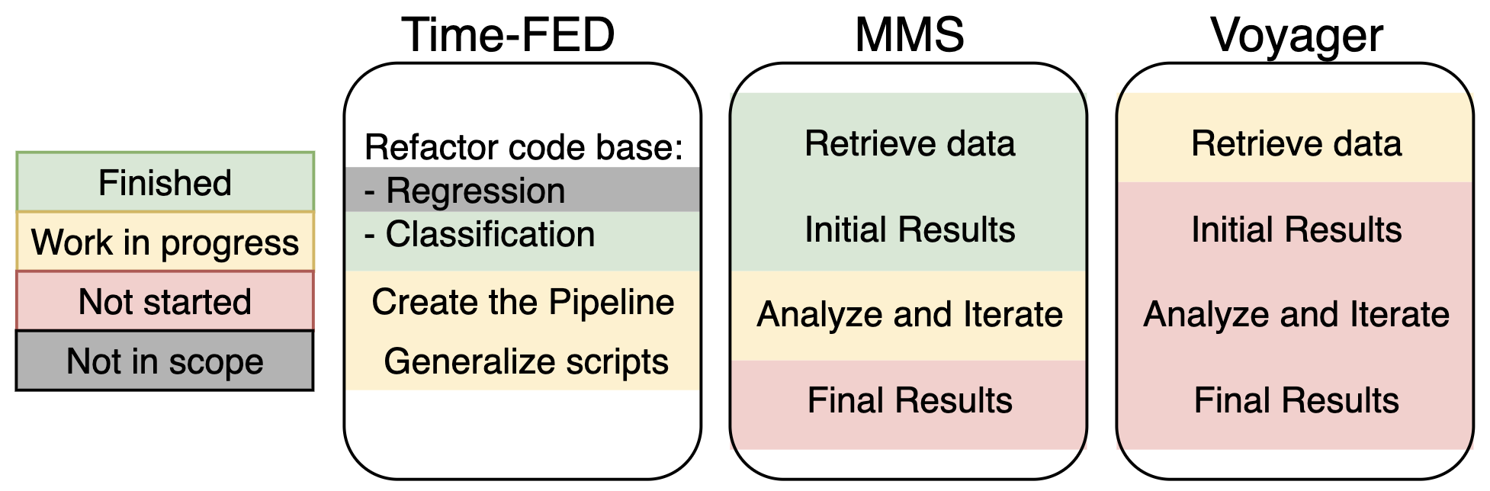
Milestones

Slide 3
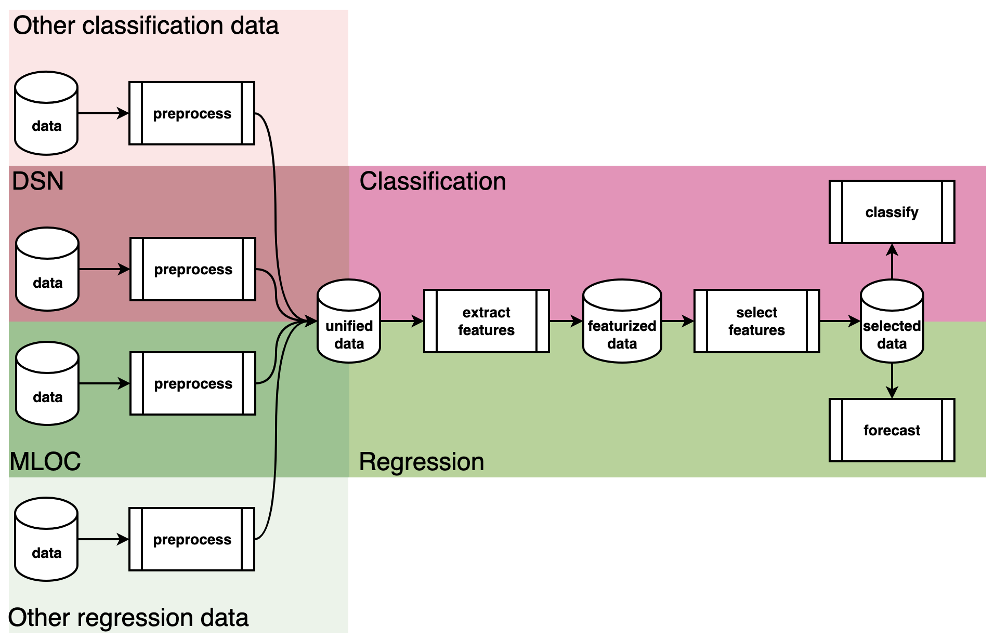
Pipeline

Slide 4
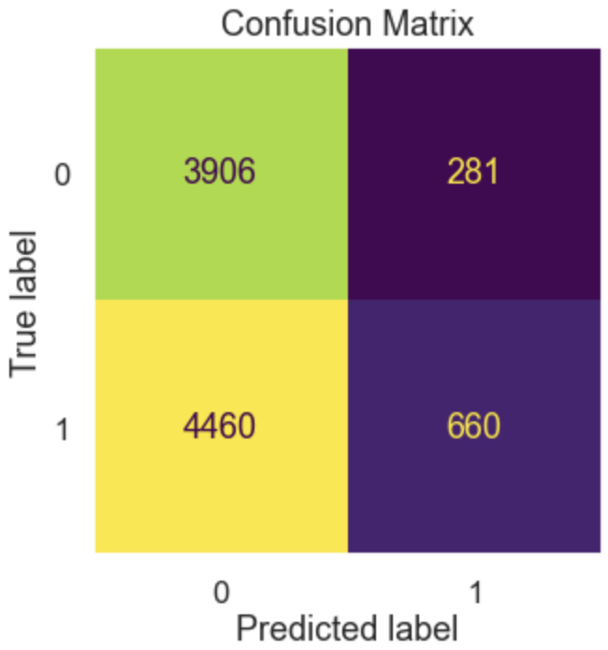
RUN 0: Pos:Neg track ratio: 1:1 Train/test split: 2018
Train shape: (22874, 912) (63.68%)
Test shape: (13046, 912) (36.32%)
accuracy = 0.6066993714548521
precision = 0.6388535031847133
recall = 0.18016885216454104
truth
0 1
predicted 0 6912 567
1 4564 1003
Metric | Score
Accuracy | 0.4906
Precision | 0.7014
Recall | 0.1289
RUN 1:
Pos:Neg track ratio: 1:2
Train/test split: 2019
Train shape: (28161, 912) (75.16%)
Test shape: (9307, 912) (24.84%)
RUN 2:
Pos:Neg track ratio: 1:1 Train/test split: 2019
Train shape: (28161, 912) (75.16%)
Test shape: (9307, 912) (24.84%) accuracy = 0.5255041518386714
precision = 0.658102766798419
recall = 0.130078125
truth
0 1
predicted 0 4650 346
1 4454 666
Top Features of the Model | Contribution Percentage
AGC Voltage Maximum | 3.5%
AGC Voltage Absolute Maximum | 3.4%
AGC Voltage Linear Trend | 2.8%
AGC Voltage Root Mean Square | 2.6%
AGC Voltage Absolute Energy | 2.6%

