Slide 1
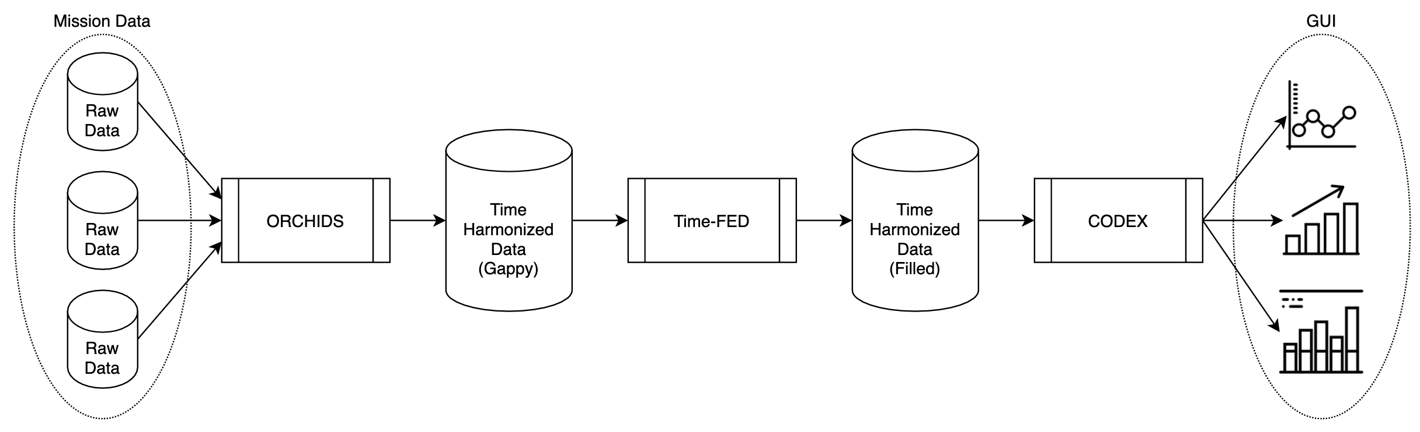
Technology Infusion
ORCHIDS time-harmonizes raw mission data together into a single output, but this data is has gaps in time
Time-FED uses ML to predict the missing and future values
CODEX presents the data via a GUI and enables further investigation and research

Slide 2
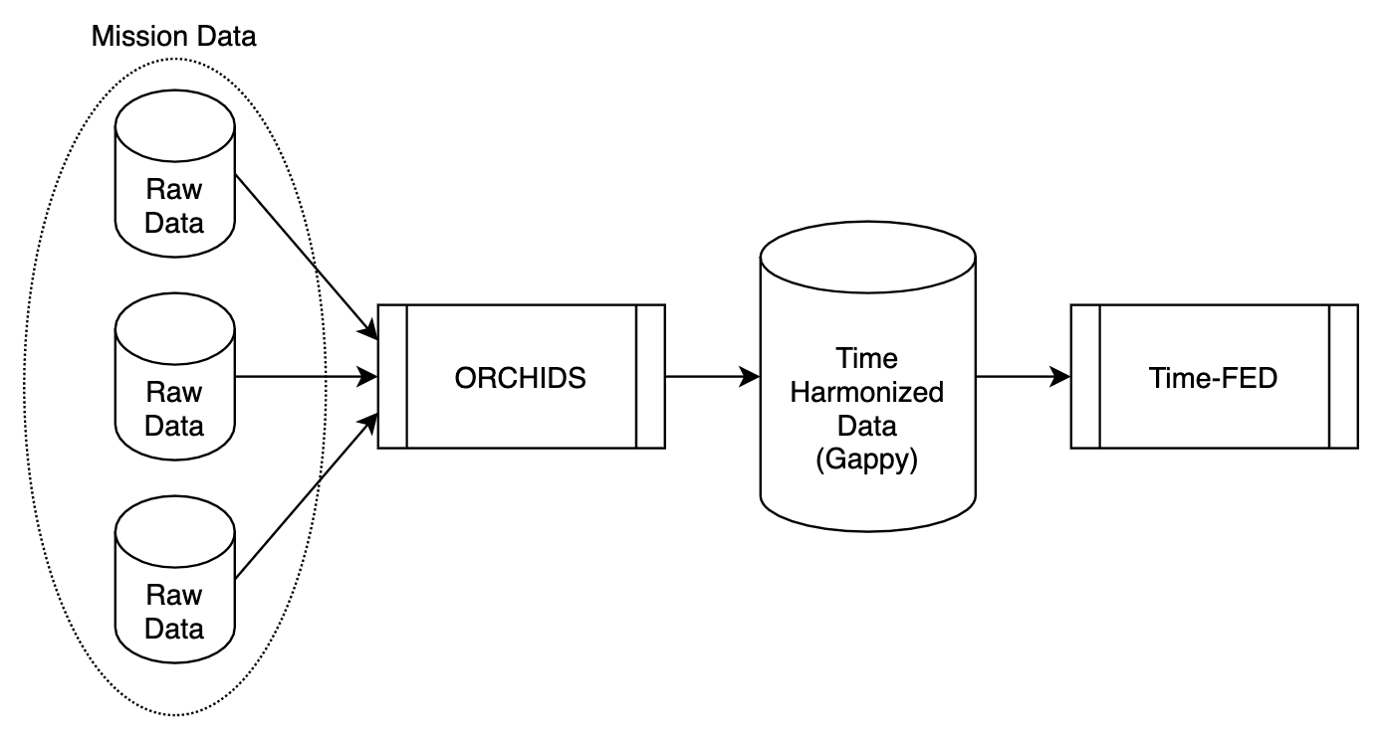
Technology Infusion
ORCHIDS time-harmonizes raw mission data together into a single output, but this data is has gaps in time
Time-FED uses ML to predict the missing and future values

Slide 3
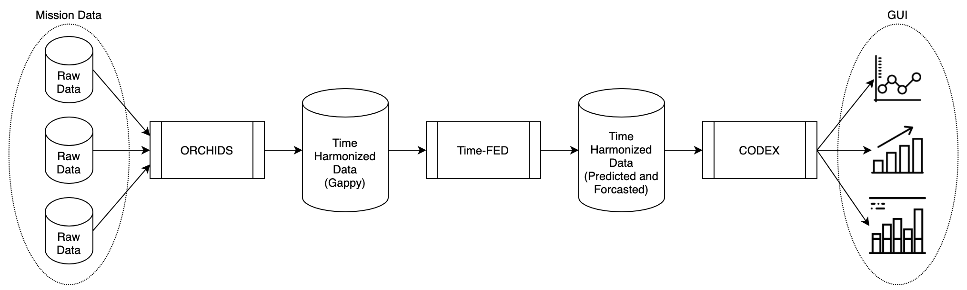
Technology Infusion
ORCHIDS time-harmonizes raw mission data together into a single output, but this data is has gaps in time
Time-FED uses ML to predict the missing and future values
CODEX presents the data via a GUI and enables further investigation and research

Slide 4
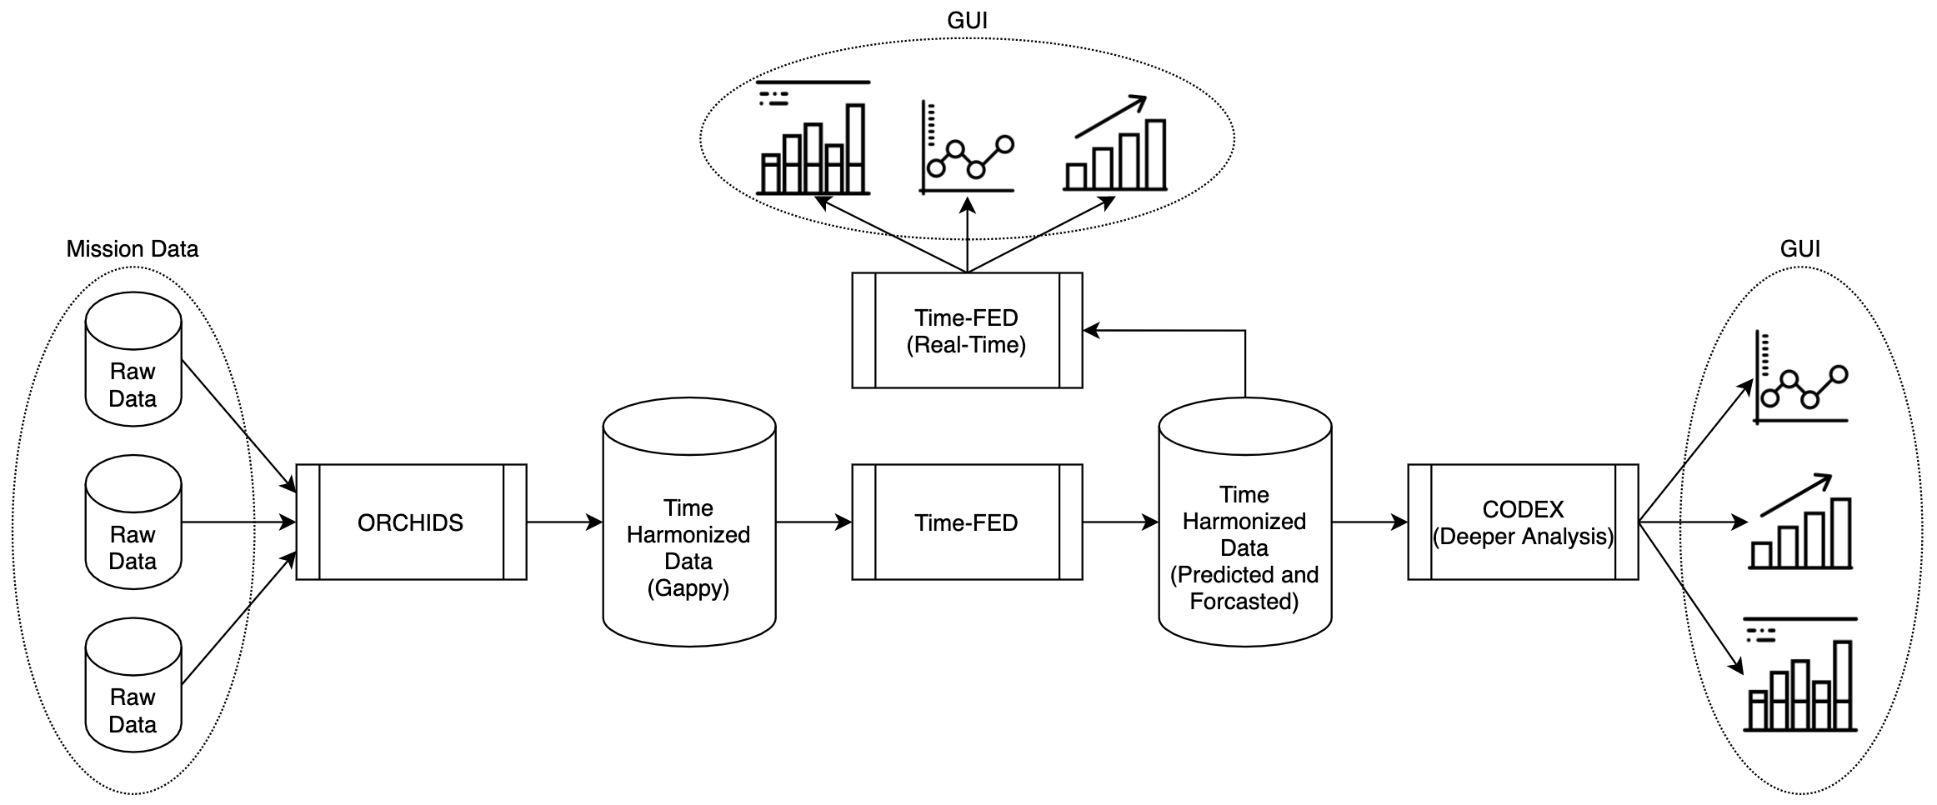
ORCHIDS time-harmonizes raw mission data together into a single output, but this data is has gaps in time
Time-FED uses ML to predict the missing and future values
Future aspiration: Develop in-house a real-time GUI to present and analyze the performance system performance
CODEX presents the data via a GUI and enables further investigation and research
Future aspiration

