Slide 1
Development of SysML Executable Python Design Patterns for Ops Activity Models Simulation
Wubing Ye
wye@caltech.edu
August 18, 2010
NASA Space Grant

Slide 2
Introduction
Goals:
To develop a Python design pattern that executes SysML activity diagrams
Create an activity design pattern that can be added to the JPL Statechart Autocoder
Agenda:
Activity diagram and class diagram overview
The Python design pattern and ActivityBase class
Example Activity diagrams
MagicDraw animator demonstrations
Future plans

Slide 3
What is an Activity Diagram?
One of nine diagrams that can be drawn in the Systems Modeling Language (SysML).
Behavior diagram, i.e. demonstrates system functionality.
Illustrates the flow of information (tokens) from action to action.
Created using the MagicDraw CASE tool.

Slide 4
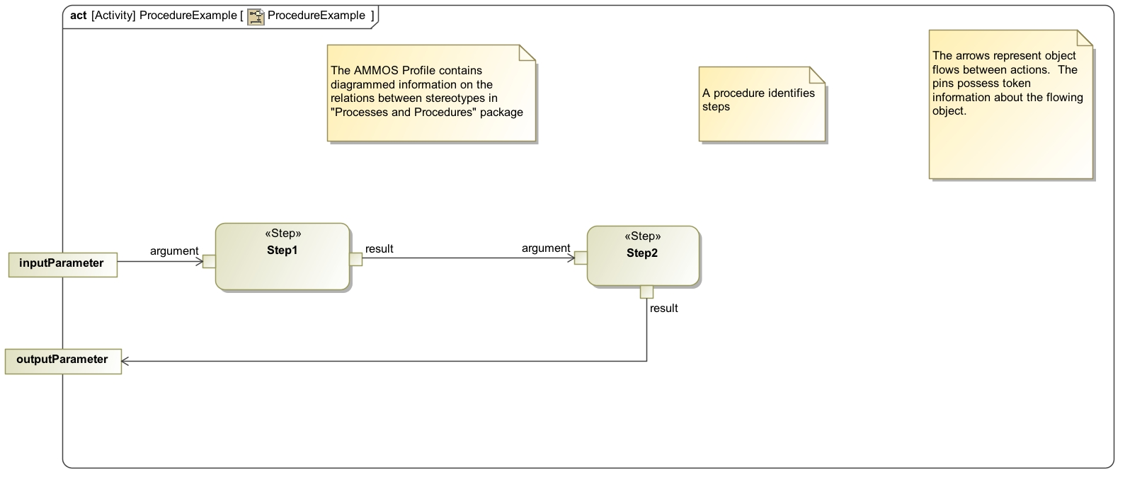
Simple Activity Diagram
Parameter Box
Input Pin
Output pin
Action Node

Slide 5
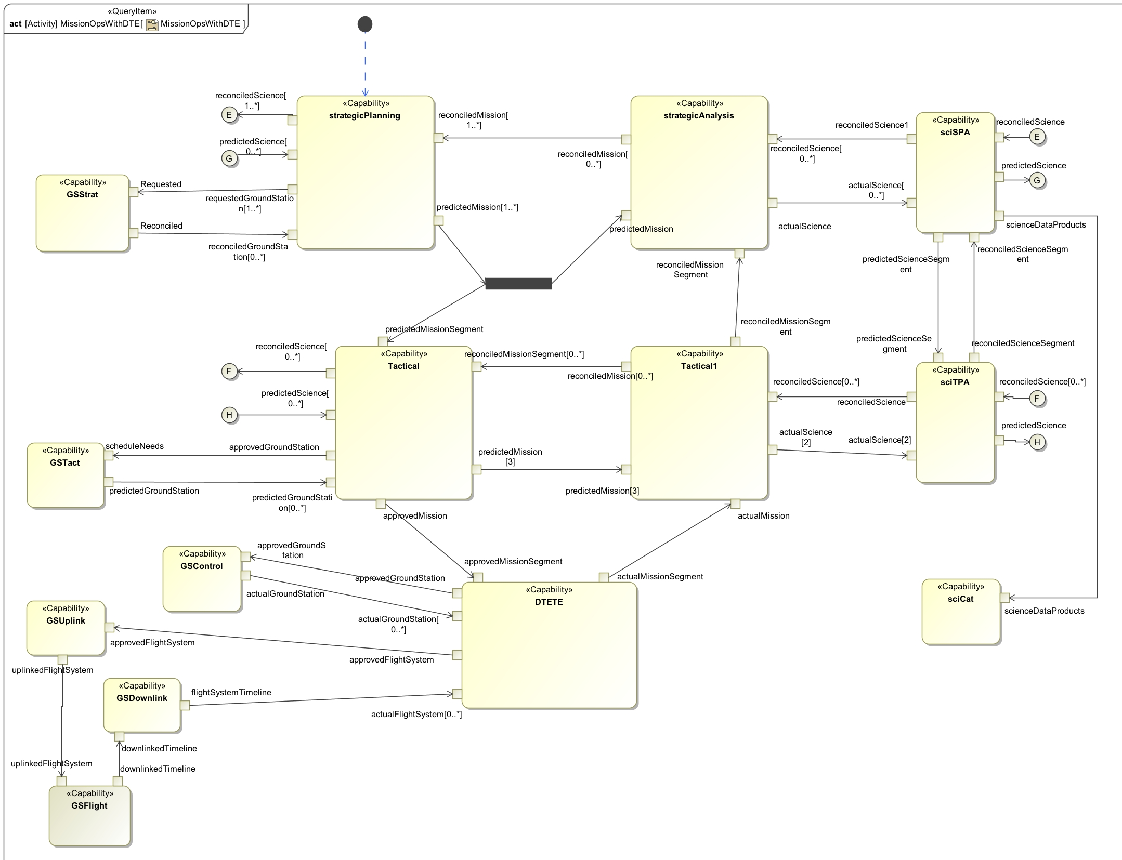

Slide 6
Class Diagrams
Another diagram option in SysML
Class – describes different types of objects or instances in a system
Each class lists its own attributes and operations
Structure diagram, i.e. class diagram shows the classes and their relationship to one another

Slide 7
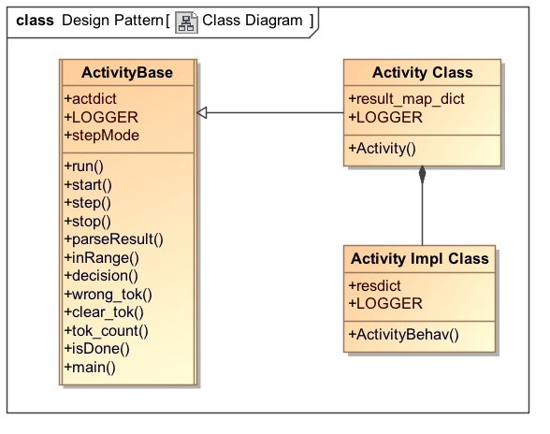
Class Diagram of Python Design Pattern

Slide 8
The Python Design Pattern
ActivityBase:
Contains generic functions and attributes that will be used by all activity codes
Accesses the “actdict” dictionary located in the Activity Class
Uses the “actdict” dictionary to keep track of tokens and action node information
Is the “conductor” of activity execution

Slide 9
Common Attributes in ActivityBase
Attribute Name | Purpose
actdict | Contains action names as keys; each action name key has the following: criteria for an action’s input pins to be satisfied a tok_list that stores input tokens exec_status that shows whether an action has executed or not method that matches key name to a callable action
LOGGER | Catalogues and stores printed messages.
stepMode | Allows individual stepping through an activity if set to “True”. Otherwise, the activity will run to completion in one step.

Slide 10
The actdict
self.actdict = {'inputParameter' : {'stdin' : 'no',
'next_step' : ['Step1’] },
'Step1' : {'argument' : {'source' : 'inputParameter',
'min_tok' : 1,
'max_tok' : 1,
'tok_list' : [] },
'method' : self.Step1,
'next_step' : 'Step2',
'exec_status' : 'Current’ },
'Step2' : {'argument' : {'source' : 'Step1',
'min_tok' : 1,
'max_tok' : 1,
'tok_list' : [] },
'method' : self.Step2,
'next_step' : 'return output parameters',
'exec_status' : 'Current’ },
'outputParameter': {'stdout' : 'no',
'final' : {'source' : 'Step2',
'tok_list' : [] } } }

Slide 11
ActivityBase Functions
Function Name | Purpose
run() | Runs in the background; calls step() when stepMode is False, otherwise terminates after mapping the input parameters.
start() | Collects input tokens and maps them to the correct input pins.
step() | A single step through the activity; executes one action.
stop() | Returns dictionary of action name and tok_lists if “stdout” in actdict is set to “yes”. Otherwise, returns nothing.
parseResult() | Maps tokens on output pins to input pins of the next action.
inRange() | Returns “True” if input pin criteria are satisfied.
decision() | Decision node; maps token to input pin of the true condition.
wrong_tok() | Returns list of input pins that are not satisfied.
clear_tok() | Clears the tok_list (input pins) of an action.
tok_count() | Counts the number of tokens in the tok_list (input pin).
main() | Utility main method for invoking activity executables.
isDone() | Returns “True” when all executable actions have finished.

Slide 12
Activity and Impl Class
Activity Class:
Contains result_map_dict which is a dictionary that has output pin names as keys and input pins as definitions
self.result_map_dict = {"inputParameter": ["Step1.argument"],
"Step1.result" : ["Step2.argument"],
"Step2.result" : ["outputParameter.final"] }
Calls Impl class which then executes the user-inputted code
Impl Class:
User-input section; returns a “resdict” dictionary

Slide 13
Design Structure Summary
Execution
Control
Data
Control

Slide 14

Important Design Questions
How are the subset of activity model features being handled?
What is the criteria for action execution?
How are input pins and parameters being checked?
Are executions ordered?

Slide 15
Activity Model Features
Feature of Model | Representation in Python
Action node | Instance and key in actdict
Input pins | Definition key under action node entry in actdict
Output pins | Key in resdict
Tokens | Treated as objects
Mapping of tokens from action node to action node | result_map_dict
Decision node | Equivalent to action node
Merge node | Multiple output pins mapped to single input pin in result_map_dict
Fork node | Token mapped to multiple inputs in the result_map_dict
Join node | Equivalent to action node
Input/Output parameter | Key in actdict
Call actions | Instanced by top-level activity model

Slide 16
Action Execution
Action must be inRange() and ‘exec_status’ must be set to either “Current” or “Continuous”
step() loops through the actdict and runs whichever step whose execution requirements are fulfilled
Once the action has finished, it will return a resdict that maps the produced tokens to the action’s output pins
The action’s input pins are then cleared and its tokens are parsed to the next action’s input pins by parseResult()
Execution order is random

Slide 17
Example Activity Diagrams
Seven examples, each demonstrating a different feature of SysML Activity diagrams:
ProcedureExample – basic diagram that demonstrates functionality
ProcessExample – action node with multiple input pins
CapabilityExample – fork node
JoinExample – fork and join nodes
IncrementExample – decision node
MergeExample – decision and merge nodes
Process1 – demonstrates hierarchy and call actions

Slide 18
ProcedureExample

Slide 19
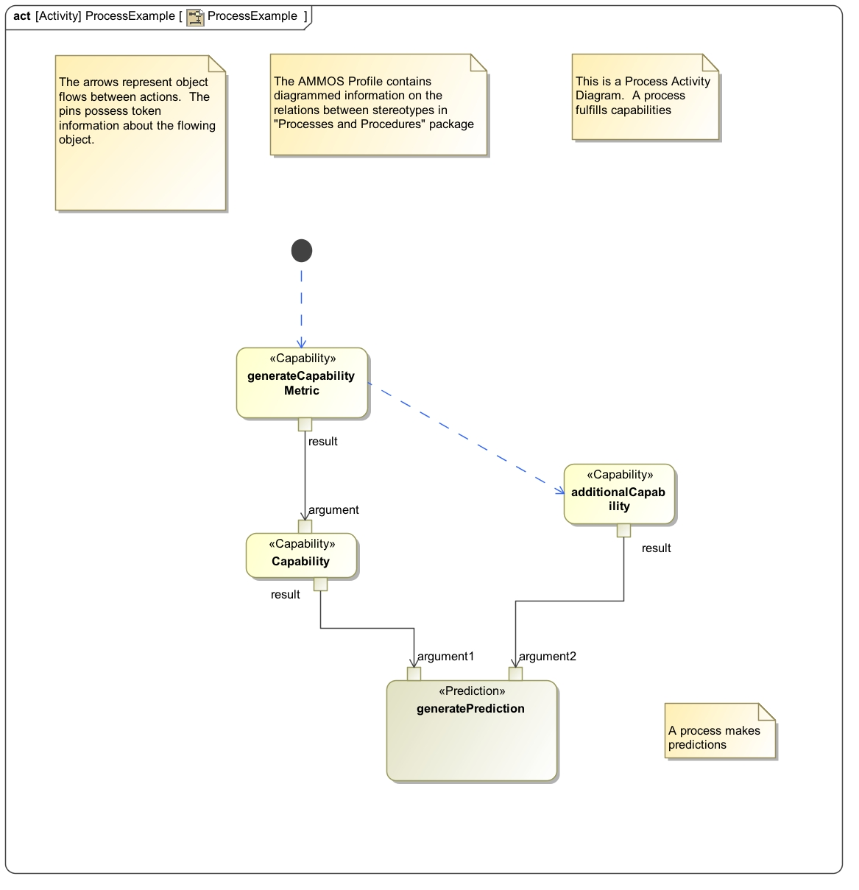
ProcessExample
Input
Pin 1
Input
Pin 2

Slide 20
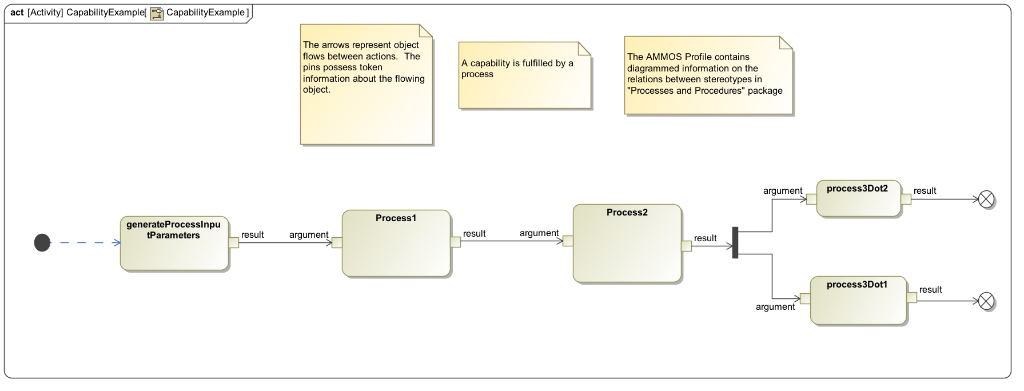
CapabilityExample
Fork Node

Slide 21
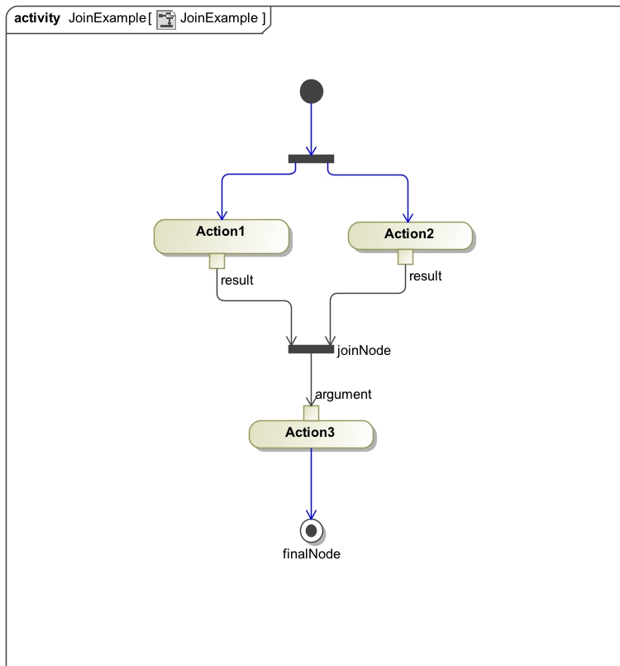
JoinExample
Fork Node
Join Node

Slide 22
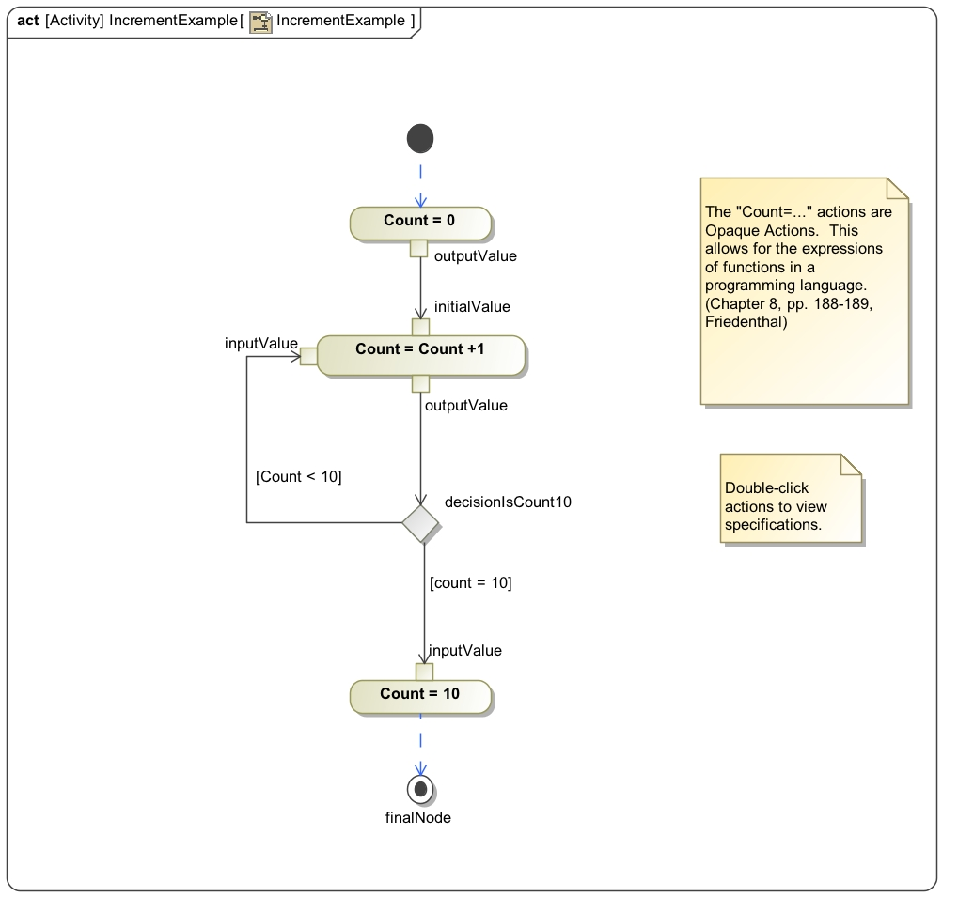
IncrementExample
Decision Node

Slide 23
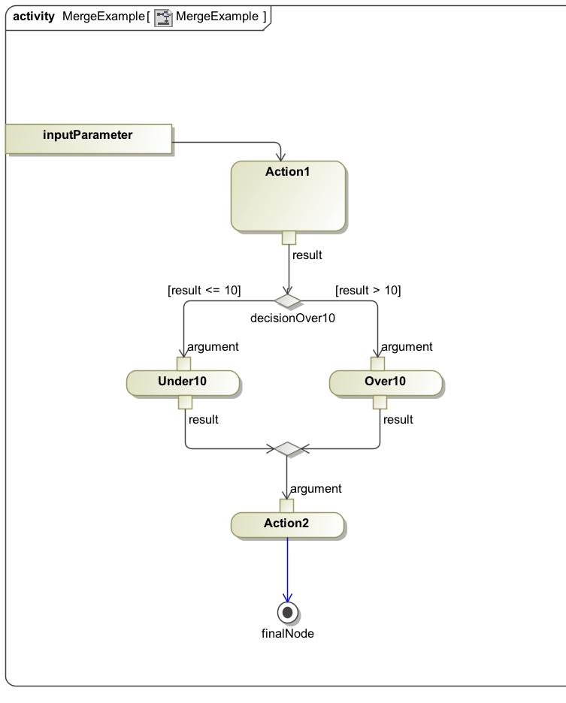
MergeExample
Decision Node
Merge Node

Slide 24
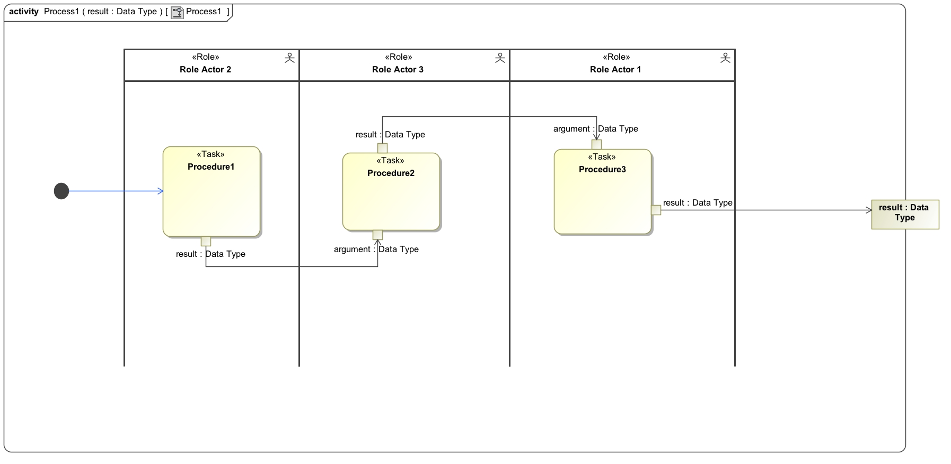
Process1
Call Actions

Slide 25
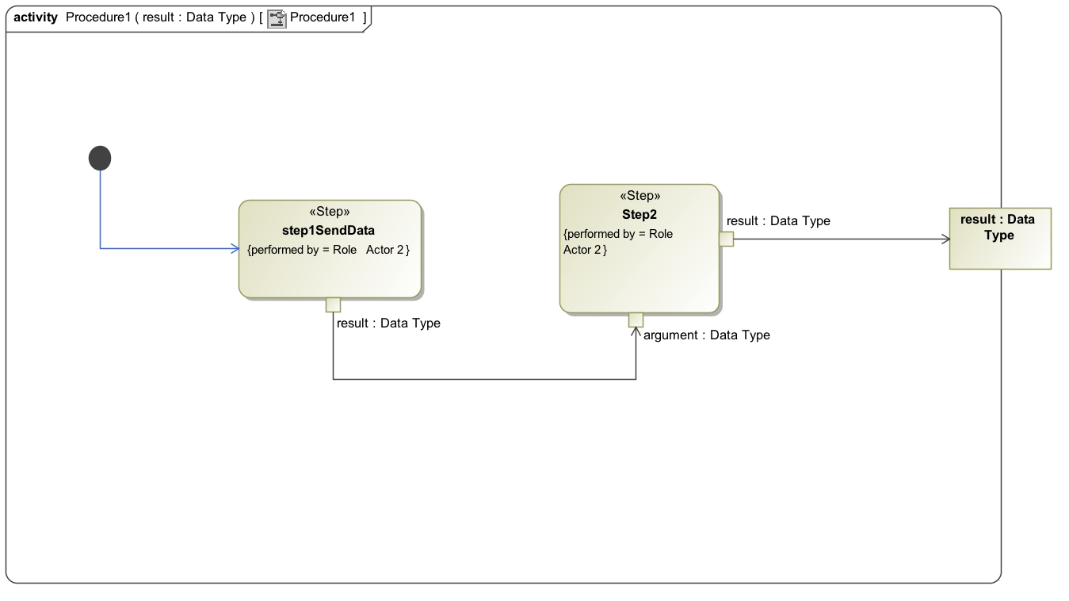
Procedure1

Slide 26
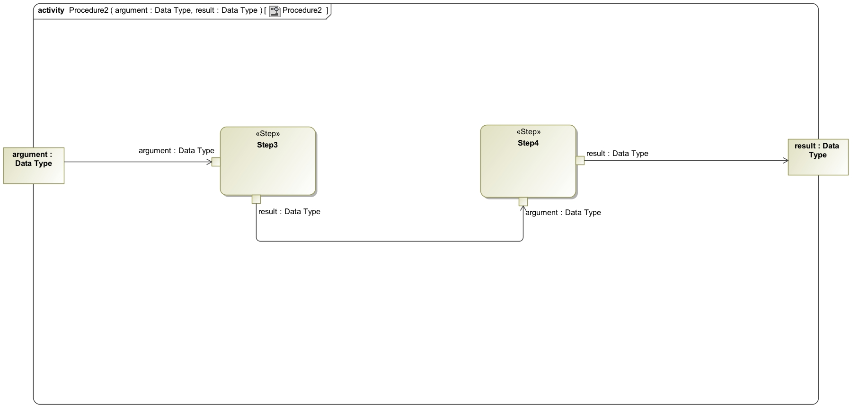
Procedure2

Slide 27
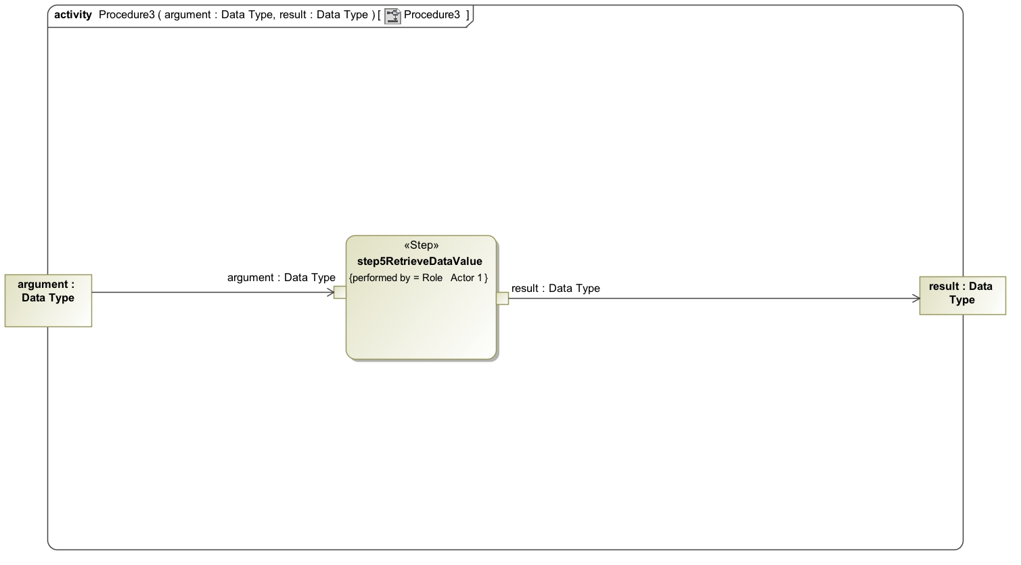
Procedure3

Slide 28

Time for Demos!!

Slide 29

Future Plans
Implement a plug-in that sorts the actdict so that action execution is ordered
Utilize stereotypes
Set priority rules so that actions with fewer token requirements will execute first.
Replace the actdict with a class system
Include this design pattern into the JPL Statechart Autocoder
Endless possibilities!

Slide 30
Summary
Developed a Python design pattern to execute SysML Activity diagram simulations
ActivityBase contains common functions and calls upon actdict to determine which action to run next
If an action’s input pins are satisfied, then it will run and produce tokens that will be mapped to the next input pin
Simulations can be run in MagicDraw
Activity class pattern ready for automatic generation

Slide 31


MissionOps Diagram

Slide 33
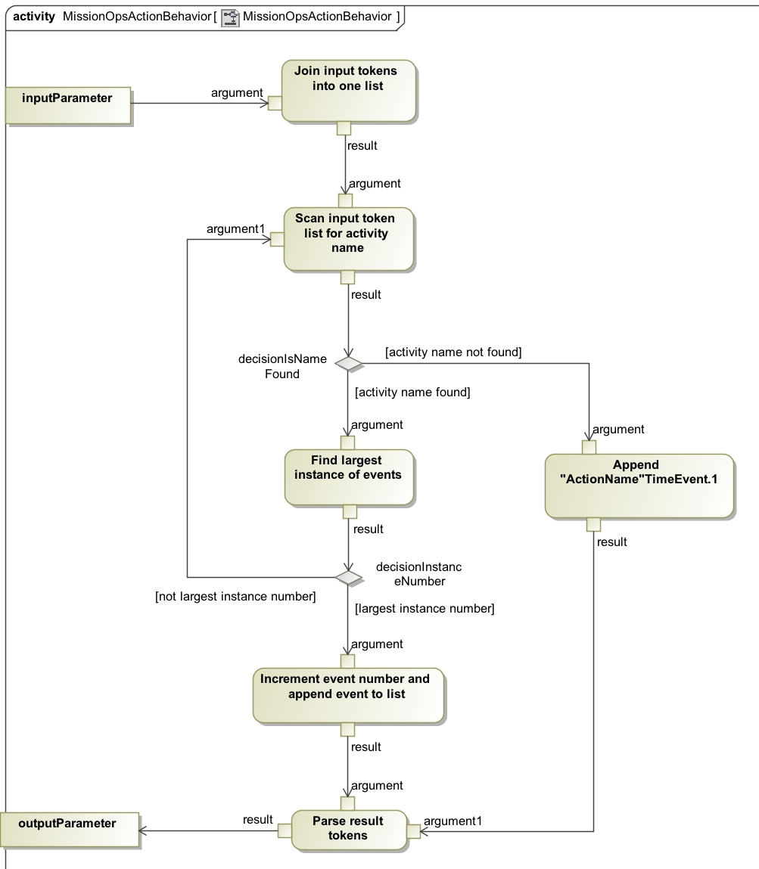
MissionOps Impl Diagram

