Slide 1
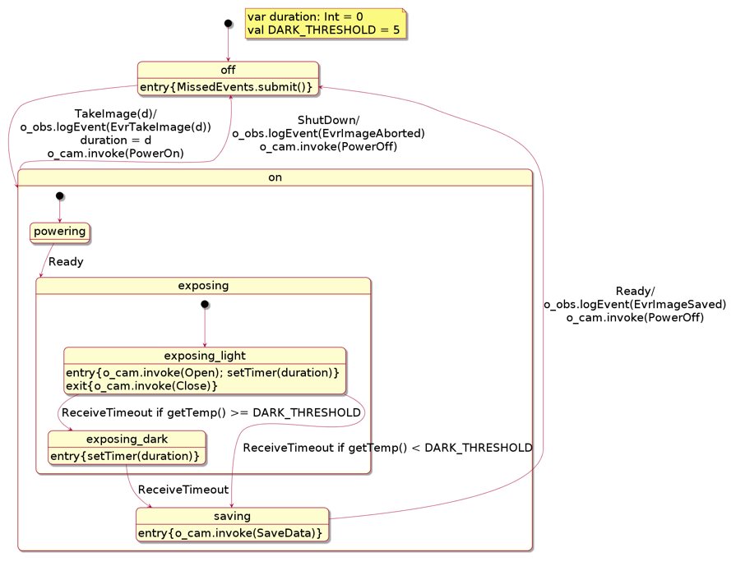

PowerOn
Open
Close
SaveData
PowerOff
Imaging
Camera
Ready
event reports
Ground
d
TakeImage(d)
ShutDown

