Slide 1

FINAL PRESENTATION
Cosmos and F’’
Date: 8/14/2018
Jordan Ishii: jordanishii1@gmail.com

Slide 2
Who am i
Senior at Azusa Pacific University – Graduating 2019
Studying Computer Science
Double-majoring in Honors Humanities
Minor in Math
Senior at Azusa Pacific University – Graduating 2019
Professional Interests
Embedded Systems – Tools, IoT, Robotics
Artificial Intelligence
Compilers and Domain Specific Languages
Personal Interests
Game Development

Slide 3
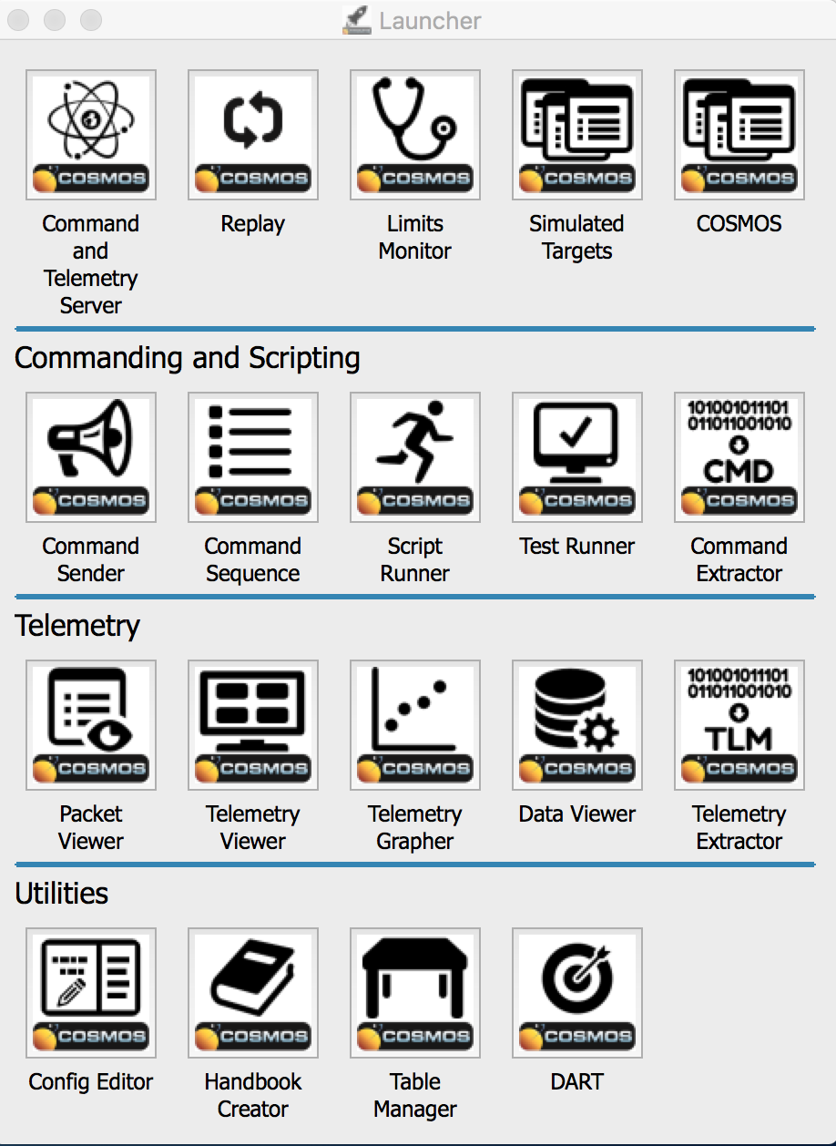
COSMOS
System for commanding and monitoring telemetry of an embedded system
Generalized and extendable to connect to anything from test equipment to development boards or satellites
Suite of built-in applications that send commands and monitor telemetry
Extendable via custom tools / scripts made in Ruby

Slide 4
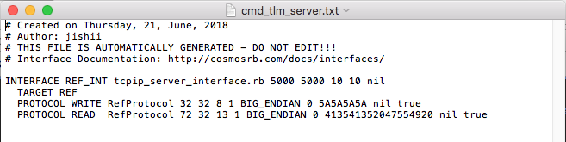
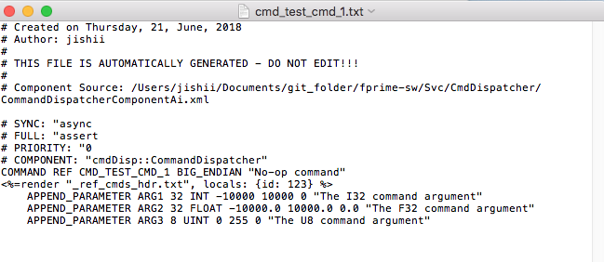
COSMOSgen.py
Embedded systems hooked up to COSMOS through series of .txt configuration files
Created tool to generate these config files and necessary scripts for F’ deployments
Installation for Ref application (or deployment) target
Execute ”cosmos demo DIR_NAME”
Execute “run_cosmosgen.sh –p PATH ../../Ref/Top/RefTopologyAppAi.xml”
Execute the COSMOS server by executing CmdTlmServer
Execute the Ref App as “./Ref –p 5000 –a 127.0.0.1”
Server Interface Config
Command Config

Slide 5
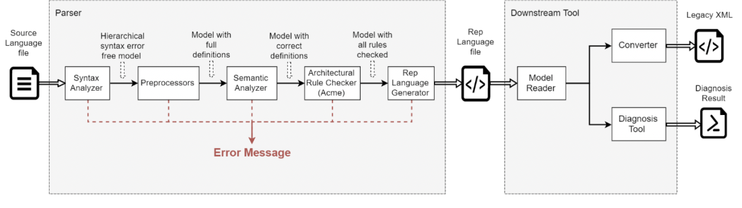
F’’
Domain specific language modeling tool for F’ software framework
2 Java programs originally built by CMU students
Additions this summer include generated imports, better scoping for types, and general semantic fixes to align with the F’ Framework more accurately

Slide 6
What I enjoyed
Challenging work with high degree of freedom
Research background, felt similar
Good balance of familiar concepts and new things to learn
Work similar to past-research experiences and classes
Learning some Ruby was fun
Enjoyed the breadth of tasks
Mix of Java, Python, Ruby
Enjoyable to learn more about flight software

Slide 7
DEMO

Slide 8
Questions

