Slide 1
FPrime Zmq Server
David Kooi
FPrime GSE Server Redesign

Slide 2
My Work at JPL
Overview of summer work
Designed new FPrime GSE Server
Uses ZeroMQ middleware
Cross platform, high-performance, asynchronous, distributed messaging library.
Supports reconnect capability
Supports protocol translation
Supports multi-target communication
Updated GSE GUI for use with ZMQ and maintained backwards compatibility with legacy TCP Server
Tested for server integrity and throughput
Implemented C++ Zmq Radio component within FPrime
Emulates a radio connection between a flight target and the GSE Server
Prevents embedded flight target from hanging up on disconnections from GSE.
Notes:
ZMQ – Fun fact, it is used by CERN’s Remote Device Access library where they need to connect thousands of data points from around the collider
Reconnect capability – Allow clients to arbitrarily connect and disconnect. Pervious server had issues with this.
Protocol Translation – FPrime GSE works with native Fprime packets. Inline protocol translation allows the Fprime ground system to be data agnostic.
Multi target - ZMQ allows many to many communication. The server provides single point communication support for sets of satellites or sets of test equipment.
Updated GSE GUI – It is important to provide backwards compatibility. The Fprime GSE GUI works with the legacy TCP server and the new ZMQServer.
Server Tests: Created a test framework for these two sets of tests.
Server Integrity – Two things: tested that the server could withstand abrupt disconnections. Tested data integrity. Need to ensure that no packets are dropped during operation.
Throughput - Tested throughput with various configurations of publishers and subscribers. Server can achieve 2mb/s.

Slide 3
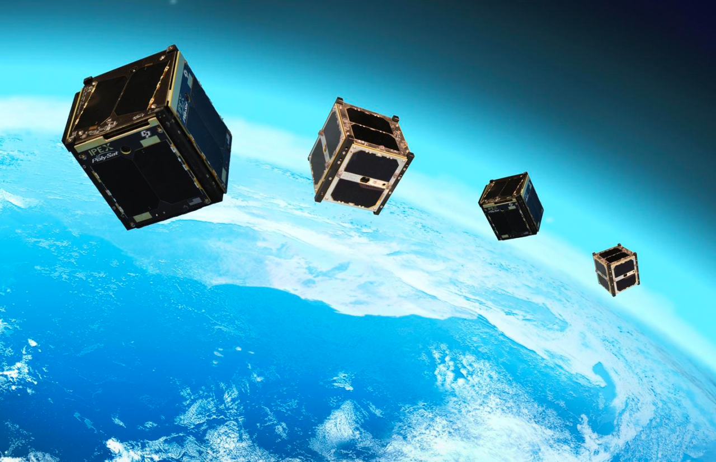
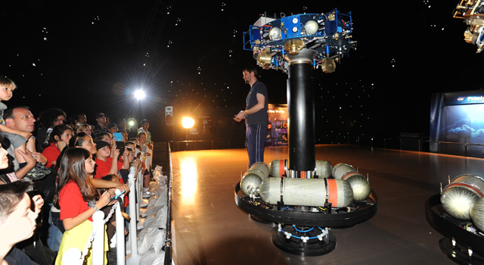
Use Cases
Near-term:
JPL’s Formation Flying Testbed
Enable multi-target communication
DoD Testbed configuration
Far-term:
Constellations of satellites
http://www.satellitetoday.com/newspace/2017/05/24/roccor-exec-supporting-900
-satellite-leo-constellation/
https://www.jpl.nasa.gov/news/news.php?feature=2985
Notes:
Formation Flying Testbed: Multiple robots streaming telemetry and receiving commands. Allows central control of the communication’s datapath
DoD testbed: Flight hardware running in parallel with a hardware simulation. Before the datapaths were separate. Now data paths go through one point.
Constellations: Have a university with 3 satellites. Instead of managing three servers, three telemetry databases, there is one server, one database with still the capability for individual spacecraft operation.

Slide 4
Design Process
Overview
This design process was followed for both the GSE ZmqServer task and the
Zmq Radio component task
Requirements
Analysis
Design
Implementation
Test

Slide 5
Design Process
GSE ZmqServer Requirements
Single point of initial connection
Client registration on a single port
Enable Publish Subscribe configuration and inspection
Publish Subscribe Architecture
Enable multi flight target to multi ground client communication
Robust client connections
Server should be able to withstand random client disconnection and reconnection
Protocol Translators
Server shall be able to communicate over protocol barriers
GSE UI Compatability
Adapt GSE UI for Zmq communication while maintaining backwards compatibility to legacy server.
Requirements
Analysis
Design
Implementation
Test

Slide 6
Design Process
GSE ZmqServer Analysis
Requirements
Became familiar with ZMQ
Learned common design patterns
ZMQ Request-Reply
ZMQ Pub-Sub
ZMQ Router-Dealer
Implemented those patterns in simple exercises
Analysis
Design
Implementation
Test

Slide 7
Design Process
GSE ZmqServer Design
Requirements
Held initial design meetings to discuss design options
Formulated a design on paper
Held further design meetings to discuss viability
Analysis
Design
Implementation
Test

Slide 8
F-Prime Server Overview
Class Diagram
Server
Composed of
Uses
AdapterBase
ZmqKernel
Subclasses
Flight Subscriber Thread
Ground Sublisher Thread
AdapterImpl_1
AdapterImpl_n
n Flight Pubscriber Threads
n Ground Publisher Threads
Routing Table
Event Reactor

Slide 9
Server Architecture
Using native FPrime
Static Subscription sockets receive all incoming packets
ZmqServer
Flight
Client 1
D
Ground
Client 1
R
R
DEALER
ZMQ Kernel
D
R
R
DEALER
Flight
Client n
D
D
D
R
Ground
Client n
R
D
D
D
DEALER
Cmd/Status
(R)
DEALER
Dynamic Publisher sockets.
One thread per connection.
Arbitrary Protocol
Native FPrime
D: zmq dealer socket
R: zmq router socket

Slide 10
Server Architecture
Using Adapters to decode
Adapters run as their
Own process
ZmqServer
Flight
Client 1
D
R
Adapter
D
Ground
Client 1
R
D
R
R
DEALER
ZMQ Kernel
D
R
R
DEALER
Flight
Client n
D
R
Adapter
D
D
D
R
Ground
Client n
R
D
R
D
D
D
DEALER
Cmd/Status
(R)
DEALER
Arbitrary Protocol
Native FPrime
D: zmq dealer socket
R: zmq router socket

Slide 11
Server Architecture
Using Adapters to encode
Adapters run as their
Own process
ZmqServer
Flight
Client 1
D
R
Adapter
D
Ground
Client 1
R
D
R
R
DEALER
ZMQ Kernel
D
R
R
DEALER
Flight
Client n
D
R
Adapter
D
D
D
R
Ground
Client n
R
D
R
D
D
D
DEALER
Cmd/Status
(R)
DEALER
Arbitrary Protocol
Native FPrime
D: zmq dealer socket
R: zmq router socket

Slide 12
Server Architecture ZMQ Kernel
Flight-Client Side
1 flight subscriber thread
1 ground subscriber thread
Ground-Client Side
ROUTER
Flight-Client Subscriber Thread
PUB
ZMQ
Internal Routing
ROUTER
Ground-Client Subscriber Thread
PUB
SUB
Flight-Client Publisher Thread
DEALER
Routing Table Command Socket tells publisher threads who to receive messages from
SUB
Ground-Client Publisher Thread
DEALER
SUB
Flight-Client Publisher Thread
DEALER
SUB
Ground-Client Publisher Thread
DEALER
SUB
Flight-Client Publisher Thread
DEALER
SUB
Ground-Client Publisher Thread
DEALER
PUB
Flight-Client and Ground-Client
communication
Is symmetrical
1 publisher thread per client
Routing Table
Client
registration creates a new publisher entry in the RoutingTable and creates a new Publisher thread
Runtime
Configurable routing through subscription and subscription commands.
Main Event Loop
Command/Status Port
(ROUTER)
Flight-Client Registration
Ground-Client Registration
Ground-Client Commands
Server Response
Server Response

Slide 13
Design Process
GSE ZmqServer Implementation
Requirements
Main ZmqServer work
Included Protocol translation work
Included GSE UI ZMQ adapter and backwards compatibility work
Analysis
Design
Implementation
Test

Slide 14
Design Process
GSE ZmqServer Testing
Requirements
Server integrity testing
Given random client connections and disconnections the server stays running
Tests for packet loss
Throughput testing
Monitor and record throughput given variable Publish Subscribe configurations and variable packet sizes >2 MB/s*
Analysis
Design
Implementation
Test

Slide 15
Design Process
Zmq Radio Component Requirements
Requirements
Zmq Radio shall be an active component
Zmq Radio Component shall attempt reconnection with the server if disconnected
Zmq Radio Component shall remain stable while disconnected
Analysis
Design
Implementation
Test

Slide 16
Design Process
Zmq Radio Component Analysis
Requirements
Reviewed existing ground socket interface component
Reviewed FPrime active component specifications
Analysis
Design
Implementation
Test

Slide 17
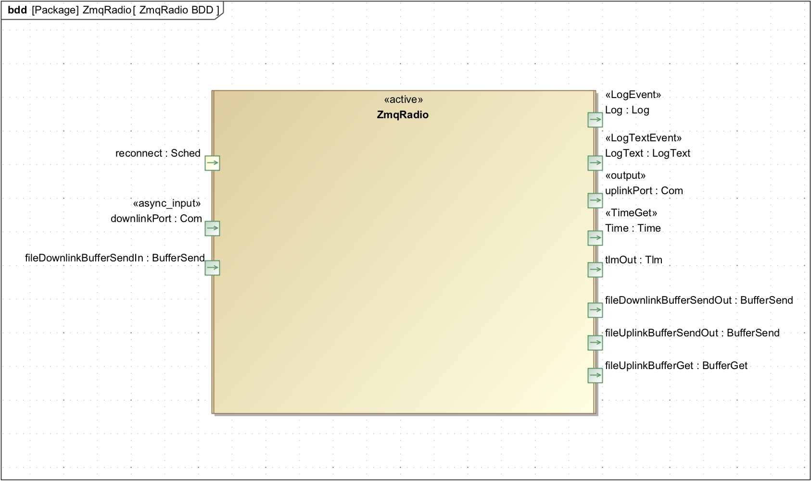
Design Process
Zmq Radio Component Design
Requirements
Design heavily driven by requirements
Analysis
Design
Implementation
Test

Slide 18
Zmq-radio Sequence Diagram
Assume component starts connected to the server.
At [1] a socket error occurs and triggers a disconnect.
At [2] all zmq resources are closed. The socket in Subscriber Task must be closed as well.
This occurs because a Context Error is created within the Subscriber Task.
At [3] the Subscriber Task calls transitionDisconnect because of it’s Context Error. The component is already disconnected so nothing happens.
At [4] the Subscriber Task creates a new subSocket because the component is connected again.
Main Component Thread
ZmqRadio::State
Subscriber Task
[1]
ZMQ Error
State.transitionDisconnect()
[2]
subSocket is blocking on a socketread
Close zmq resources
Block until all sockets are closed
State= DISCONNECTED
Sched In
[3]
Context Error when zmq resources are closed
Connect()
State.transitionDisconnect()
Close subSocket because of zmq error
Attempt Reconnect Fails
State = DISCONNECTED
State.transitionDisconnect()
Disconnected so idle
Telemetry In
State = DISCONNECTED
Disconnected so idle
Sched In
Disconnected so drop packets
Connect()
Disconnected so idle
Attempt Reconnect Succeeds
State.transitionConnect()
State = CONNECTED
[4]
Connected so create subSocket and block on read

Slide 19
Design Process
Zmq Radio Component Implementation
Requirements
Main work for the Zmq Radio Component
Analysis
Design
Implementation
Test

Slide 20
Design Process
Zmq Radio Component Testing
Requirements
One unit test to verify state changes
Functional end-to-end inspection
Analysis
Design
Implementation
Test

Slide 21
Demo Overview
Multi-target datapath with SpacePacket translation
Flight
Client 1
SpacePacket
ZmqServer
D
R
R
R
Ground
Client 1
R
F’ Packet
D
DEALER
SpacePacket
D
D
DEALER
Flight
Client n
D
F’ Packet
R
Ground
Client n
D
D
R
D
DEALER
DEALER
D: zmq dealer socket
R: zmq router socket

Slide 22
What I learned
Experience with the full design cycle
Requirements, Analysis, Design, Implementation, Test
Learned how flight qualified code is developed
Multiple design and code reviews for the zmq-radio C++ component
Learned standard documentation procedures
Good experience using and building with ZMQ middleware
Notes:
Full Design cycle – It was useful to iteratively design the server. Since was new to ZMQ one design path would need to back up and be reanalyzed.
The full timers were very helpful in considering design challenges and approaches.
Flight qualified code: We had several code reviews for the zmq-radio. It was useful to see flight qualified code in practice.
Documentation Procedures: Learned the Fprime markdown format for design documents. I like the presentation and will take the method back to our cube sat team.
Good experience working on a distributed system. I became more comfortable working with multithreaded and multiprocess applications. I am glad to have learned one distributed messaging library because this make it easier to learn others in the future. =

Slide 23
Conclusion
Learned a lot this summer
Much can be taken back to school
Concrete steps towards becoming a better engineer
Thank you: Len Reder for guidance throughout the project. Garth Watney for help with the FPrime tool suite Tim Canham for FPrime design and library support Brian Campuzano for frequent development input
Notes:
Back to school: Fprime is open source. We are looking into using the framework for our C&DH subsystem. This means there is a possibility the server will be used at our school.
Better engineer: Became more familiar with the design process. Learned a new messaging technology. The scope of the task required extensive documentation. This exercised my information presentation ability. Very glad to have been here.

