Slide 1

FINAL PRESENTATION
Cosmos and F’’
Date: 8/15/2018
Mentors: Garth Watney, Leonard Reder
Jordan Ishii: jordanishii1@gmail.com

Slide 2
Who am i
Senior at Azusa Pacific University – Graduating 2019
Studying Computer Science
Double-majoring in Honors Humanities
Minor in Math
Professional Interests
Embedded Systems – Tools, IoT, Robotics
Artificial Intelligence
Compilers and Domain Specific Languages
Personal Interests
Game Development

Slide 3
High level introduction
COSMOS – Open source ground support software created by Ball Aerospace
F Prime – Software framework created by JPL consisting of component framework utilizing code generation to generate commonly used patterns in architecture
F Prime Prime - Domain specific language with tool suite for the F Prime flight software framework originally written by a group of CMU students

Slide 4
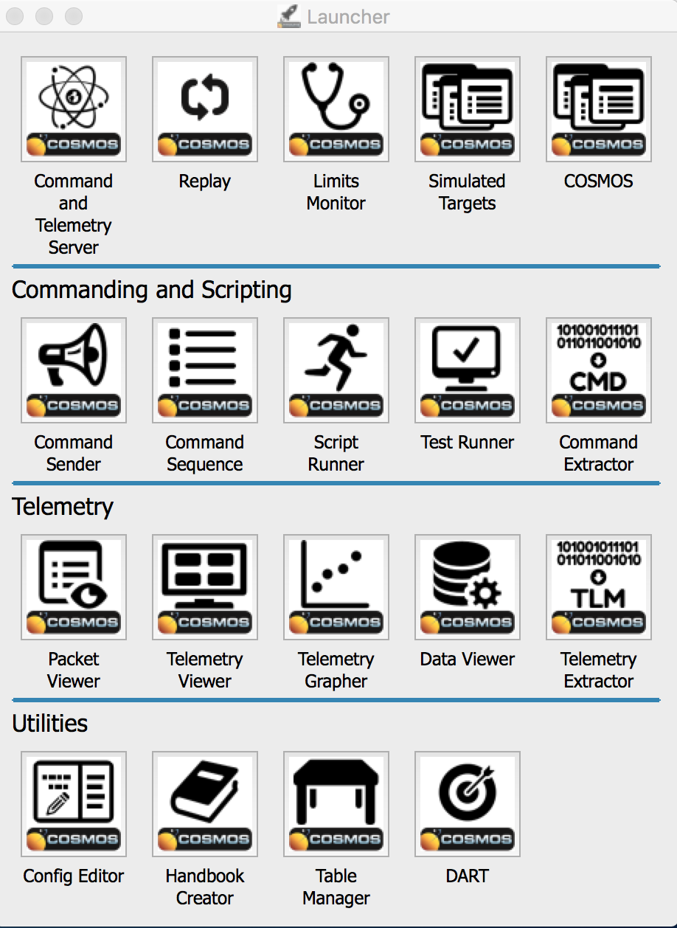
COSMOS Description
Generalized and extendable to connect to anything from test equipment to development boards or satellites
Suite of built-in applications that send commands and monitors telemetry
My task: create a code-generating tool that makes all the necessary config files to connect a running F Prime system to COSMOS
COSMOS is more detailed GSE than standard F Prime GUI, useful for customer

Slide 5
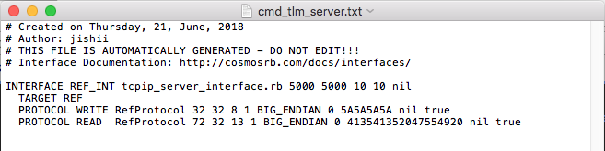
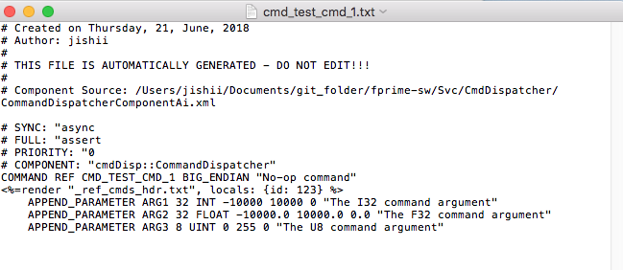
COSMOSgen.py
Tool written in Python and uses Cheetah templating software
Config files and Ruby scripts, encapsulate all telemetry, event, command, server and protocol information
Generated by running on command line with F Prime Topology XML as input
Server Interface Config
Command Config

Slide 6
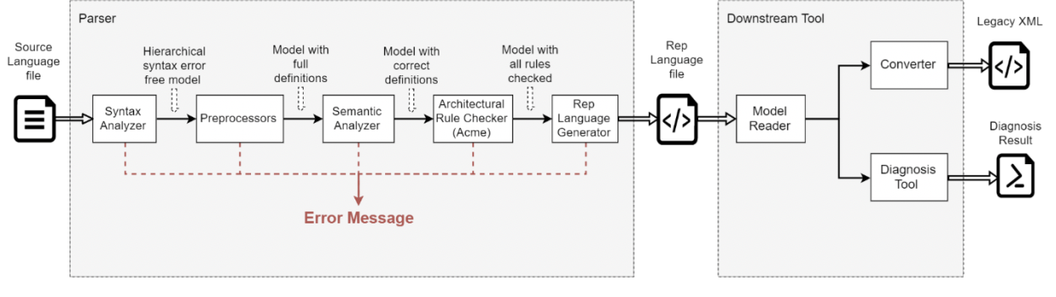
F Prime Prime
Lightweight modeling language to replace MagicDraw and eliminate the need to write raw XML
I matured language and compiler programs made by CMU students to bring closer to intended functionality
Originally littered with issues (i.e. global namespace, importing)
Additions this summer include generated imports, better scoping for types, and general semantic fixes to align with the F Prime Legacy XML more accurately

Slide 7
What I Got out of summer
Enjoyed challenging work with high degree of freedom
Some issues with F Prime Prime proved difficult
Improved on some familiar concepts, learned many new things
Work similar to past-research experiences and classes (making tools)
Learning some Ruby, improving Python on COSMOS was fun
Enjoyed the breadth of tasks
Learning more about flight software in both projects
What I’d like to do in the future:
Planning on grad school, working more in language design and implementation potentially something I’d like to do

Slide 8
DEMO

Slide 9
Questions

