Slide 1
Cosmos
Tailoring cosmos for use with fprime deployment applications

Slide 2
Overview
COSMOS – Open source system to interface embedded system commanding and telemetry-monitoring
Generalized and extendable to connect to anything from test equipment to development boards or satellites with support for TCP/IP, Serial, UDP, and custom protocols
Functionality similar to Fprime’s GSE.py
Drawbacks: No unit conversions, only 2 types of limits, no multi string commands, string length must be specified by user before sending commands

Slide 3
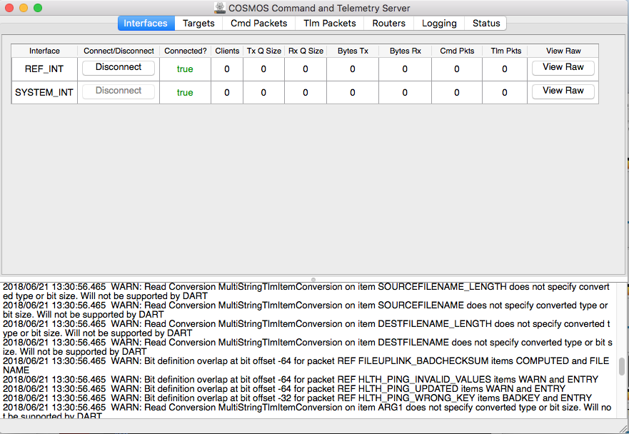
Overview cont.
Target = Deployments connecting with Fprime
Each target has an interface within Cosmos to send and receive telemetry
Support EVR’s and channels, but no difference inside of Cosmos – both generalized as telemetry

Slide 4
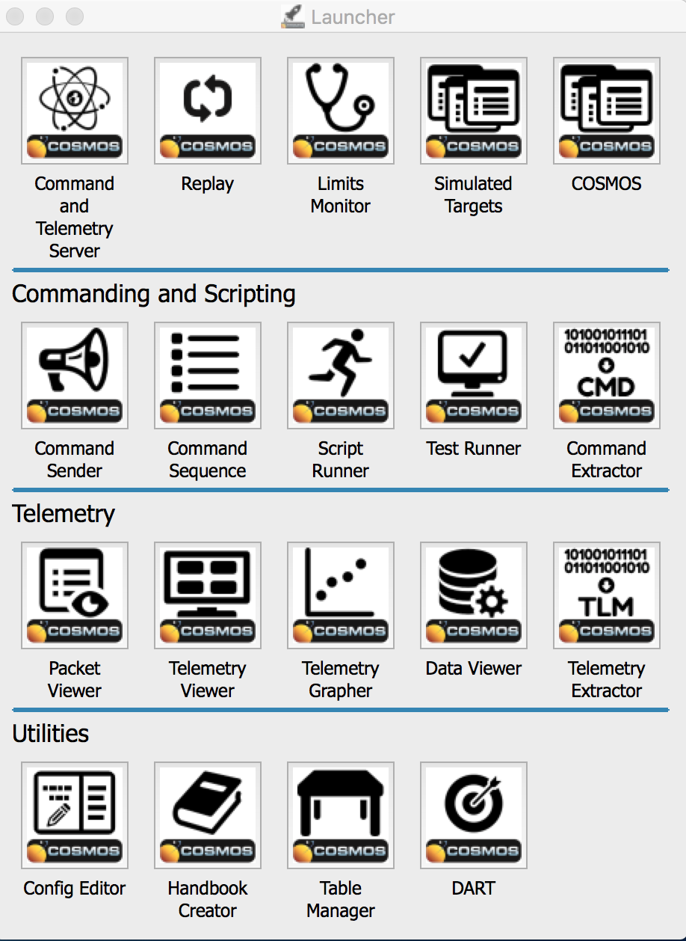
Tools
Suite of built-in applications that send commands and monitor telemetry
Command and Telemetry Server application communicates with the other applications via JSON messaging
New apps can be built using COSMOS API and JSON communication or built entirely from scratch

Slide 5
configuration
Cosmos targets, interfaces, and tools all configured in text files using Cosmos API
Cosmos installed via gem install, demo built by command “cosmos demo DIR_NAME”
Main uses: specifying contents of cmd, tlm packets, creating interface, setting paths for tools to find target configurations

Slide 6
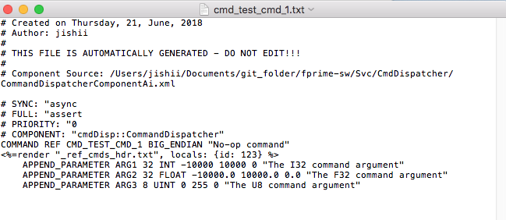
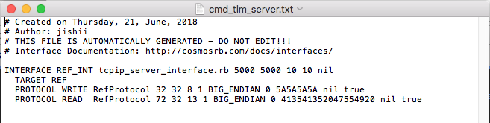
Configuration cont.
Support for multi-string telemetry but not commands, support all Fprime data types and serializables
Embedded ruby capability to reuse text
Servers, write protocols and read protocols link to Ruby scripts allowing for custom creation

Slide 7
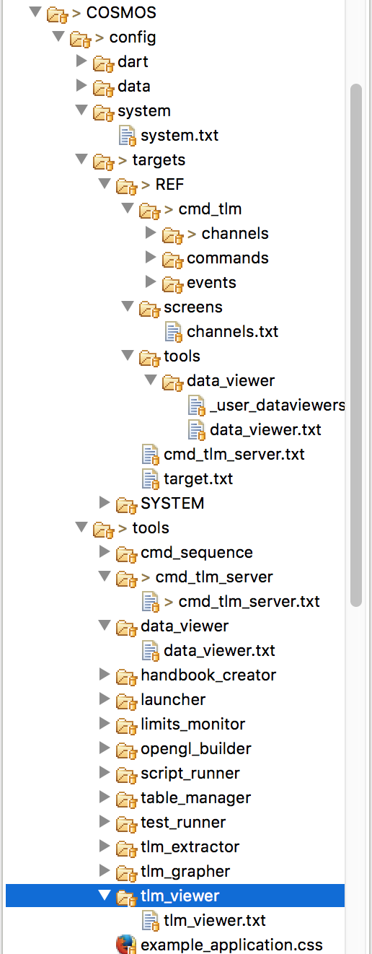
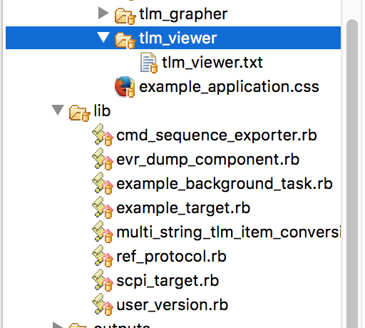
CONFIGURATION CONT.
Adds /targets directories to cosmos path
Contains definitions of cosmos tlm and cmd. Each directory also contains a partial file with packet header arguments
Defines channel screen
Controls EVR display
Partial add-on
Allows multi string tlm packets
EVR view config
Interface config
Reference to scripts in /lib
Drops first 13 bits Ref app sends
Adds directories to cosmos path
Config files for every tlm packet item

Slide 8
Generator tool overview
Cosmosgen.py added to Autocoders/bin, cosmos package added to Autocoders/src/utils
Tool takes Topology XML path as input, generates all necessary config files to add deployment target, interface, and EVR + channel views to Cosmos
Cheetah templates for each config file that needs generating
Installation for Ref app simple as running ”cosmos demo DIR_NAME”, running script with –p PATH, and starting CmdTlmServer followed by Ref app

Slide 9
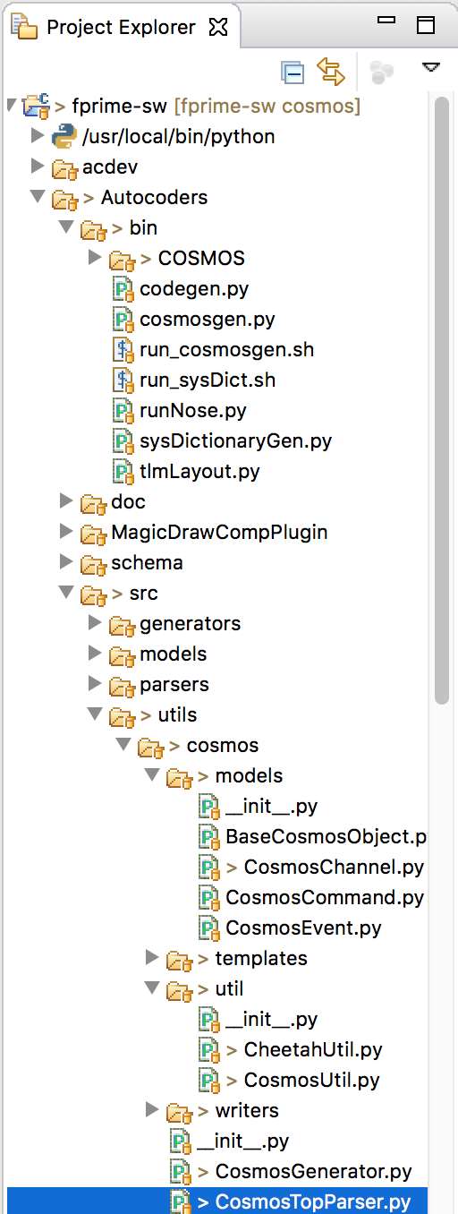
Generator tool structure
main()
Contain packet data used by .tmpl files
Contain constants for the deployment
Creates writers and calls their write() method
Parses data from XMLParser and creates models

Slide 10
demo
Install cosmos demo via command “cosmos demo DIR_NAME”
Connect COSMOS server to Fprime Ref app client
Run cosmosgen Tool and connect to Fprime
Demonstrate commands, telemetry in views
Remove other targets
Demonstrate grapher, extractor

