Slide 1
Fprime OpenMCT Server
Aaron Doubek-Kraft
7/24/2018

Slide 2
Outline
OpenMCT Overview
Fprime OpenMCT Server
Demo
Notes:
Overview
How we use OpenMCT to work with telemetry produced by fprime application

Slide 3
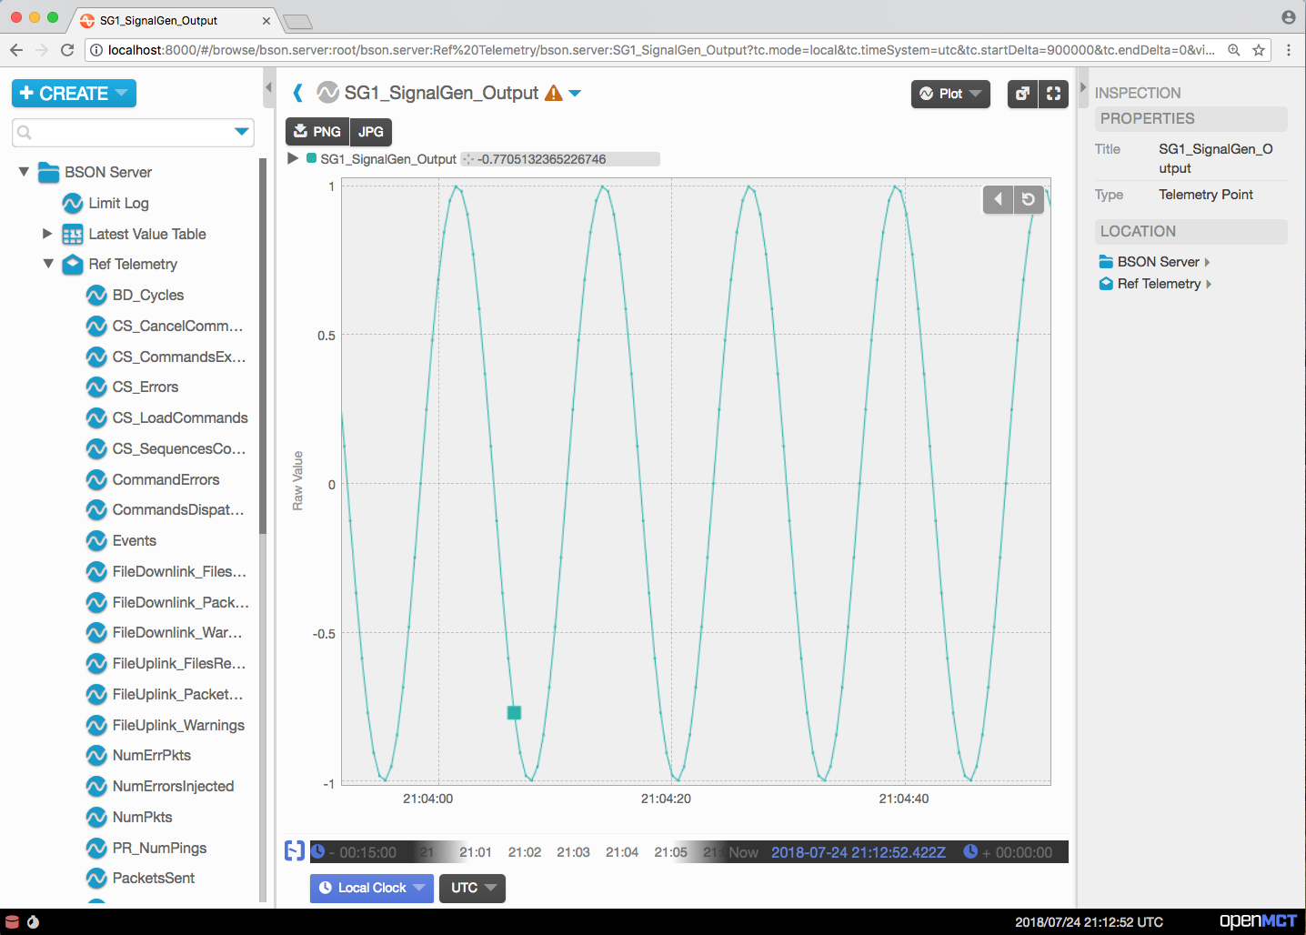
What is OpenMCT?
Open Source Mission Control Technologies
Web framework for building mission control applications
Telemetry plotting, dictionary integration, user-defined layouts
Notes:
Being developed at Ames Research Center
JavaScript, HTML, CSS – formerly AngularJS but moving away from that in favor of Vue.js
Out of the box functionality includes telemetry plotting, dictionary integration (telemetry exposed as OpenMCT objects), custom layouts involving multiple objects in the same view

Slide 4
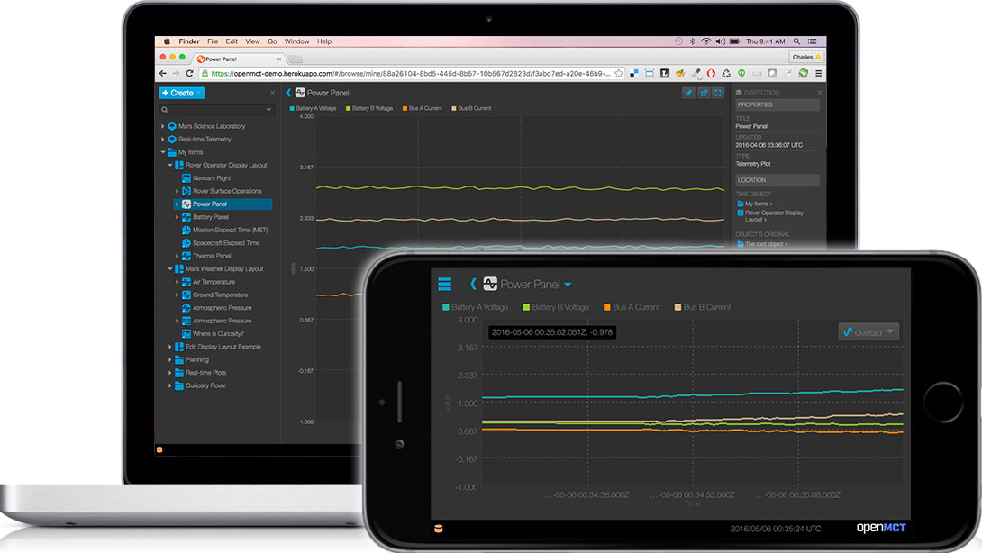
Why OpenMCT?
Portable – Any platform, any OS
Flexible – OpenMCT APIs provide straightforward extension points
Composable – User-defined objects can be saved and shared
Notes:
Portable -- Works on any device with a modern web browser and an internet connection
Flexible – Developers can define own object types with views driven by telemetry
Composable – All objects can be lossless represented as JSON configuration, so user defined objects can be saved to a database, or sent and loaded in other instances

Slide 5
OpenMCT BSON Server
Out-of-the-box telemetry integration solution
Dictionaries defined for OpenMCT in JSON configuration files
Listens for a stream of BSON (Binary JSON) telemetry packets
Notes:
Starting point
Previously, OpenMCT defined an API to declare and load dictionaries, this provides an out-of-the-box solution for integrating telemetry sources
JSON configuration files define packets and telemetry points
Listens for a stream of BSON (Binary JSON, messaging format) packets on a websocket
Add more detail about sub-bullets
Explain npm scripts, outputs, and functionality

Slide 6
Fprime OpenMCT Server
Python Autocoder builds JSON dictionaries from deployment XML
Node.js script builds OpenMCT configuration files
Node.js BSON Adapter app converts fprime binary to BSON packets
Notes:
My contribution
Has to be configured for a particular deployment

Slide 7
Architecture
CouchDB
HTTP
ThreadedTCPServer
OpenMCT BSON Server
BSON Adapter
Binary Packets Over TCP
BSON Packets
Over TCP
Binary Packets Over TCP
Binary, JSON?
HTTP, TCP
Fprime Application
COSMOS
Web GUI
Notes:
1. TCP Server producing binary packets and OpenMCT server accepting BSON packets, need intermediary to decode fprime packets and convert them into BSON packets in the format expected by OpenMCT
2. Apache CouchDB server allows layout persistence (talk more about that)
3. Working on additional sources of input (binary or JSON stream packets from COSMOS, reading binary log files)

Slide 8
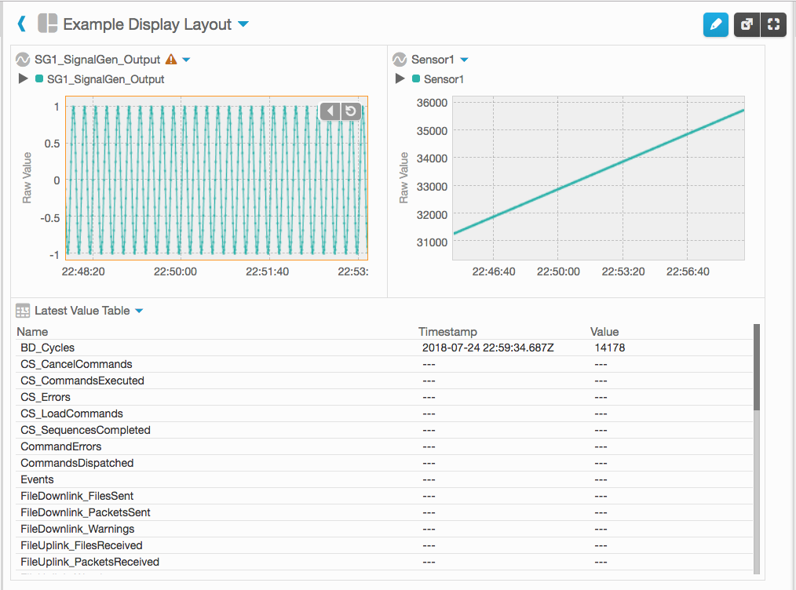
Object Persistence
OpenMCT supports building custom layouts with multiple objects
Object persistence allows saving and sharing
Apache CouchDB works as persistence backend with minimal configuration
Notes:
CouchDB plugin provided with OpenMCT

Slide 9
Potential Improvements
New sources of input (COSMOS JSON packets/histories)
OpenMCT Widgets
Commanding
EVR/Channel Histogram
Spectrum Plot
Channel vs. Channel Plotting
3D Plotting

Slide 10
Presentation Over
Let’s have a demo
Notes:
Describe steps

