Slide 1
Cosmos
Tailoring cosmos for use with Fprime deployment applications
Date: 6/28/2018
Jordan Ishii: jordanishii1@gmail.com

Slide 2
Outline
COSMOS – open source user interface that connects to embedded systems
Built-in tools to send commands, receive and display telemetry
COSMOS configured and customized via text files
Some optional Ruby API code maybe needed
cosmosgen.py generator tool uses Fprime topology XML to create the necessary configuration files for COSMOS to handle Fprime command and telemetry data

Slide 3
Cosmos Overview
Generalized and extendable to connect to anything from test equipment to development boards or satellites
Included support for TCP/IP sockets, serial, or UDP socket interfaces
Custom interfaces possible
Functionality similar to Fprime’s GSE (a.k.a. GDS)
Fprime COSMOS configuration generated from Fprime Topology XML
No unit conversion currently supported
Variable length command arguments not supported (i.e. strings, etc.) – A COSMOS issue
Not yet supporting complex serializable telemetry channels (this is coming)
Not yet tested on a Linux platform but should work

Slide 4
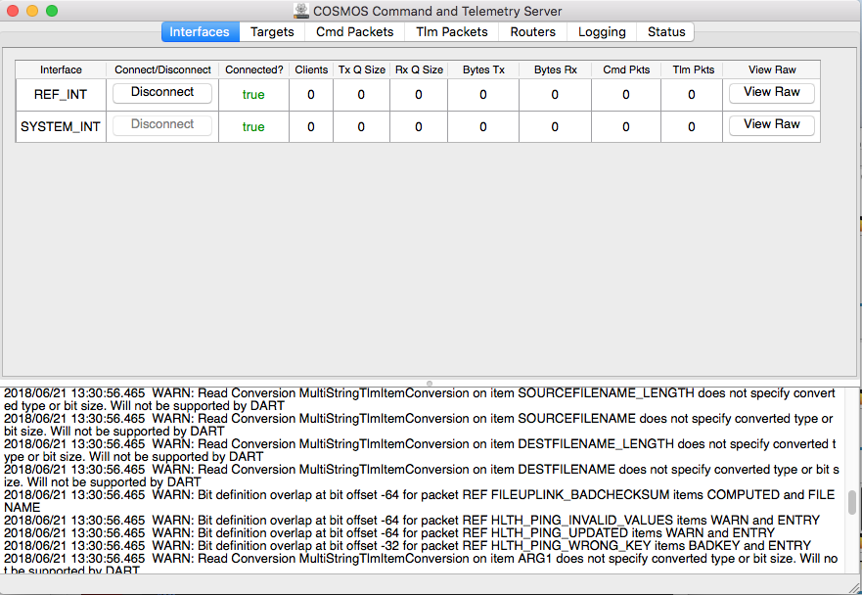
Overview cont.
Option to view raw data for only a certain tlm or cmd packet
Displays modal window with all incoming / outgoing hex
Target = Fprime deployments (e.g. target embedded application)
Each target has an interface within COSMOS to send and receive telemetry
REF_INT shown is the Fprime Ref app
Support EVR’s and channels
Both generalized telemetry within COSMOS
Telemetry screens for monitoring channels
Data viewer app for monitoring EVR’s
Displays errors and all incoming tlm and commands
CmdTlmServer Application

Slide 5
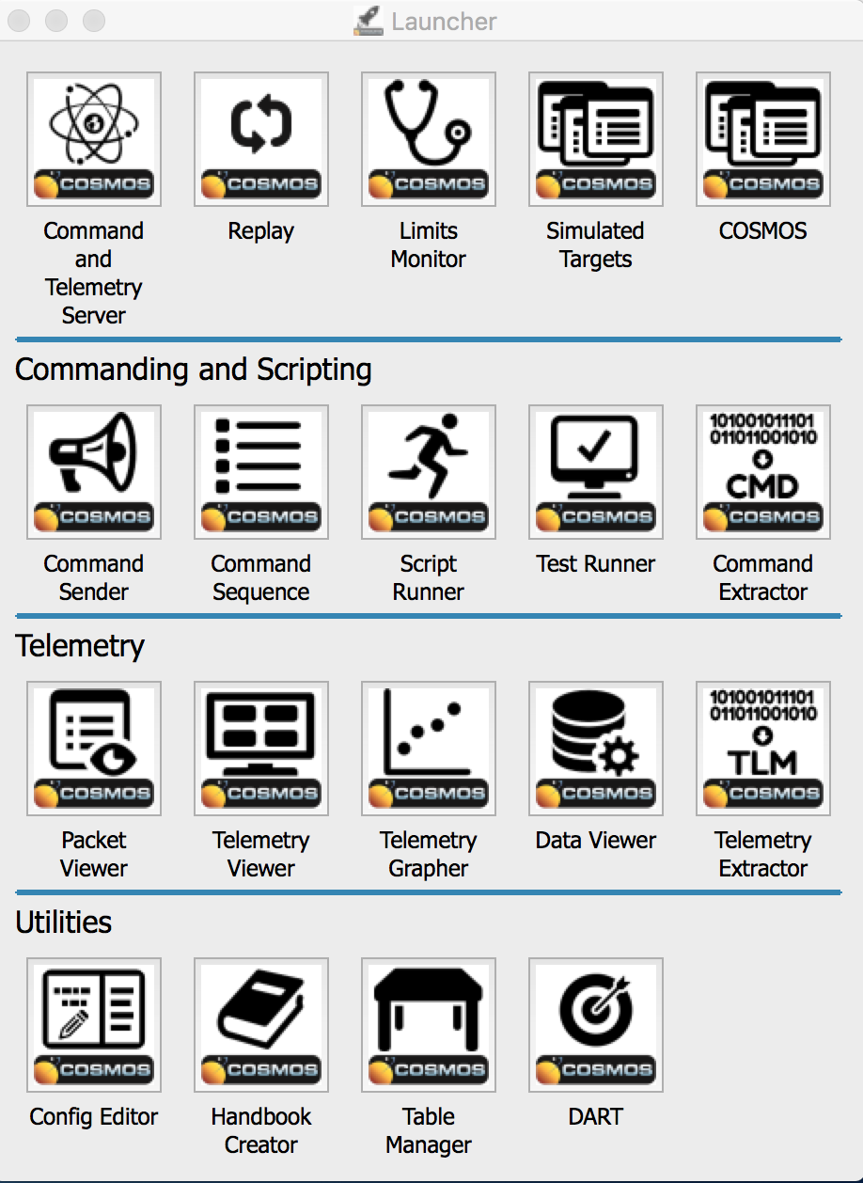
Tools
Suite of built-in applications that send commands and monitor telemetry
Other utility applications:
Binary file reader (Telemetry Extractor, Table Manager)
Script runner, Test runner
Text editor for config files with documentation and syntax completion (Config Editor)
Long term trending database on top of PostgreSql database integrated within all viewer apps to simulate certain time ranges (DART)
Launcher Application
Notes:
Say that we’ll cover the telemetry viewer and commanding apps later

Slide 6
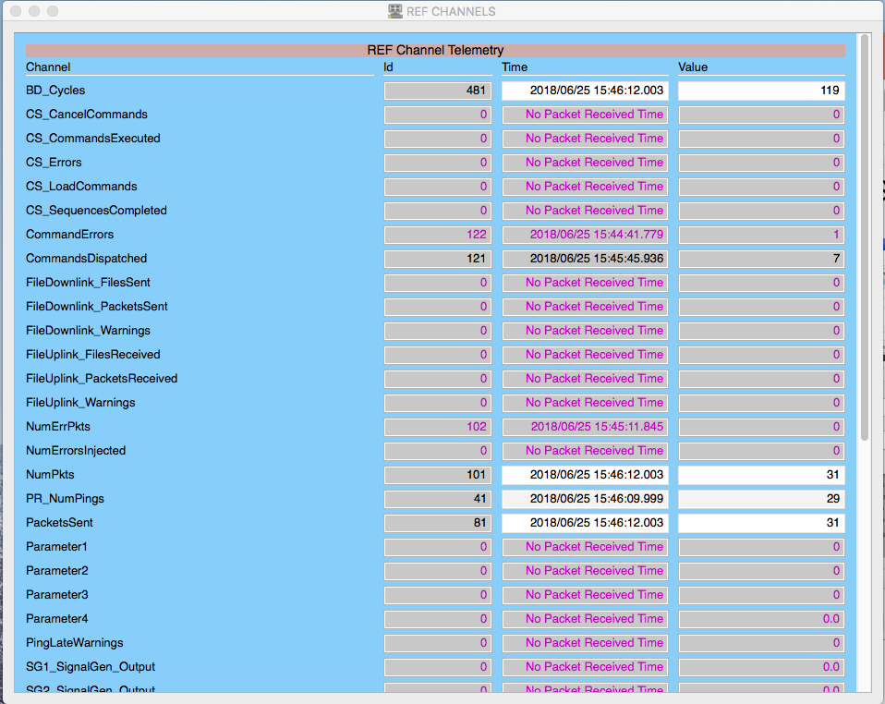
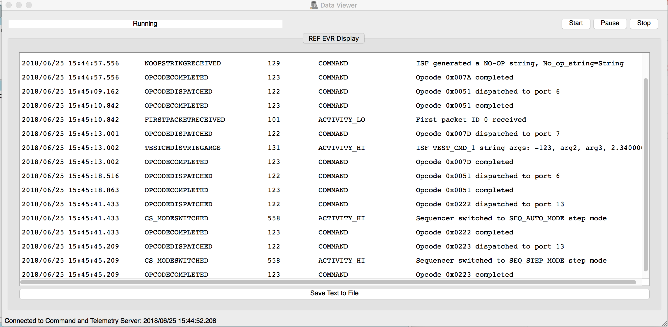
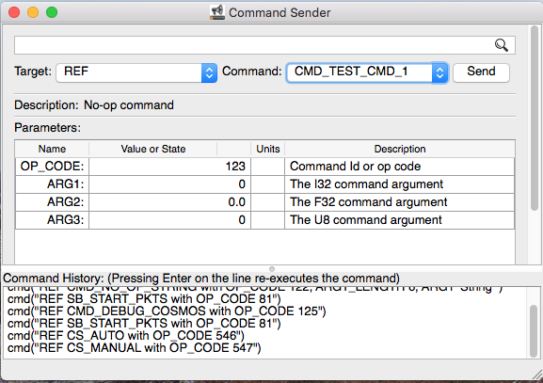
Tools
TLM Viewer
Uses ruby version of graphics library qt
May customize with graphs, user input, formatted text
Data Viewer
Writes plain text – cannot customize style
Configure views using ruby script
Command sender
May alter argument values from middle column
May use api in command history text box to resend commands

Slide 7
configuration
COSMOS installed via Ruby’s “gem install” command
The default configuration generated by the command “cosmos demo DIR_NAME”
COSMOS has specific configuration text files to adapt it to any embedded target:
Interface/Protocol files
Command packet files
Telemetry (channel, EVR) packet files
Tools configuration files

Slide 8
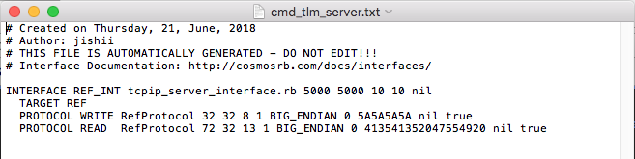
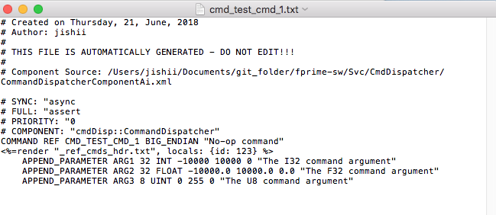
Configuration cont.
Servers, write protocols and read protocols link to ruby scripts allowing for custom creation
Support for multi-string telemetry but not commands, support all Fprime data types and serializables
Header files for commands and telemetry created using syntax <%= %>
Server Interface Config
Command Config

Slide 9
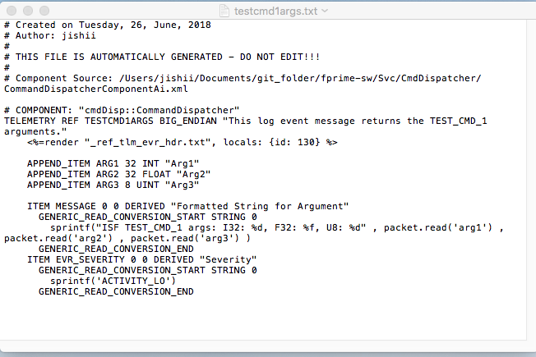
Configuration cont.
Link to header file
Comments contain extra data from XML file
EVR argument data contain name and type
”Derived” items not in packet sent from target
EVR Config

Slide 10
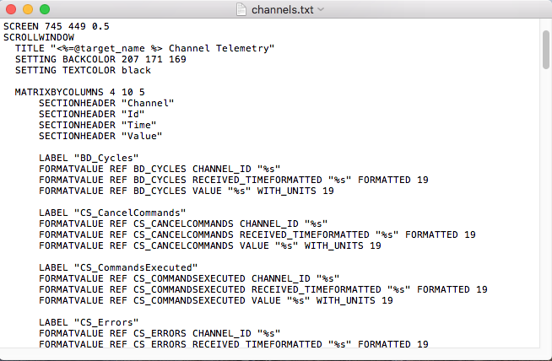
Configuration cont.
Layouts include Vertical, Horizontal, Matrix
Settings change color and size of screen
Any telemetry data can be put in Value widget
Channel Screen Display Config

Slide 11
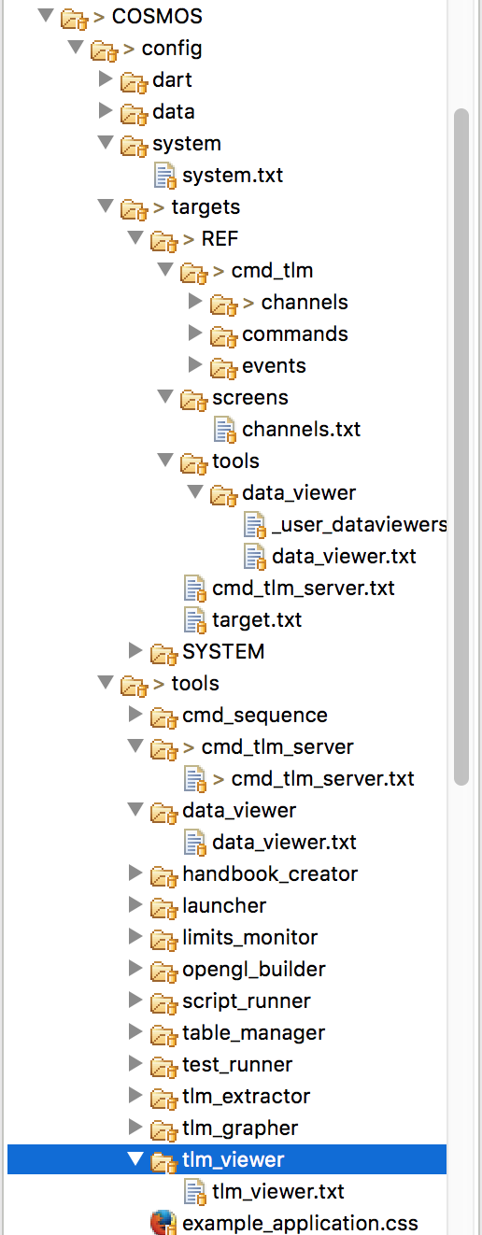
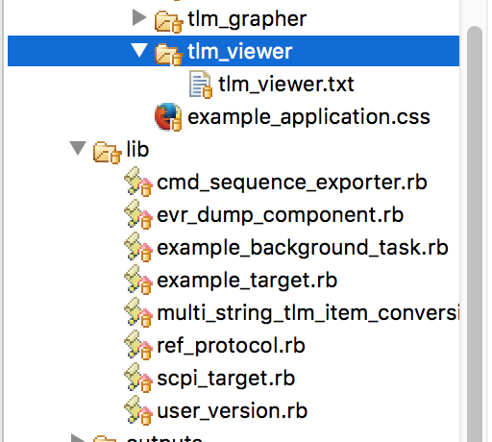
CONFIGURATION CONT.
Adds /targets directories to cosmos path
Controls EVR display from Data Viewer app
Contains definitions of cosmos tlm and cmd. Each directory also contains a partial file with packet header arguments
Defines channel screen
Partial add-on
Allows variable-length tlm packets
EVR view config
Interface config
Adds target tool directories to cosmos path
Drops first 13 bits Ref app sends
Reference to scripts in /lib
Config files for every tlm packet item

Slide 12
Generator tool overview
Tool takes topology XML as input, and generates all necessary config files to add deployment targets, interfaces, and commands, EVR’s, channels configuration to COSMOS
Tool reused the Fprime (codegen.py) XML parsing classes
Cheetah templates for each config file that is generated
cosmosgen.py is added to Autocoders/bin, COSMOS generator package added to Autocoders/src/utils
Installation for Ref application (or deployment) target
Execute ”cosmos demo DIR_NAME”
Execute “run_cosmosgen.sh –p PATH ../../Ref/Top/RefTopologyAppAi.xml”
Execute the COSMOS server by executing CmdTlmServer
Execute the Ref App as “./Ref –p 5000 –a 127.0.0.1”

Slide 13
Generator tool structure
main()
Codegen.py
Manages filesystem and creates writers
Parses data from XMLParser and creates models
Generator
Cosmos Parser
Models
Writers
XML Parsers
Write Cheetah templates to .txt and .rb file
Reused from Fprime codegen.py

Slide 14
Summary
COSMOS sends commands, receive and display EVR and channel telemetry
Config text files control COSMOS functionality – extendable through Ruby API and JSON communication
cosmosgen.py generates config files
Certain files optionally edited
Tool structured with models as go-between for Writers and Parsers

Slide 15
demo
Install COSMOS demo via command “cosmos demo DIR_NAME”
Connect COSMOS server to Fprime ref app client
Run cosmosgen tool and connect to Fprime
Demonstrate commands, telemetry in views
Remove other targets
Demonstrate grapher, extractor

