Slide 1
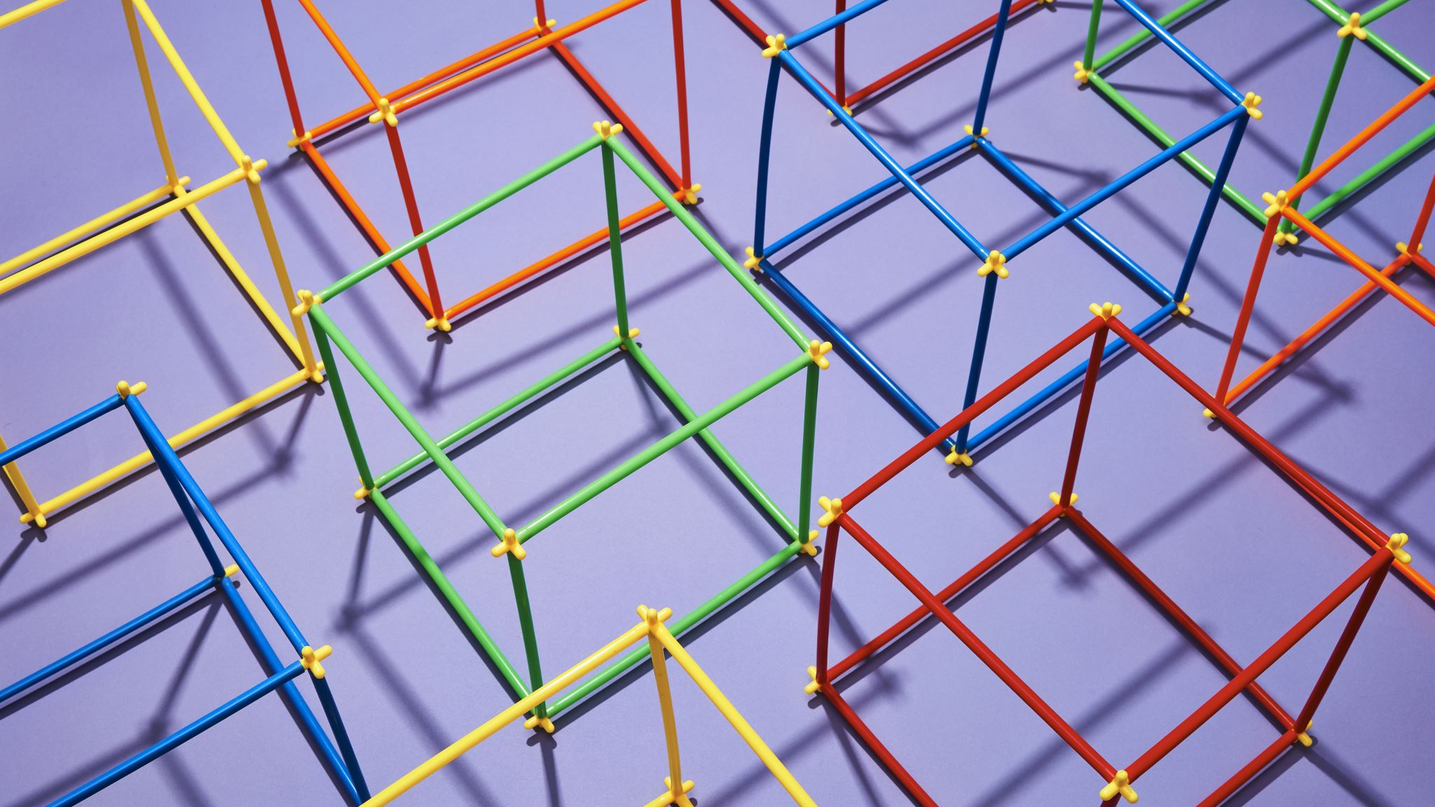
Neural Ranking Architecture
Deepti Saravanan

Slide 2
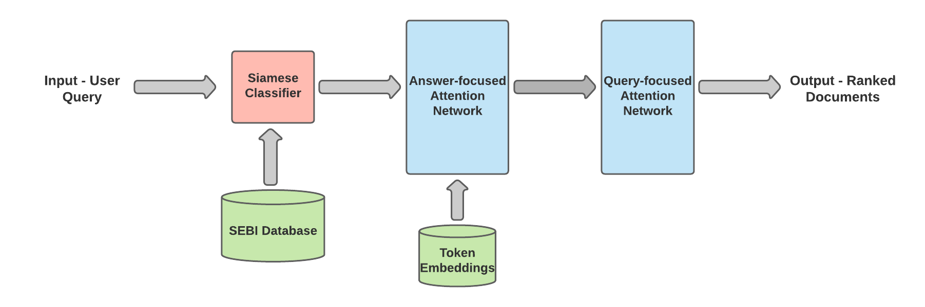
Neural Ranking - Architecture

Slide 3
Training and Testing
Zero shot learning
Train – Regulations
Test – Others
Training data
Query Generation – Knowledge Graph triplets
weak ranked order generated by aggregating results from tf-idf, BSTM etc
Aggregation function – Local Kemenization / Borda's Method
70% Relevant passages, 30% distractors (hard negative samples)
Loss function
Triplet loss function

Slide 4
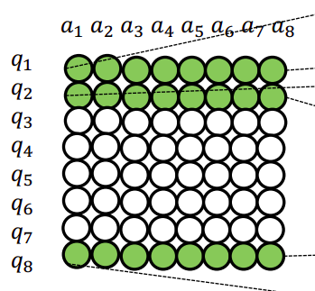
Individual Components
Siamese classifier – Relevant / Non-relevant given a query
Input – Query and text data
Output – Relevant text data
Answer-focused Attention Network
Question-Answer tokens matrix of cosine similarity values – context embedding
Context embedding – SEBI BERT
Frequency vector per query (query term + closely related terms)
Model Parameter – Weights in dense layer
Query-focused Attention Network
Question-Answer tokens matrix
Model Parameter – Assign importance to query tokens (softmax)
Dense layer – concatenation of context vector and position vector

