Slide 1

SpAtten - Review
Deepti Saravanan

Slide 2
Motivation
Reduce computation
Optimal Memory Usage
Avoid redundancy in human language
Pruning layer-wise
3 Major Steps:
1. Cascade Token / Head Pruning
2. Local Value Pruning
3. Progressive Quantization

Slide 3
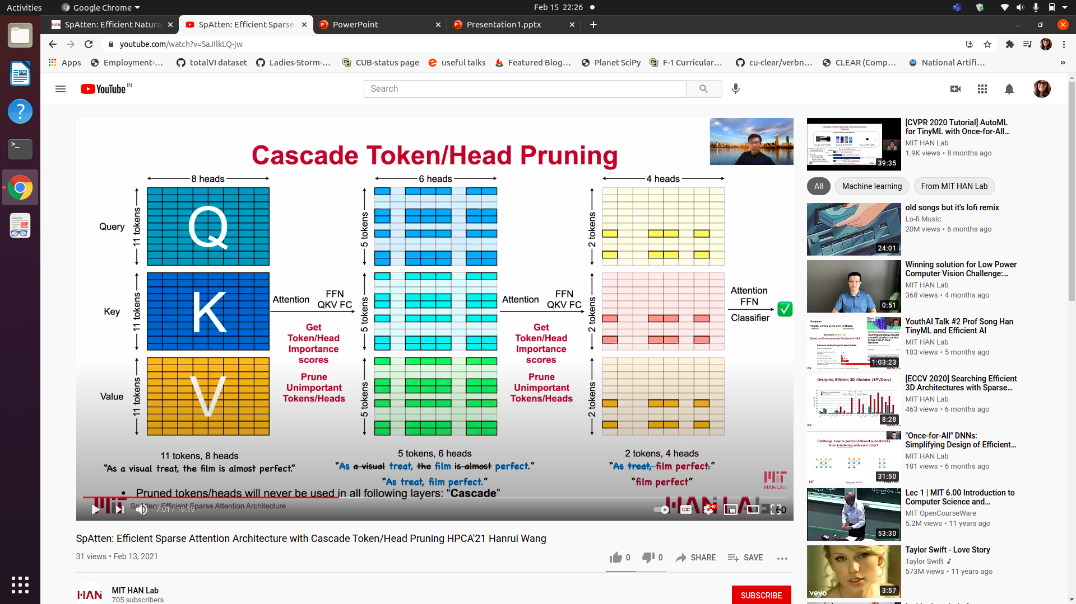
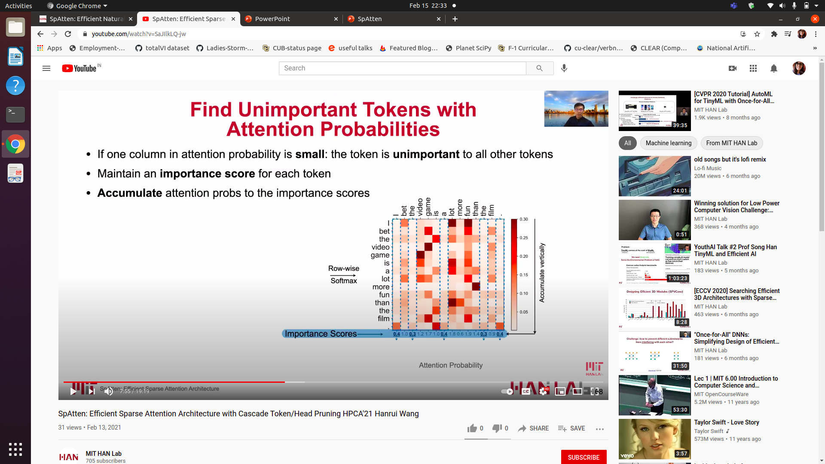
Cascade Token / Head Pruning

Slide 4
Local value pruning
Cascade token / head Pruning – Find unimportant token in current layer, prune in next layer
Local value pruning - Find unimportant token in current layer, prune in current layer

Slide 5
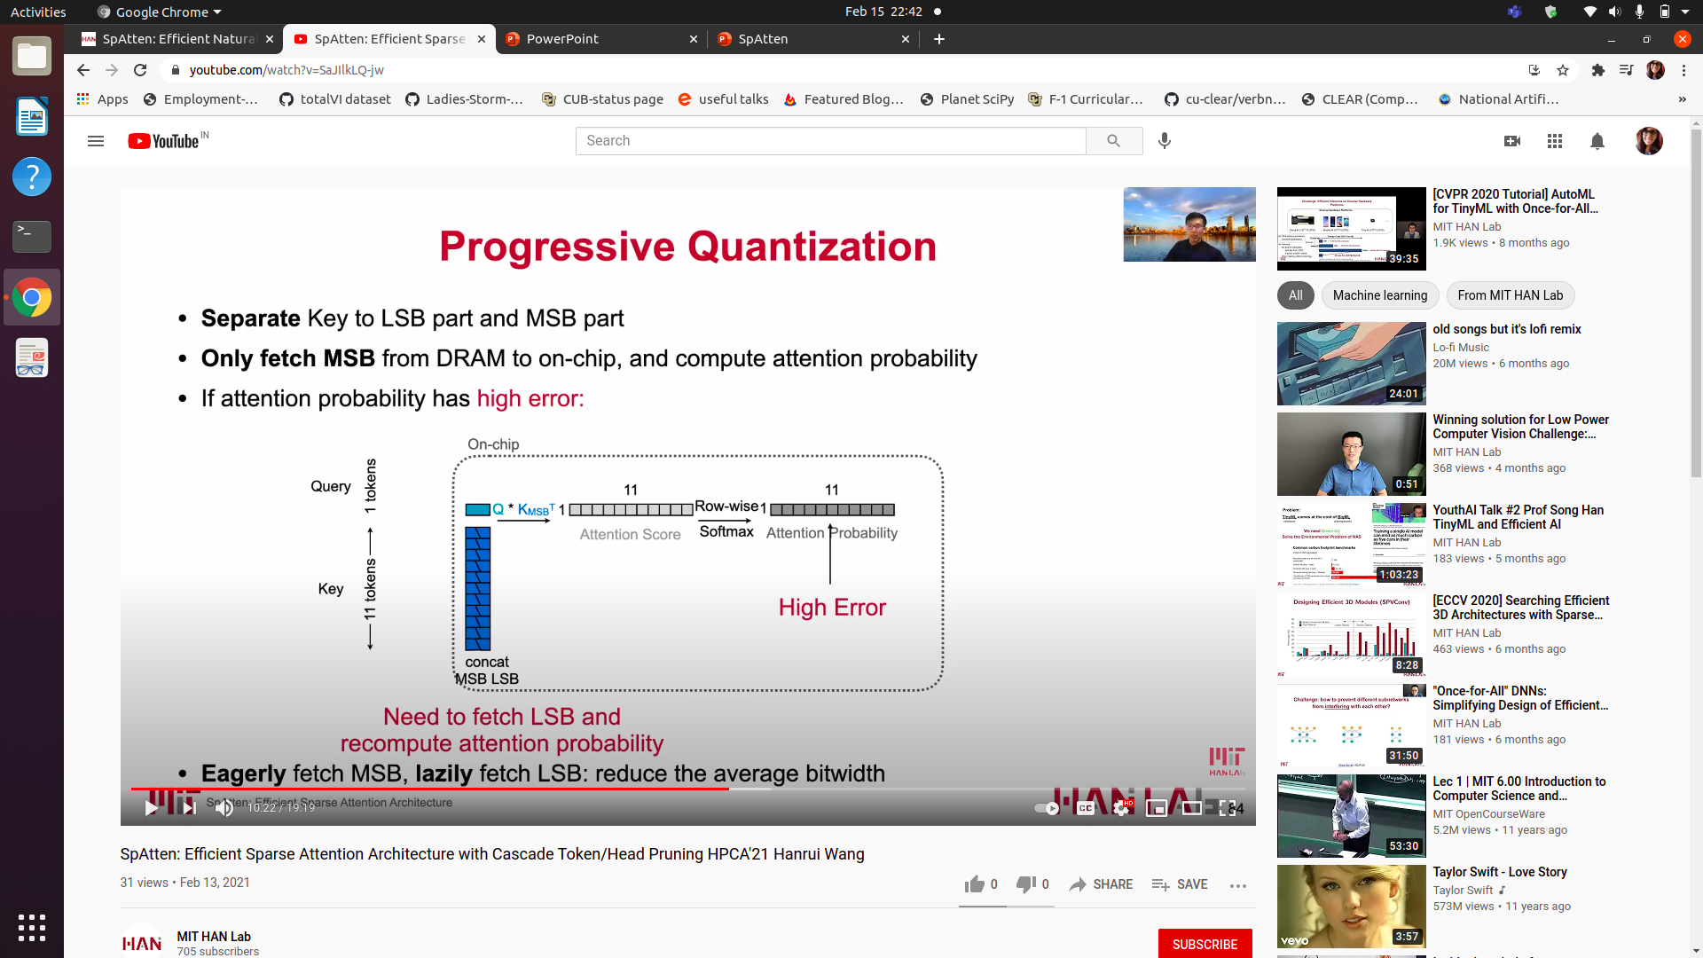
Progressive quantization
Separate Key – LSB and MSB
Compute Attention Probability using MSB
If high error -> LSB also considered
Eagerly fetch MSB, lazily fetch LSB
Larger max attention probability – smaller error

Slide 6
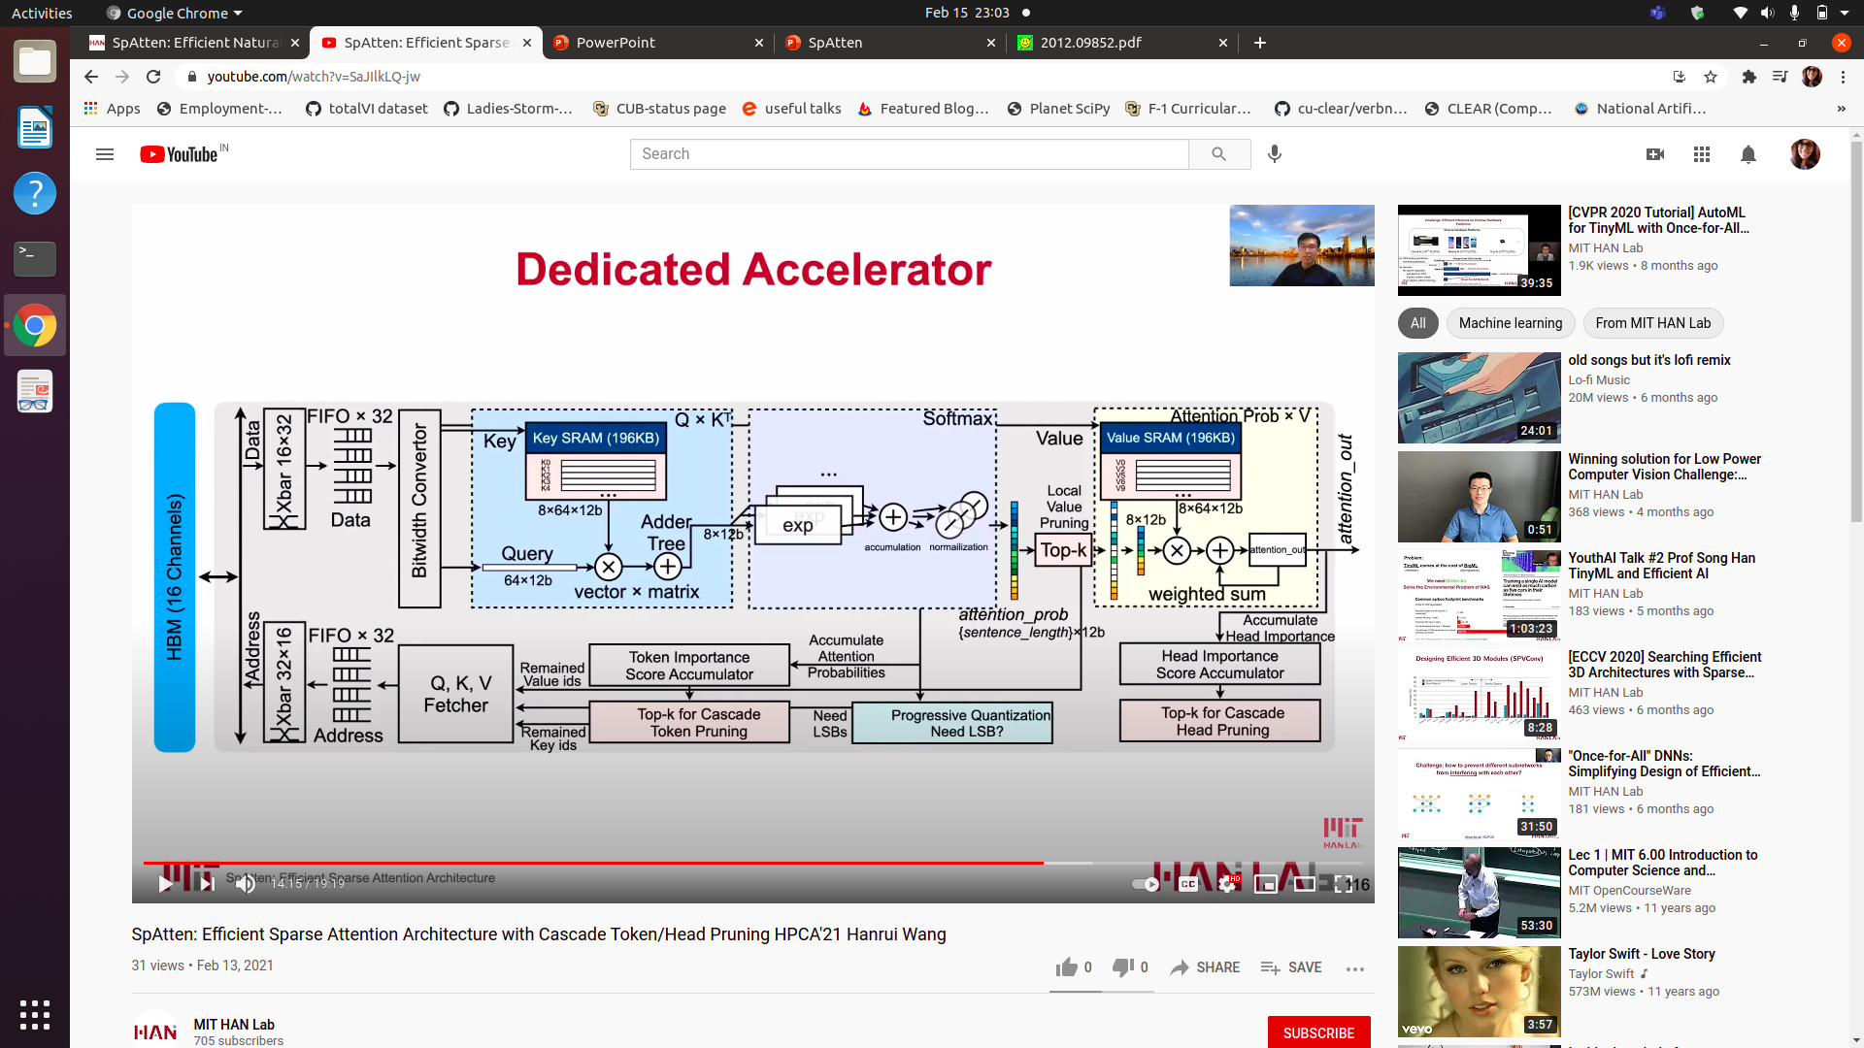
Hardware architecture

