Slide 1
Prediction of Access to Improved Source of Drinking Water using Machine Learning
CAPSTONE PROJECT
Presented By:
Jagdambika Prasad Menaria
College – Institute of Engineering and Technology, Udaipur University – Mohan Lal Sukhadia University Branch – Computer Science and Engineering

Slide 2
OUTLINE
Problem Statement
Proposed System/Solution
System Development Approach (Technology Used)
Algorithm & Deployment
Result (Output Image)
Conclusion
Future Scope
References

Slide 3
Problem Statement
Access to safe and improved drinking water is a critical global health issue and a key Sustainable Development Goal (SDG 6). However, monitoring and predicting the percentage of the population with access to improved water sources across different regions and demographics is a complex challenge. There is a need for a data-driven system to accurately forecast this access. Such a system can help governments and NGOs to identify vulnerable areas, allocate resources effectively, and formulate targeted policies to improve water infrastructure and public health.

Slide 4
Proposed Solution
The proposed solution is to develop a machine learning model that predicts the percentage of a population having access to an improved drinking water source based on various socio-demographic factors.
Data-driven Approach: We use a dataset (Improved Source of Drinking Water.csv) containing information categorized by State, Sector (Rural/Urban), Gender, and specific Indicators.
Automated Model Building: The project leverages the IBM Watson Studio AutoAI service. This tool automatically preprocesses the data, trains multiple regression algorithms, and selects the best-performing model.
Prediction Goal: The model is trained to predict the 'Value' column, which represents the percentage of the population corresponding to a specific indicator.

Slide 5
System Approach
Cloud Platform: IBM Cloud ☁️
Development Environment: IBM Watson Studio
Core Technology: AutoAI for automated machine learning.
Model Frameworks: Python-based libraries like Scikit-learn and XGBoost.
Dataset: Improved Source of Drinking Water.csv

Slide 6
Algorithm & Deployment
The AutoAI experiment tested several algorithms and identified the XGBoost (Extreme Gradient Boosting) Regressor as the best-performing model for this prediction task.
What is XGBoost? It is a powerful ensemble learning algorithm that builds decision trees sequentially. Each new tree corrects the errors of the previous ones, leading to a highly accurate and robust model.
Key Model Parameters (from the project):
n_estimators: 20max_depth:
6learning_rate: 0.1
Deployment : The trained model pipeline is saved and can be deployed as a web service using IBM Watson Machine Learning. This allows for making real-time predictions by sending new data (like State, Sector, etc.) to the model through an API.

Slide 7
Result
The model demonstrated excellent performance in predicting access to improved drinking water.
Model Accuracy: The final model, P5 - XGB Regressor, achieved an R-squared (R2) score of 0.999. An R2 score this close to 1 indicates that the model's predictions are extremely close to the actual values.
Feature Importance: The model identified the most influential factors for its predictions. The top 3 features were:
Indicator (The specific metric being measured)
State (The geographical region)
Sector (Whether the area is Rural or Urban)

Slide 8
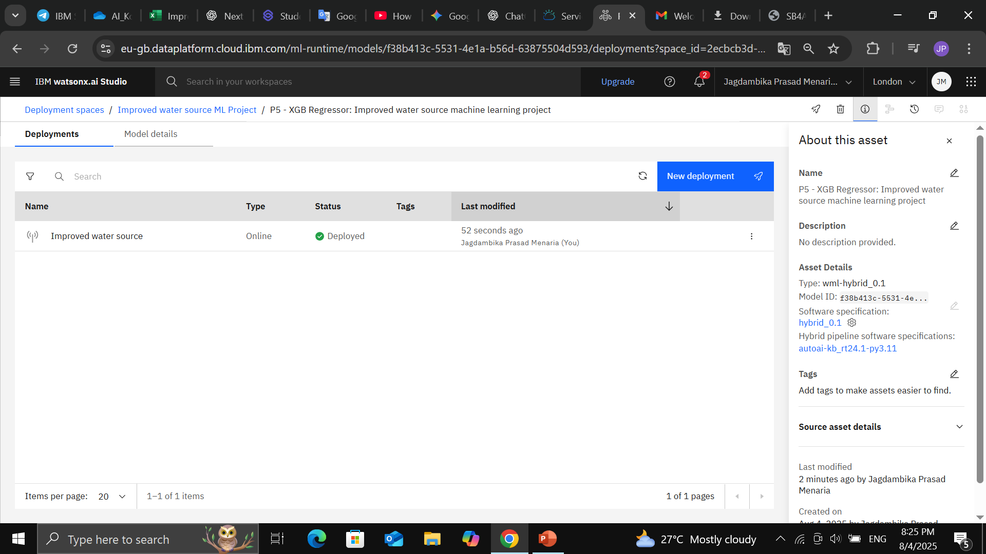
Result

Slide 9
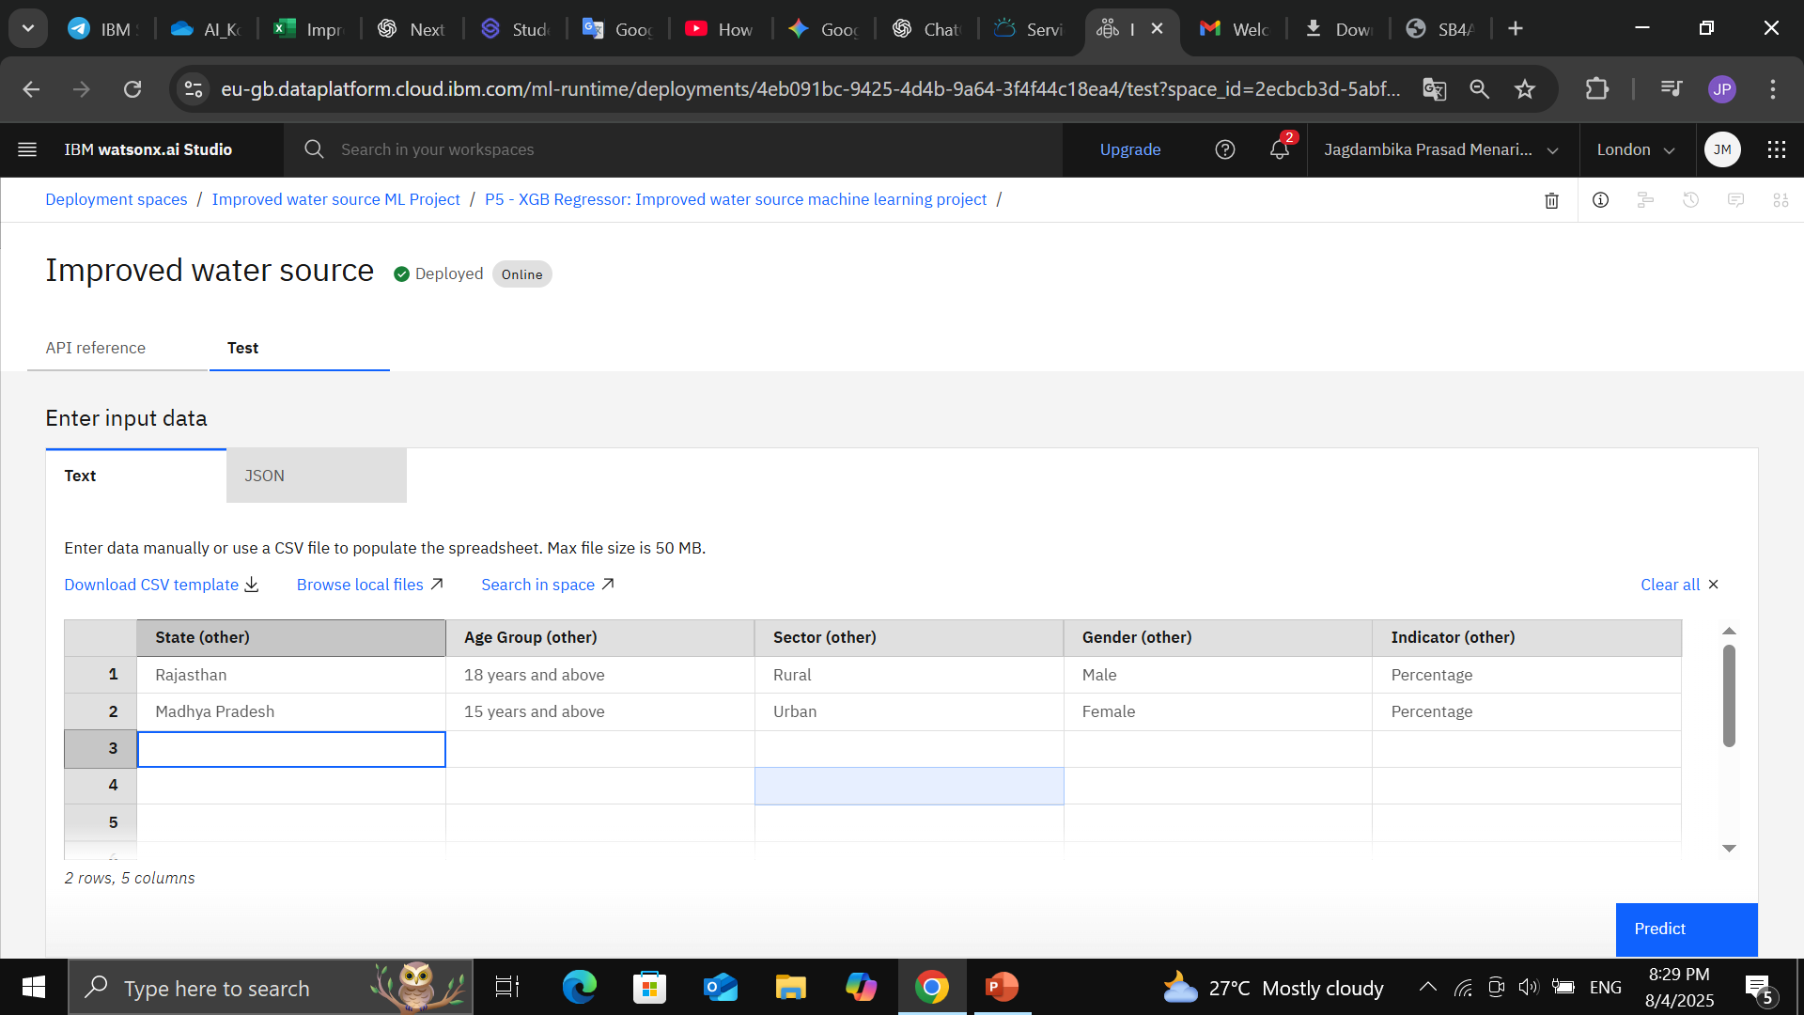
Result

Slide 10
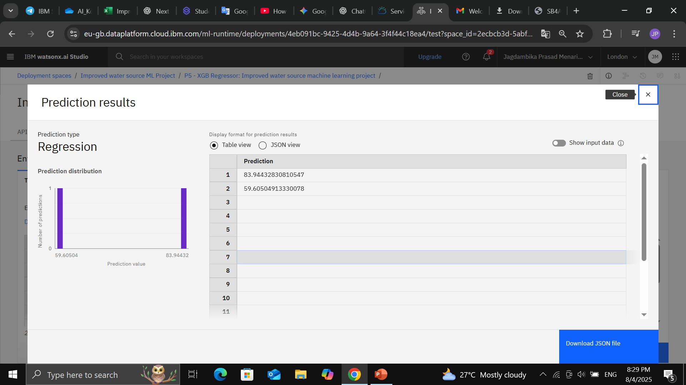
Result

Slide 11
Conclusion
This project successfully developed a highly accurate machine learning model to predict access to improved drinking water sources.
The use of IBM Watson Studio and AutoAI significantly accelerated the model development process.
The XGBoost Regressor model achieved an outstanding R2 score of 0.999, proving its effectiveness.
The insights from feature importance confirm that geographical location and the urban-rural divide are critical determinants of water access.
This predictive tool can be a powerful asset for policymakers, enabling data-driven decisions for better resource allocation and strategic planning to achieve universal access to safe drinking water.

Slide 12
Future scope
Enhance Data: Incorporate more granular data, such as district-level information, local economic indicators, climate data (e.g., rainfall), and details on government water schemes to further improve accuracy.
Time Series Forecasting: If historical data over several years is collected, time-series models could be developed to predict future trends in water access.
Interactive Dashboard: Create a web-based interactive dashboard where users (like policymakers or researchers) can select different states and demographics to see the predicted outcomes visually.

Slide 13
References
cloud.ibm.com
Watsonx.ai.Studio
AI data KOSH by GOI

Slide 14
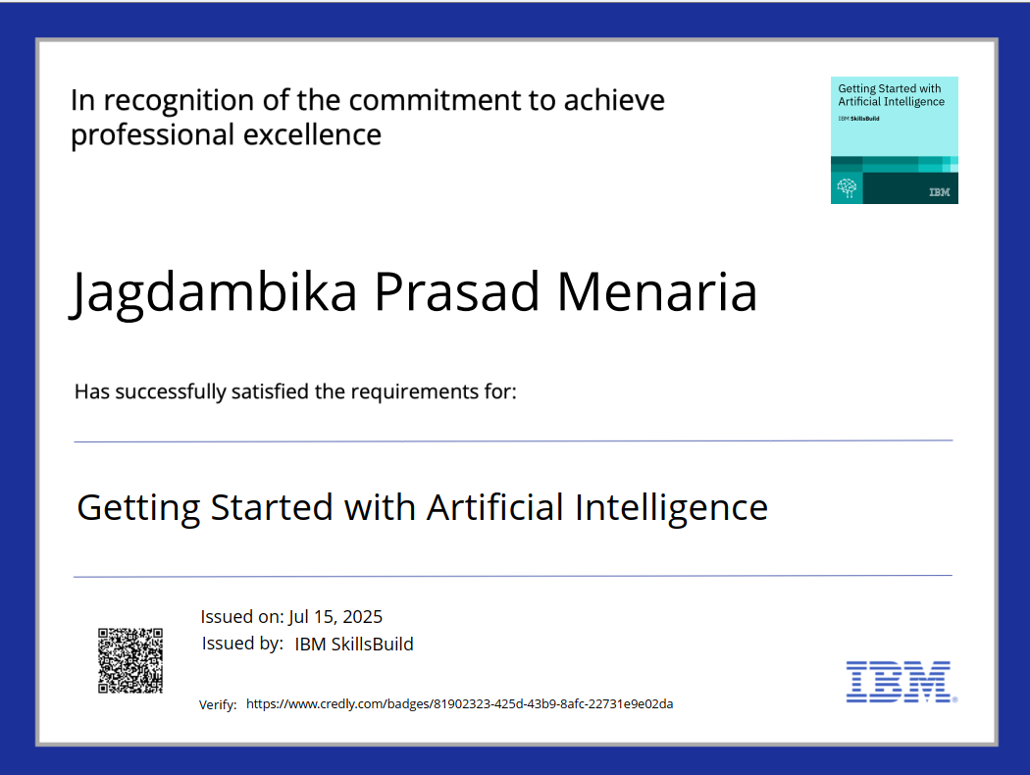
IBM Certifications

Slide 15
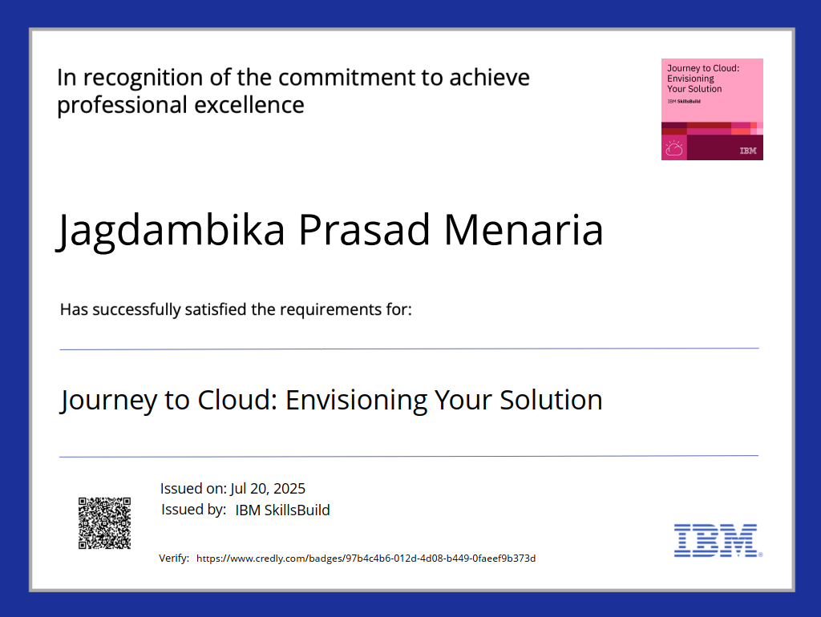
IBM Certifications

Slide 16
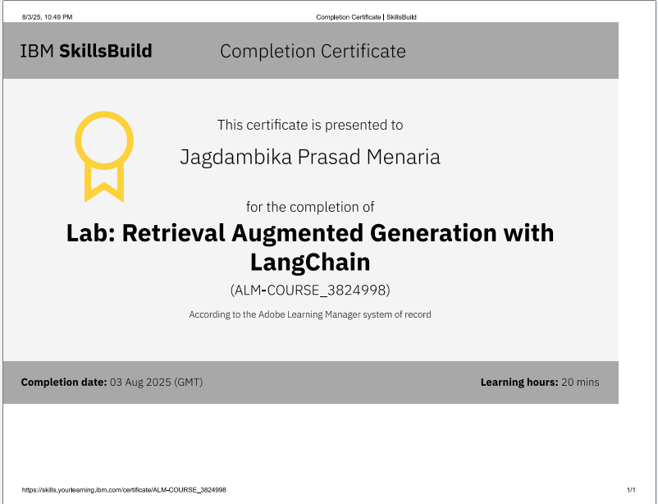
IBM Certifications

Slide 17
THANK YOU

