Slide 1
Power BI - DIAD
Dashboard in an Day

Slide 2












Jenkins NS
Modern Workplace Solution Architect | Consultant
17+ Years of experience
Power Platform, Microsoft Teams, and SPFx Specialist
International Speaker | Author | Trainer
SPS/M365 Bangalore Organizer
aOS Ambassador
jenkinsns@gmail.com
in/jenkinsns
@jenkinsns
http://www.jenkinsblogs.com
https://www.youtube.com/user/jenkinsns

Slide 3
Business Intelligence (BI) Concepts

Slide 4
BI Tools
Microsoft Power BI
Tableau
Sisense
Looker
datapine
Zoho Analytics
Yellowfin
Answer Dock
Hotjar
ReportPlus
QlikView
SAP BusinessObjects Lumira
SAP Crystal Reports
SAP Business Intelligence
Vista
Clootrack

Slide 5
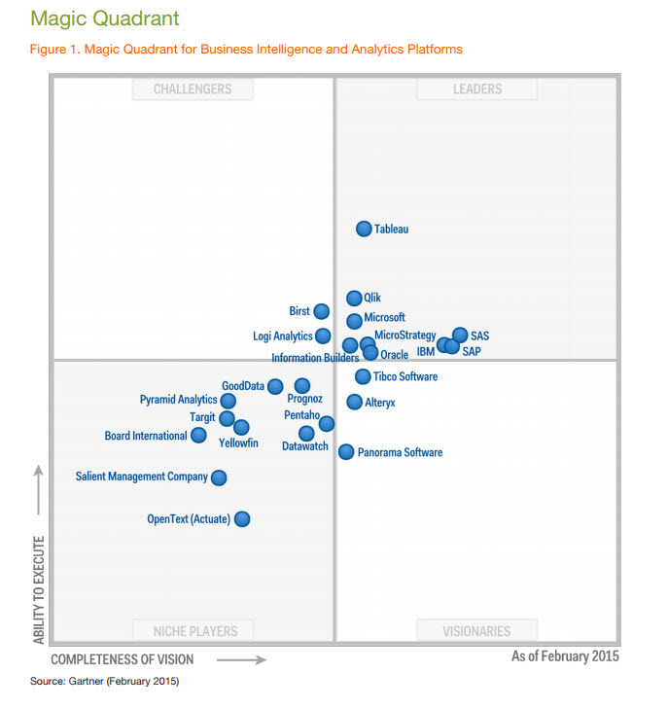

Slide 6
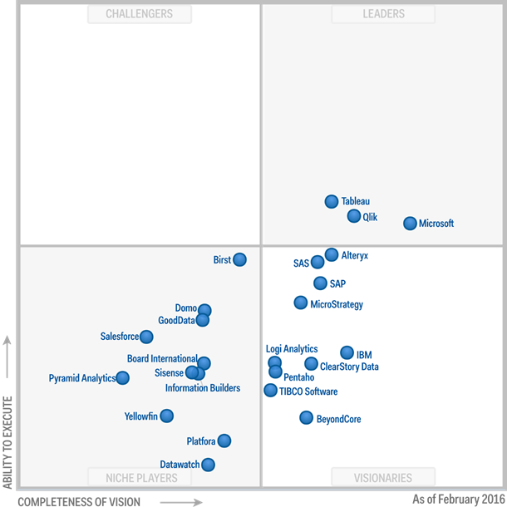

Slide 7
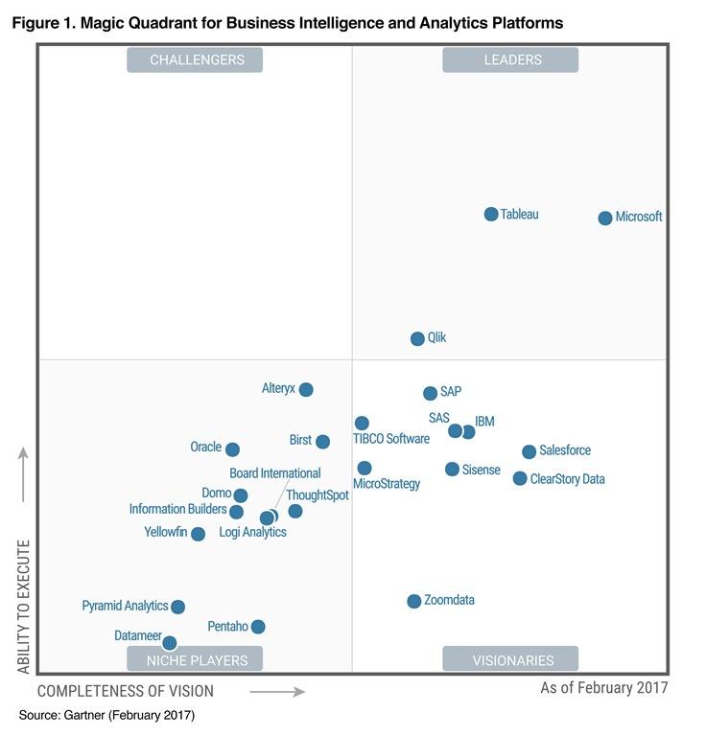

Slide 8
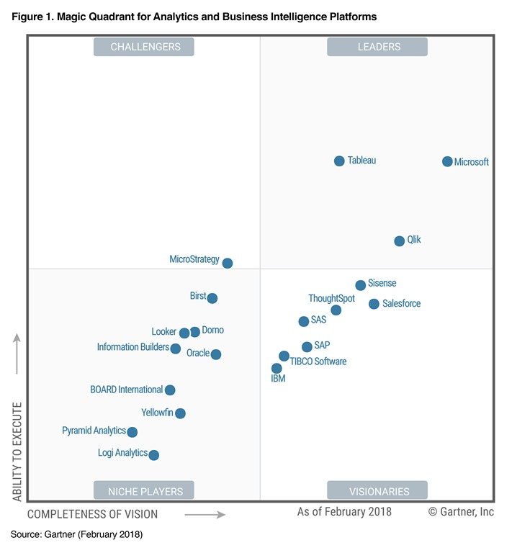

Slide 9
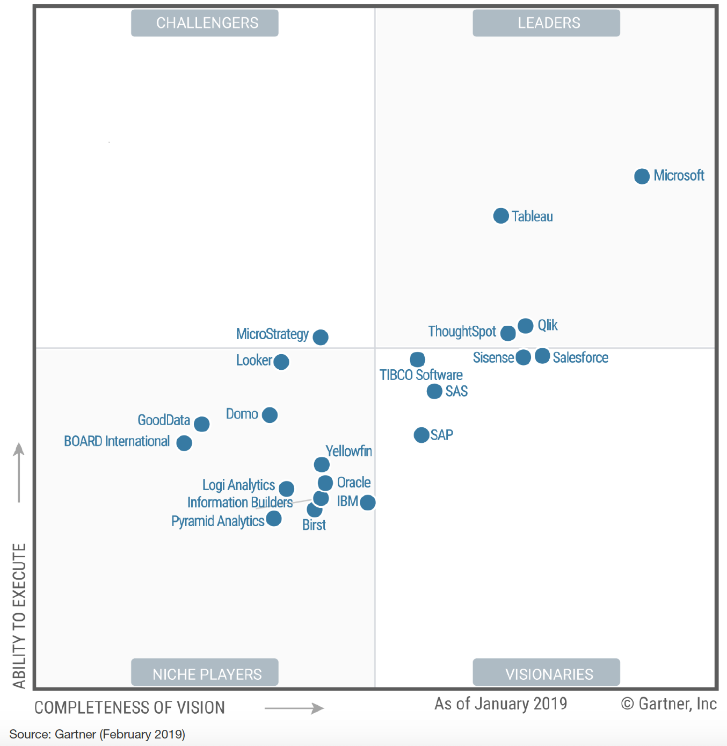

Slide 10
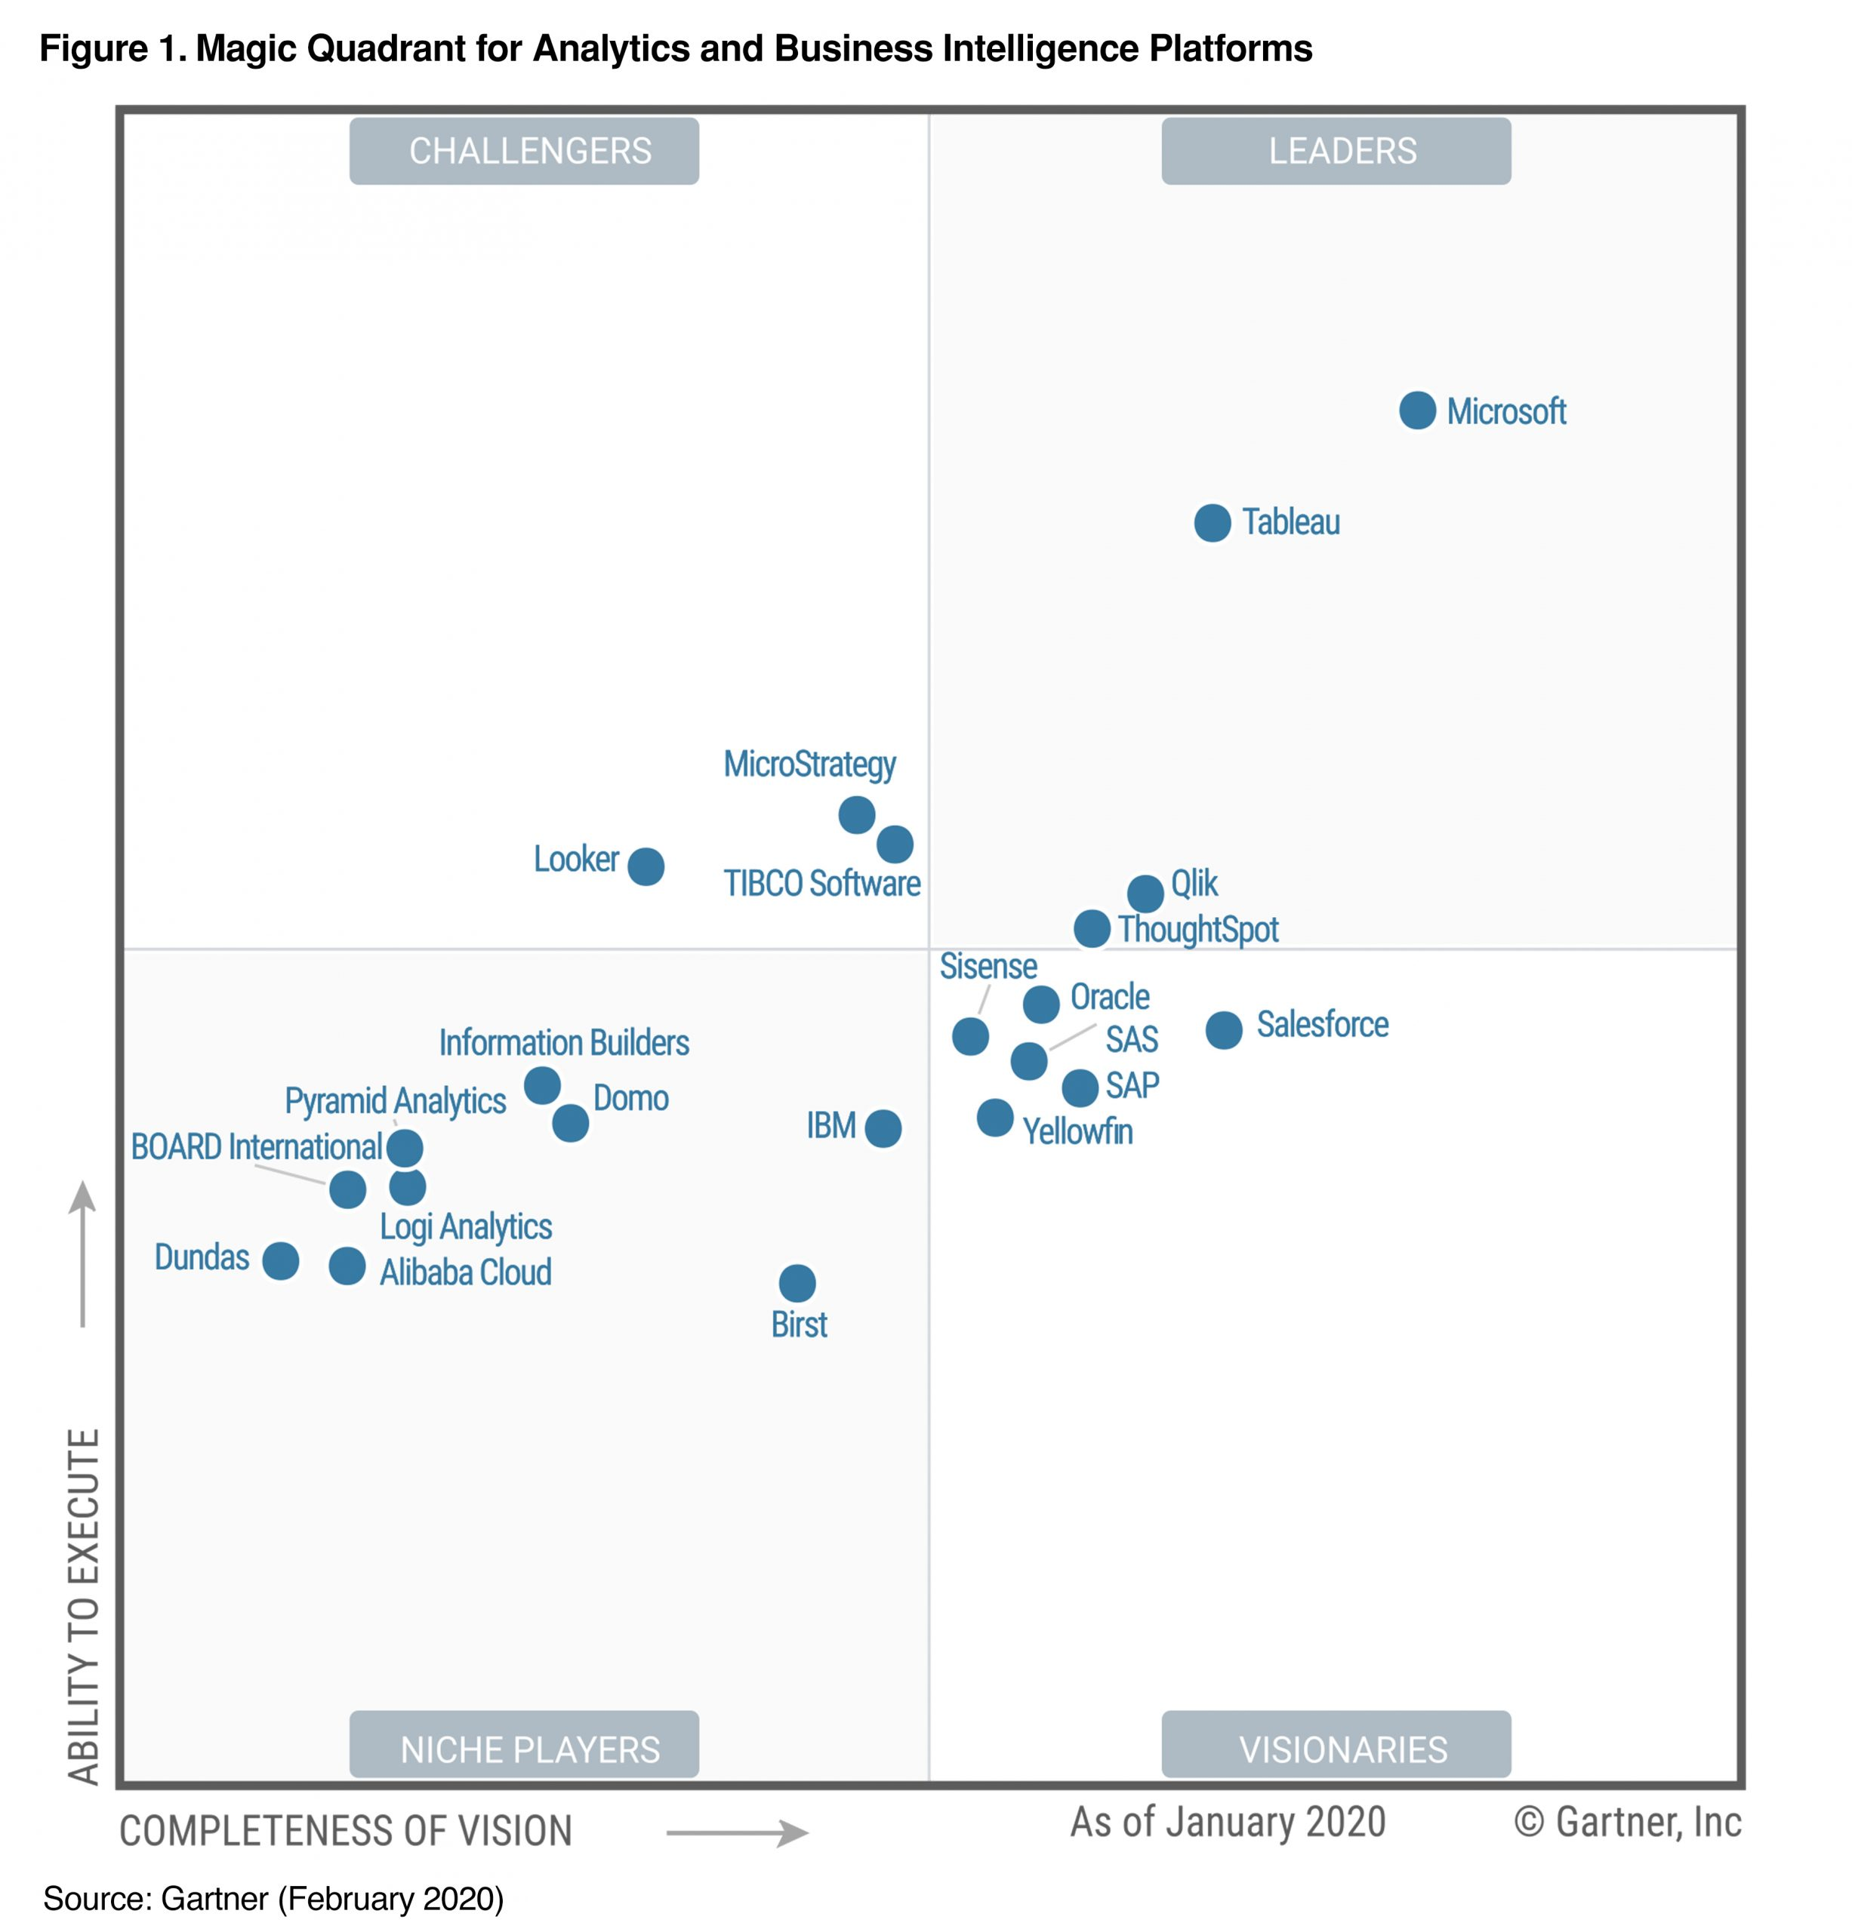

Slide 11
Microsoft Power BI

Slide 12
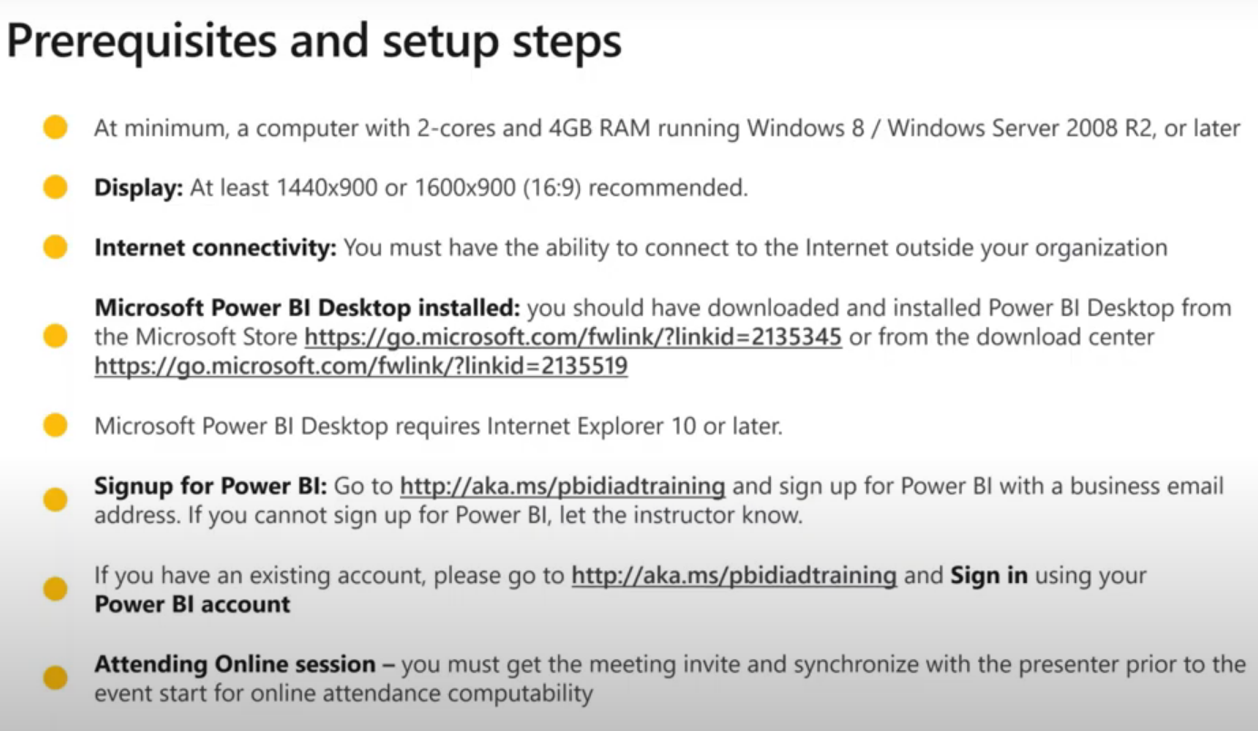

Slide 13
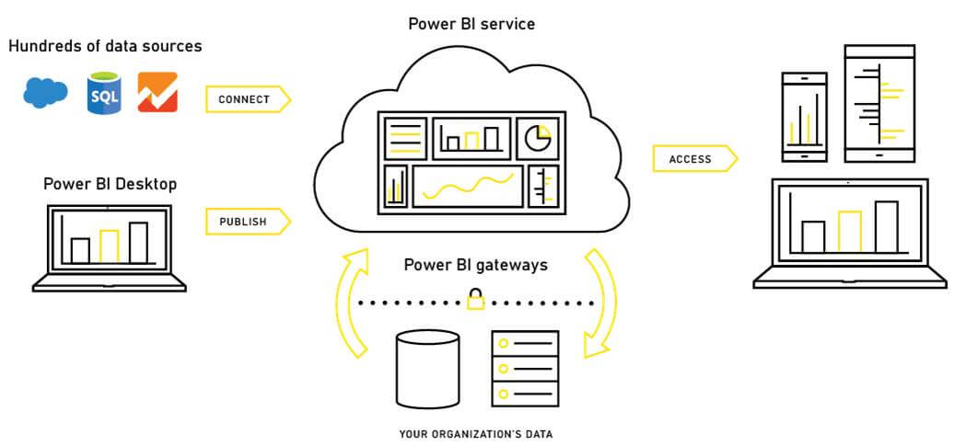
PBI Architecture

Slide 14

Author
Share and Collaborate
Large scale deployments
Share and Collaborate
App dev
Power BI
Desktop
Power BI
Service
Power BI
Premium
Power BI
Report Server
Power BI
Embedded
Free data analysis
And report authoring tool
Cloud-based modern business analytics solution
Dedicated capacity for increased Governance
Visual analytics embedded in your applications
On-premises report server

Slide 15
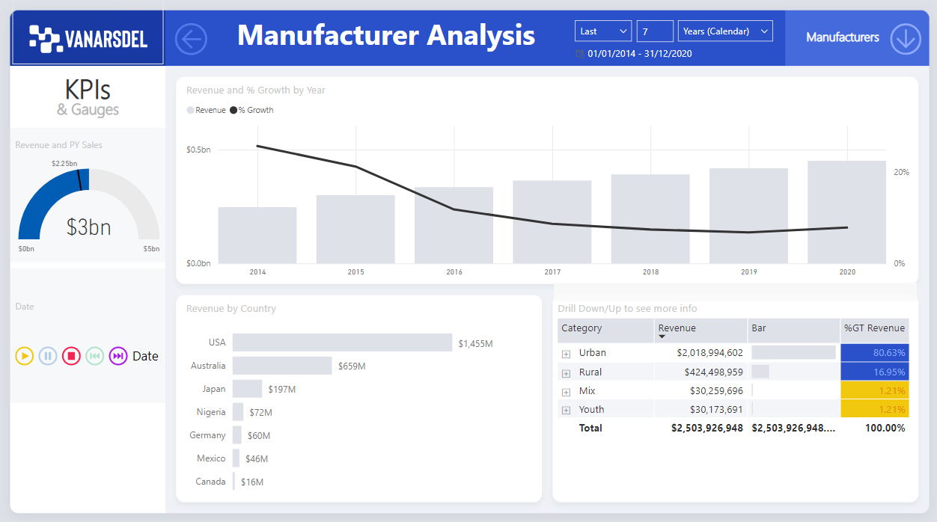

Slide 16
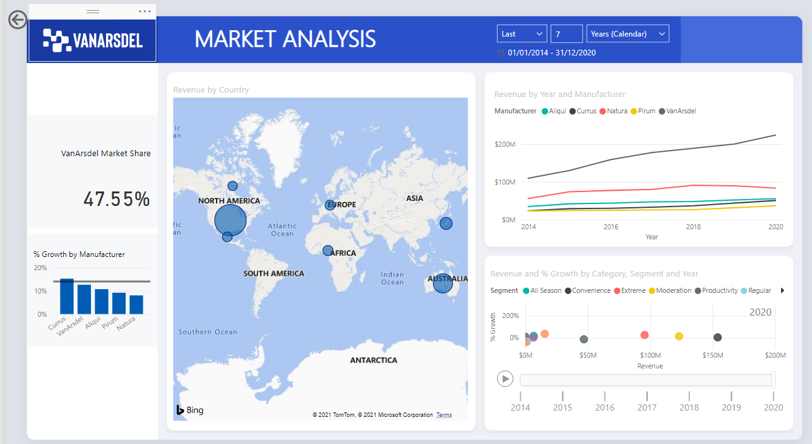

Slide 17
An Introduction

Slide 18
Power BI Flow
Extract
Transform
Load
Data Modelling
DAX
Report Building
Publish report
Dashboard Creation
Share and Collaborate
ETL (Power Query)
PBI Desktop
PBI Service

