Slide 1
Office 365 & SharePoint Administration
Notes:
Welcome Everyone to the course

Slide 2

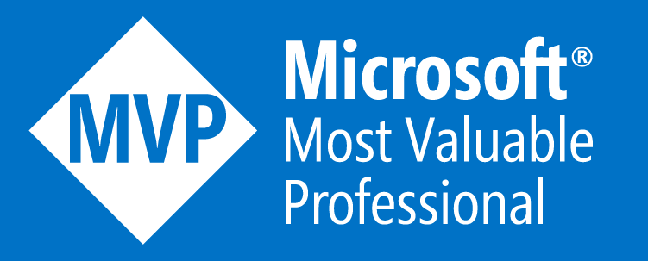
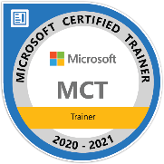










Jenkins NS
Office Development MVP | MCT | Solution Architect | International Speaker
16+ Years of experience
Microsoft Teams, Power Platform and SPFx Specialist
International Speaker | Blogger | Trainer
SPS Bangalore Organizer
aOS Ambassador
jenkinsns@gmail.com
in/jenkinsns
@jenkinsns
http://www.jenkinsblogs.com
jenkinsns
https://www.facebook.com/spfxinfo/
https://www.facebook.com/msteamsinfo
https://www.youtube.com/user/jenkinsns

Slide 3

Hello! Introduce yourself
Let’s get acquainted:
Your name
Title/function
Experience
Your expectations for the course
Notes:
Ask students to introduce themselves and provide their backgrounds, product experience, and expectations for the course.
Record student expectations on a whiteboard or flip chart that you can reference during class.

Slide 4
Module 1: Designing Your Microsoft 365 Tenant

Slide 5
Module Agenda
Planning Your Microsoft 365 Experience
Planning Microsoft 365 in Your On-Premises Infrastructure
Planning Your Identity and Authentication Solution
Planning Your Service Setup
Planning Your Hybrid Environment
Planning Your Migration to Microsoft 365
Exercise – Planning the Transition to Microsoft 365

Slide 6
Lesson 1: Planning Your Microsoft 365 Experience

Slide 7
Lesson Introduction
This lesson examines key components and tasks related to Microsoft 365, such as:
Microsoft 365 Components
Microsoft 365 Subscription Options
Planning a Migration to Microsoft 365

Slide 8
Microsoft 365 Subscription Options
Microsoft 365 Business
Targets small to medium-sized organizations that require cloud collaboration and have up to 300 users. Includes the following subscriptions:
Microsoft 365 Apps for Business - Includes fully installed Office apps, but it does not include email, instant messaging, and HD video conferencing.
Microsoft 365 Business Basic - Does not include full versions of the Office apps, but it does include email with a 50-GB mailbox per user, instant messaging, and HD video conferencing for up to 250 users.
Microsoft 365 Business Standard - Includes fully installed Office applications, email, Azure AD, Azure information protection, Exchange Online advanced threat protection, Intune, MDM, and Windows 10.
Microsoft 365 Business Premium- Includes both fully installed Office applications and email with a 50-GB mailbox per user, instant messaging, and HD video conferencing.
Notes:
See the topic which contains description of the similarities and differences between E1, E3, and E5. Discuss these with the class/

Slide 9
Microsoft 365 Subscription Options (continued)
Microsoft 365 Enterprise
Targets medium-sized and enterprise organizations that need a cloud collaboration solution, compliance tools, a corporate social network, an intranet site and web conferencing, and the ability to include an unlimited number of users. Includes the following subscriptions:
Office 365 E3 - Includes business services such as email, file storage and sharing, Office for the web, and meetings and IM, plus the ability to install Office applications locally, as well as application enterprise management, self-service business intelligence, and compliance tools.
Office 365 E5 - Includes all E3 features, plus advanced security, analytic tools, public switched telephone network (PSTN) conferencing and cloud PBX (private branch exchange) for cloud-based call management.
Office 365 F3 - Designed for Firstline Workers. It does not include a license to install Office applications locally; this is a cloud-based subscription that only provides access to online versions of Office.
Microsoft 365 Apps for enterprise – (formerly Office 365 ProPlus) Includes online versions of Office, cloud file storage, and sharing capabilities with 1 TB storage per user. Also includes the option to fully install Office applications locally.
Notes:
See the topic which contains description of the similarities and differences between E1, E3, and E5. Discuss these with the class/

Slide 10
Microsoft 365 Subscription Options (continued)
Microsoft 365 Education
Provides cloud productivity and collaboration solutions for students and teachers.
Includes online versions of Office, cloud file storage, and sharing capabilities with 1 TB storage per user.
Includes email with a 50-GB mailbox per user, instant messaging and Skype connectivity, team sites, school video portals, online classes with audio and HD video conferencing, Yammer for school social network, and compliance tools.
Enterprise Mobility + Security
Add-on service that can be added to the Office 365 E3 and E5 subscriptions.
Provides options to protect against unknown device intrusions, malware threats, and additional identity protection.
When added to a Office 365 E5 subscription, Cloud App Security and Azure Advanced Threat Protection (ATP) are also included.
Notes:
See the topic which contains description of the similarities and differences between E1, E3, and E5. Discuss these with the class/

Slide 11

Enterprise Mobility and Security Components
EMS contains the following services that focus on data and identity protection, as well as protection again unknown device intrusion and malware threats:
Microsoft Azure Active Directory
Azure AD Premium P1 edition
Azure AD Premium P2 edition
Azure AD Identity Protection
Azure AD Privileged Identity Management
Azure Information Protection
Microsoft Intune

Slide 12
Planning Your Microsoft 365 Subscription
An organization should consider the following questions when it plans to purchase a Microsoft 365 subscription:
Which business needs will drive the organization to move to Microsoft 365?
What is the organization’s current IT infrastructure?
What is the organization’s change-management process?
How many employees will use Microsoft 365 and what are the organization’s plans for growth?

Slide 13
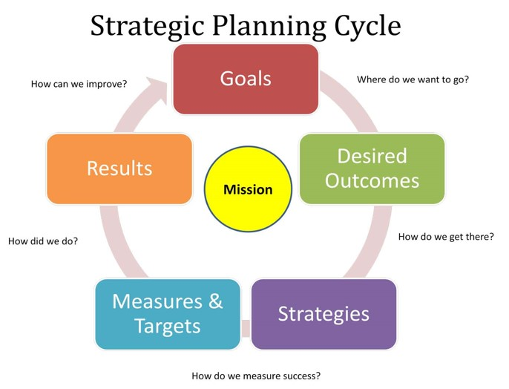
Planning a Migration to Microsoft 365
Organizations that migrate to Microsoft 365 should plan on performing the following tasks:
Decide which Microsoft 365 plan(s) meets the organization’s requirements
Inventory the current environment in the organization
Make key deployment decisions
Fix potential deployment blockers and clean up the organization
Configure the Microsoft 365 subscription
Set up accounts and mailboxes
Migrate existing data to Microsoft 365
Validate functionality
Migrate users to Microsoft 365

Slide 14

Discussion – Choosing a Microsoft 365 Subscription
You run an IT consulting firm who supports a variety of medium-sized businesses, each of which has an average of 1000 employees. One of the businesses you’re working with is ABC Construction, who does a lot of sub-contract framing work for various construction firms. As such, ABC Construction has employees working at multiple job sites simultaneously.
ABC’s owner has stated that a full Microsoft 365 subscription is the best option for most of his staff.
He wants to make his IT environment more remotely managed by each site foreman.
One of the owner’s big requests is to begin using video conferencing. Rather than having conference calls with all the site foremen, the owner wants to start using video conferencing between ABC management and all the foremen.
Which type of Microsoft 365 subscription would you suggest for ABC Construction, who is looking to reduce their IT cost and improve their productivity?
Notes:
Possible solution:
Set the company up with Microsoft 365 Business Basic. It offers email, Teams’ collaboration, and storage. It also supports up to 250 users in one video conference, which would be more than sufficient for ABC Construction.

Slide 15
Lesson 2: Planning Microsoft 365 in Your On-Premises Infrastructure

Slide 16
Lesson Introduction
When you move an enterprise organization to Microsoft 365, it's important to plan exactly what steps you need to take, when to perform them, and who will perform them
It is important that you:
Prepare your organization for Microsoft 365
Estimate network bandwidth requirements
Test your existing network
Understand best practices for integration with Microsoft 365
Identify deployment advisory strategy

Slide 17
Preparing your Organization for Microsoft 365 Enterprise
If your company needs assistance on where to begin its transition process, it’s recommended that it implement FastTrack Center Benefit for Microsoft 365
Consider bandwidth requirements
It’s recommended that companies with a legacy environment perform a system review and clean-up depending on the longevity of their Active Directory environment

Slide 18
Microsoft 365 Deployment Planning Checklist
Using a pre-deployment checklist allows your company to create timelines and set goals and subtasks that will help keep your Microsoft 365 deployment on schedule.
Microsoft provides the Microsoft 365 Deployment Planning Checklist to help get you started.
Key areas within the checklist include:
Determine your deployment goals
Inventory your current environment and make key deployment decisions
Fix potential deployment blockers
Set up Office 365 services to work for your organization
Roll out to users

Slide 19
Discussion – Microsoft 365 Deployment Planning Checklist
Review the Microsoft 365 Deployment Planning Checklist in your student manual, then discuss the following questions:
Based on your experience with system deployments, are there any key tasks that you feel are missing from the checklist?
Which area do you feel is most important for a successful implementation?
Which task(s) typically provides the most problems, and why? What have you done to mitigate those issues in past deployments?
If you had to make one key recommendation to someone new to deploying systems that would help them achieve success, what would it be?

Slide 20
Estimating Network Bandwidth Requirements
Microsoft 365 is a managed service which is designed to work in any environment that has a valid internet connection
Using Microsoft 365 might increase the utilization of your organization’s internet circuit
You should perform the following steps to estimate your network’s bandwidth:
Assess the number of clients
Determine which Microsoft 365 services and features will be available for clients to use
Measure the network use for a pilot group of clients
Cross-check your results against Microsoft’s calculators
Use the measurements from the pilot group to extrapolate the entire organization's needs

Slide 21

Testing Your Existing Network
Microsoft provides several tools to help organizations test and validate their upload, download, and latency constraints
These network tools include:
Microsoft Message Analyzer
Microsoft Remote Connectivity Analyzer
Microsoft 365 Support and Recovery Assistant
This Photo by Unknown Author is licensed under CC BY-SA

Slide 22

Best Practices for Integrating to Microsoft 365
Microsoft 365 network traffic performs best when it's treated as a trusted Internet service and allowed to bypass much of the traditional filtering and scanning
When planning your integration, you should consider the following best practices:
Ensure proxy and firewall devices are configured and sized to handle the additional traffic
Bypassing the authentication requirement for the Microsoft 365 domains
Existance of many shared calendars and mailboxes
Determine the maximum number of supported devices for a public IP address
Bypassing the filtering to the Microsoft 365 domains can improve connectivity and performance
Internal network settings that can affect performance

Slide 23
Microsoft 365 URLs and IP Address Ranges
As a Software as a Service (SaaS) application, Microsoft 365 has a large number URL’s and IP addresses representing Microsoft 365 service front-end servers
These URL’s and IP addresses are referred to as endpoints
You should review all IP Addresses and URL’s that are required for Microsoft 365 to function correctly within your organization

Slide 24
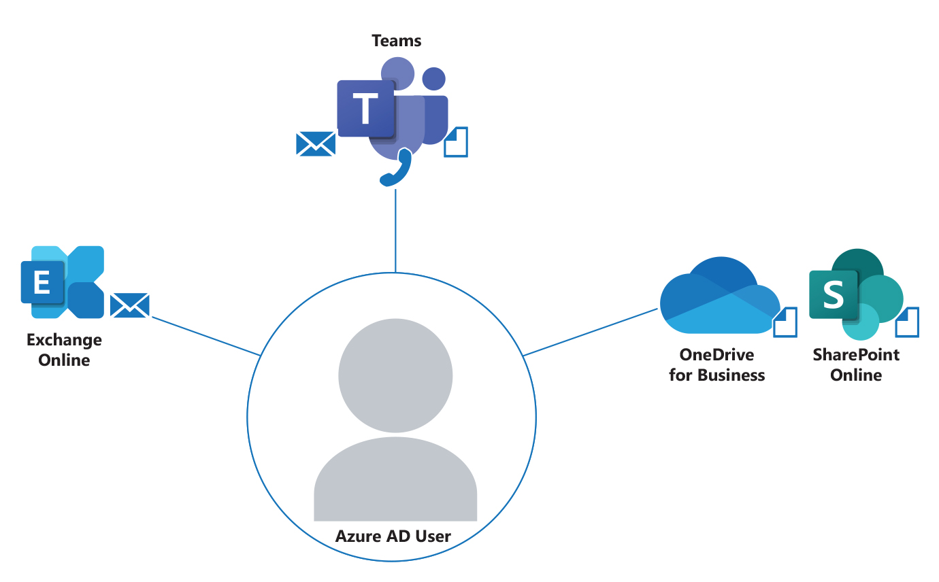
Identify Deployment Advisor Strategy for Microsoft 365 Services
Microsoft 365, in conjunction with Azure Active Directory (Azure AD), provides different avenues for companies to authenticate into its services
Different authentication strategies that can be implemented in an organization’s tenant include:
Cloud only
Password Hash Synchronization
Azure AD Pass-Through Authentication
Azure AD pass-through Authentication with Seamless Single Sign On (SSO)
Federated SSO (with Active Directory Federation Services (AD FS)
Regardless of the deployment strategy used to implement Microsoft 365 services, all resources are bound to the Azure AD user, and the Azure AD user is the "source" for all other resources.

Slide 25
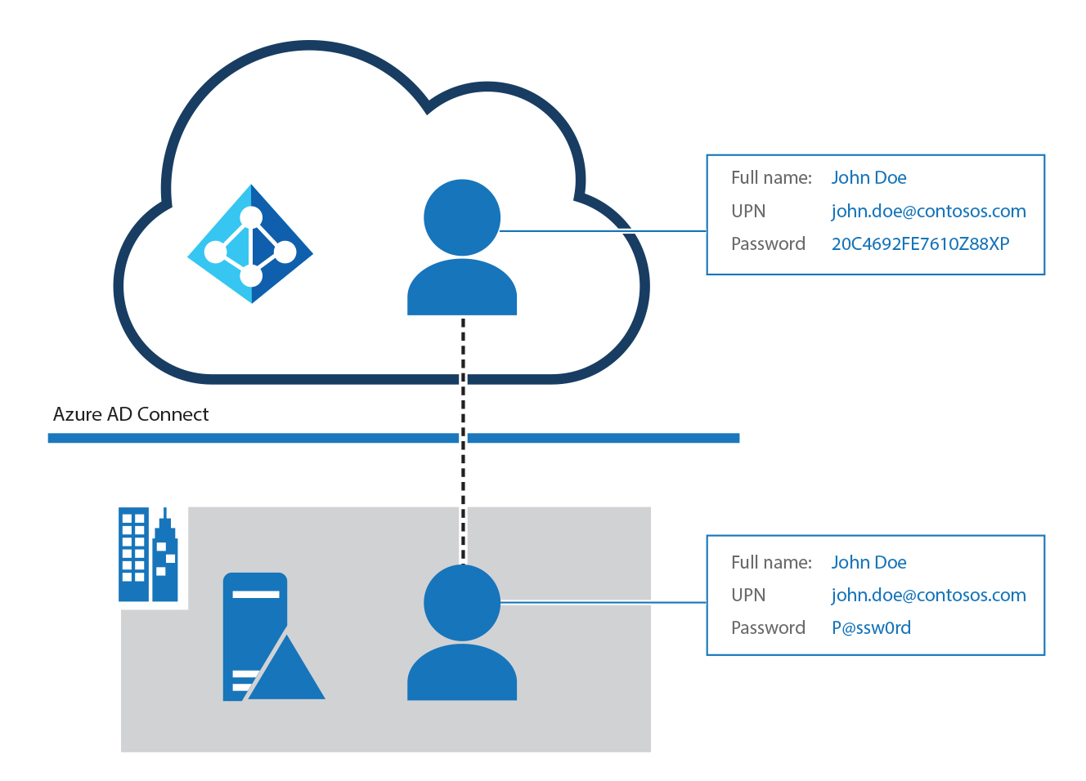
Using Password Hash Synchronization
For organizations employing Microsoft 365, it's critical that they enable password hash synchronization no matter what authentication method they use in their on-premises infrastructure, for the following reasons:
High availability and disaster recovery
On-premises outage survival
Identity protection
Notes:
High availability and disaster recovery
Organizations can avoid outages by using password hash synchronization because the Microsoft Azure AD cloud authentication service scales globally and is always available.
On-premises outage survival
Organizations dealing with on-premises outages are typically back online within a matter of hours when using password hash synchronization as their authentication method. By using access to email through Microsoft 365, they can work to resolve issues and access other cloud-based workloads.
Identity protection
Azure AD Identity Protection provides one of the best ways for organizations to protect users in the cloud. It can identify whether any usernames or passwords have been compromised, and affected users can be blocked or forced to change their passwords when they try to sign in with leaked passwords.

Slide 26
Lesson 3: Planning Your Identity and Authentication Solution

Slide 27
Lesson Introduction
To properly plan your identity and authentication solution, you should plan for the following:
Directory synchronization
Azure AD Connect
Azure AD Connect pass through
Active Directory Federation Services (for ADFS on-premises deployments))
Active Directory Federation Services in Microsoft Azure (for ADFS deployments on Azure)
Planning your identity and authentication solution requires an understanding of Azure Active Directory Seamless Single Sign-On, which is also covered in this lesson.

Slide 28
Modern Authentication in Microsoft 365 Deployments
Modern authentication is a Microsoft solution based on Active Directory Authentication Libraries (ADAL)
Modern authentication leverages the Open Authorization (OAuth) standard for an application or client software to obtain access tokens from an authentication provider in order to access resources
For the Microsoft 365 services, the default state of modern authentication is:
Exchange Online is On by default
SharePoint Online is On by default
Skype for Business Online is On by default
Modern authentication is automatically turned On for Office 2016 client apps

Slide 29
Multi-Factor Authentication in Microsoft 365 Deployments
Multi-factor authentication (MFA) is a method of authentication that requires the use of more than one verification
MFA works by implementing two or more of the following verification methods:
A randomly generated pass code
A phone call
A phone SMS
A smart card (virtual or physical)
A biometric device
The Office 2013 device apps support MFA through the Active Directory Authentication Library (ADAL)

Slide 30
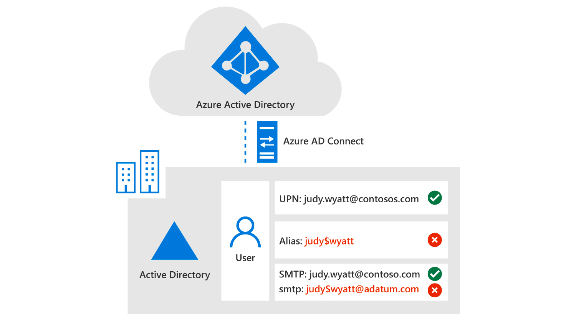
Planning Directory Synchronization
Directory synchronization is the most common provisioning choice for enterprise customers who are moving to Microsoft 365
Directory synchronization allows identities to be managed in the on-premises AD DS and all updates to that identity are synchronized to Microsoft 365
When you set up directory synchronization in Microsoft 365, you should run the IdFix tool
When planning for directory synchronization, you should consider the following:
Multi-forest deployment requirements
Multi-forest deployment scenario
Azure AD Connect synchronization features

Slide 31
Planning Azure AD Connect Pass-Through Authentication
Pass-through authentication (PTA) provides a password validation for Azure AD authentication services
PTA uses a software agent running on one or more on-premises servers to validate the users directly with your on-premises Active Directory
When planning for Azure AD Connect Pass-through Authentication, you should consider the following:
Key benefits
Feature highlights
Supported scenarios
Unsupported scenarios

Slide 32
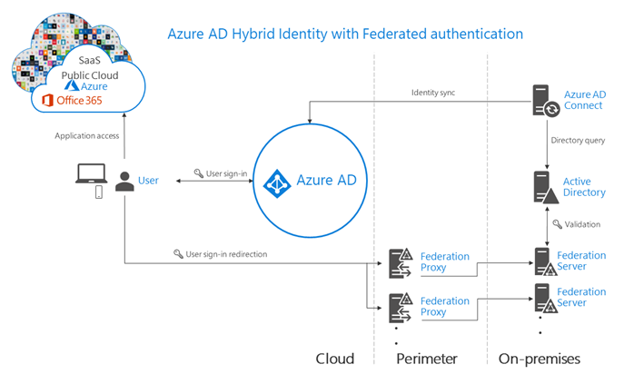
Federated Authentication in Microsoft 365 Deployments
With federated authentication, Azure AD hands off the authentication process to a separate, trusted authentication system, such as on-premises AD FS, to validate each user’s password

Slide 33
Planning Active Directory Federation Services in Microsoft Azure
Windows Server Active Directory Federation Services (ADFS) can be deployed on Azure virtual machines
Best practices for this approach include:
Deploy Active Directory domain controllers for all user domains in the same network as the AD FS servers
Deploy multiple AD FS nodes for high availability and balancing the load
Deploy one or more Web Application Proxy nodes for internet access
Never expose security token service (STS) servers directly to the Internet
Restrict access from the Web Application Proxy nodes to internal network resources

Slide 34
Restricting Traffic in an AD FS Deployment
Because Azure does not provide a native, full-featured firewall capability, the following options can be used to restrict traffic:
Azure Network Access Control Lists
Barracuda NG Firewall
An endpoint access control list (ACL) is a security feature available for Azure deployments.
An ACL provides the ability to selectively permit or deny traffic for a virtual machine endpoint.
This packet filtering capability provides an additional layer of security. You can specify network ACLs for endpoints only. You can't specify an ACL for a virtual network or a specific subnet contained in a virtual network.
It is recommended to use network security groups (NSGs) instead of ACLs, whenever possible.
When using NSGs, endpoint access control list will be replaced and no longer enforced.
A network security group contains security rules that allow or deny inbound network traffic to, or outbound network traffic from, several types of Azure resources.

Slide 35
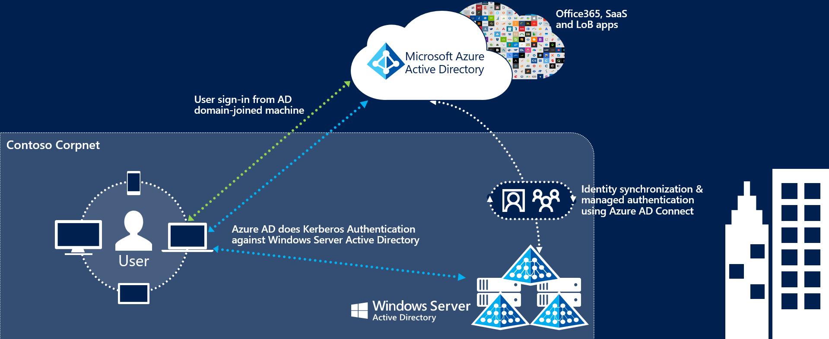
Azure Active Directory Seamless Single Sign-On
Azure Active Directory Seamless Single Sign-On automatically signs users in when they are on their corporate devices connected to their corporate network
This feature provides users with easy access to their organization’s cloud-based applications without needing any additional on-premises components

Slide 36
Lesson 4: Planning Your Service Setup

Slide 37
Lesson Introduction
To properly plan for Microsoft 365 services setup, you should:
Plan your Email
Plan Your File Storage and Migration
Plan Your Microsoft Teams Environment
Plan for Active Directory integration

Slide 38
Planning Your Email
Planning your email strategy is critical for your company to maintain longevity
The first step in your planning effort is determining the service you’re migrating from
You should also keep in mind the following considerations:
Current email system
Exchange Server version
Long-term coexistence with Exchange
User numbers
IMAP connections
POP3 connections
You must carefully decide when to change the DNS MX record for a domain in a Microsoft 365 migration to point to Exchange Online

Slide 39
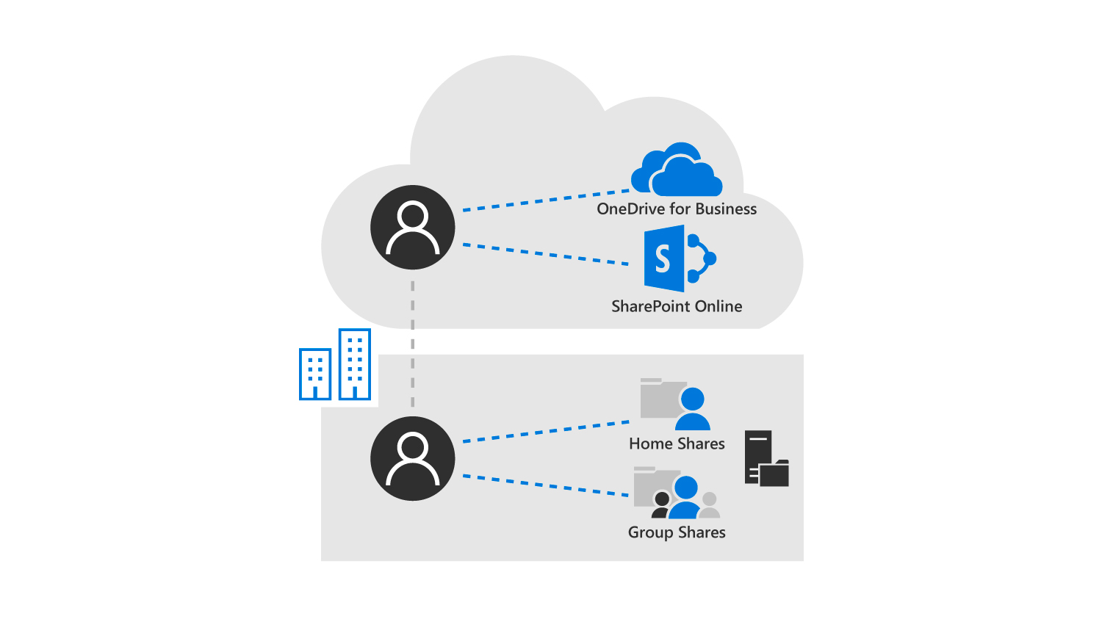
Planning Your File Storage and Migration
Collaboration and file storage is facilitated in Microsoft 365 through two key services:
One Drive for Business
SharePoint Online
You should also consider the following storage locations when planning your file storage strategy:
OneDrive for Business
Microsoft 365 Team site
Microsoft 365 Team subsite
Microsoft 365 Site collections
Accessing a file server from a company notebook is not that different from accessing SharePoint and OneDrive resources with an Azure AD user. These legacy file servers and home drives can be migrated to SharePoint Online and OneDrive for Business.

Slide 40
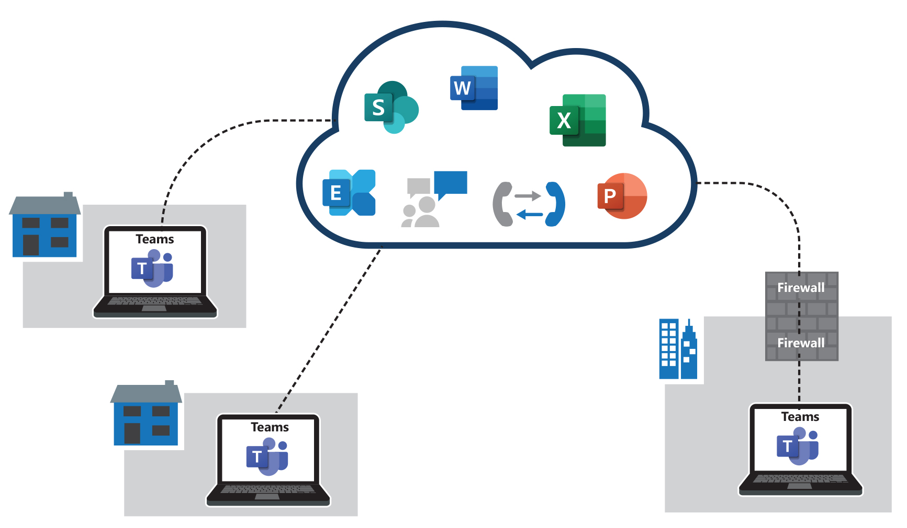
Planning Your Microsoft Teams Environment
Microsoft Teams, which provides the backbone for enterprise voice and video in Microsoft 365, is built on four core principles:
Chat for today’s teams
A hub for teamwork
Customization options
Trusted security
To ensure optimal traffic flow when using Teams, traffic must be allowed to flow both between the internal network segments (for example, between sites over the WAN) as well as between the network sites and Microsoft 365.
Organizations will experience degraded performance if they do not open the correct ports or if they actively block specific ports.
Review Teams’ network and bandwidth requirements to optimize performance.

Slide 41
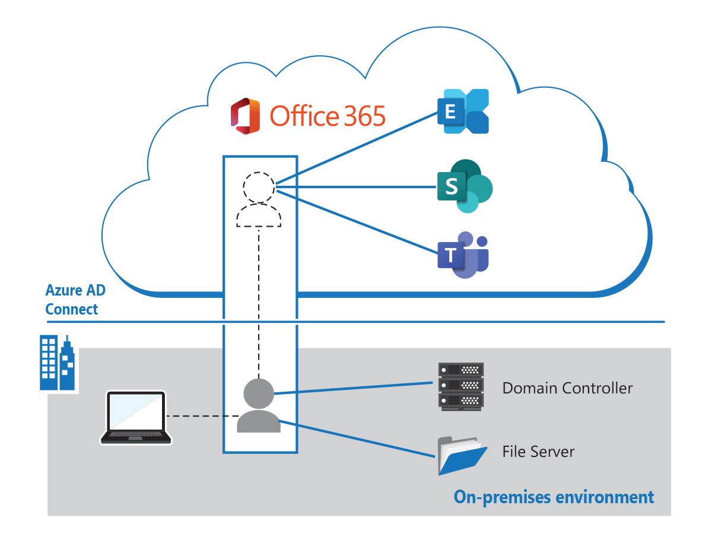
Planning for Active Directory Integration
Microsoft 365 provides many ways to manage your user and group synchronization, all of which can be managed using an application called Azure Active Directory (AD) Connect
Azure Active Directory Connect is made up of two primary components:
Synchronization services
Azure AD Connect Health

Slide 42
Lesson 5: Planning Your Hybrid Environment

Slide 43
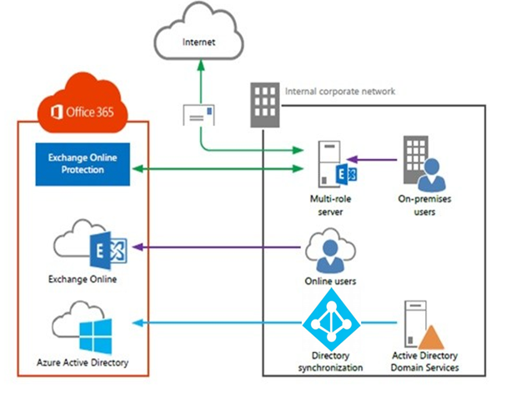
Lesson Introduction
A hybrid environment is when you connect your existing on-premises services such as Exchange and Active Directory with corresponding services that are housed in the Cloud
When planning your hybrid environment, you should plan for the following:
Your Hybrid Exchange environment
Your Hybrid SharePoint environment
Your Hybrid Skype For Business environment

Slide 44
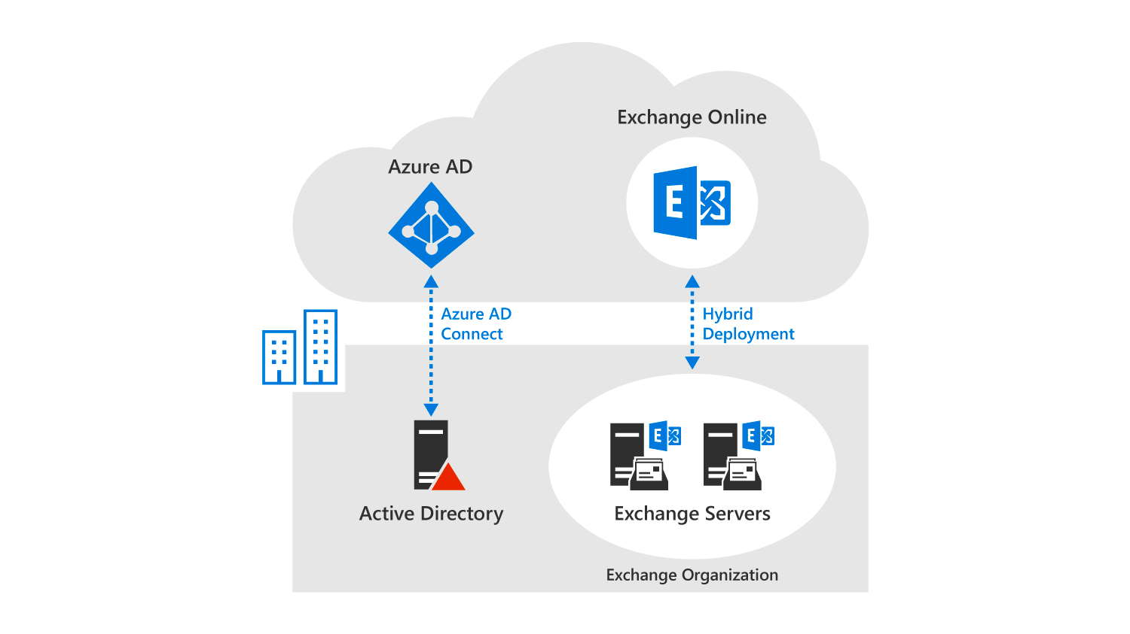
Planning Your Hybrid Exchange Environment
When planning your hybrid Exchange environment, you must consider the following:
Hybrid deployment requirements
Exchange ActiveSync clients
Mailbox permissions migration
Support for cross-premises mailbox permissions
Offboarding
Mailbox forwarding settings
You should also consider changes to an Exchange hybrid environment
In a hybrid deployment, the on-premises Exchange organization and Exchange Online in the cloud are connected as separate, independent organizations.
Azure AD is the counterpart of a local Active Directory, and Exchange Online is the counterpart for on-premises Exchange servers.

Slide 45
Planning Your Hybrid SharePoint Environment
When planning for SharePoint hybrid, you should plan for the following features:
Hybrid SharePoint taxonomy and hybrid content types
Hybrid OneDrive for Business
Cloud hybrid search for SharePoint
Hybrid profiles
The extensible hybrid app launcher
Hybrid site following
Server-to-server authentication
Hybrid federated search for SharePoint Server
Connectivity from Microsoft 365 to SharePoint Server

Slide 46
Planning Your Hybrid Skype for Business Environment
When planning a hybrid Skype for Business environment, you must focus on hybrid connectivity between an on-premises deployment of Skype for Business Server and Teams since Skype for Business online is no longer available
Split domain configuration has the following effect on users:
Users who are homed on-premises can interact with on-premises Skype for Business servers
Users who are homed online can interact with Skype for Business online services
Users from both environments can collaborate with each other by using Instant Messaging, participating in conference calls, VoIP calls, and so on
Azure Active Directory Connect is used to synchronize the organization’s on-premises directory with Microsoft 365

Slide 47
Lesson 6: Planning Your Migration to Microsoft 365

Slide 48
Lesson Introduction
When you move an enterprise organization to Microsoft 365, it's important to plan exactly what steps you want to take, when to perform them, and who will perform them
You need to:
Have a deployment planning checklist
Clean up your directory
Plan your mail migration
Consider performance impact when migrating mail
Consider network impact when migrating mail

Slide 49
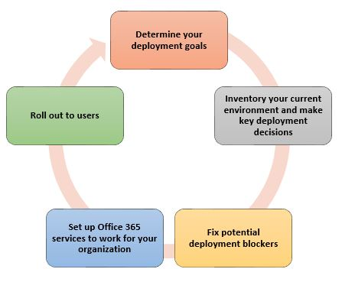
Deployment Planning Checklist for Microsoft 365

Slide 50
Cleaning up Your Directory
Before you begin synchronizing your Active Directory, it is recommended to first clean it up
Cleaning Active Directory typically includes the following steps:
Ensure that each user who will be assigned Microsoft 365 service offerings has a valid and unique email address in the proxyAddresses attribute
Remove any duplicate values in the proxyAddresses attribute
If possible, ensure that each user who will be assigned Microsoft 365 service offerings has a valid and unique value for the userPrincipalName (UPN) attribute in the user’s user object

Slide 51
Planning your Mail Migration
There are five different migration strategies you can use to move your organization’s data:
Internet Message Access Protocol (IMAP) Migration
Cutover migration
Staged migration
Hybrid deployment
Third-party migration

Slide 52
Performance Considerations when Migrating Mail

Slide 53
Network Considerations when Migrating Mail
When considering network impact you should consider the following:
Network capacity
The amount of time it takes to migrate mailboxes to Microsoft 365 is determined by the available and maximum capacity of your network
Network stability
A fast network doesn’t always result in fast migrations. If the network isn’t stable, data transfer takes longer because of error correction. Depending on the migration type, error correction can significantly affect migration performance
Network delays
Intrusion detection functionality configured on a network firewall often causes significant network delays and affects migration performance
Internet delays affect overall migration performance
Users in the same company might have cloud mailboxes that reside in datacenters in different geographical locations

Slide 54
Lesson 7: Exercise – Planning the Transition to Microsoft 365

Slide 55

Paper-based Lab Exercise
Exercise 1: Planning the Transition to Microsoft 365
You have been tasked with moving Adatum to Microsoft 365 as its cloud solution. The CEO has requested that you create a transition timeline that includes suggestions on how the new infrastructure will be utilized.
Download the planning document from the site listed in your student manual.
Step 1 - Each student should review the information provided and answer the questions in the document.
Step 2 - After completing the assessment, exchange it with one of your fellow students and review each other’s assessment. Identify the key differences between your two proposals.
Step 3 – Review your assessments with the class and come to a final solution for Adatum.
Notes:
A copy of the planning document is available in the MCT DLC for this course. The document has suggested solutions for each question. Use these suggested answers to help drive the discussion. You should allot approximately 1 hour for this exercise.

Slide 56
Lesson 8: Module Review

Slide 57
Discussion – Module Review
What are your key takeaways from this module, and why?
What are the key features discussed in this module that you foresee implementing at your organization?

