Slide 1
Implement SharePoint hybrid search

Slide 2
Module agenda
Overview of SharePoint hybrid search
Configure SharePoint hybrid search

Slide 3
Lesson 1: Overview of SharePoint hybrid search

Slide 4
Lesson Introduction
Overview of SharePoint hybrid search
Overview of cloud hybrid search
Overview of hybrid federated search - Outbound
Overview of hybrid federated search - Inbound
Overview of hybrid federated search - Bidirectional

Slide 5
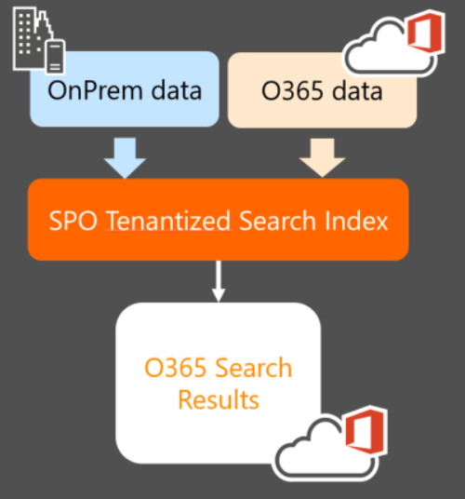
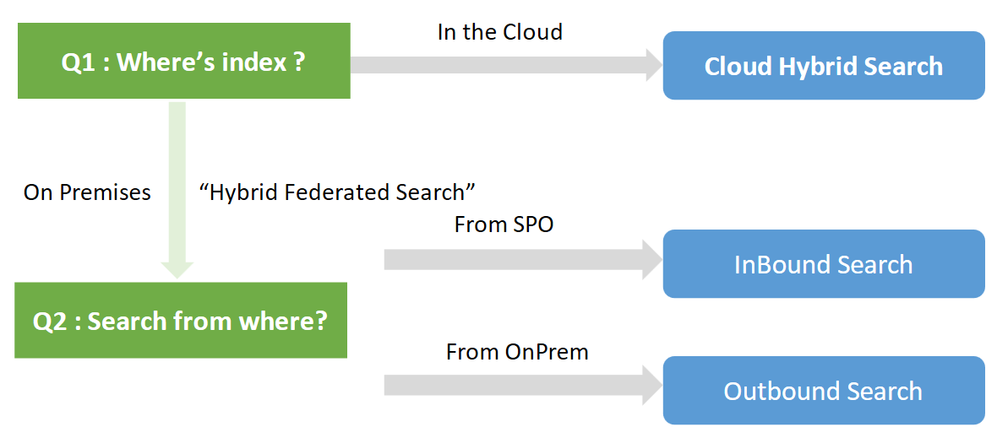
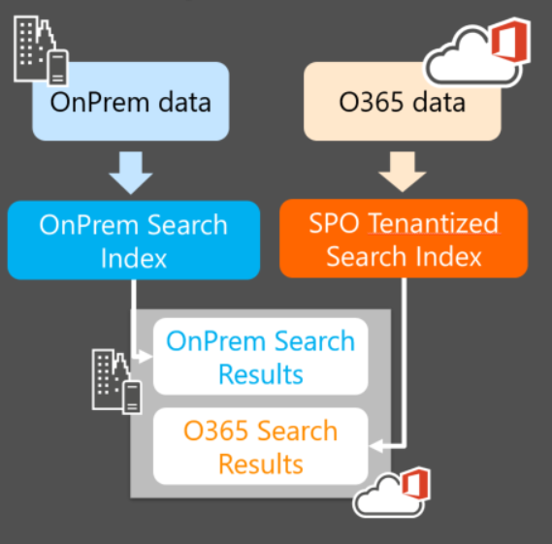
Overview of SharePoint hybrid search
Cloud Hybrid Search
Single Index in the cloud
Single Result Block
Hybrid Federated Search
Separated search indexes
Separated Result Blocks

Slide 6
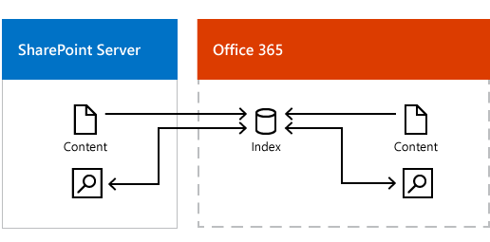
Overview of cloud hybrid search
Cloud hybrid search experience
Benefit of cloud hybrid search
Cloud hybrid search flow

Slide 7
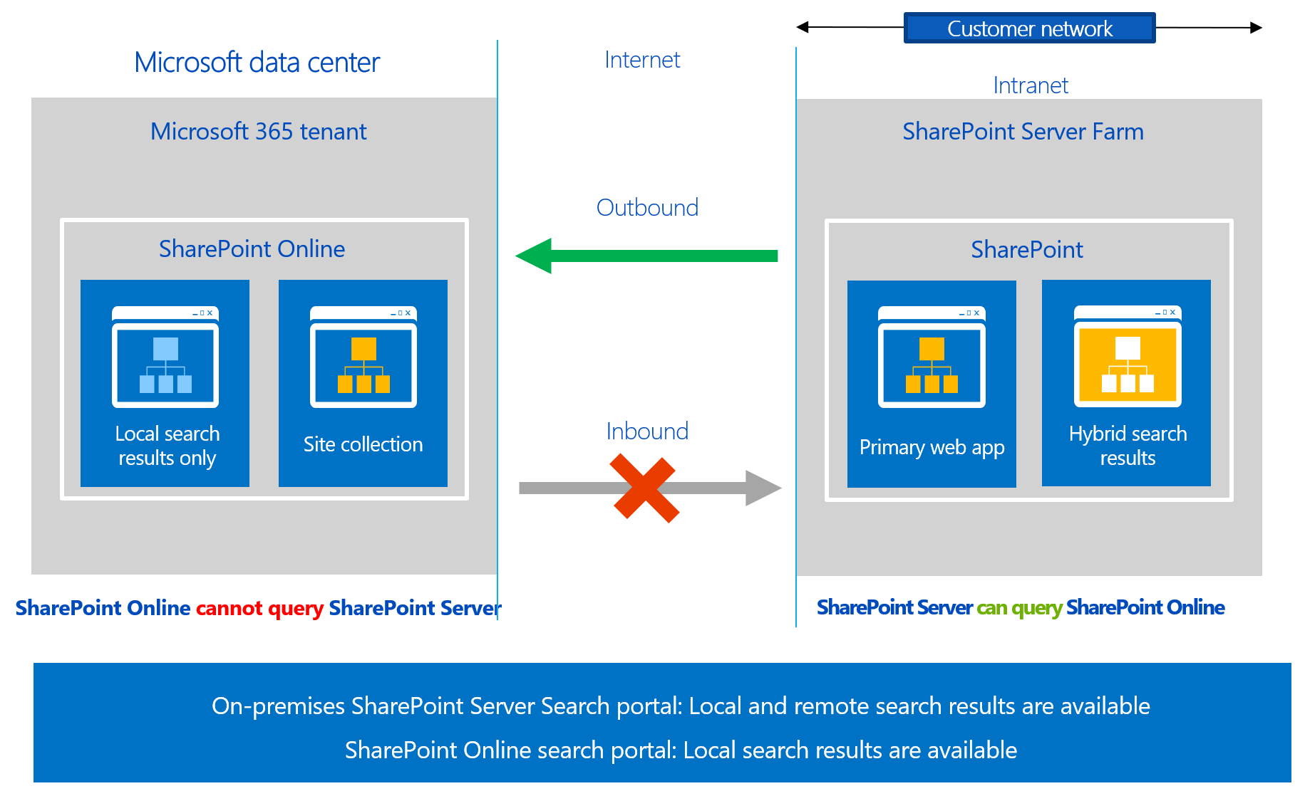
Overview of hybrid federated search - Outbound

Slide 8
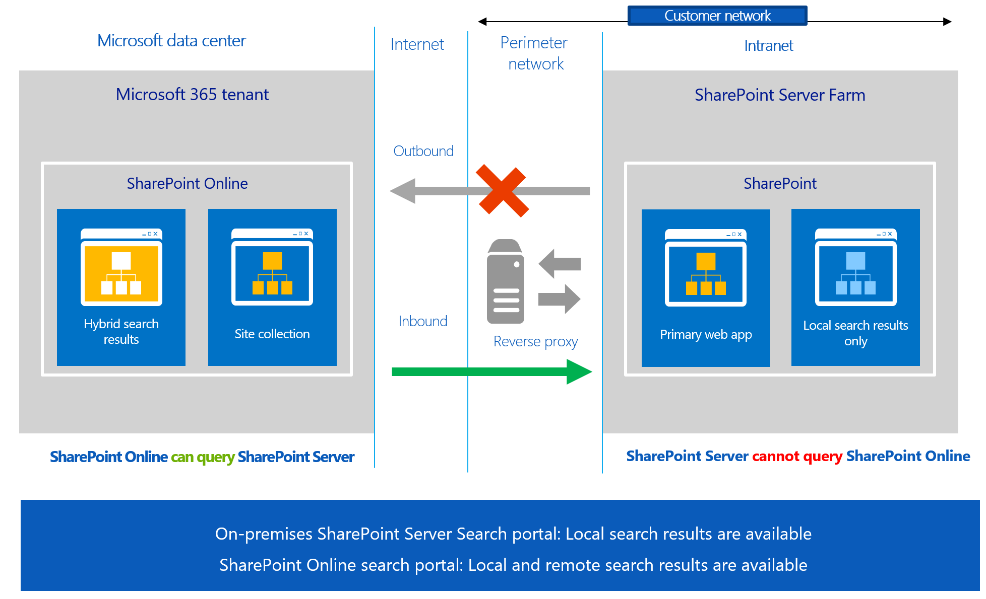
Overview of hybrid federated search - Inbound

Slide 9
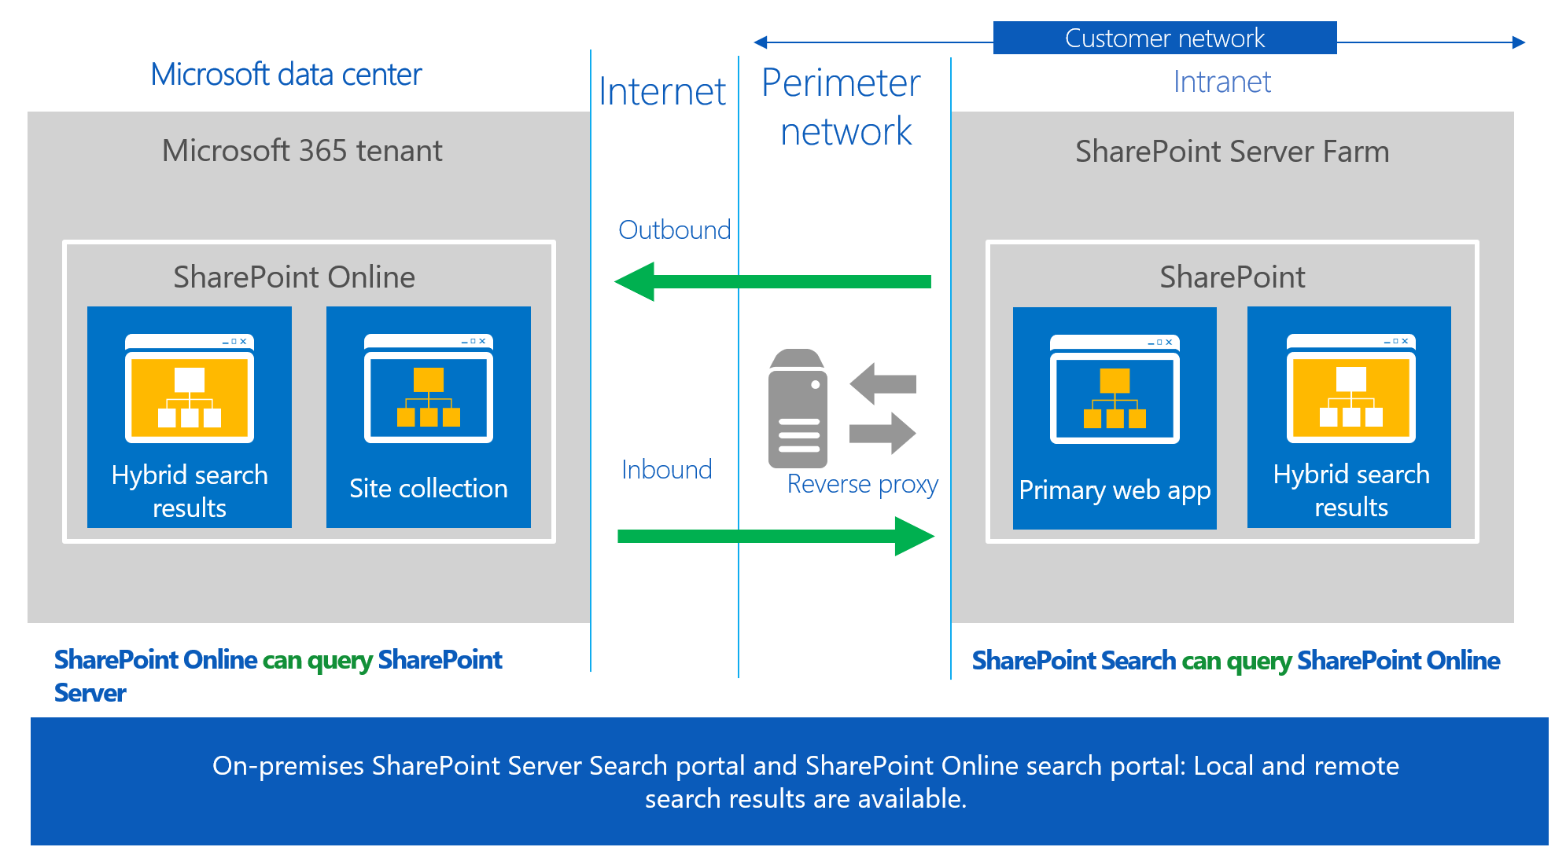
Overview of hybrid federated search - Bidirectional

Slide 10
Lesson 2: Configure SharePoint hybrid search

Slide 11
Lesson Introduction
Overview of hybrid search configuration
Configure server-to-server authentication
Configure cloud hybrid search
Display cloud hybrid search results
Configure hybrid federated search - Outbound
Configure hybrid federated search - Inbound
Configure hybrid search for sensitive data

Slide 12
Overview of hybrid search configuration
Required configuration steps | Cloud Hybrid Search | Outbound Federation Search | Inbound Query Federation
Configure Microsoft 365 for SharePoint hybrid | Yes | Yes | Yes
Set up SharePoint services for hybrid environments | Yes | Yes | Yes
Configure up server-to-server authentication | Yes | Yes | Yes
On-premises Search service application | Yes (Cloud SSA) | Yes | Yes
Configure inbound connectivity | - | - | Yes
Configure a reverse proxy | - | - | Yes
Configure Search results display | Yes | Yes | Yes

Slide 13
Configure server-to-server authentication
Configure the Security Token Service (STS) in SharePoint Server
Install online service management tools on a web server in your SharePoint Server farm.
Configure server-to-server authentication:
Set variables you'll be using in later steps.
Upload the new on-premises STS certificate to SharePoint in Microsoft 365.
Add a Service Principal Name (SPN) to Azure.
Register the SharePoint in Microsoft 365 application principal object ID with on-premises SharePoint Server.
Configure a common authentication realm between your on-premises SharePoint Server farm and SharePoint in Microsoft 365.
Configure an Azure Active Directory application proxy on-premises.

Slide 14
Configure cloud hybrid search
Required configuration steps | Details
Configure Microsoft 365 for SharePoint hybrid | Configure your Microsoft 365 tenant for a hybrid environment, including registering your domain, configuring UPN suffixes, and synchronizing your user accounts.
Set up SharePoint services for hybrid environments | Configure the needed SharePoint services for hybrid search, including User Profiles, MySites, and the Application Management service.
Configure up server-to-server authentication | Configure server-to-server authentication from SharePoint Server to SharePoint in Microsoft 365.
Create a Cloud Search Service Application | Create a cloud Search service application in SharePoint Server then create content sources for cloud hybrid search to crawl. 1. By running the Hybrid Picker wizard. 2. By running the CreateCloudSSA.ps1 and Onboard-CloudHybridSearch.ps1 PowerShell scripts.
Configure Search results display | Create result source and verify that cloud hybrid search works.

Slide 15
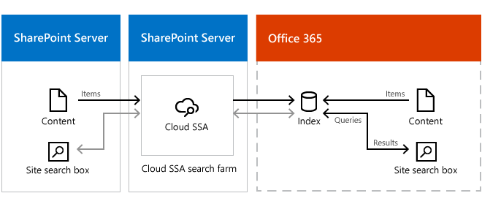
Display cloud hybrid search results
Create a result source that defines how to get search results from the search index in Microsoft 365
Set the result source as the default result source for the cloud Search service application

Slide 16
Configure hybrid federated search - Outbound
Required configuration steps | Details
Configure Microsoft 365 for SharePoint hybrid | Configure your Microsoft 365 tenant for a hybrid environment, including registering your domain, configuring UPN suffixes, and synchronizing your user accounts.
Set up SharePoint services for hybrid environments | Configure the needed SharePoint services for hybrid search, including User Profiles, MySites, and the Application Management service.
Configure up server-to-server authentication | Configure server-to-server authentication from SharePoint Server to SharePoint in Microsoft 365.
On-premises Search service application | Configure on-premises search service application if not already.
Configure Search results display | Configure your search service application to display search results from Microsoft 365.

Slide 17
Configure hybrid federated search - Inbound
Required configuration steps | Details
Configure Microsoft 365 for SharePoint hybrid | Configure your Microsoft 365 tenant for a hybrid environment, including registering your domain, configuring UPN suffixes, and synchronizing your user accounts.
Set up SharePoint services for hybrid environments | Configure the needed SharePoint services for hybrid search, including User Profiles, MySites, and the Application Management service.
Configure up server-to-server authentication | Configure server-to-server authentication from SharePoint Server to SharePoint in Microsoft 365.
On-premises Search service application | Configure on-premises search service application if not already.
Configure inbound connectivity | Configure authentication from Microsoft 365 to SharePoint Server.
Configure a reverse proxy | Configure a reverse proxy device for your on-premises environment.
Configure Search results display | Configure your search service application to display search results from SharePoint Server in Microsoft 365.

Slide 18
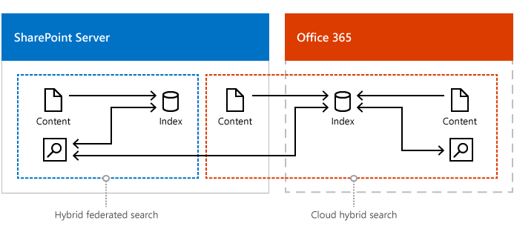
Configure hybrid search for sensitive data
When metadata from sensitive, on-premises content is allowed in the Microsoft 365 index
When metadata from sensitive, on-premises content isn't allowed in the Microsoft 365 index

Slide 19
Lab: Configuring SharePoint Hybrid

