Slide 1
Module 4 : Office 365 Overview

Slide 2
SharePoint Online Overview

Slide 3
Lesson Introduction
SharePoint Online is an Intranet-based website application that allows companies to collaborate and manage content across the span of their network and beyond
Some of the key features of SharePoint Online include:
Local Site management
Hub Sites
Encryption Services
Data Loss Prevention
Anti- Malware Protection
External Sharing

Slide 4
Local Site Management
SharePoint Online allows for its own independent, intranet site collections
Some of the different styles of sites include:
Personal blogs
Community
Company Feed
Site Feed
Wikis
Team Sites
Permission levels play a major role in creating separate sites, as well as segregating and restricting access to content

Slide 5
SharePoint Hub Sites
SharePoint hub sites connect and organize sites based on organizational attributes such as project, department, division, or region. This makes it easier to:
Discover related content such as news and other site activities
Apply common navigation, branding, and site structure across associated sites
Search across all associated sites
SharePoint administrators determine:
How many hub sites can be created in your organization
Who can associate sites with each hub site
Whether associating a site to a hub requires approval
You can add sites to a hub site using either of the following methods:
You can create a new site that is automatically associated with your hub site by selecting Create site in the top right corner of the hub site.
Existing sites can be linked to a hub site through an approved association flow. Hub site owners can set up your SharePoint hub site to automatically evaluate requests for sites before the association takes place.

Slide 6
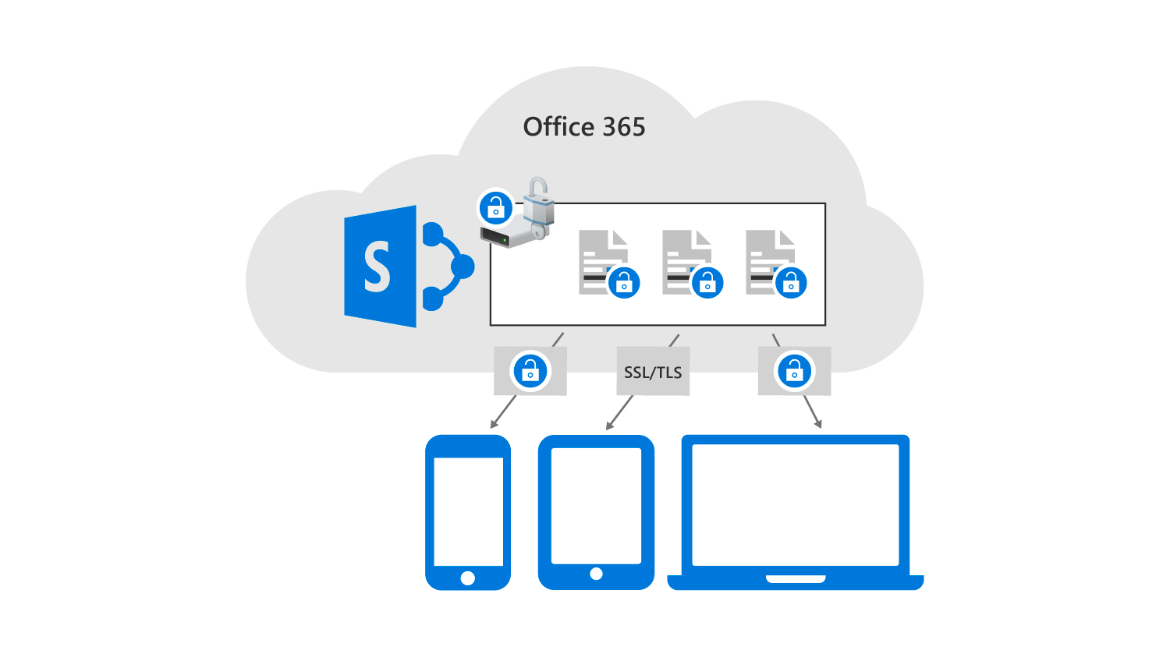
Encryption Services
SharePoint provides encryption for customer data at rest or in-transit based on Rights Management Services
Encryption at rest
Encryption at rest provides BitLocker encryption by default
Per-file encryption
Encryption of data in-transit
Client communication with the server
Data movement between datacenters
The data in the Office 365 datacenter is encrypted at rest, then it's encrypted in transit when downloaded or sent to a client, and it remains encrypted at rest on the external devices

Slide 7
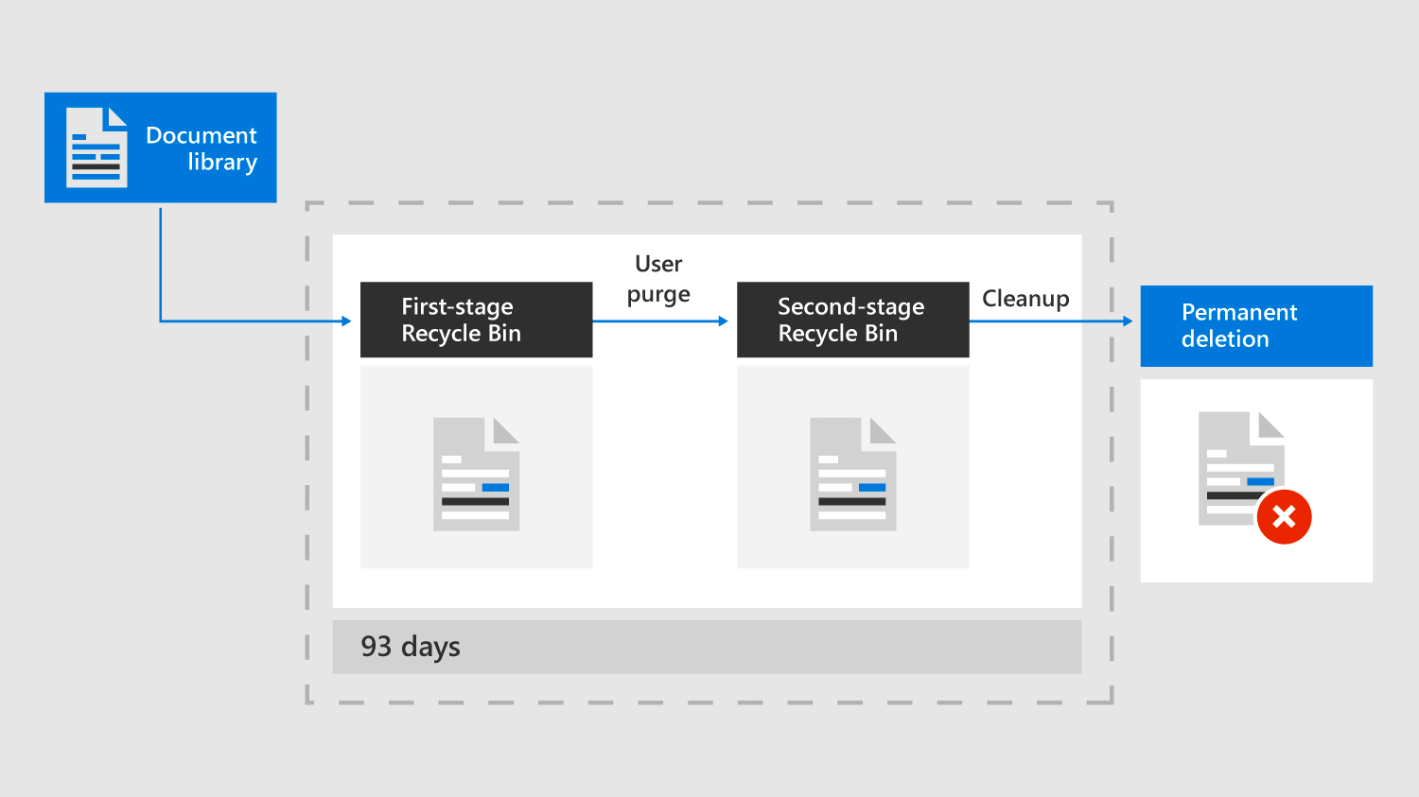
Recovering Deleted Content
SharePoint Online has several options to maintain and recover content that has been deleted or misplaced
A common way to recover deleted content is through the Recycle Bin. There are two types of Recycle Bins in Sharepoint:
Local Recycle Bin
Site Collection Recycle Bin
You can also use versioning to recover content:
Track history of a version
Restore a previous version
View a previous version
Point-in-time recovery is a last resort when trying to restore an item

Slide 8
Anti-Malware Protection
SharePoint Online provides anti-malware protection for files uploaded and saved to document libraries
The following options help provide anti-malware protection:
Layered Defenses Against Malware
Real-time Threat Response
Fast Anti-Malware Definition Deployment

Slide 9
External Sharing
The external sharing features of SharePoint Online lets users in your organization share content:
with people outside the organization (such as partners, vendors, clients, or customers).
between licensed users on multiple Office 365 subscriptions if your organization has more than one subscription.
When users share files and folders, recipients will be prompted to sign in if they have a Microsoft account.
These recipients will typically be added to your directory as guests, and then permissions and groups work the same for these guests as they do for internal users.
External sharing is turned on by default for your entire SharePoint Online environment and the sites in it. You may want to turn it off globally before people start using sites or until you know exactly how you want to use the feature.
SharePoint Online has external sharing settings at both the organization level and the site level (previously called the "site collection" level).
To allow external sharing on any site, you must allow it at the organization level. You can then restrict external sharing for other sites.
If a site's external sharing option and the organization-level sharing option do not match, the most restrictive value will always be applied.

Slide 10
Microsoft Teams Overview

Slide 11
Lesson Introduction
Microsoft Teams brings together conversations, meetings, files, Office apps, and third-party integrations. It provides a single hub for teamwork in Office 365
When planning and implementing Teams you should consider the following:
The Teams’ infrastructure
Teams services in Office 365
User authentication and guest access in Teams
Audio Conferencing
Phone systems and voicemail in Teams

Slide 12
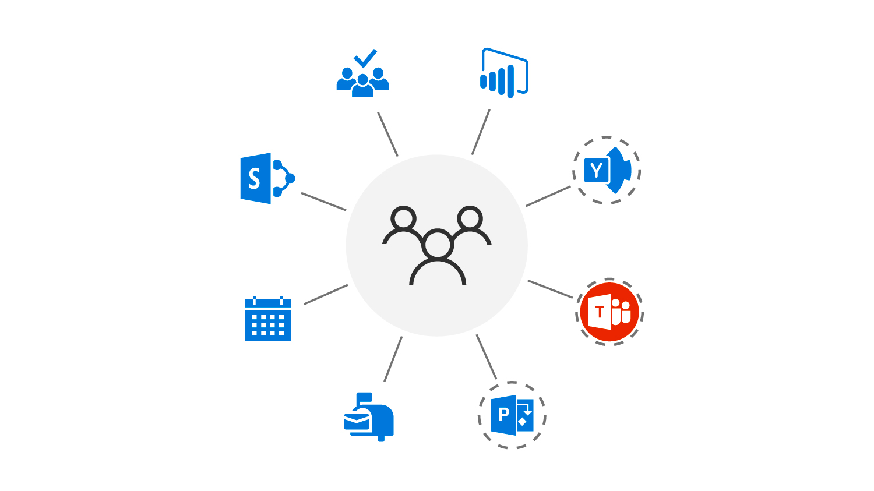
Teams Infrastructure
Microsoft Teams can implement an Office 365 Group, a SharePoint Online site, and an Exchange Online group mailbox
A team can be created using existing Office 365 Groups, allowing existing group memberships and contents stored in SharePoint Online and Exchange Online to be available within Teams
Teams provides a meeting experience built on the next generation, cloud-based infrastructure that is also used by Skype and Skype for Business
To extend Teams capabilities, use Connectors, Tabs, and Bots - available as Apps - to bring external information, content, and intelligent bot interaction to Teams

Slide 13
Using Collaboration Apps in Office 365
Office 365 is designed for the unique workstyle of every group and includes purpose-built, integrated applications, including:
Microsoft Teams as the backbone for enterprise voice and video
Outlook for enterprise-grade email, now with Groups functionality
SharePoint for sites and portals, intelligent content services, business process automation, and enterprise search
Yammer for driving company-wide connections

Slide 14
Authentication and Access
Access to Microsoft Teams can be enabled or disabled on a per-user basis by assigning or removing the Microsoft Teams product license
Microsoft Teams user-level licenses are managed directly through the Office 365 Admin Center
When a license SKU is assigned to a user, a Microsoft Teams license is automatically assigned, and the user is enabled for Microsoft Teams

Slide 15
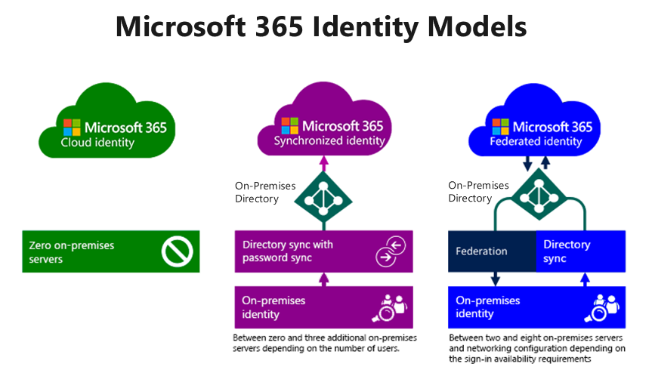
User Authentication
Microsoft Teams supports all the identity models that are available with Microsoft 365, including:
Cloud Identity
Synchronized Identity
Federated Identity

Slide 16
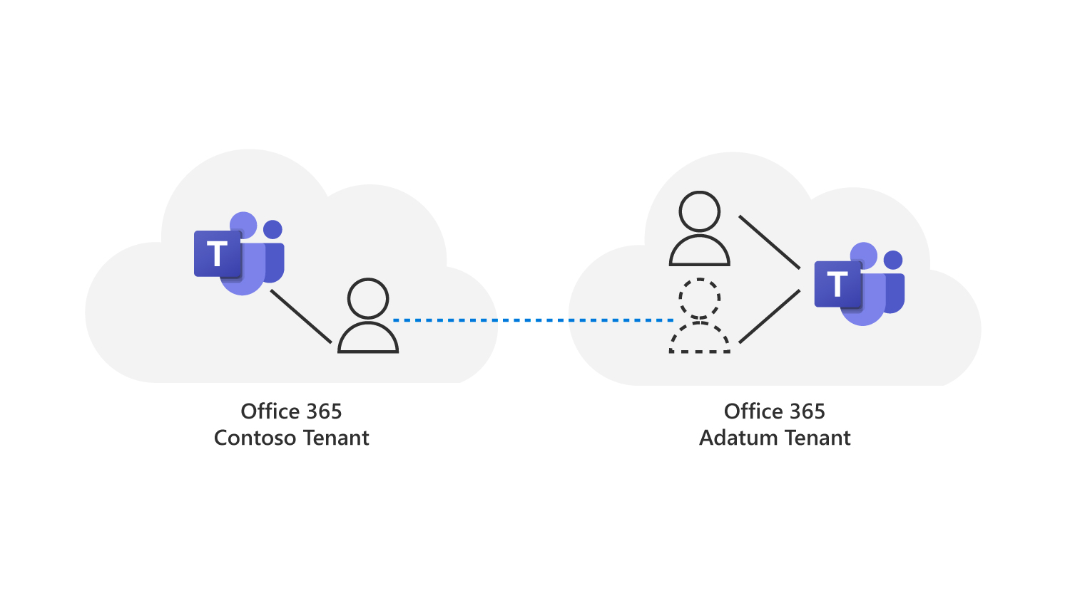
Guest Access
Guest access in Microsoft Teams allows teams in your organization to collaborate with people outside your organization
Guest access is included with all Office 365 Business Premium, Office 365 Enterprise, and Office 365 Education subscriptions - No additional Office 365 license is necessary
Organizations using Teams can provide external access to teams, documents in channels, resources, chats, and applications to their partners, while maintaining complete control over their own corporate data
For guest access to work, users in each tenant need access to Teams (licenses), and guest users (the dotted user) must use their own Azure AD user accounts from their originating tenant to access the remote Teams resources in another tenant.

Slide 17
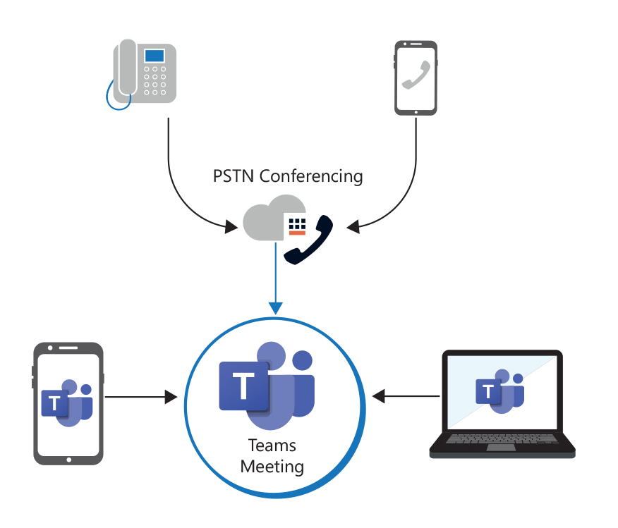
Audio Conferencing
Anyone who has the dial-in number and conference ID can join a Microsoft Teams meeting
Whether you are calling in using a phone or the Microsoft Teams apps, you can hear everyone else on the call, and they can hear you
Audio Conferencing in Office 365 supports international dial-in conferencing
Participants of a meeting can join through the Teams app on different devices, or through a phone from any device that can call into PSTN.

Slide 18
Managing Audio Conferencing
To configure your organization’s users for audio conferencing, you first must assign an audio conferencing license to each user and then assign a conference ID
You must use the Office 365 Admin Center to assign audio conferencing licenses
A conference ID is automatically assigned to a user when they are set up for audio conferencing using Microsoft as the audio conferencing provider
Static IDs are used when people in your organization don't want to remember a random number

Slide 19
Managing User Settings for Audio Conferencing
You can edit the Audio Conferencing settings for an individual user in your organization
These settings include options such as the audio conferencing provider, default toll or toll-free number, conference ID, and PIN

Slide 20
Implementing Phone System in Teams
Before your organization implements calling within Microsoft Teams, it must analyze its business requirements in relation to the Teams’ calling features. These include:
Connecting to the PSTN
Service availability and user locations
Phone System licensing
Phone numbers and emergency locations
Voicemail
Optional: Calling identity
Optional: Dial plans

Slide 21

Discussion – Office 365 Adoption Strategies
Adatum has begun transitioning to Microsoft 365 as their hosted cloud solution. One of Adatum’s largest suppliers, Fabrikam Inc., has also started transitioning to Microsoft 365.
Up to this point, the two companies have been using email as their primary method of collaboration. However, a string of successful spear phishing attacks has led them to re-evaluate their dependence on this method of communication.
As Adatum’s Enterprise Administrator (EA), you have been asked by your CEO to work with Fabrikam’s EA to design a new method of collaboration between the two organizations that is not mail dependent.
Now that you have reviewed Exchange Online, SharePoint Online, and Microsoft Teams and have a better understanding of their collaboration features, what type of problems could you foresee when implementing this request?
What adoption strategies could you put in place to have the employees adhere to your provided solution?

Slide 22
Power Platform Overview

Slide 23
Lesson Introduction
Microsoft’s Power Platform provides users with the following tools that can be used to create solutions that accelerate their business:
Power Apps
Power Automate
Power BI
Power Virtual Agents
This lesson provides an overview of the Power Platform tools so that you can see how they work together.
Each tool will be covered in detail in the upcoming lessons.

Slide 24
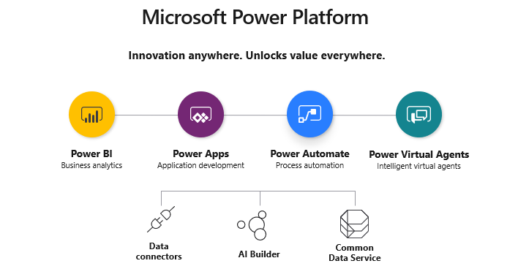
Introduction to Power Platform

Slide 25
Power Platform Administration
The Power Platform Admin Center provides a unified portal for administrators to manage environments and settings for Power Apps, Power Automate, and Power BI.
The Power Platform Admin Center provides the following capabilities:
Help and support
Analytics
Environments
Data Integration
Data Gateways
Data Policies
Notes:
Use this slide to demonstrate the Power Platform Admin Center and display and discuss these features in the bulleted list. You should also mention this to students: The Power Platform admin center also includes links to the product specific admin centers, including the Power Apps admin center. Over time, features from the Power Apps Admin center are being migrated to the Power Platform Admin center. Until the move to the Power Platform Admin center is complete, admins can manage environments and settings in the Power Apps Admin center.

Slide 26
Power Platform Security Overview
The Power Platform security model includes the following features:
Authentication
Licensing
Security Roles
Sharing
Environments serve as containers to separate apps that may have different roles, security requirements, or target audiences.
When users create an app in an environment, that app is only permitted to connect to the data sources that are also deployed in that same environment, including connections, gateways, flows, and Common Data Service databases.
Environments have two built-in roles that provide access to permissions:
Environment Admin role
Environment Maker role
Environments
Connector permissions
Advanced security in CDS instances
DLP policies

Slide 27
Power Apps Overview

Slide 28
Lesson Introduction
Power Apps provides a rapid, low code development environment for building custom apps that satisfy business needs and support integration and interaction with existing data.
Power Apps provides a simple user interface so that every business user or professional developer can build custom apps.

Slide 29

Introduction to Power Apps
Microsoft PowerApps is a service that lets you build business apps that run in a browser or on a phone or tablet, and no coding experience is required.
There are three types of PowerApps:
Canvas apps
Model-driven apps
Portals

Slide 30
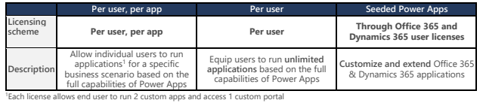
Power Apps Administration
Admins can manage environments and settings in the Power Apps Admin center.
There is an additional layer of administration through the Power Apps Portals admin center.
The Power Apps Portals admin center is available only when a portal is provisioned successfully, which enables the admin to perform advanced administrative actions on portals.
Licensing is on a per user and per user/per app basis.
Notes:
Use this opportunity to demonstrate the Power App admin center. Also mention that over time, features from the Power Apps Admin center are being migrated to the Power Platform Admin center. Until the move to the Power Platform Admin center is complete, admins can manage environments and settings in the Power Apps Admin center. Examples of items that may not yet be available on the Power Platform Admin center include the option for admins to view and download tenant specific information (user licenses and quotas) and some environment-specific resource views.

Slide 31
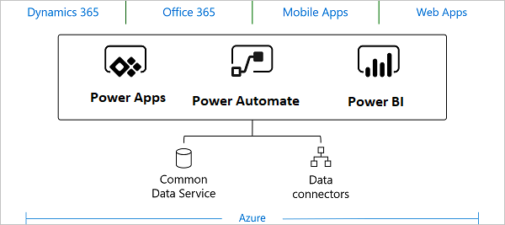
Connecting Power Apps to Data
Connectors act as a bridge from the data source to the Power App (or workflow in Power Automate), thereby allowing information to be transported back and forth.
Power Apps supports over 275 connectors for popular services and on-premises data sources, including SharePoint, SQL Server, Office 365, Salesforce, and Twitter.
Connections to on-premises data sources, such as an on-premises SharePoint service, require the use of an on-premises data gateway.
When an app or workflow creates a connection to a data source, the connector typically requires some form of authentication.
The Common Data Service is a type of data source that lets you securely store and manage data that is used by business applications.

Slide 32
Creating a Canvas Power App
There are three ways to start creating a canvas Power App:
Start from blank
Start from a template
Start from data
When starting with a blank canvas, the app creator can add data sources to the app by either adding controls or connecting to a data source.
Controls are the user interface elements of the application, whose properties can be configured for appearance and behavior. The app creator builds the canvas app by adding controls.
Saving changes to a canvas app automatically publishes them only for the app creator and anyone else who has permissions to edit the app.
When an app creator finishes making changes, he or she must explicitly publish the changes to make them available to everyone with whom the app is shared.
Once the app is published, the app creator can specify which users in the organization can run the app and which users can modify and even reshare the app.
Notes:
Demonstrate how to start an app and show them the three panes in Power Apps Studio.

Slide 33
Running a Power App
The process of running a Power App varies depending on the app type.
Canvas apps can be run on mobile devices, SharePoint Online, and Microsoft Teams.
App creators that are part of Microsoft Partner Network can share a canvas app with customers to generate leads for their business by using AppSource.com and Power Apps Test Drive solutions.
Model-driven apps run on a mobile device using the Dynamics 365 mobile app (the Power Apps mobile app cannot be used to run a model-driven app).
If a user does not have the Dynamics 365 app for phones and tablets installed, the app can be run on a web browser on a tablet, as long as the device has a sufficiently high screen resolution.
Notes:
Demonstrate how to start an app and show them the three panes in Power Apps Studio.

Slide 34
Power Automate Overview

Slide 35
Lesson Introduction
Power Automate provides a low-code platform for building workflow and process automation.
In this lesson, you will learn how to use Power Automate to build a workflow that meets your business needs and interacts with your business data.
You will also learn how to administer Power Automate.

Slide 36

Introduction to Power Automate
Microsoft Power Automate is an online workflow service that enables an organization to work smarter and more efficiently by automating workflows across its most common apps and services. Workflow examples include:
Instantly respond to high-priority notifications or emails
Capture, track, and follow up with new sales leads
Copy files from one service to another
Collect data about your business and share that information with your team
Automate approval workflows
You can create the following types of flows in Power Automate:
Automated flows
Instant flows
Scheduled flows
Business process flows
UI flows
Notes:
Mention that Power Automate was formerly known as Microsoft Flow. Some students may have been familiar with Flow and are wondering how it relates to Power Automate.

Slide 37
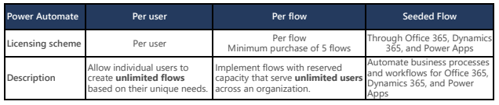
Power Automate Administration
General purpose Power Automate capabilities are licensed on a standalone basis.
Limited Power Automate capabilities are also included within Power Apps, Office 365, and Dynamics 365 licenses.
Administrators use the admin center to create and manage additional environments, which are spaces to store, manage, and share your organization’s business data, apps, and flows.
Benefits provided by environments include:
Data locality
Data loss prevention
Isolation boundary for all resources
Common data source

Slide 38
Connecting Flows to Data
Power Automate is similar to Power Apps in that it uses connectors to act as a bridge from the data source to the workflow.
Connectors can either be public or custom.
Connectors make triggers and actions available that can be used by flows.
Triggers are used by flows to start the execution of the workflow.
Actions are used by flows to perform a defined set of actions during execution.
Some of the triggers that are more commonly used in flows include:
When an item is created
When an item is created or modified
When an item is deleted
Some of the actions that are more commonly used in flows include:
Add an attachment
Copy a file
Check in a file
Check out a file

Slide 39
Creating a Flow
There are three ways to start creating a flow:
Start from blank
Start from a template
Start from a connector
The Power Automate Designer is a feature-rich tool that enables users to configure every detail of flow logic.
The following elements are used when creating a flow:
Triggers
Actions
Dynamic content
Peek code
Functions
Advanced functionality
The Flow Checker checks for any errors or warnings in your flow and calls out the actions where the errors or warnings occur.

Slide 40
Running a Flow
Once a flow is saved without errors, it is active and available to run when the trigger condition is satisfied.
Button (instant) flows run when manually triggered.
Flows can be scheduled to run when a trigger condition occurs, or they can be run immediately by pressing the Run button.
Flows can be shared with other users as co-owners or run-only users.
When a user adds another user or group as an owner of a flow, that flow becomes a team flow (which only show up under Team flows). Co-owners of the flow can also modify the flow using the connections that already exist.
Run-only sharing is an option when the flow is manually triggered (button flows). The user with whom the flow is shared can only run it; the user cannot edit the flow.
Flows can be run from the following sources:
A flow can be executed from within SharePoint when a flow containing a SharePoint List is shared.
Users can create, manage, and run flows from within Microsoft Teams.
Power Automate flows can be created, managed, and run from the Power Automate mobile phone app.

Slide 41
Power BI Overview

Slide 42
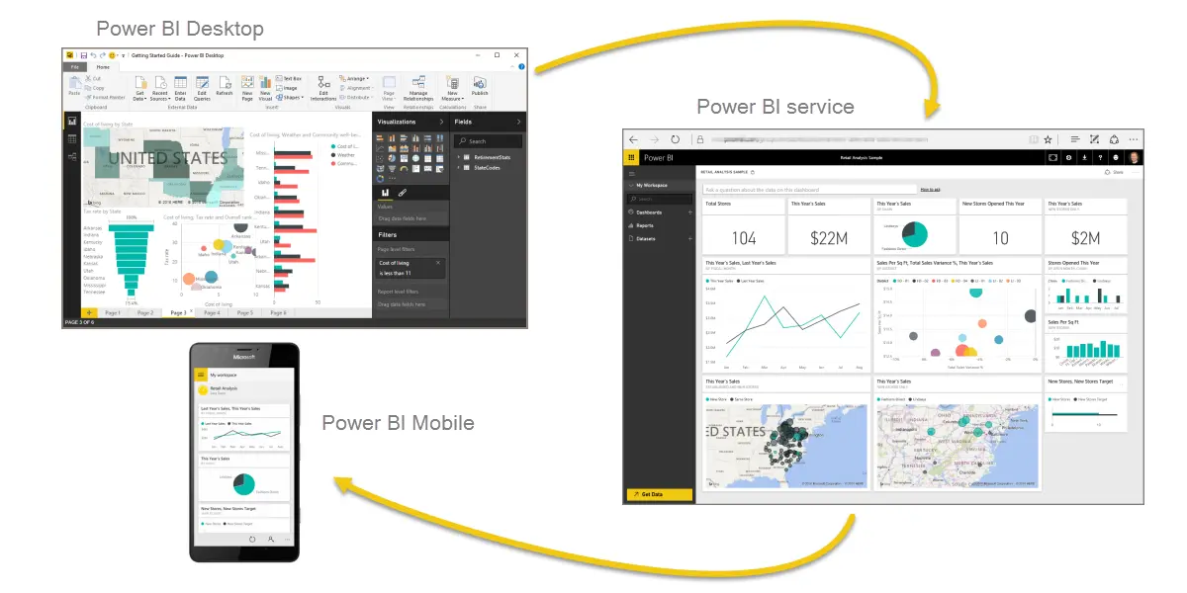
Lesson Introduction
Microsoft Power BI (Business Intelligence) is a collection of software services, apps, and connectors that work together to turn your unrelated sources of data into coherent, visually immersive, and interactive insights.
In this lesson, you will examine how to:
Connect Power BI to data
Create a Power BI report
Create a Power BI dashboard
Share and view a Power BI report

Slide 43

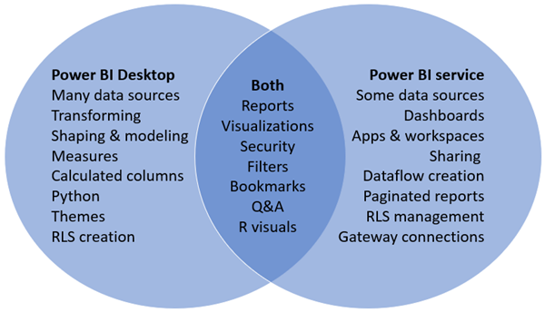
Introduction to Power BI
Microsoft Power BI is a suite of business analytics tools that deliver insights throughout your organization.
Power BI enables your users to:
Connect to hundreds of data sources
Simplify data prep
Drive ad hoc analysis
Produce reports and publish them for your organization to consume on the web and across mobile devices
Create personalized dashboards with a unique, 360-degree view of their business.
Scale across the enterprise, with governance and security built-in

Slide 44
Power BI Administration
Global admins and Power BI service admins can access the following Power BI-related information in the Power BI portal:
Power BI licensing is on a per-user basis; the following options are available:
Per-user – Power BI Pro and Power BI free licenses. A free license enables a user to consume content in a workspace assigned to a Power BI Premium license and access to some of the features of the Power BI service for their own personal content in their My Workspace.
Power BI Premium licensing. Provides dedicated capacity to deliver more consistent performance and support larger data volumes in Power BI. Enables widespread distribution of content by Power BI Pro users without requiring users who view the content to have Power BI Pro licenses.
Usage metrics
Power BI users, groups, and admins
Audit logs
Tenant settings
Capacity settings
Embed codes
Organization visuals
Dataflow settings
Workspaces
Custom branding

Slide 45
Connecting Power BI to Data
Power BI Desktop supports three methods for connecting to data:
Import - With this method, the selected tables and columns from the data source are imported into Power BI Desktop.
As a user creates or interacts with a visualization, Power BI Desktop uses the imported data.
To see underlying data changes since the initial import, the user must refresh the data by re-importing the full dataset.
DirectQuery - No data is imported or copied into Power BI Desktop when using DirectQuery.
As the user creates or interacts with a visualization, Power BI Desktop queries the underlying data source, so the data being viewed is always current.
Live Connection - A live connection can be used in the following scenarios:
A user connects to a dataset that has been shared/published to the Power BI service for the purpose of creating new reports.
A user connects to Common Data Services and SQL Server Analysis Services (which also supports import).

Slide 46
Creating a Power BI Report
While Power BI reports can be created in either Power BI Desktop or the Power BI service, creating a report in Power BI desktop is the more common workflow.
When Power BI Desktop is opened, the user is presented with a blank canvas, which is where the user creates reports and visuals from his or her data.
The steps to creating a Power BI report include:
Step 1 – Importing Data. The user selects the data source to which Power BI Desktop can connect. The data is then displayed in the Fields pane.
Step 2 – Creating Visuals. The user must select the type of visualization he or she desires. Dragging data fields onto the bottom portion of the Visualizations pane builds and organizes the visual.
Step 3 – Sharing a Report. When publishing a report, the user must select the destination from the list of workspaces.
Once the report is published, the report creator and the users with whom the report has been shared who possess edit privileges can create a Dashboard based on the report’s visuals.

Slide 47
Creating a Power BI Dashboard
A Power BI Dashboard is a selected group of visuals within the Power BI service that originate from one or more reports to provide quick insight into the data being presented.
A dashboard must fit on a single page, often called a canvas.
To create a dashboard, the user must:
Access a report that he or she either owns or has been given edit privileges to.
Open the report in edit mode and hover over a visual on the report to reveal the pin icon.
Select the pin icon to open the Pin to dashboard dialog box, which asks the user if the visual is to be pinned to a new or existing dashboard.
The user can continue to add visuals to the dashboard. Alternatively, the user can pin an entire report page to the dashboard.

Slide 48
Sharing and Viewing a Power BI Report and Dashboard
Sharing gives selected people access to dashboards and reports so they can view and interact with the shared content.
A Power BI Pro license is required to share content. Recipients also need Power BI Pro licenses, unless the content is in a Premium capacity.
When a user shares a dashboard or report, the people with whom it is shared can view it and interact with it, but they cannot edit it.
They see the same data as the owner or person who shared the content, unless row-level security (RLS) is applied.
Users within the organization with whom the content is shared can also reshare it if that option is configured.
Resharing is not allowed when content is shared externally.
Reports and dashboards can also be added as tabs to Teams channels, and they can be embedded as a report web part with SharePoint Online.
Once a report or dashboard is shared, the recipient can view and interact with the content using the Power BI service.

Slide 49
Power Virtual Agents Overview

Slide 50
Lesson Introduction
Power Virtual Agents empowers teams to easily create powerful bots using a guided, no-code graphical interface without the need for data scientists or developers.
This is the latest pillar in the Power Platform. This lesson simply introduces you to the product functionality and walks you through the steps on how to create a bot.

Slide 51
Introduction to Power Virtual Agents
Power Virtual Agents addresses many of the major issues with bot building in the industry today:
It eliminates the gap between the subject matter experts and the development teams building the bots, and the long latency between teams recognizing an issue and updating the bot to address it.
It removes the complexity of exposing teams to the nuances of conversational AI and the need to write complex code.
It minimizes the IT effort required to deploy and maintain a custom conversational solution.
Key features of Power Virtual Agents include:
Get started in seconds
Empower your subject matter experts
Enable rich, natural conversations
Enable bots to take action
Monitor and improve bot performance

Slide 52
Creating a Bot using Power Virtual Agents
Creating a bot from start to finish is a five-step process:
Create the bot. This is the overlying structure that you will assign your conversation to.
Create a topic for the bot. A topic is basically a conversation. Once you create the bot, you will create the topic, which is the dialog tree that specifies how your bot responds to a user's question.
Test the bot. Once you have your conversation authored into a topic, you can test it out in real time to see if it’s working as you expected.
Publish the bot. Once you are satisfied with the content authored in your bot, you can publish your bot to a website.
Analyze the performance of your bot. Once your bot has completed interactions with users, statistics are available that you can review to analyze how well the bot performed.
Notes:
You should use this time to demonstrate how to create a bot from steps 1 through 5 by performing the steps outlined in the student manual.

Slide 53
Additional Resources Overview

Slide 54
Lesson Introduction
Additional services in Office 365 include:
Sway
Planner

Slide 55
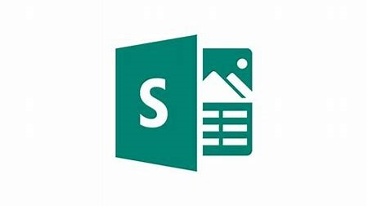
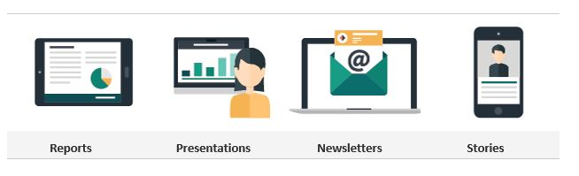
Introduction to Sway
Microsoft Sway is a free app that lets you create and share interactive reports, presentations, personal stories, newsletters, vacation memories, school and work projects, and more
Sway allows users who have a Microsoft account to combine text and media to create a presentable website

Slide 56

Introduction to Planner
Microsoft Planner is a planning application in Office 365 that enables you to organize your work, manage and assign tasks, and collaborate with your teams
With Microsoft Planner, you can create a plan, build a team, assign tasks, and update status
With Microsoft Planner, everyone can see who is working on what projects at all times
You can organize your tasks by adding one or more Planner tabs to a team channel in Teams

Slide 57
Device Management Overview

Slide 58
Lesson Introduction
In Microsoft 365, device management is administered through Microsoft Intune, which manages mobile devices and apps
Intune offers both mobile device management (MDM) and mobile application management (MAM) capabilities
This lesson introduces you to device management and specifically to Microsoft Intune, as well as the following supporting features:
Security baselines
Conditional access

Slide 59
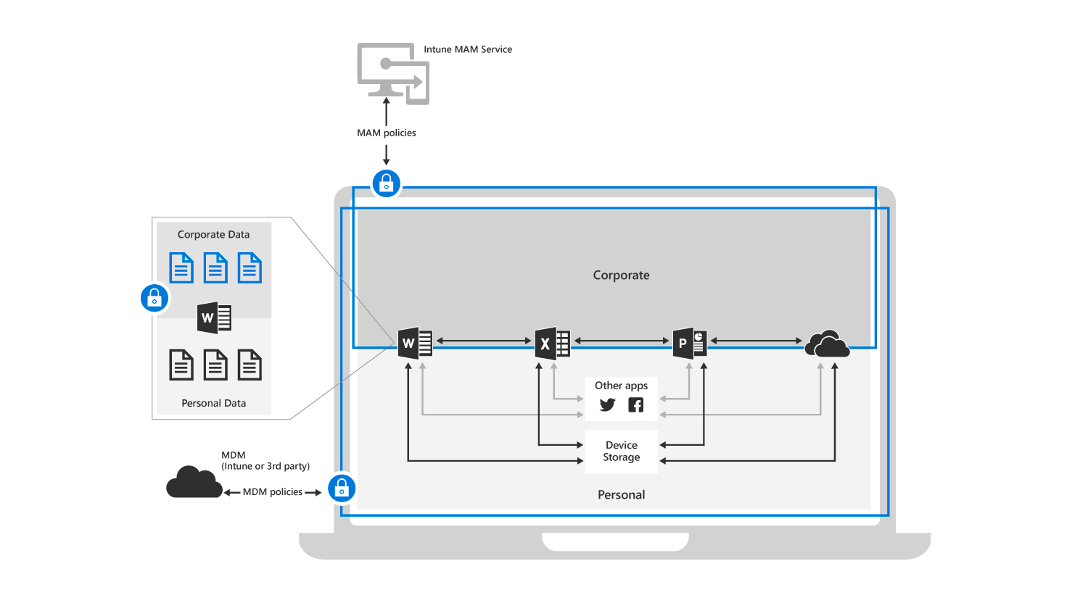
Introduction to Device Management
Microsoft Intune is the Microsoft 365 component designed to protect and secure your organization’s resources and data by:
Managing the mobile devices and PCs your workforce uses to access company data
Managing the mobile apps your workforce uses
Protecting your company information by helping to control the way your workforce accesses and shares it
Ensuring devices and apps are compliant with company security requirements
Device management solutions provided through Intune include:
Mobile device management (MDM)
Mobile application management (MAM)
Diagram showing the layers of protection that MDM and MAM protection policies offer together

Slide 60
Using Security Baselines to Secure Devices
A security baseline is a default set of Microsoft-recommended configuration settings within Intune that will help you secure and protect your users and devices
These settings are based on feedback from Microsoft security engineering teams, product groups, partners, and customers
You deploy security baselines to groups of users or devices in Intune, and the settings apply to devices that run Windows 10 or later
Benefits of using security baselines include:
Implementing best practices and recommendations designed by industry-leading security experts
If you're new to Intune and not sure where to start, then security baselines enable you to quickly create and deploy a secure profile
If you currently use group policy, migrating to Intune for device management is much easier with these baselines, which are natively built in to Intune and include a modern management experience
When a default value doesn’t work for your environment, you can customize the baseline to apply the settings you need

Slide 61
Using Conditional Access to Manage Devices and Apps
Conditional Access is an Azure AD feature that works with Intune to enable you to control the devices and apps that are allowed to connect to your email and company resources based on location, device, user state, and application sensitivity
Conditional Access provides granular access control while giving users an experience that allows them to do their best work from any device, and from any location
There are two types of Conditional Access with Azure AD and Intune:
Device-based Conditional Access. Ensures that only managed and compliant devices can access company resources. You can optionally set a policy in Azure AD to only enable computers that are domain-joined, or mobile devices that are enrolled in Intune to access Office 365 services.
App-based Conditional Access. Intune app protection policies help protect your company data on devices that are enrolled into Intune. You can also use app protection policies on employee-owned devices that are not enrolled for management in Intune.

Slide 62
Discussion – Office 365 Collaboration
Your team is supporting a political campaign, whose campaign manager has decided to use Microsoft 365 to support the campaign.
He wants your team to come up with a strategy for collaboration so that he can maximize the use of his Microsoft 365 E5 subscriptions.
Your team consists of an Exchange Administrator, Security and Compliance Administrator, and Teams Administrator.
Devise a strategy for each administrator that uses all the Office 365 services that will get the most out the Microsoft 365 tenant.
Notes:
Suggested strategies: Starting with Teams administrator, you could create several Team breakout groups for intercommunications between the campaign employees. All work source material will be stored in the Team’s storage repositories.
Then you could have the Exchange administrator create several policies to keep the campaign’s outbound and inbound mail flow integrally secure, and you could show managers how to create proper distribution lists for constituents.
Finally, the Security and Compliance administrator could set up alerts along with audits to keep track of critical and marginal issues that may arise. He would also assist with probing for possible weaknesses by using the Attack Simulator to target random groups that could possibly be vulnerable for leaks.

Slide 63
Discussion – Module Review
What are your key takeaways from this module, and why?
What are the key features discussed in this module that you foresee implementing at your organization?

