Slide 1
Module 2: Configuring Your Microsoft 365 Tenant

Slide 2
Module Agenda
Configuring Your Microsoft 365 Experience
Lab 1-Exercise 1 – Initialize your Microsoft 365 Tenant
Managing User Accounts and Licenses in Microsoft 365
Managing Security Groups in Microsoft 365
Lab 1-Exercise 2 – Manage Users and Groups
Implementing Your Domain Services
Lab 1-Exercise 3 – Add a Custom Domain
Leveraging FastTrack and Partner Services

Slide 3
Lesson 1: Configuring Your Microsoft 365 Experience

Slide 4
Lesson Introduction
When configuring your Microsoft 365 tenant, you should know how to:
Set up your organizational profile
Manage your tenant’s subscriptions
Manage your services and add-ins
Finalize your tenant

Slide 5
Setting up Your Organization Profile
Completing your company’s Organization profile is essential for setting up your company’s tenant
You should use the Microsoft 365 Admin Center to edit your organization profile
You must be a Global Admin to edit the Organization profile
You can't change the country or region for your subscription
The country or region where your organization is headquartered determines which services are available to you, the taxes and billing currency, and the location of the data center.
To change your organization's country or region, sign up for a new account, choose the desired country or region, and purchase a new subscription.

Slide 6
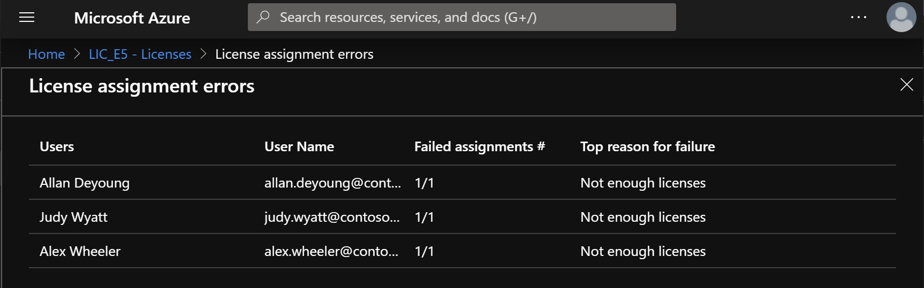
Managing Your Tenant Subscriptions
Maintaining minimum subscription requirements for your company is essential to remaining functional
You can review all active and deprovisioned licenses from the Subscriptions page located under the Billing tab in the Admin Center
Purchasing additional licenses changes the monthly billing date
Additional actions that can be performed from the Subscriptions page include:
Add a partner of record
Add a subscription
Convert a subscription
Purchasing an insufficient number of licenses can result in implementation delays

Slide 7
Managing Your Services and Add-ins
You may need to assign additional licenses, such as Project Online, Visio, or SharePoint Design
These add-on services can be found in the Purchase Services tab, which is located under the Billing section of the Microsoft 365 Admin Center
Some of the subscriptions provide a standard 30-day trial before the service add-on becomes degraded and must be paid for

Slide 8
Finalizing Your Tenant Configuration
You should use the following checklist when finalizing the configuration of your Microsoft 365 tenant:
Have all the users been moved over to Microsoft 365?
Do the users have a functional mailbox and has their data been migrated to their account?
Have all the resources been created?
Have all permissions been established?
Has the vanity domain(s) been moved successfully?
Have all Windows 10 devices been enrolled to Intune?
If the company has SCCM, has co-management been established with Intune?
Has your company established proper governance policies for mobile devices?
Have the DNS records been updated and published globally?
If Azure Active Directory Connect is in place, is the connector properly configured?
If Multi-Factor Authentication is employed, has it been properly configured?
Are the mailing policies in place to protect inbound and outbound mail flow?
Is the Organizational profile set up with the correct information?

Slide 9
Lesson 2: Lab 1 - Exercise 1

Slide 10

Lab Exercises
Lab Introduction
IMPORTANT: Read through the lab introduction that appears in the student manual before you start the labs.
Exercise 1: Initialize your Lab Environment
Task 1 - Obtain Your Office 365 Credentials
Task 2 - Set up the Organization Profile
Task 3 – Prepare for Microsoft Azure Active Directory
Task 4 – Prepare for External Access using Microsoft Teams

Slide 11
Lesson 3: Managing User Accounts and Licenses in Microsoft 365

Slide 12
Lesson Introduction
As the Administrator of your organization’s Microsoft 365 environment, you will be responsible for creating and managing user accounts for all your users.
This includes:
Understanding user identities
Creating user accounts
Managing user accounts
Managing user licenses
Recovering deleted user accounts

Slide 13
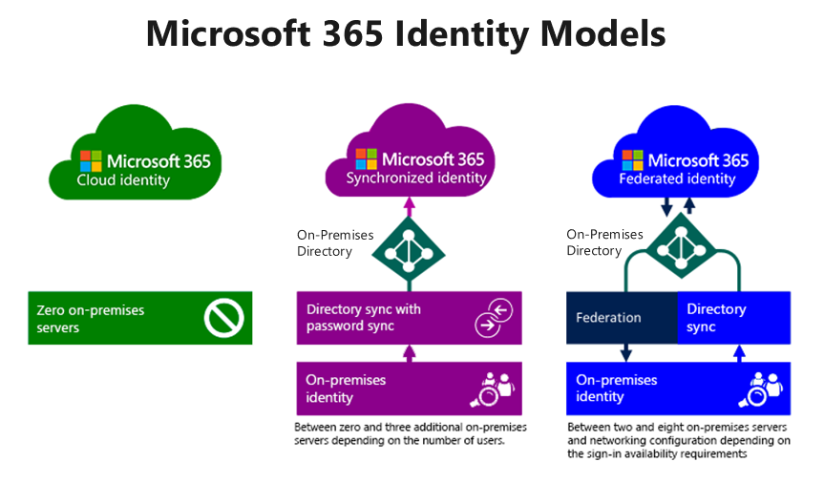
Overview of User Identities
To plan user identities, you must first understand the different user identities in the Microsoft 365 Identity Model:
Cloud identities
Synchronized identities
Federated identities

Slide 14
Creating User Accounts
Depending on your needs, you can use the following methods to provision user accounts:
Microsoft 365 admin center
Import multiple users
Windows PowerShell
Directory synchronization

Slide 15
Managing User Accounts
Managing user accounts involves managing several account settings, such as:
Assigning administrator roles
Setting users’ sign-in status
Specifying user location settings
Assigning licenses
You can use the Microsoft 365 admin center to edit single or multiple users

Slide 16
Managing User Licenses
One of the most basic tasks for Microsoft 365 Administrators is to manage users and manage their licenses
Your organization’s users need licenses to use Microsoft 365 services such as Outlook, SharePoint Online, and Skype for Business Online
When you assign a license to a user, the service is automatically set up for that user
Only members of the Microsoft 365 Global admin and User Management admin roles can assign or remove licenses
To assign a license, you can use the Microsoft 365 admin center or Windows PowerShell

Slide 17
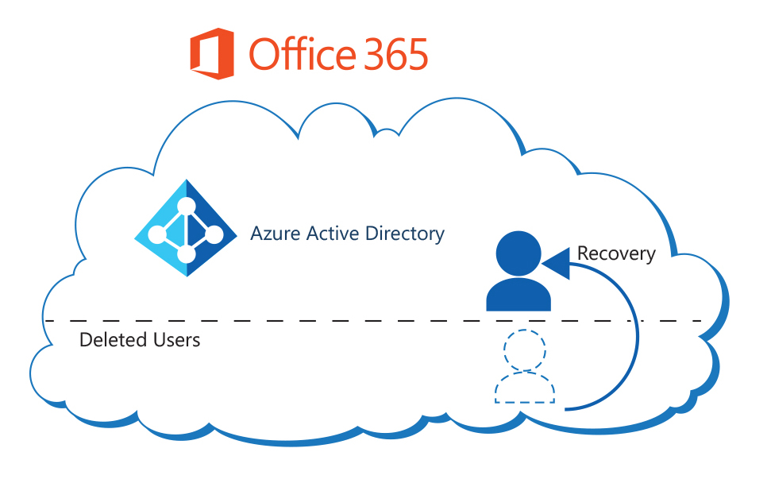
Recovering Deleted User Accounts
When users leave your organization, they usually no longer require a user account in Microsoft 365
When you delete a user account, the assigned Microsoft 365 license for that user becomes available, which you can assign to another user
When you delete a user account, the account becomes inactive and the user cannot sign in to access Microsoft 365 services
Microsoft 365 retains the account as a “soft deleted” inactive account for 30 days after deletion; this enables you to restore the account if necessary
You can restore deleted user accounts using the Microsoft 365 admin center or Windows PowerShell (by using the Restore-MsolUser cmdlet)
Deleted users are still a part of their managed tenant.
A recovery operation simply re-activates the Azure AD user.

Slide 18
Lesson 4: Managing Security Groups in Microsoft 365

Slide 19
Lesson Introduction
After you create your users for the Microsoft 365 tenant, you can optionally create groups for distributing email to multiple users with Exchange Online.
To do this you need to:
Understand groups in Microsoft 365
Understand how to create and manage groups
Understand how to use Azure AD Privileged Identity Management

Slide 20
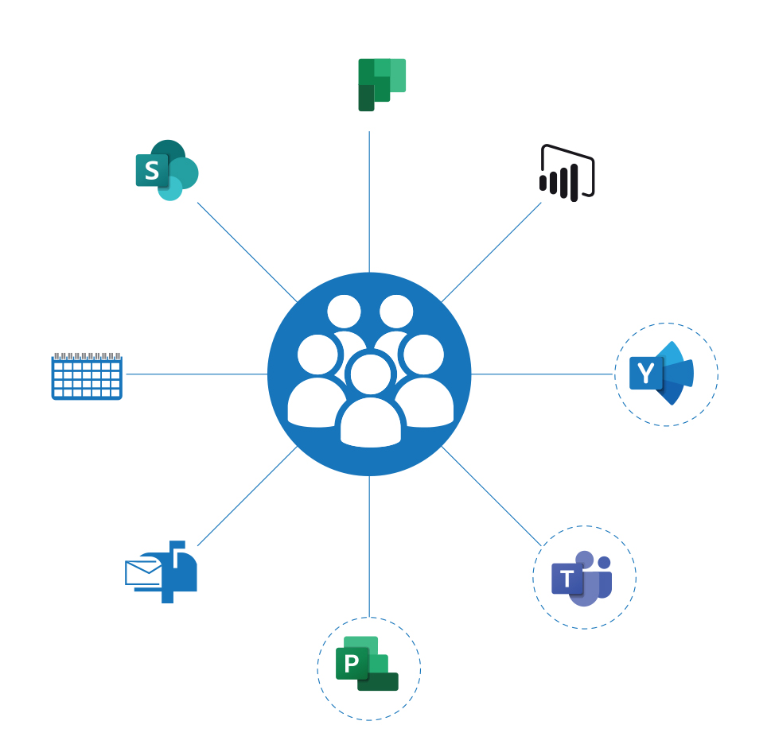
Overview of Groups in Microsoft 365
You can use groups to manage sets of users at the same time in Microsoft 365
Supported types of groups in Microsoft 365 include:
Office 365 group
Distribution list
Mail-enabled security group
Security group
Dynamic distribution group (Exchange only)

Slide 21
Creating and Managing Groups
You can use the Microsoft 365 admin center or Windows PowerShell to create a security group in the Microsoft 365
To ensure that you create and manage your groups correctly, you should consider the following best practices:
Keep your group naming convention simple but clear
Create policies and procedures for ongoing group maintenance
Add users to security groups and then add those security groups to the default groups rather than adding individual users to the default groups
Maintain a consistent and well-defined account provisioning process

Slide 22
Groups in Exchange Online and SharePoint Online
If you want to create groups of users so you can send email to them all at the same time, you can do that in the Exchange admin center:
Distribution group
Security group
Dynamic distribution group
SharePoint groups are created automatically when you make a site collection. A security group you create in SharePoint is only recognized by that SharePoint site collection.
You do not need security groups to be secure.
You can always grant user permissions and access to sites individually.
But with security groups, you can easily manage larger groups of users.
Notes:
Let's take a look at some frequently asked questions related to security groups:
Question: How is a security group different from security groups I create in SharePoint?
Answer: Security groups can be used with SharePoint, Exchange, MDM, Windows, and more. A security group you create in SharePoint is only recognized by that SharePoint site collection.
Question: Do I have to use security groups for my organization to be secure??
Answer: No. This is just one more way you can manage security for your organization. You can always grant user permissions and access to sites individually. But with security groups, you can easily manage larger groups of users.
Question: Can I send email to a security group?
Answer: Yes. But if you want to use groups for email and collaboration, it is recommended that you create an Office 365 group instead.

Slide 23
Lesson 5: Lab 1 - Exercise 2

Slide 24
Lab Exercises (continued)
Exercise 2: Manage Users and Groups
Task 1 - Create a User Account for Adatum’s Enterprise Administrator
Task 2 - Create and Manage Groups
Task 3 - Recover Groups using PowerShell

Slide 25
Lesson 6: Implementing Your Domain Services

Slide 26
Lesson Introduction
This lesson will provide you with insight into how to implement your domain services by covering the following topics:
Implementing Your Domain Services
Adding a Custom Domain to Microsoft 365
Planning DNS for Custom Domains
DNS Record Requirements
Setting up a Custom Domain

Slide 27
Planning for Custom Domains
You should consider the following factors before adding custom domains to Microsoft 365:
Multiple Domains
Subdomains
Domain numbers
Domain adding order
DNS record hosting
Access to the DNS console
Not registering DNS
Not changing all records
DNS record propagation timings

Slide 28
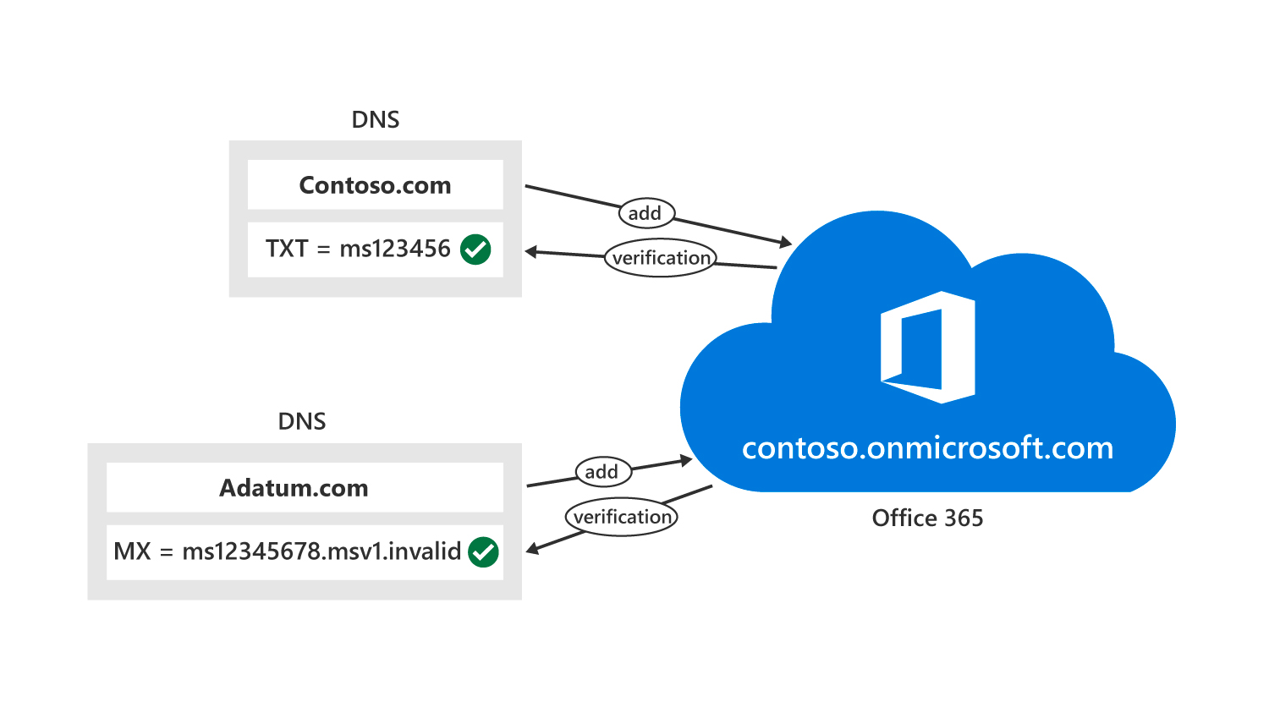
Adding a Custom Domain to Microsoft 365
If an organization has a domain name that it wants to add to Microsoft 365, it must perform the following steps to add a custom domain to Microsoft 365:
Check that you have ownership of the domain
Check that you have administrative access to manage DNS for the domain
Check that you can make changes to the DNS records
Sign into the Microsoft 365 admin center
Confirm domain ownership for the domain
Change the default domain to the new domain
Add users and assign licenses
Set the domain purpose and finish configuring DNS
Public domains must point to Office 365 to receive emails and use them in Office 365.

Slide 29
Planning DNS for Custom Domains
A publicly available DNS zone setup is very important during the Microsoft 365 deployment for organizations that want to use custom domains
The following options are available for hosting the DNS zone for a custom domain:
Have a third-party provider, such as GoDaddy, host the DNS zone for the custom domain
Host the DNS zone on-premises by using or deploying DNS servers
When planning DNS zones for custom domains, organizations can choose between the following two scenarios:
Internal DNS zones and external DNS zones have different names
Internal DNS zones and external DNS zones have the same name (referred to as Split-brain DNS or “split DNS” for short)

Slide 30
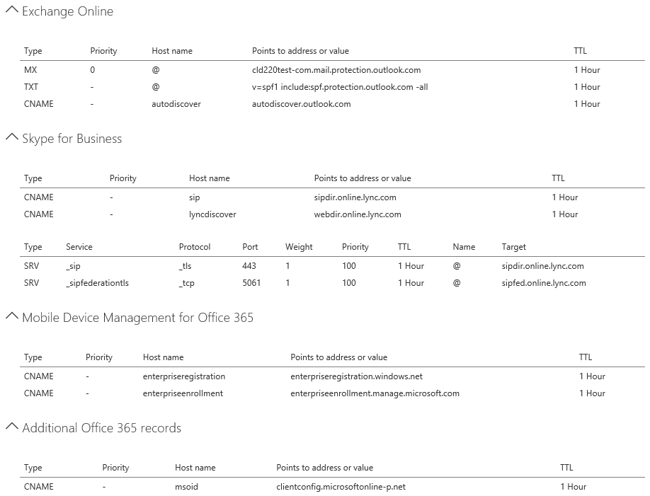
DNS Record Requirements
Microsoft 365 uses the following subset of DNS records:
DNS records for Exchange Online
DNS records for Skype for Business Online
DNS records for Mobile Device Management for Microsoft 365

Slide 31
Setting up a Custom Domain
When adding a custom domain, you must choose how you want to verify that you own the domain.
If your domain is registered at GoDaddy or 1&1, Microsoft 365 will set up your records automatically.
You can have an email sent to the registered contact for the domain with a verification code. If you don't recognize or have access to the email on record, you can use the next option to use a TXT record to verify your domain.
You can use a TXT record to verify your domain.
You can choose how you want to make the DNS changes required for Office to use your domain.
You can have Microsoft 365 add the DNS records for you (recommended)
You can add the DNS records yourself

Slide 32
Lesson 7: Lab 1 - Exercise 3

Slide 33
Lab Exercises (continued)
Exercise 3: Add a Custom Domain
Task 1 – Add a Custom Domain

Slide 34
Lesson 8: Leveraging FastTrack and Partner Services

Slide 35
Lesson Introduction
Before using FastTrack, you should have a good understanding of what is required for leveraging FastTrack and partner services

Slide 36
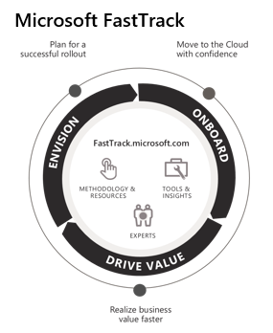
Introduction to FastTrack
FastTrack provides an organization with personalized assistance at any time, as long as its subscription is active
FastTrack for Microsoft 365 offers:
An ongoing, repeatable benefit included in an organization’s subscription
End-to-end guidance from Microsoft engineering or approved partners
Online resources and tools for all customers using Microsoft 365, Azure, or Dynamics 365

Slide 37
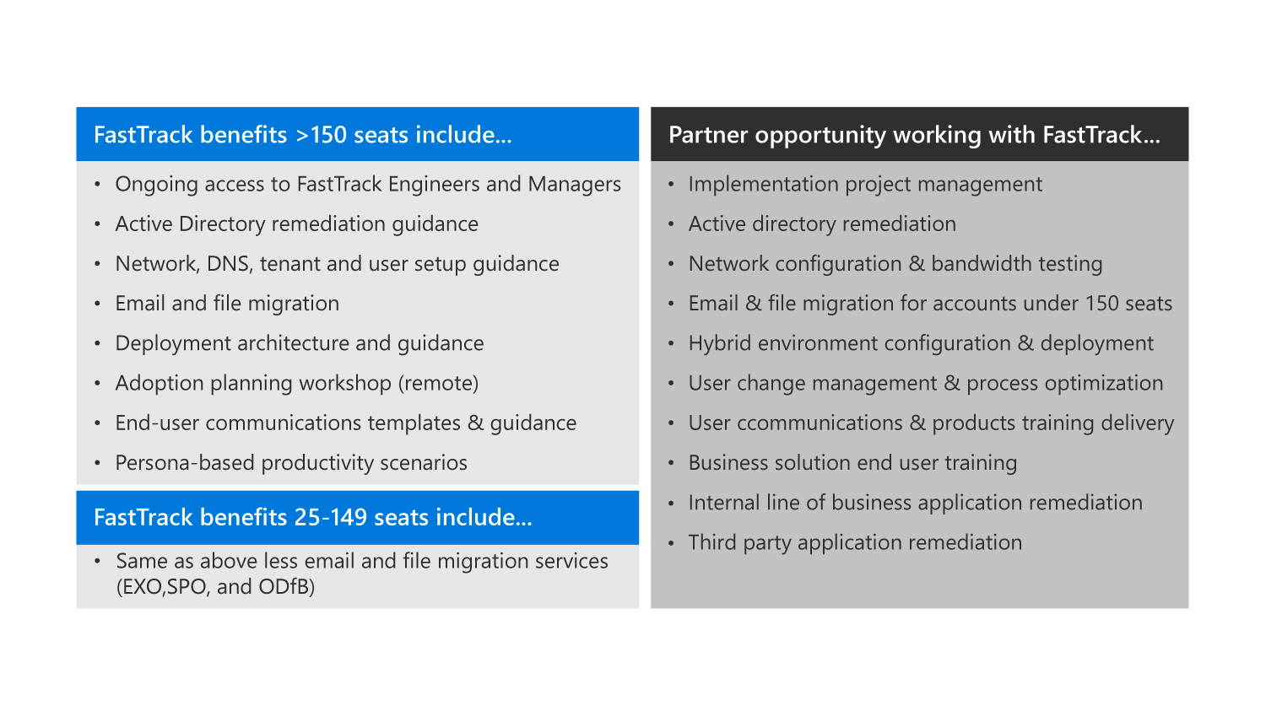
FastTrack Requirements
The FastTrack Center provides assistance for the following Microsoft 365 services:
Exchange Online
SharePoint Online
OneDrive for Business
Skype for Business Online
Microsoft Teams
Power BI
Project Online
Yammer Enterprise
Microsoft 365 Apps for enterprise
Microsoft StaffHub

Slide 38
Requesting a Partner
When looking for a partner to assist you with the FastTrack process, you should begin by accessing the I’m looking for a solution provider website
The website displays a list of partner candidates that you can choose from
Once the onboarding process is complete, you can see your partner’s information in the Partner Services tab

Slide 39
Lesson 9: Module Review

Slide 40

Discussion – Module Review
What are your key takeaways from this module, and why?
What are the key features discussed in this module that you foresee implementing at your organization?

