Slide 1
Module 3: Managing Your Microsoft 365 Tenant

Slide 2
Module Agenda
Configuring Microsoft 365 Admin Roles
Lab 2-Exercise 1 – Manage Administration Delegation
Managing Tenant Health and Services
Lab 2-Exercise 2 – Monitor and Troubleshoot Microsoft 365
Managing User-Driven Client Installations
Managing Centralized Microsoft 365 Apps for enterprise Deployments
Lab 2-Exercise 3 – Install Microsoft 365 Apps for enterprise

Slide 3
Lesson 1: Configuring Tenant Roles

Slide 4
Lesson Introduction
This lesson examines the following topics that provide the required prerequisite knowledge to effectively configure Microsoft 365 tenant roles:
Microsoft 365 Permission model
Exchange Admin role
SharePoint Admin role
Modern Desktop Admin role
Security and Compliance Admin roles
Teams Admin role
Configuring Tenant Roles
Azure AD Privileged Identity Management

Slide 5
Microsoft 365 Permission Model Overview
Microsoft 365 provides several predefined administrator roles that you can assign to users in your organization to ease administrative burdens
The permission model in Microsoft 365 on which administrator roles are based is referred to as Role-Based Access Control (RBAC )
Online services, such as Exchange Online and SharePoint Online, have their own permission models
There are other administrator roles available in the RBAC model (such as Global Administrator, Billing Administrator, and Password Administrator, among others)

Slide 6
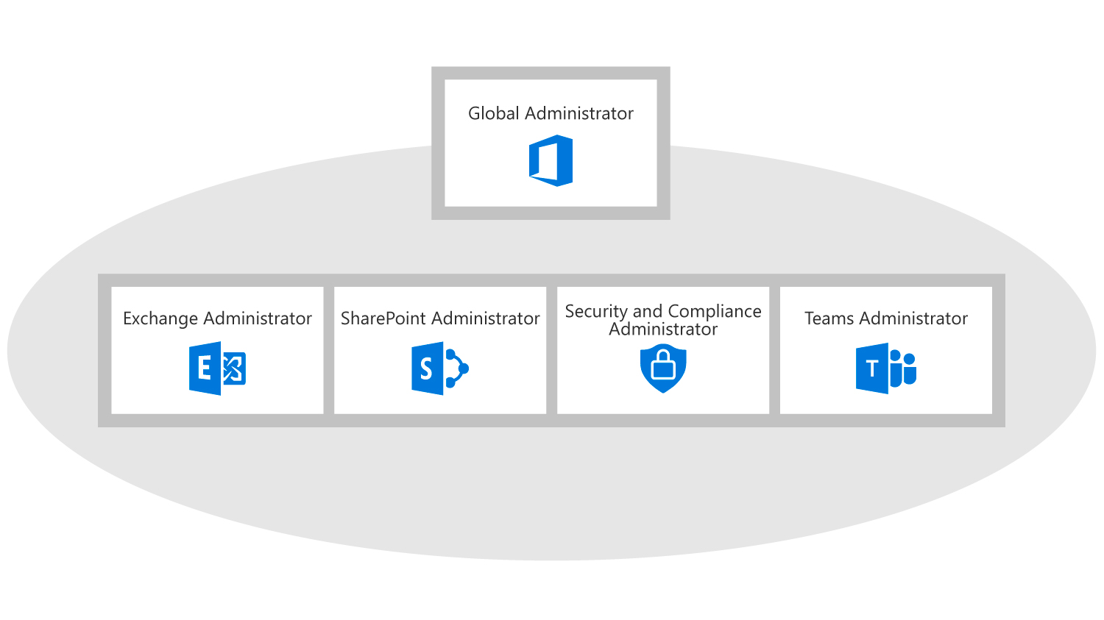
Using Admin Roles In Microsoft 365
In Microsoft 365 you use administrator roles to assign specific administrative functions to users
Each admin role maps to common business functions and gives permissions to do specific tasks in the Microsoft 365 admin center
You can manage admin roles in Microsoft 365 using the Microsoft 365 admin center or Windows PowerShell. Key roles include:
Global administrator
Billing administrator
Dynamics 365 Service administrator
Exchange administrator
Password administrator
Skype for Business administrator
Power BI administrator
Service administrator
SharePoint administrator
User Management administrator
Notes:
Mention how the diagram illustrates the relationship between the service admin roles and the Global admin role

Slide 7
Exchange Administrator
The Microsoft 365 Exchange Administrator role contains permissions for managing all aspects of the Exchange product
Some of the key responsibilities assigned to the Microsoft 365 Exchange Administrator role are:
Planning and deployment
Message policy and compliance
Security Functions
Mail Flow Management
Reports and Troubleshooting

Slide 8
SharePoint Administrator
The Microsoft 365 SharePoint Administrator role contains permissions for managing all aspects of the SharePoint Online product
Some of the key responsibilities assigned to the Microsoft 365 SharePoint Administrator role are:
Site collections
InfoPath
User profiles
BCS
Term store
Records management
Search
Secure store
Apps
Settings
Configure hybrid

Slide 9
Modern Desktop Administrator
The Microsoft 365 Modern Desktop Administrator role contains permissions for managing all aspects of the Windows and device monitoring products
Some of the key responsibilities assigned to the Microsoft 365 Modern Desktop Administrator role are:
Planning and deployment of Devices
Device Compliance
Monitoring services
Update Management

Slide 10
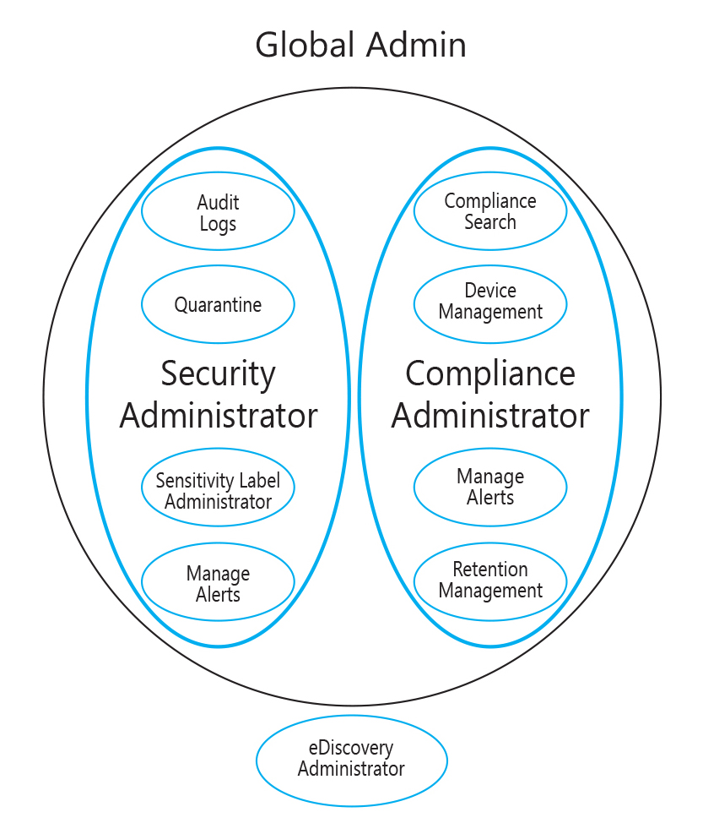
Security and Compliance Administrator
The Microsoft 365 Security Admin and Compliance Admin roles contain permissions for managing all aspects of security and compliance in your tenant
Key responsibilities assigned to these roles include:
Archiving
Data loss prevention
Device Management
Permissions
Retention
Auditing and investigation

Slide 11
Teams Administrator
The Microsoft 365 Teams Administrator role contains permissions for managing all aspects of the Microsoft Teams product
Some of the key responsibilities assigned to the Microsoft 365 Teams Administrator role are:
Managing Teams services
Creating Microsoft 365 groups
Managing the Calls and Meetings feature within the Teams service
Troubleshooting communication issues within Teams using basic and advanced troubleshooting toolsets

Slide 12
Configuring Tenant Roles
To assign an administrator role you can use Microsoft 365 Admin Center or Windows PowerShell
If you do not have in-house administrators, you can delegate your administration to a Microsoft partner
When you delegate administration to a partner, they receive the ability to specify administration roles for your organization when they create users on your behalf
Delegated administrators are restricted to the following two roles:
Full administration
Limited administration

Slide 13
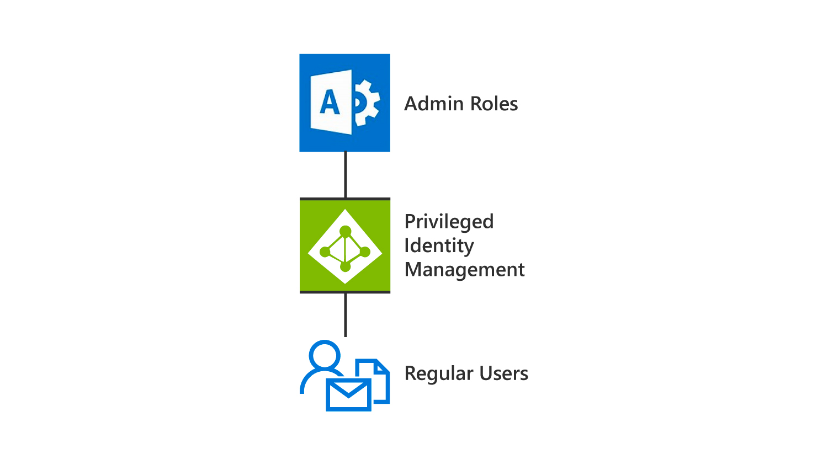
Azure AD Privileged Identity Management
Azure AD Privileged Identity Management enables you to manage, control, and monitor access within your organization
Azure AD Privileged Identity Management helps your organization:
See which users are assigned privileged roles to manage Azure resources, as well as which users are assigned administrative roles in Azure AD
Enable on-demand, "just in time" administrative access to Microsoft Online Services
See a history of administrator activation, including changes made
Get alerts about changes in administrator assignments
Require approval to activate Azure AD privileged admin roles
Review membership of administrative roles
Regular user can use PIM to elevate privileges and access the admin centers

Slide 14

Discussion – Implementation scenario
You have been hired as an Enterprise Administrator at a marketing company, which works with several enterprise-class organizations.
After reviewing the company’s current identity landscape, you noticed that there is only one user who controls all functional security parameters for the business.
You also discovered that users are not required to ever change their passwords.
As the Enterprise Admin, what should you do to protect the company and create redundancy?
Notes:
Suggested actions - Set up a security group to break up administrative actions among more than one user. Also set up an additional Microsoft 365 Global administrator account to be used for emergency operations, and then change the “Password change” policy to every 60 days.

Slide 15
Lesson 2: Lab 2 – Exercise 1

Slide 16

Lab Exercises
Exercise 1: Manage Administration Delegation
Task 1 - Assign Delegated Administrators in the Microsoft 365 Admin Center
Task 2 - Manage Delegated Administrators with Windows PowerShell
Task 3 - Verify Delegated Administration

Slide 17
Lesson 3: Managing Tenant Health and Services

Slide 18
Lesson Introduction
For many companies, Microsoft 365 is their first major public cloud endeavor
One of the challenges of this endeavor is learning how the IT team monitors Microsoft 365
You need to learn how to monitor your infrastructure using Microsoft 365 tools

Slide 19
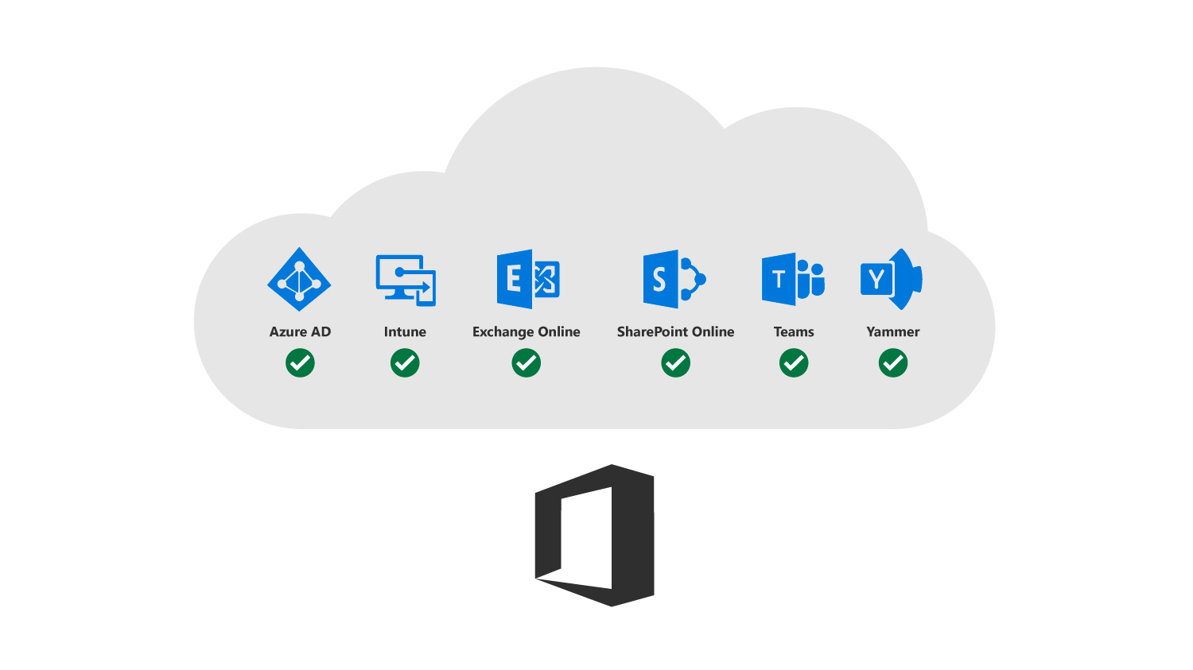
Monitoring Service Health
You can access the Service Health page in the Microsoft 365 Admin Center
Each online service’s health will display one of the following statuses:
Normal service
Extended recovery
Investigating
Service restored
Service interruption
Additional information
Service degradation
PIR published
Restoring service

Slide 20
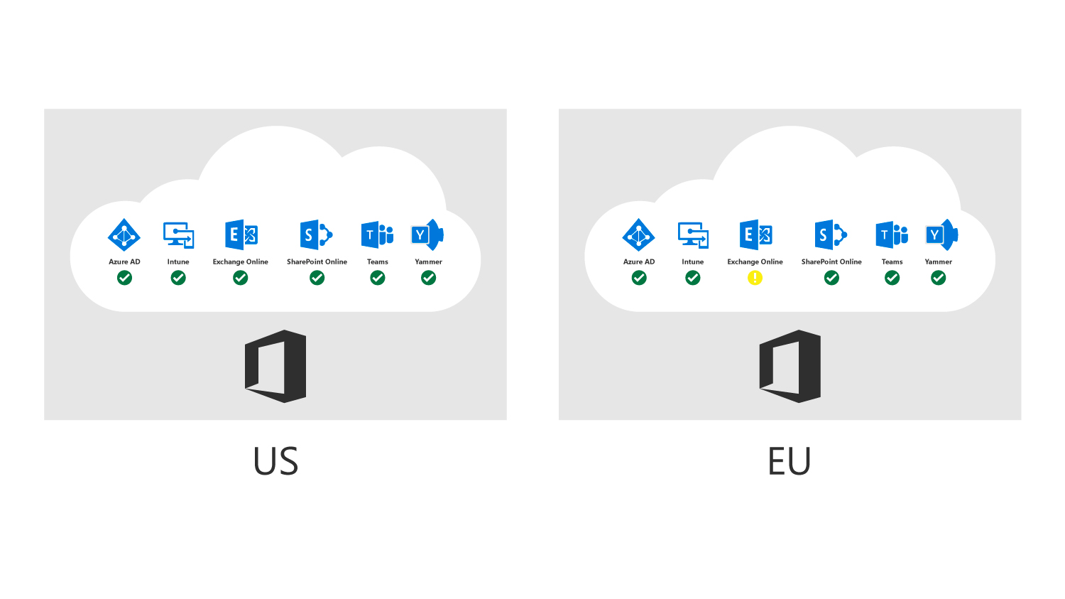
Developing an Incident Response Plan
You should perform the following steps to develop an incident response plan:
Validate the incident and confirm that your environment is affected
Determine whether the incident is relevant to your company
Review for timeline checks once relevancy and degradation have been established
Develop a backup solution in case the service is degraded for longer than an acceptable timeframe

Slide 21
Requesting Assistance from Microsoft
Microsoft Support provides global technical, pre-sales, billing, and subscription support with every Microsoft 365 subscription
Support is available online through the Microsoft 365 portal and by telephone for both paid and trial subscriptions
Technical support for Microsoft 365 subscriptions aids with basic installation, setup, and general technical usage
Microsoft assigns a severity level to a case when it’s opened. It’s based on an assessment of the issue type and customer impact. For example:
Sev A (Critical)
Sev B (High)
Sev C (Non-critical)

Slide 22
Lesson 4: Lab 2 – Exercise 2

Slide 23
Lab Exercises (continued)
Exercise 2: Monitor and Troubleshoot Microsoft 365
Task 1 - Troubleshoot Mail Flow in Microsoft 365
Task 2 - Monitor Service Health and Analyze Reports
Task 3 - Submit a Help Request to Microsoft Support

Slide 24
Lesson 5: Managing User-Driven Client Installations

Slide 25
Lesson Introduction
Microsoft 365 Apps for enterprise is intended to provide users with the most up-to-date tools to allow them to maximize their productivity
With an Microsoft 365 Apps for enterprise installation, users can be provided with current versions of each of the Office products
The Microsoft 365 Apps for enterprise installation is automatically activated for a user if he or she possesses an appropriate license

Slide 26
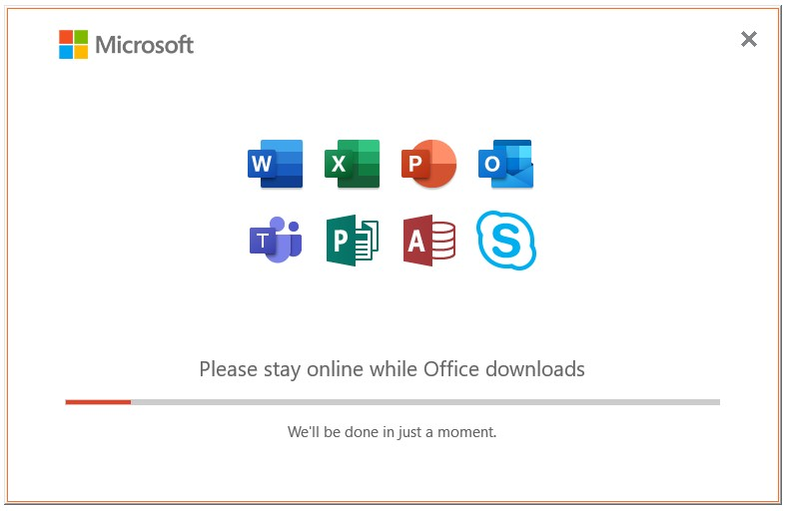
Microsoft 365 Apps for enterprise Overview
Microsoft 365 Apps for enterprise is a downloadable version of the Microsoft productivity suite and includes:
Microsoft Word 2016, Excel 2016, PowerPoint 2016, Outlook 2016, Access 2016, Publisher 2016, and OneNote 2016
Microsoft 365 Apps for enterprise is included in several Microsoft 365 subscriptions
The license assigned to a user determines what is available for download and use
Microsoft 365 Apps for enterprise uses streaming deployment by using Click-to-Run technology
Some Microsoft 365 plans can add subscriptions of Microsoft Visio and Microsoft Project

Slide 27
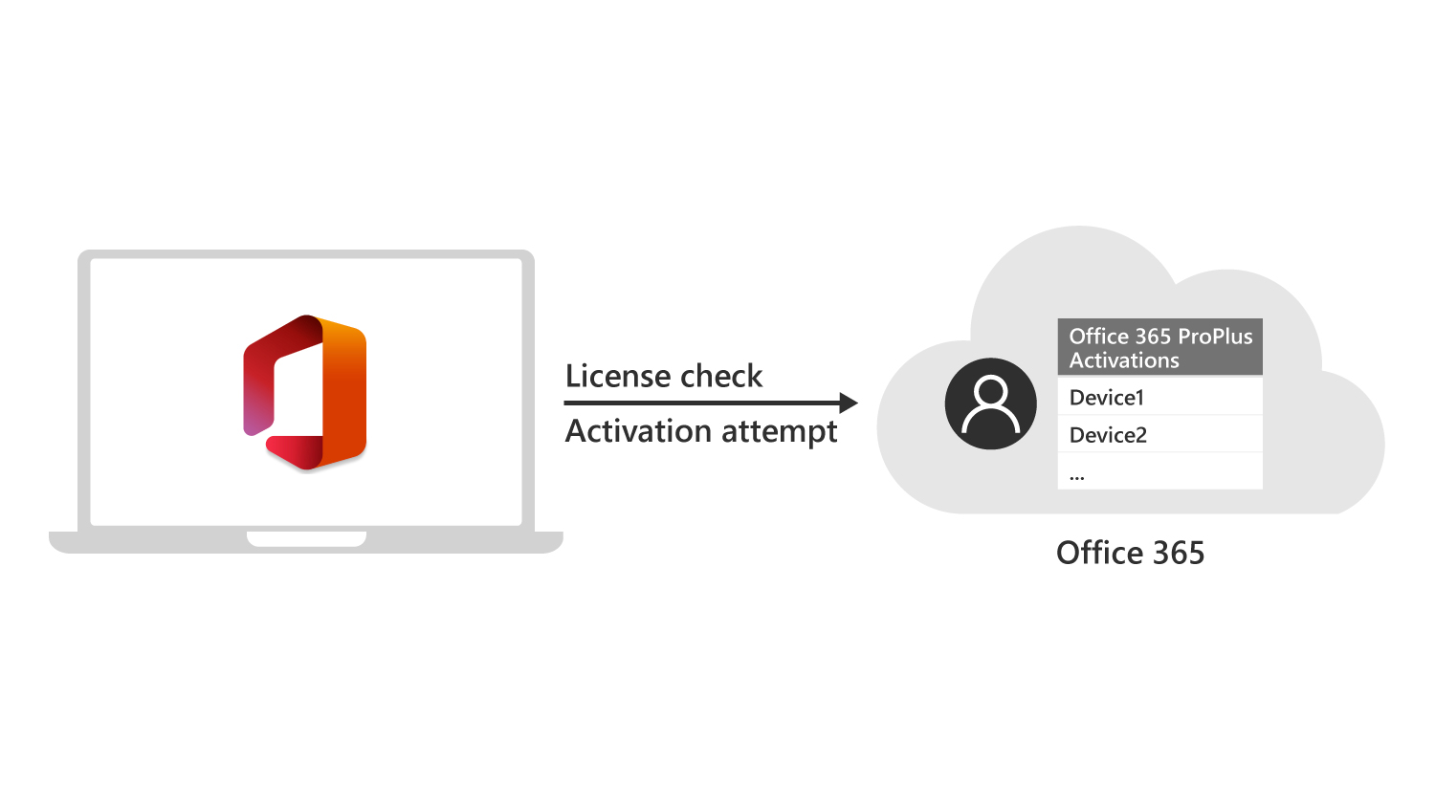
Microsoft 365 Apps for enterprise Licensing and Activation
A single Microsoft 365 Apps for enterprise license enables a user to deploy Microsoft 365 Apps for enterprise on up to five different devices
Microsoft 365 Apps for enterprise communicates with the Office Licensing Service and the Activation and Validation Service to obtain and activate a product key
As long as the device connects to the Internet at least once every 30 days, Office remains fully functional
If the device goes offline for more than 30 days, Office enters reduced functionality mode until the next time a user makes a connection
As soon as a device is activated, it is added to the user’s active devices.

Slide 28
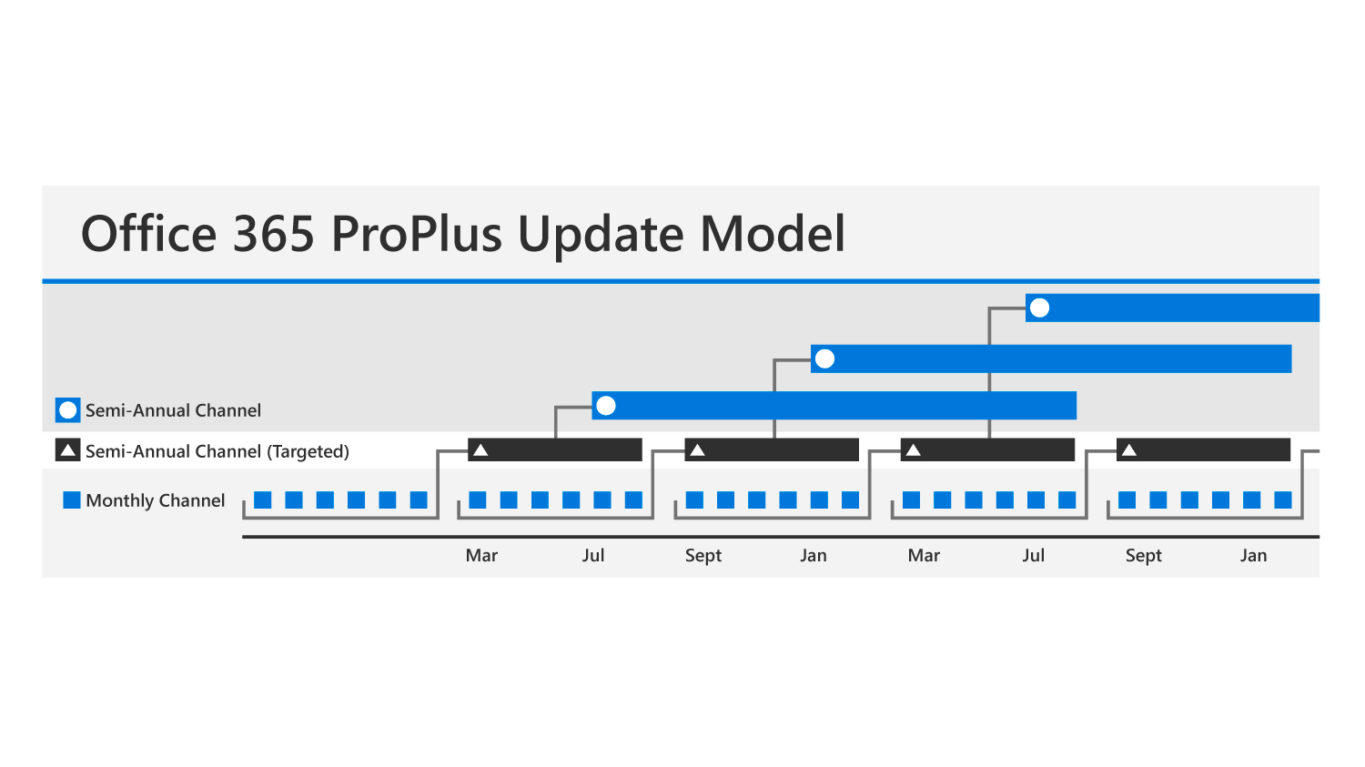
Microsoft 365 Apps for enterprise Update Options
Microsoft 365 Apps for enterprise applications are automatically updated when newer versions become available
There are three update branches:
Current Channel
Deferred Channel
First Release for Deferred Channel
You can use three methods for applying update branches to users:
Using the Microsoft 365 admin center
Using the Office Deployment Tool (Office 2016 version)
Using Group Policy

Slide 29
Discussion – Microsoft 365 Apps for enterprise Update Branches
Which Microsoft 365 Apps for enterprise update branch do you think your organization will use, and why?
Similarly, which of the three methods of applying update branches to users do you think your organization will use, and why?

Slide 30
Obstacles to a Successful Installation
Lack of information technology (IT) expertise
End of support for Windows XP
Incorrect licenses
Bandwidth limitations
Users without administrator rights

Slide 31
Restricting User Access to Microsoft 365 Apps for enterprise
Some organizations do not want users to have the ability to install application software on their laptop and desktop computers
You can configure available software options in the Microsoft 365 admin center

Slide 32
Lesson 6: Managing Centralized Microsoft 365 Apps for enterprise Deployments

Slide 33
Lesson Introduction
To manage centralized Microsoft 365 Apps for enterprise deployments you should:
Understand deployment process
Know how to use ODT to configure Microsoft 365 Apps for enterprise deployment
Know how to use Group Policy to configure Microsoft 365 Apps for enterprise deployment
Understand how to manage update to Microsoft 365 Apps for enterprise

Slide 34
Microsoft 365 Apps for enterpriseDeployment Overview
The following software distribution tools are examples of mechanisms that can be used to manage Office installations:
Configuration Manager
Intune
Non-Microsoft software distribution
Group Policy login scripts
Scripted installation
For Click-to-Run, you must configure the Office client through Group Policy and the Office Deployment Tool
You can use the following tools to complement each other:
Office Deployment Tool (ODT)
Group Policy

Slide 35
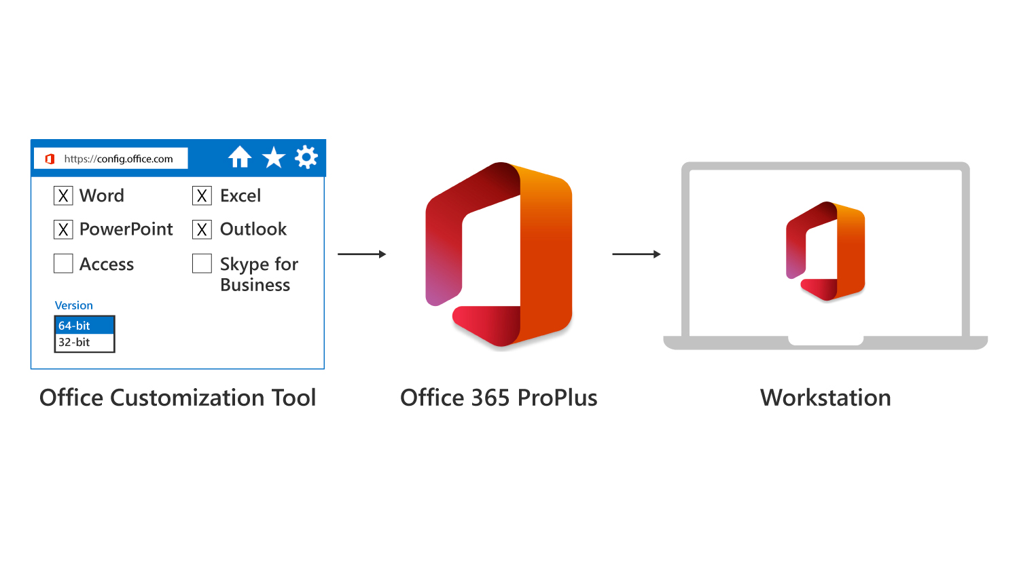
Configuring Microsoft 365 Apps for enterprise with the ODT
The Office Deployment Tool (ODT) is used to perform the following tasks:
Download Office source files
Install or remove Click-to-Run or customize installations
Apply software update policies
To customize the Microsoft 365 Apps for enterprise deployment, you can use the Office Customization Tool to modify the configuration.xml file to specify various settings
The Office Customization Tool can run in any browser to create a custom installation package, which can then be deployed to workstations.
Notes:
Mention that the ODT supports the following command-line switches:
/download <path to configuration.xml> to specify the download
/configure <path to configuration.xml> to specify the Office source file location
/packager to prepare Office source files so that you can use Click-to-Run in an App-V infrastructure

Slide 36
Deploying Microsoft 365 Apps for enterprise using Group Policy
You can use Group Policy tools to manage Microsoft 365 Apps for enterprise installations
You can use Group Policy to manage general Office settings and application-specific settings, such as managed add-ins
You can use Group Policy to control each user's first-run experience

Slide 37
Discussion – Configuring Microsoft 365 Apps for enterprise
Microsoft 365 Apps for enterprise can be configured using the Office Deployment Tool and Group Policy. Do you plan to use these tools to configure your Microsoft 365 Apps for enterprise deployment, and if so, how?

Slide 38
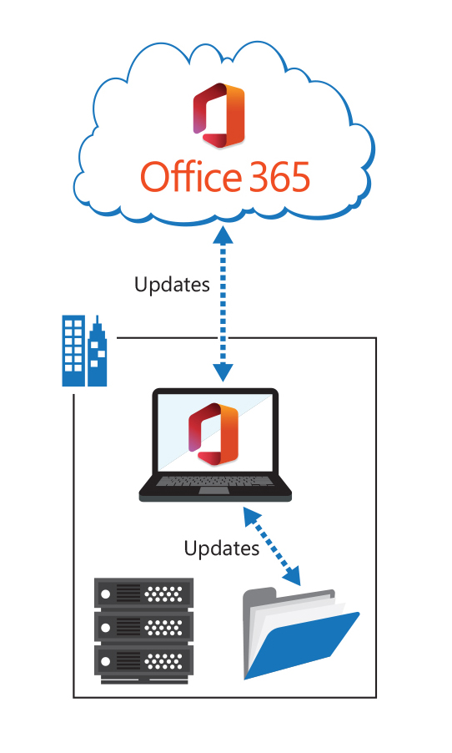
Managing Microsoft 365 Apps for enterprise Updates
Click-to-Run uses an optimized software-update model that provides unobtrusive background updates
Updating options include:
Automatic from cloud
Automatic from network
Rerun setup.exe by using Electronic Software Delivery (ESD)
Office clients can be on an outdated build for only 12 months
Administrators can configure update behavior by using the Office Deployment Tool configuration.xml
Microsoft 365 Apps for enterprise clients can be updated through GPO, or from a file share, or directly from Microsoft 365

Slide 39
Discussion – Implementation scenario
You work for Fabrikam, Inc., who has just acquired a small competitor.
The newly acquired company uses legacy operating systems (Windows 7 Home edition) and has been using a volume license for Office 2010.
It also uses workgroups to manage its work environment.
Fabrikam employs Microsoft 365, which it uses to manage all corporate-owned devices, as well as all personal devices that are used for company-related work.
Given this information, what strategy would you recommend to update the newly acquired company to meet Fabrikam’s standards.
Notes:
Suggested actions - Set up Microsoft 365 to manage all devices with the use of Intune, then push an image to the synced devices that update them to Windows 10. From there, you can update the devices with Office 2010 to Office Apps through policy update.

Slide 40
Lesson 7: Lab 2 – Exercise 3

Slide 41
Lab Exercises (continued)
Exercise 3: Install Microsoft 365 Apps for enterprise
Task 1 – Verify how licensing affects installing Microsoft 365 Apps for enterprise
Task 2 – Verify how the global Office download setting affects installing Microsoft 365 Apps for enterprise
Task 3 – Perform a User-Driven Installation of Microsoft 365 Apps for enterprise

Slide 42
Lesson 8: Module Review

Slide 43
Discussion – Module Review
What are your key takeaways from this module, and why?
What are the key features discussed in this module that you foresee implementing at your organization?

