Slide 1
Microsoft Teams Administration

Slide 2
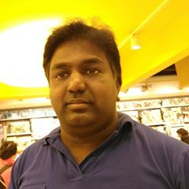











Jenkins NS
Modern Workplace Solution Architect | Consultant
15+ Years of experience
Microsoft Teams, Power Platform and SPFx Specialist
International Speaker | Blogger | Trainer
SPS Bangalore Organizer
aOS Ambassador
jenkinsns@gmail.com
in/jenkinsns
@jenkinsns
http://www.jenkinsblogs.com
jenkinsns
https://www.facebook.com/spfxinfo/
https://www.facebook.com/msteamsinfo

Slide 3
Course Overview
Microsoft Teams
Microsoft Teams Administration
Teamwork Solutions Development Workshop
Upgrading from Skype for Business to Microsoft Teams
Introduction
Architecture of Microsoft Teams
Setup Environment
Chat, teams, channels, & apps in Microsoft Teams
Apps & connectors in Microsoft Teams
Communicate with users from other organizations in Microsoft Teams
External access in Microsoft Teams
Guest access in Microsoft Teams
Meetings and live events in Microsoft Teams
Limits and specifications for Microsoft Teams
Microsoft Teams adoption
Microsoft Teams Admin center
Governance, management and Lifecycle
Security & Compliance
Manage Teams
Manage Meetings
Manage Messaging
Manage apps
Call Quality Overview
Dynamic emergency calling
Live Events
Phone System
Direct Routing
Manage using PowerShell
Teams Developer Platform – Overview and Opportunity
Building Apps and Solutions with Microsoft Teams
Extend your solution with Microsoft Graph
Building Teams Apps using Solution Accelerators
Teams Lifecycle management and Design Guideline for Apps
Introduction to Upgrade
Plan your upgrade
Coexistence and Interoperability
Administrator experience

Slide 4
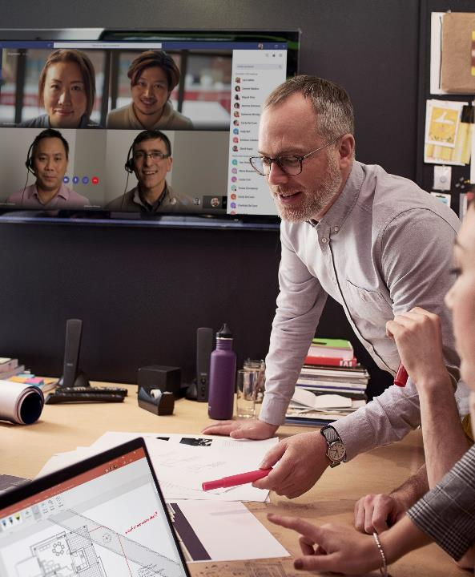
Agenda
Microsoft Teams Admin center
Governance, management and Lifecycle
Security & Compliance
Manage Teams
Manage Meetings
Manage Messaging
Manage apps
Call Quality Overview
Dynamic emergency calling
Live Events
Phone System
Direct Routing
Manage using PowerShell

Slide 5
Customer Stories
Questions

Slide 7

Jenkins NS
Modern Workplace Solution Architect | Consultant
Microsoft Teams, Power Platform and SPFx Specialist
International Speaker | Blogger | Trainer
SPS Bangalore Organizer
aOS Ambassador
jenkinsns@gmail.com
in/jenkinsns
@jenkinsns
http://www.jenkinsblogs.com
jenkinsns
https://www.facebook.com/spfxinfo/
https://www.facebook.com/msteamsinfo

