Slide 1
Microsoft Teams Administration

Slide 2












Jenkins NS
Modern Workplace Solution Architect | Consultant
15+ Years of experience
Microsoft Teams, Power Platform and SPFx Specialist
International Speaker | Blogger | Trainer
SPS Bangalore Organizer
aOS Ambassador
jenkinsns@gmail.com
in/jenkinsns
@jenkinsns
http://www.jenkinsblogs.com
jenkinsns
https://www.facebook.com/spfxinfo/
https://www.facebook.com/msteamsinfo

Slide 3
Course Overview
Microsoft Teams
Microsoft Teams Administration
Teamwork Solutions Development Workshop
Upgrading from Skype for Business to Microsoft Teams
Introduction
Architecture of Microsoft Teams
Setup Environment
Chat, teams, channels, & apps in Microsoft Teams
Apps & connectors in Microsoft Teams
Communicate with users from other organizations in Microsoft Teams
External access in Microsoft Teams
Guest access in Microsoft Teams
Meetings and live events in Microsoft Teams
Limits and specifications for Microsoft Teams
Microsoft Teams adoption
Microsoft Teams Admin center
Governance, management and Lifecycle
Security & Compliance
Manage Teams
Manage Meetings
Manage Messaging
Manage apps
Call Quality Overview
Dynamic emergency calling
Live Events
Phone System
Direct Routing
Manage using PowerShell
Teams Developer Platform – Overview and Opportunity
Building Apps and Solutions with Microsoft Teams
Extend your solution with Microsoft Graph
Building Teams Apps using Solution Accelerators
Teams Lifecycle management and Design Guideline for Apps
Introduction to Upgrade
Plan your upgrade
Coexistence and Interoperability
Administrator experience

Slide 4

Agenda
Microsoft Teams Admin center
Governance, management and Lifecycle
Security & Compliance
Manage Teams
Manage Meetings
Manage Messaging
Manage apps
Call Quality Overview
Dynamic emergency calling
Live Events
Phone System
Direct Routing
Manage using PowerShell

Slide 5
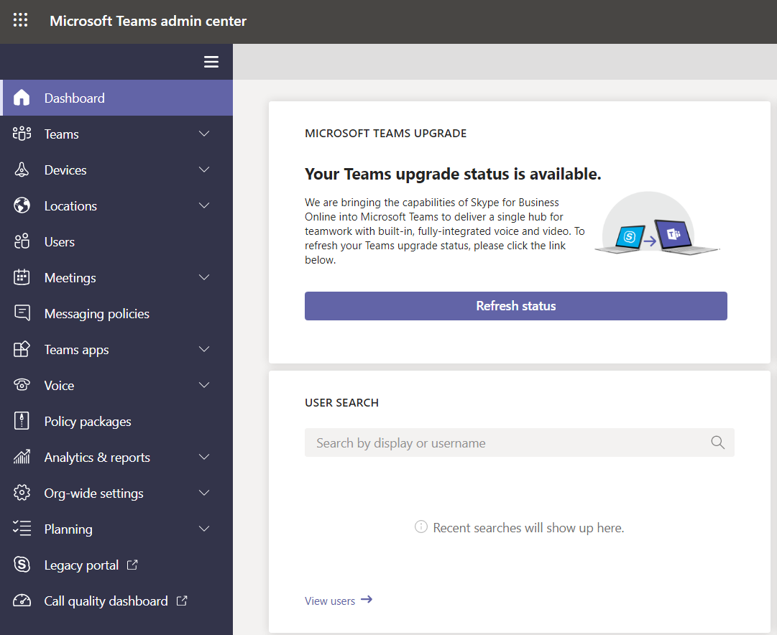
Microsoft Teams admin center
Walkthrough

Slide 6
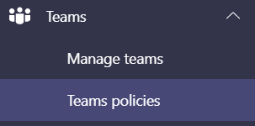
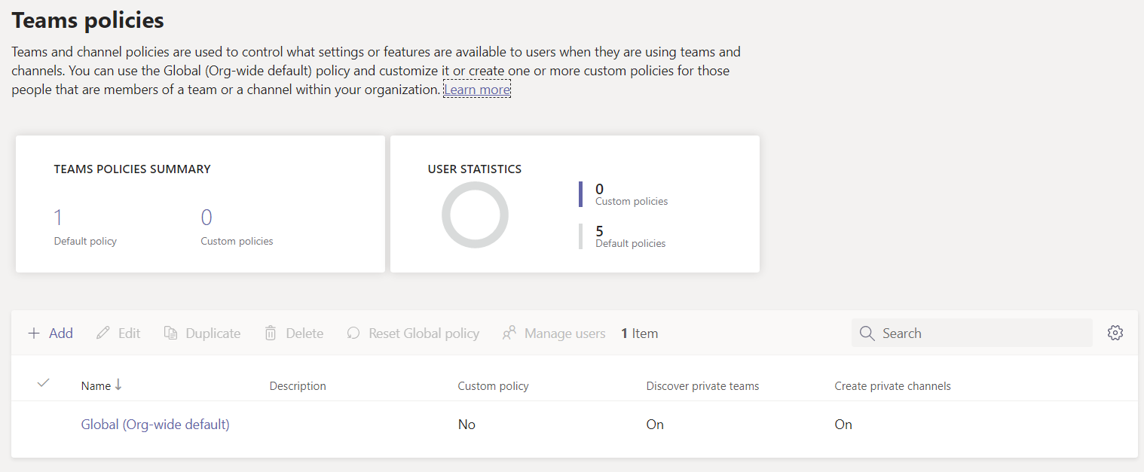
Manage Teams policies in Microsoft Teams
As an admin, you can use teams policies in Microsoft Teams to control what users in your organization can do in teams and channels. For example, you can set whether users are allowed to discover private teams in search results and in the team gallery and whether users are allowed to create private channels.
You manage teams policies by going to Teams > Teams policies in the Microsoft Teams admin center. You can use the global (Org-wide default) policy or create custom policies and assign them to users. Users in your organization will automatically get the global policy unless you create and assign a custom policy.
You can edit the global policy or create and assign a custom policy. If a user is assigned a custom policy, that policy applies to the user. If a user isn't assigned a custom policy, the global policy applies to the user. After you edit the global policy or assign a policy, it can take a few hours for changes to take effect.

Slide 7
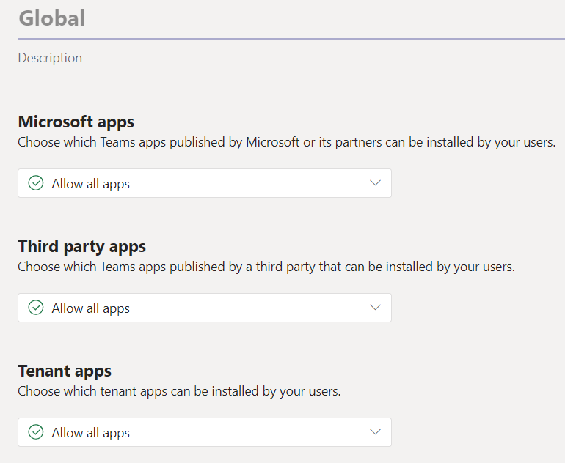
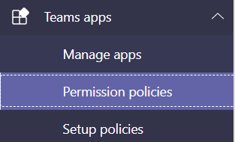
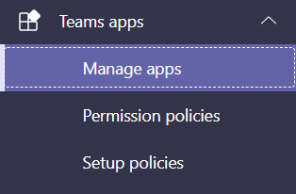
Manage apps in Microsoft Teams
What is Teams App Permission Policy?
As an admin we can start provision different of apps to different teams in Microsoft Teams. With Teams App Permission policy, we can define what are app users can use in user level, and organization level.
Type of Teams apps
There are three types of Teams apps is available, that is
1st Party App or Microsoft App
Third party App or Non-Microsoft apps
Custom App or Organisational LOB App

Slide 8

Microsoft Teams Admin Center
Block Apps and only allow specific apps to be used by users in Teams.
First party Apps
LOB Apps (Custom Apps)
External Apps (3rd Party Apps)
1st Party Apps
3rd Party Apps
Custom Apps
Notes:
Objective: Reinforce our teamwork position - Microsoft 365 meets the diverse needs of teams with an integrated solution that is secure
We’ve designed Microsoft 365 to meet the unique needs of every group.
For each of those categories of teamwork, Microsoft 365 includes a purpose-built application.
Teams as the hub for teamwork where groups that actively engage and are working on core projects can connect and collaborate
Yammer for people to connect across their company, sharing ideas on common topics of interest
Outlook where teams can communicate in a familiar place, and can easily create modern distribution list with groups in Outlook
SharePoint for keeping content at the center of teamwork, making files, sites and all types of content easily shareable and accessible across teams
Office Apps – enabling co-authoring in familiar apps like Word, Excel, and PowerPoint
With these tools coming together in Microsoft 365 – teams get a holistic solution.
What’s unique about teamwork in Microsoft 365 is that all of these applications are built on an intelligent fabric - suite-wide membership service with O365 Groups; suite-wide discovery and intelligence with Microsoft Graph, and suite-wide security and compliance.
Office 365 Groups - A membership service providing a single identity for teams across Office applications and services
Microsoft Graph - Suite-wide intelligence that maps the connection of people and content to surface insights
Security and Compliance - Proactive security that simplifies IT management with intelligence built-in

Slide 9
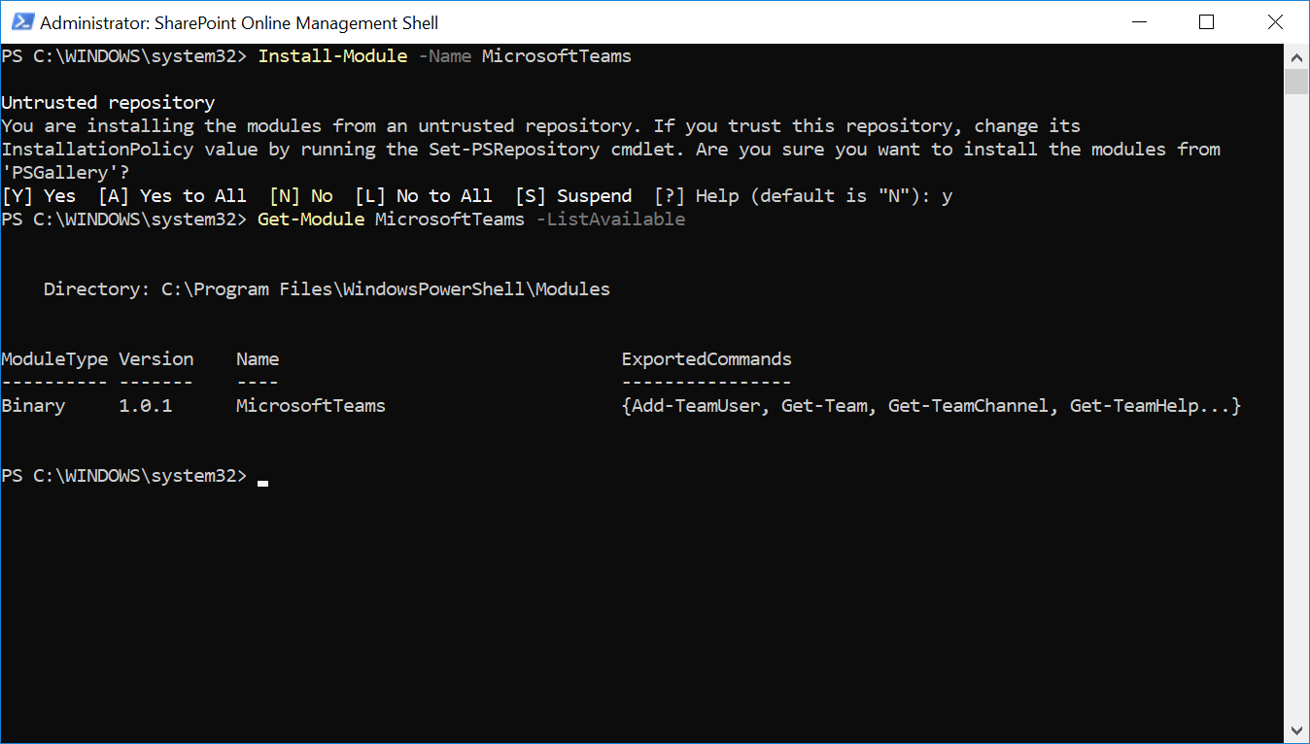
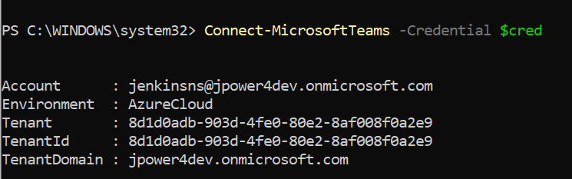
Microsoft Teams PowerShell
https://docs.microsoft.com/en-us/powershell/module/teams/?view=teams-ps
Install Microsoft Teams Module
Install-Module -Name MicrosoftTeams –Force
Verify the Module Installed
Get-Module MicrosoftTeams –ListAvailable
Connect Microsoft Teams
Connect-MicrosoftTeams -Credential $cred

Slide 10
Cmdlet | Description
Connect-MicrosoftTeams | Connects an authenticated account to use for Microsoft Teams environment
Disconnect-MicrosoftTeams | Disconnects from the Microsoft Teams environment
Get-Team | Retrieves teams with particular properties or information
Get-TeamChannel | Gets all the channels for a team
Get-TeamHelp | Provides a list of commands for Microsoft Teams
Get-TeamUser | Returns the users of a specific team
New-Team | Provisions a new Team, or converts a group to a team
New-TeamChannel | Adds a new channel to a team
Add-TeamUser | Adds an owner or member to the team
Remove-Team | Deletes a team
Remove-TeamChannel | Deletes a channel
Remove-TeamUser | Removes an owner or member from a team
Set-Team | Updates properties of a team
Set-TeamChannel | Updates Team channel information

Slide 11
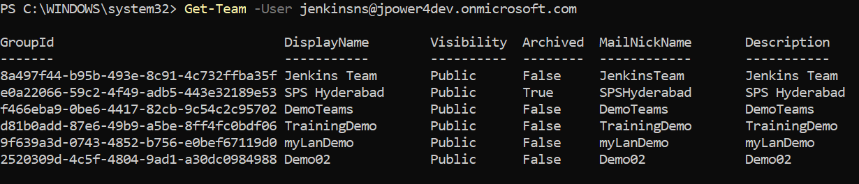
Microsoft Teams PowerShell
Get-Team
Get-Team -User jenkinsns@jpower4dev.onmicrosoft.com

Slide 12
Microsoft Teams Governance
Governance is not about limiting freedom. The point is to be able to manage Teams while removing chaos and sprawl so users can work in a compliant fashion that does not affect their day to day productivity. You need to remember that Microsoft Teams is built on top of Office365 Groups. So, Microsoft Teams uses the Office365 Group settings and policies in the background. Some of the Teams governance controls discussed here
Restrict Office 365 Group Creation to set of users
Office 365 Group Expiration Policy
Check for Teams without Owners
Check for inactive Teams
Guest Access in Teams
Teams Classifications
Retention Policy
Office 365 Group Naming Policy
Data Loss Prevention

Slide 13
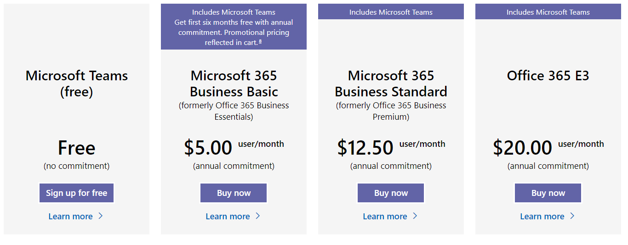
Microsoft Teams License

Slide 14
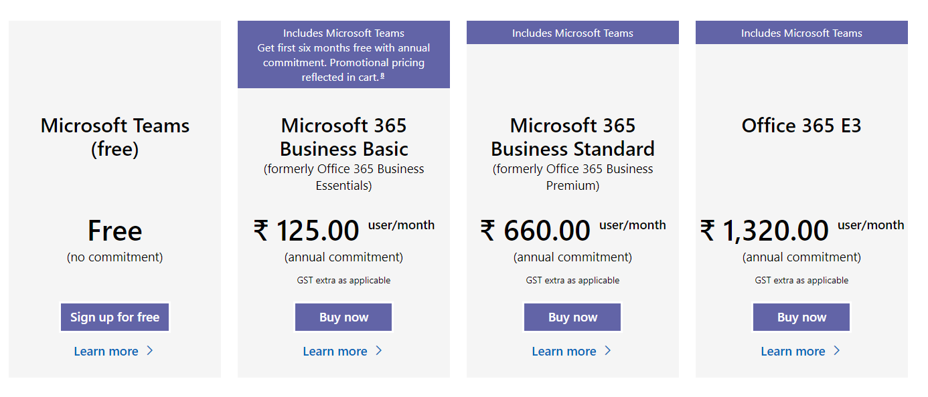
Microsoft Teams License
https://www.microsoft.com/en-in/microsoft-365/microsoft-teams/compare-microsoft-teams-options
https://www.microsoft.com/en-us/microsoft-365/microsoft-teams/compare-microsoft-teams-options
https://www.microsoft.com/en-in/microsoft-365/microsoft-teams/free#office-ContentAreaHeadingTemplate-dd899go

Slide 15
Security & Compliance

Slide 16
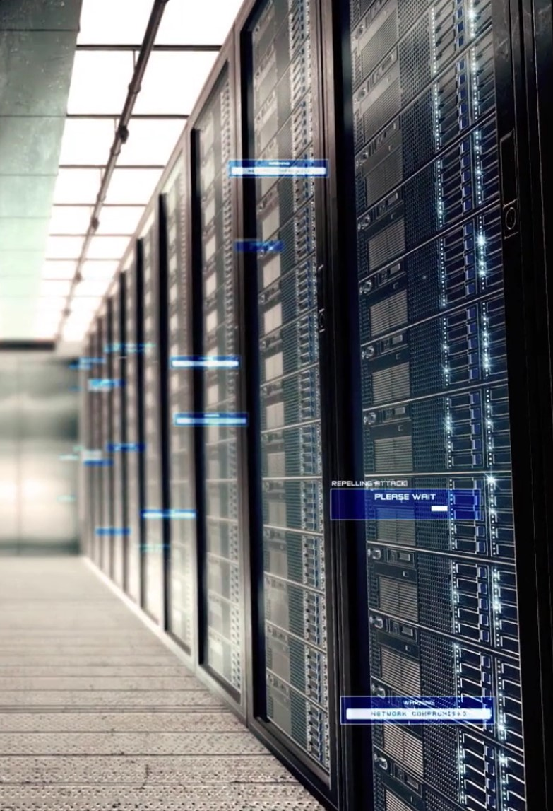
Security and Privacy
Security
Privacy
Security by design
Data Encryption at rest and in transit
Dedicated security professionals
Threat models, Security Reviews, Automated Security Tools
Penetration testing with regular rotation of 3rd party penetration testers
All keys stored in Azure Key Vault
Admin: Screening, training, access control
Host: Access control, anti-malware, patch management, AAD Modern Authentication
Network: Firewalls, edge routers
Facility: Physical controls, video surveillance, access control
Bug Bounty Program (We pay friends, hackers and researchers to find security bugs)
Privacy by design
Data stored in-region based on tenant affinity
No customer content accessible in logs or telemetry
Grant least privilege required to complete task
Dedicated Privacy professionals
Adhere to Office 365 data classification and data handling standards
Access to Production environments is locked down
General Data Protection Regulation (GDPR) compliant
Notes:
Security and Privacy are core pillars of the product
When it comes to security, there is a whole bunch of O365 data handlings standards that we adhere to
Data at rest is encrypted
Data in transit is encrypted
All keys are stored in Azure key vault
We have a bunch of standard tools that we install on all our services, things like fuzz trust, we have credential scanners, there is a long list of tools that we use to track and monitor security
Every time we have a feature, we pull together a threat model. We have security reviews with dedicated security experts in our organization. If we identify a vulnerability or bugs, we fix them of course
And then we pay a rotating set of penetration testers - these are basically 3rd party hackers, professional hackers, that we pay to try to find vulnerability in the product to again identify vulnerabilities and fix them
Lastly a big thing we also do, MS Teams participates in the Microsoft Bounty Program, so friends, researches, hackers if they find any security bugs, we pay them up to 15k dollars for finding any security bugs
On the privacy front, we also have dedicated privacy folks
A few things worth noting here:
Customer data at rest remains in region. So if your organization has O365, subscription in the France, your data will remain in European Union datacenters and adhere to European Union laws
Customer content cannot and up in logs or in telemetry, we're constantly screening for that to make sure that our devs aren't introducing anything that would break those rules
Any operation folks, who ever do need to access any of the Azure servers, they have to go through a just-in-time process where their access is granted just in time and when their taks is completed, their access is removed and all of that is audited into an audit log for tacking purposes and to adhere to the compliance rules and standards.
And we of course go through audits on a regular basis where we have to proof that we adhere to all these rules and standards
A big privacy topic for all our European customers is of course GDPR - Global Data Protection Regulation - which is out of the European Union. It's basically a set of privacy rules for the most part and we will adhere to this ahead of the May 2018 deadline

Slide 17

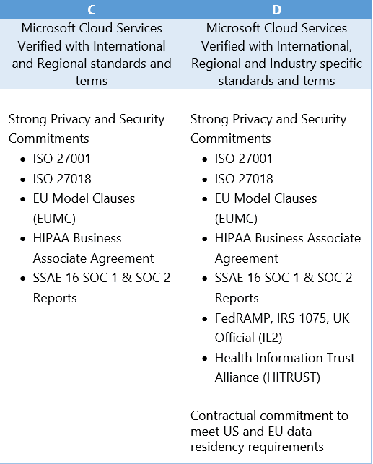
Compliance Tiers
http://aka.ms/STP is where you can download the audit reports
https://aka.ms/MicrosoftComplianceStandards for Microsoft Compliance Standards Download
Controls
Environments
More than 950 Office 365 controls
Access control
Auditing and logging
Identification and authorization
Awareness and training
Continuity planning
Incident response
Risk assessment
Communication protection
Information integrity
Deployment Approvals and management
Ongoing compliance processes
Recurring audits like SOC, FEDRAMP, ISO+ independent verification
Notes:
Where are we at from a certification perspective?
There are a lot of certifications that we adhere to, and we at Microsoft, we kind of break it down into tiers. We're currently what we call Tier C certification, that means that we have gone through an external soc audit, we've gone through an external ISO audit, we adhere to HIPAA, the EU model clause. And these audits happen on a recurring basis every year.
We have some links here on the slide where you can actually download the audit reports that have happened
Looking forward, we're working towards what we call level D certification. The big thing here is the fed ramp audit, that is for the US government. We're looking to deploy for the US government datacenters next year (2018) as well

Slide 18








How Teams Enables Information Protection
Email
1:1 chats
Group chats
Channel messages
O365 Information Protection tools
eDiscovery
Legal Hold
Compliance content search
Archive
Retention
Audit Logs
Microsoft
Teams
Chat
service
O365
substrate
SharePoint Files
OneNote/Wiki
OneDrive for Business
Notes:
To enable Information Protection we leverage the same services and user experiences that Exchange and SharePoint use.
To do this we post all chats and messages to Exchange mailboxes through the Substrate (internal service)
When you chat in Teams, that goes down to the chat service. And then we have a service internally that we refer to as substrate. That looks at the chat and decides what to do with it.
If you have a 1:1 chat with someone, then that chat is posted to a hidden folder in the user mailbox of all participants of that conversation
If you have a team conversation, that chat is posted to the group mailbox.
Then files, we talked about that, either SP or ODfB.
And OneNote/Wiki is actually physically stored in the SP as well
In doing that, all the information protection tools that you might be using with Exchange and SP today become available for you.
Worth calling out: Today the information protection features only work when the mailbox is online (it will not work when the mailbox is on-premise), but we are working on it in the first half of the next calendar year to provide support for On Prem users.
Funny Story for Audit Logs: Developer delete and we found out.

Slide 19
Customer Stories
Questions

Slide 21

Jenkins NS
Modern Workplace Solution Architect | Consultant
Microsoft Teams, Power Platform and SPFx Specialist
International Speaker | Blogger | Trainer
SPS Bangalore Organizer
aOS Ambassador
jenkinsns@gmail.com
in/jenkinsns
@jenkinsns
http://www.jenkinsblogs.com
jenkinsns
https://www.facebook.com/spfxinfo/
https://www.facebook.com/msteamsinfo

