Slide 1
Scripting Languages
Desenvolvimento de Jogos de Computador
Daniel Pereira (ei11132@fe.up.pt)
João Pedro Dias (ei11137@fe.up.pt)
José Pedro Pinto (ei12164@fe.up.pt)

Slide 2
definition
“Scripting language: (skript´ing lang´gwij) (n.) A high-level programming language that is interpreted by another program at runtime rather than compiled by the computer's processor as other programming languages (such as C and C++) are.”
in webopedia
“Pretty much, simplified programming.” in League of Legend Forum

Slide 3









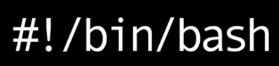
Scripting Languages
PAWNSCRIPT

Slide 4





games & scripts
Many games use scripting languages for animation and game play logic.
Sometimes you can extend the game actions, scenarios and missions using scripts.
This is a great way to give power to the game owner (player).

Slide 5
Scripting Language Proprieties
Almost all scripting languages are cross-platform besides the ones that are specific to the operative system (Bash, PowerShell, AppleScript)
The level of access to game engine can vary:
When its used to create a game the scripting language can interact directly with the game engine.
When its used by the players the access is high-level, and may depend on the game and the implementation of it.
Integrate very well into many languages, particularly C/C++.

Slide 6

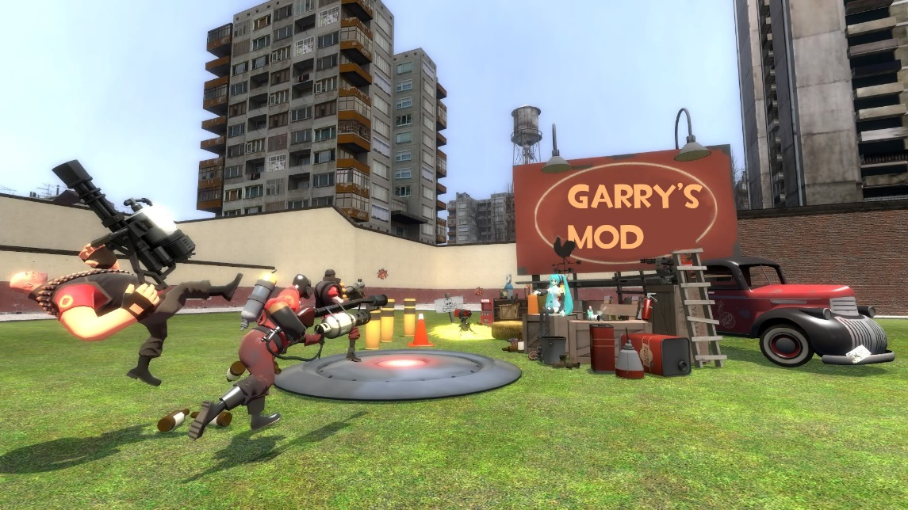
Case Study Garry’s Mod
Garry’s mod is an open world game.
You can create everything like buildings, weapons and characters, gamemodes and other neat features.
Lua is the scripting language used to create and animate anything you want to add to the game.

Slide 7
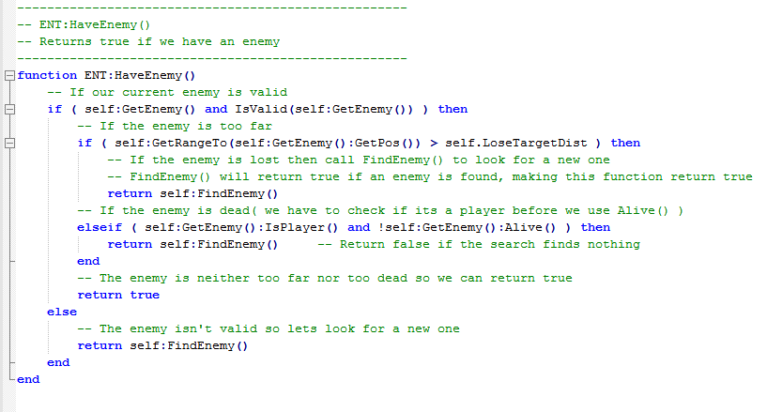
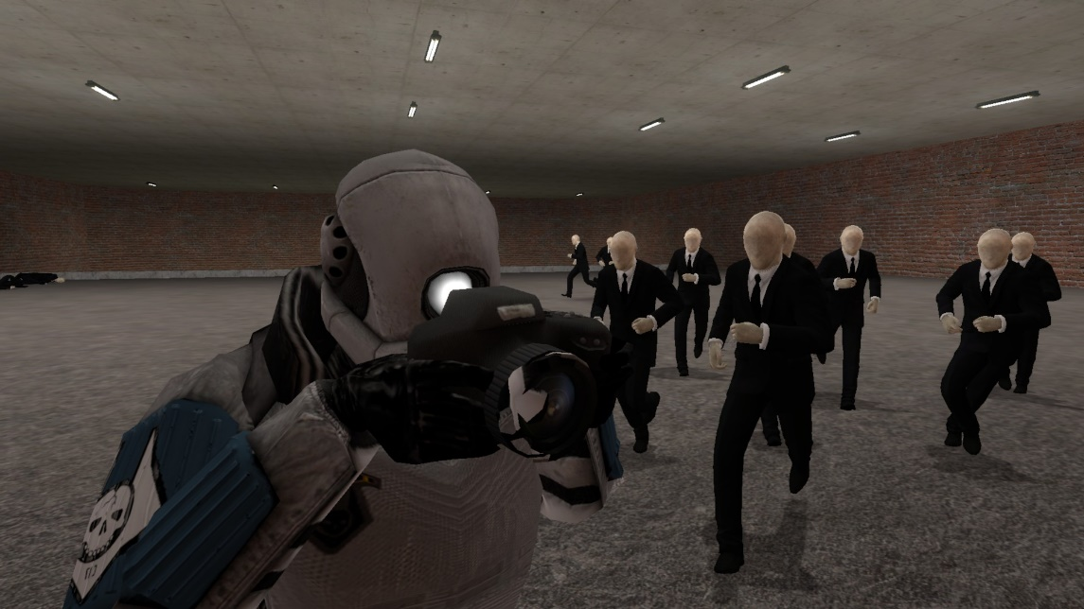
Case Study Garry’s Mod

Slide 8



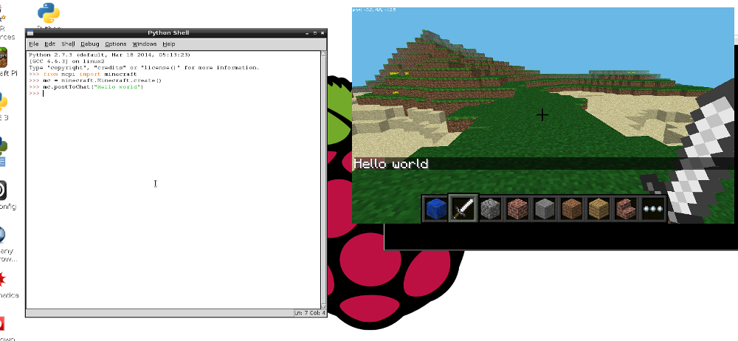
Case Study Minecraft PI
Minecraft free version built for Raspberry PI.
Uses Python scripting language for manipulating the world.
Principally used as a programming teaching tool for kids!

Slide 9
Scripting Advantages
Flexibility of type defining.
Rapid turnaround of interpretation.
Higher level semantics.
Development speed.
Ease of learning.

Slide 10
Scripting Disadvantages
Syntactic and other limitations.
Tend to limit their efficiency and expressive power.
Have very limited support for concurrency, data structuring, information hiding, object-oriented programming, regular expressions, etc.
Disturbingly easy to write bugs into the script-side of your game code that are very difficult to detect because due to the use of specific language features they will only trigger in very specific unforeseen circumstances, at runtime.

Slide 11
Useful links
Lua Language: http://www.lua.org/
Squirrel Language: http://squirrel-lang.org/
Raspberry Pi + Python: http://www.raspberrypi.org/resources/learn/
Garry’s mod: http://wiki.garrysmod.com/page/Category:Lua_Tutorials

Slide 12
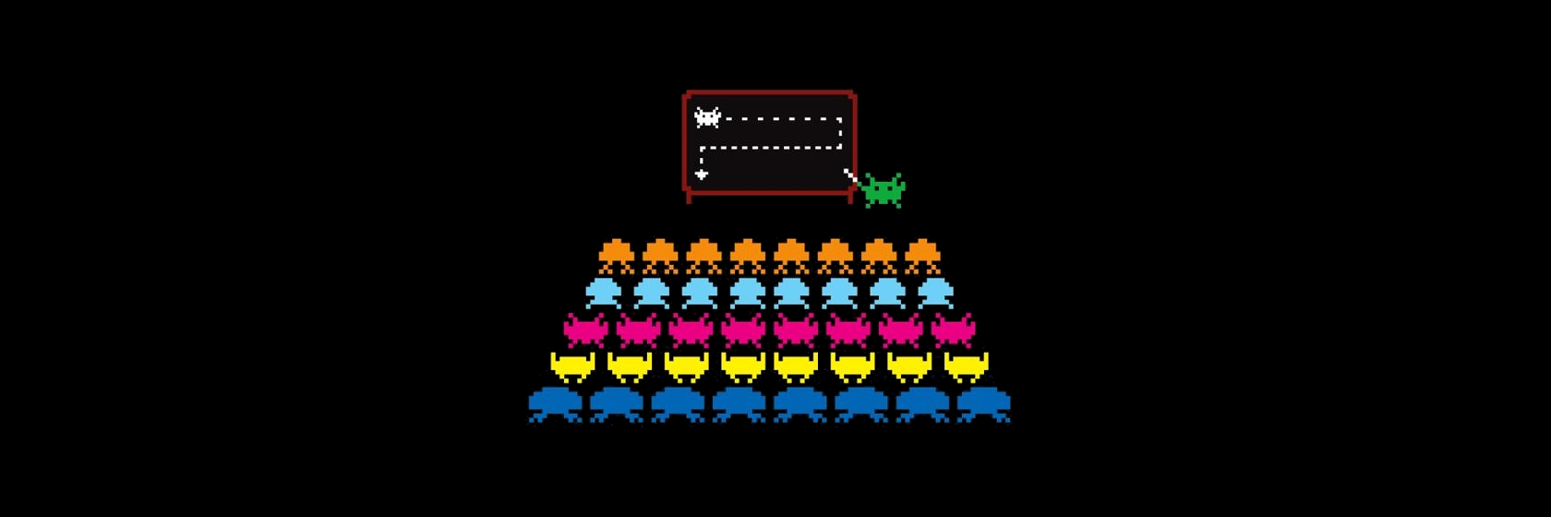
Thank you!
Questions?

