Slide 1
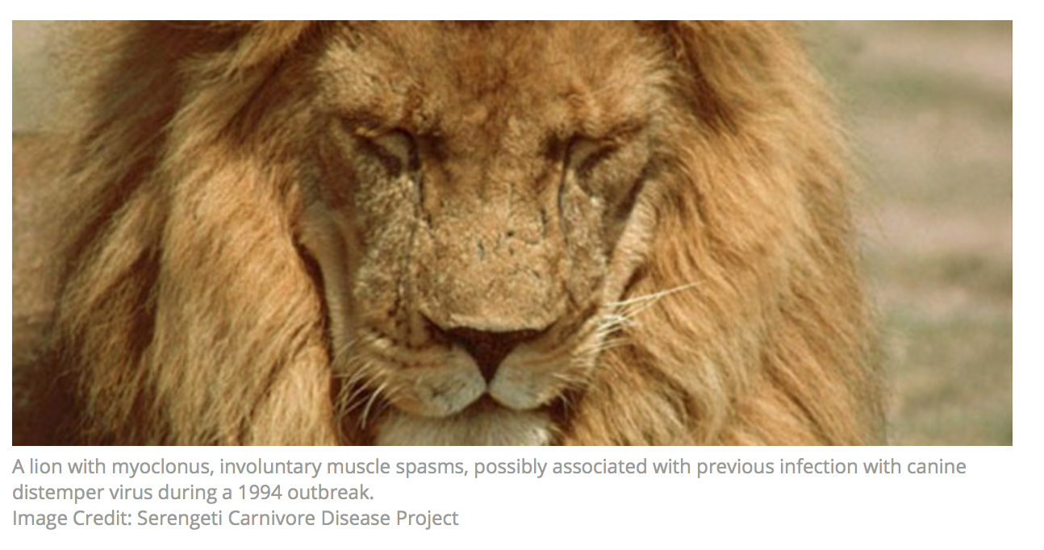

Signals of Selection in Host Genome (Nectin4 as Proxy)
GDW2019 Group Exercise with Nectin 4: Hypothesis, Genomic Workflow, Findings, and Future Directions

Slide 2
Nectin4 Workflow –Step 1
Hypothesis
Research shows CDV co-receptor Nectin4 is linked with the neurological form of CDV in carnivores, particularly felids and canids.
HO: Nectin4 exhibits neutral evolution among mammalian lineages, tracking speciation.
H1: Nectin4 has variants linked with neurologic CDV susceptibility

Slide 3
Nectin4: Step 2
Assembling Data for a Pilot Study
1) Understand the Host: Mammalian Evolution and Phylogeny
2)Genome mining of existing sequences from representative lineages (NCBI, ENSEMBL) refGene
3)Download and translate into coding sequences (e.g. Geneious)

Slide 4
Carnivore Order

Slide 5
Nectin4: Step 3
Alignment of Nectin4 Sequences from 32 Taxa
Programs: Aliview (Muscle), ClustalX, Clustal Omega, Mafft, PRANK
Which works best with coding regions?
MUSCLE, PRANK or adapting programs to identify codon (aligned as translated codons)
What is the key feature of multiple sequence files (MSA) that alignment programs must resolve ?
Indels

Slide 6
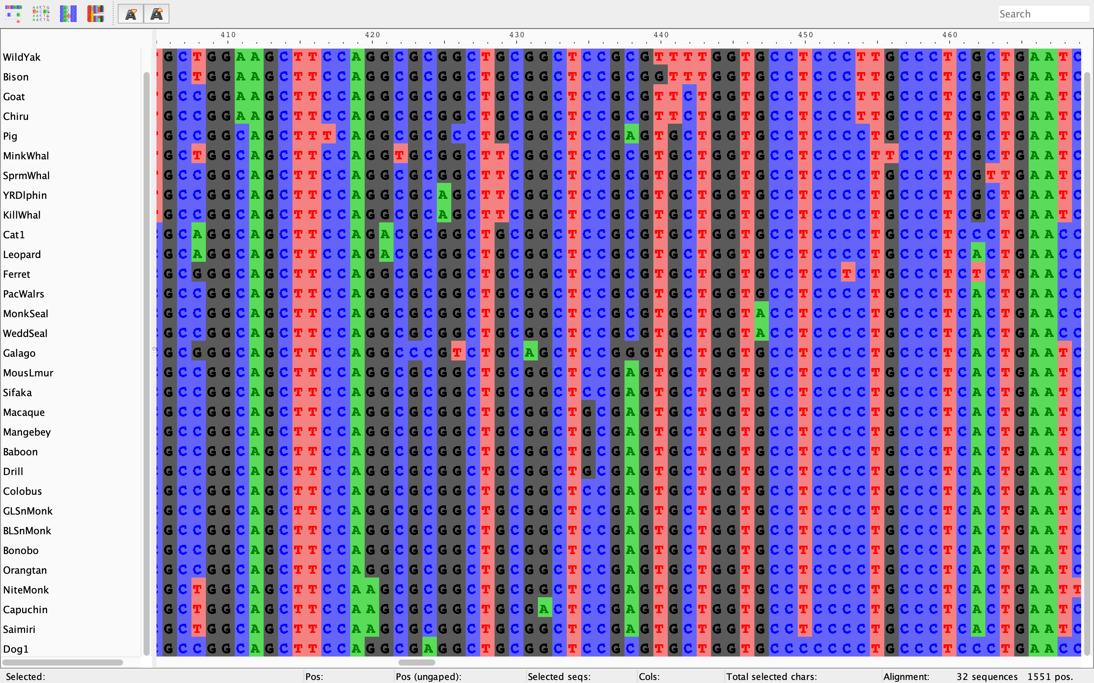

Slide 7
Feliformia
Caniformia

Slide 8
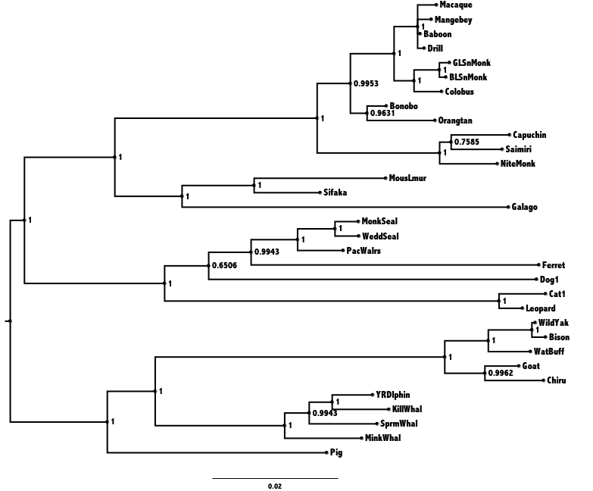
Nectin4: Step 4
MP ME ML Bayes

Slide 9
ML Phylogeny
100 BS reps

Slide 10
Testing Coding Regions for Signals of Adaptive Evolution
Is there evidence of selection operating on a gene?
Where does selection occur within the gene? What regions, motifs, amino acids are under selection?
Mapping the selection event on the phylogenetic tree. Is there a specific species or lineage that is experiencing selection?
Assessing the form of selection (i.e. negative or positive) and identifying the codon (s), and a priori testing for statistical rigor.
Are other genes exhibiting compensatory changes coincident with selection?

Slide 11
Testing for Selection in Aligned Sequences (MSA)
Aligned codon sequences must be in frame with no stop codons.
Remove recombination motifs and/or analyze partitions of MSA that are confirmed identical by descent.
Permits unbiased estimates of parameters
A resolved phylogenetic tree of the multiple sequence file.
Pre-existing species tree established from other analyses
A poorly resolved tree will be unable to adequately test for selection and result in spurious results.

Slide 12
Molecular Selection In Coding Sequences
dN – nonsynonymous (missense) substitution
dS – synonymous substitutions
= dN/dS
= 1 (Neutral), no functional effect
< 1 (Purifying selection), selected to maintain function
> 1 (Diversifying selection), selected for adaptation to change in function

Slide 13
Categories of Codon Selection Models
Among sites:
Ho: Variable selection pressure possible among sites within YGOI (your-gene-of-interest) but no sites exhibit positive selection
Among branches:
Ho: Average dN/dS is the same among all branches in the phylogeny for YGOI.
Among clades:
Ho: Average dN/dS for YGOI is the same for each lineage within the phylogeny
Branch-site:
Ho: Variable selection pressure is possible among sites with YGOI and no sites exhibit positive selection in any particular lineage relative to the rest of the phylogeny.

Slide 14
HyPHy: HYpothesis testing using PHYlogenies
Step 1: GARD (Genetic Algorithm for Recombination Detection)
Pre-Analyses for Selection
Identify Recombinant Regions of Alignment
Step 2: Among Sites Model across Phylogeny (pervasive selection)- Programs listed progressive larger datasets
FEL (Fixed Effects Likelihood) ,
SLAC (Single-Likelihood Ancestor Counting) ,
FUBAR (Fast, Unconstrained Bayesian AppRoximation)
Step 3: Among sites Models within a subset of branches within a phylogeny
MEME (Mixed Effects Model of Evolution)
Step 4: Branch-site Models
aBSREL (adaptive Branch-Site Random Effects Likelihood)
Notes:
Are individual sites subject to episodic (at a subset of branches) positive or purifying selection?
 MEME (Mixed Effects Model of Evolution) tests for episodic selection at individual sites. Note that MEME does not accept a priori branch specications (this feature is being introduced with
v2.3-dev and later). MEME is the preferred approach for detecting positive selection at individual sites.
Are individual branches subject to episodic (at a subset of sites) positive or purifying selection?
 aBSREL (adaptive Branch-Site Random Effects Likelihood) is an improved version of the common "branch-site" class of models. aBSREL allows either for a priori specication of branch(es) to test for selection, or can test each lineage for selection in an exploratory fashion. Note that the exploratory approach will sacrice power. aBSREL is the preferred approach for detecting positive selection at individual branches
FEL (Fixed Effects Likelihood) is suitable for small-to-medium sized data sets.
hyphy.org/getting-started/#using-hyphy
2/4
5/24/2019 HyPhy - Hypothesis Testing using Phylogenies - Information, documentation, and news about the HyPhy software package
 SLAC (Single-Likelihood Ancestor Counting) is an approximate method with accuracy similar to FEL, but suitable for larger datasets. However, SLAC is not suitable for highly-diverged sequences.
 FUBAR (Fast, Unconstrained Bayesian AppRoximation) is suitable for medium-to-large data sets and is expected to have more power than FEL for detecting pervasive selection at sites. FUBAR is the preferred approach for inferring pervasive selection.

Slide 15
Basic Steps to CodeML
Create 3 files: data, tree and control
Load files into GUI interface
Select Parameters for appropriate test
Depending on numbers of sequences, genetic information, pattern of mutation, length of sequence…..
CodeML can take minutes or hours to run
Record Ln likelihood value
Compare with ln likelihood of null model.
Determine significance by the log-likelihood ratio model (LRT).
Δλ = 2 (l₁ - l₀) chi-square 2 d.f.
For Branch-Site Models
Δλ = 2 (l₁ - l₀) chi-square 2 d.f. P-value/2

Slide 16
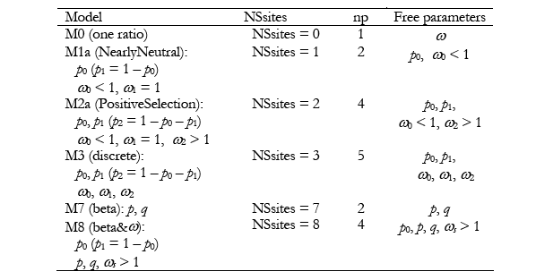
Site Models
LRT
Model M1a and Model M2a, 2 df
Model M7 and Model M8, 2 df

Slide 17
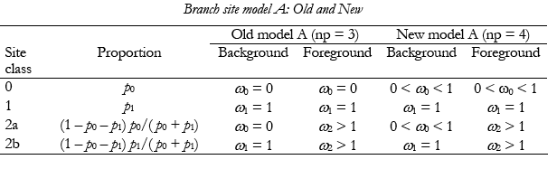
Branch Site Models
Branch-site
Model A recommended
Model = 2
NSsites=2
Compare LRT with Null Model A
Model=2
NSsites=2
But, ω=1, fixed.
Results include MLC files and Rst files which will include any BEB analyses that will identify putative sites under selection.

Slide 18
Nectin4: Step 5
Tests for Selection with PAML
We use a constraint tree corrected according to known mammalian evolution.
Likelihood values:
Among Sites Models Branch Site Models
Model 0 Carnivores
Model 1 Dog-like
Model 2 Cat-like
Model 7
Model 8

Slide 19
Nectin4: Among Sites Models
Table 1. Tests for selection among codons of Nectin4 in Mammals using models implemented in PAML 4.8 using the likelihood method
Criteria | Model | Parameter estimates | Ln likelihood | LRT 2 df | Selected Codon, BEB Posterior Probability
Among Sites | M0 (one ratio) | k = 3.26438 w ₀= 0.12726 | -7210.145636 | NA | NA
 | M1a (nearly neutral) | k = 3.37983 w₀= 0.04628 (p₀=0.88353) w₁= 1.00000 (p₁=0.11647) | -7131.607388 | NA | NA
 | M2a (selection) | k = 3.37982 w₀=0.04628 (p₀=0.88353) w₁= 1.00000 (p₁=0.116470) w₂= 24.47759 (p₂=0.00000) | -7131.607388 | M2a vs M1a NS | 409 S 0.646
 | M7 (b distribution, neutral) | k =3.29736 b distribution p= 0.13854 q=0.81699 | -7126.396981 | NA | NA
 | M8 (b distribution, selection) | k = 3.29588 w_{s}= 0.02930 (p₁ = 1.22390) b distribution p₀= 0.97070 p=0.16546 q=1.29682 | -7124.109459 | M8 vs M7 4.6, P=0.1, 2 d.f. NS | 14 A 0.617 17 W 0.845 32 L 0.863 74 A 0.614 78 G 0.907 193 T 0.638 309 P 0.804 314 T 0.769 341 A 0.581 342 P 0.711 409 S 0.967* 481 R 0.688

Slide 20
Nectin4: Branch-Site Models
Table 2. Test of selection of Nectin4 among lineages using revised branch-site Model A and test 2 as implemented in PAML 4.8
Model A | Parameter Estimates |  |  |  |  | Ln likelihood LRT test 2,1df | Selected Codon, Posterior P Positive sites for foreground lineages Prob (w>1):
 |  | Site Class | p | w0 background | w1 foreground
Felid lineage | k=3.37927 | 0 1 2a 2b | 0.87897 0.11127 0.00867 0.00110 | 0.04491 1.00000 0.04491 1.00000 | 0.04491 1.00000 5.55434 5.55434 | LnL0 = -7129.218766 LnL1 = -7128.155700, P=0.07 | 25 A 365 C | 0.932 0.936
Caniform Lineage | k=3.37985 | 0 1 2a 2b | 0.88353 0.11647 0.00000 0.00000 | 0.04628 1.00000 0.04628 1.00000 | 0.04628 1.00000 1.00000 1.00000 | LnL0=-7130.813821 LnL1=-7131.607388 P=0.10 NS | Both back ground and foreground share same values.
Carnivore Lineage | k=3.37305 | 0 1 2a 2b | 0.88088 0.10867 0.00930 0.00115 | 0.04536 1.00000 0.04536 1.00000 | 0.04536 1.00000 1.65644 1.65644 | Lnl0= -7130.813821 Lnl1= -7130.579671 NS | 25 A 33 A 86 S 87 K 277 Q 365 C | 0.675 0.679 0.817 0.709 0.586 0.689

Slide 21
Future Directions?

