Slide 1

Working with…

Slide 2
Recap of process leading up to BEAST…
Question/hypothesis > Grant > Samples > Nucleic acid extraction
> NGS/Sanger > De novo assembly/mapping to reference
> Consensus sequences (+/- metadata) > Alignment/trimming
> Test for recombination > Nucleotide substitution model selection
> Revisit your question
> Choose appropriate phylogenetic analysis to answer your question!
> If above involves BEAST…proceed!
> Validate BEAST model/run and priors*
Notes:
Testing evolutionary hypotheses while accounting for phylogenetic uncertainty
Modeling other values across a tree

Slide 3
Some common questions applied to BEAST
How does geography influence evolution between samples/populations?
What is the timeline of evolution across…(samples, species, etc)?
What is the mutation rate across my tree?
Does the mutation rate differ along different branches?
Approximately when did xx variant emerge?
What is the relationship between hosts/pathogens?
Cross-species transmission vs. host specificity
How has a particular phenotype evolved across taxa?
Notes:
Many of these deal with time

Slide 4
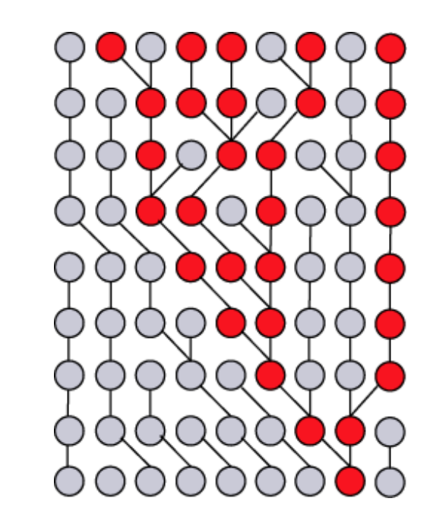
BEAST uses the coalescent to work backwards in time when estimating trees….
t=0 current time (sample)
t₋₁ = previous generation
.
.
.
.
.
.
.
The probability of coalescence is related to genetic diversity and population size in each generation…
ie: effective population size
t_{-n}

Slide 5
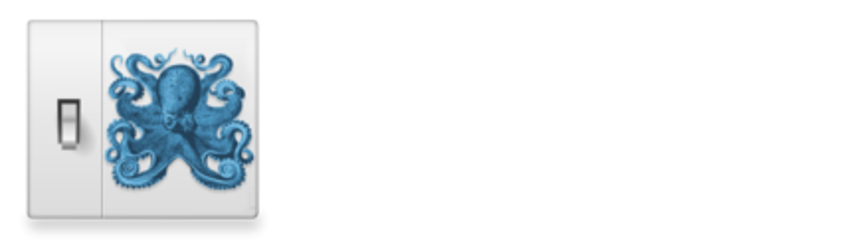
More of a package than a single software…
BEAUTi – Input data, set parameters, create the BEAST input file
Notes:
Defining parameter space…mcmc robot example

Slide 6
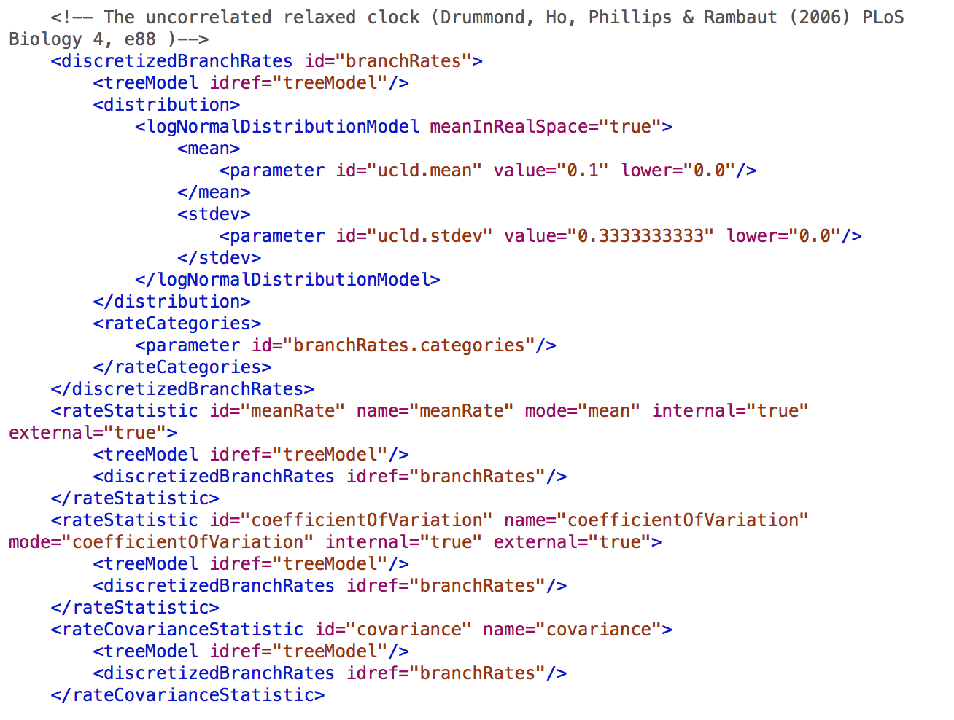
More of a package than a single software…
BEAUTi
XML Format

Slide 7
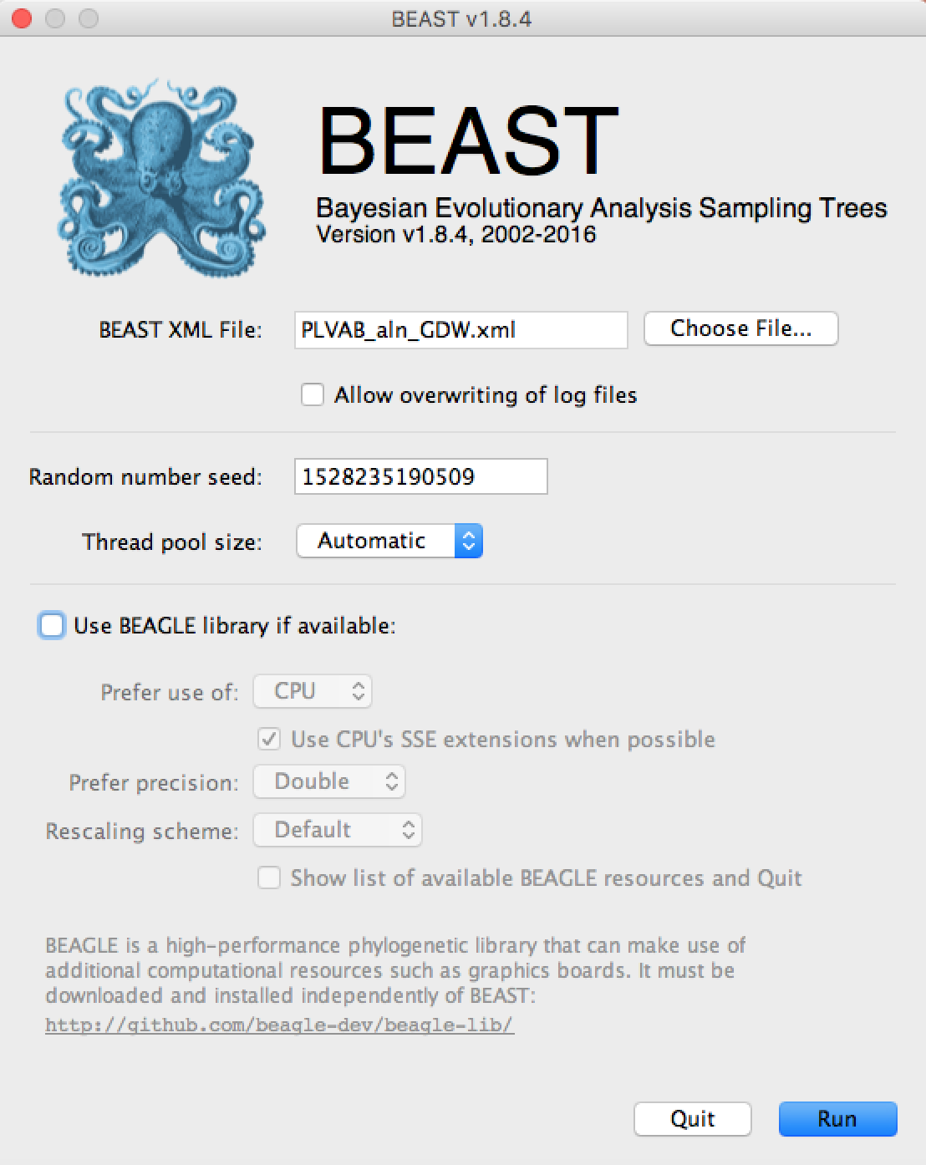
More of a package than a single software…
BEAUTi

Slide 8
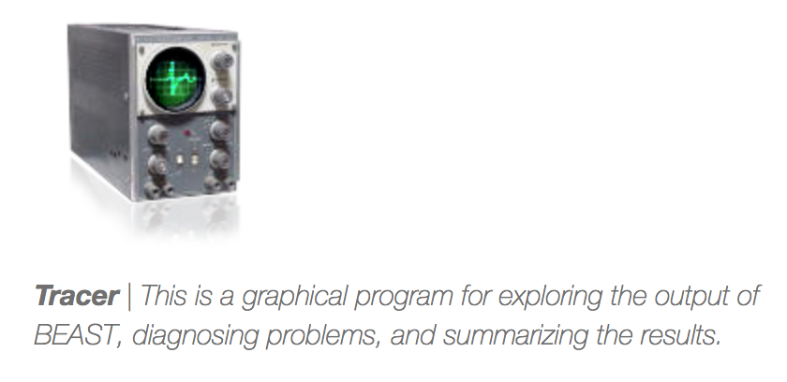
More of a package than a single software…
BEAUTi
Tracer – view
BEAST output and
summarize results

Slide 9
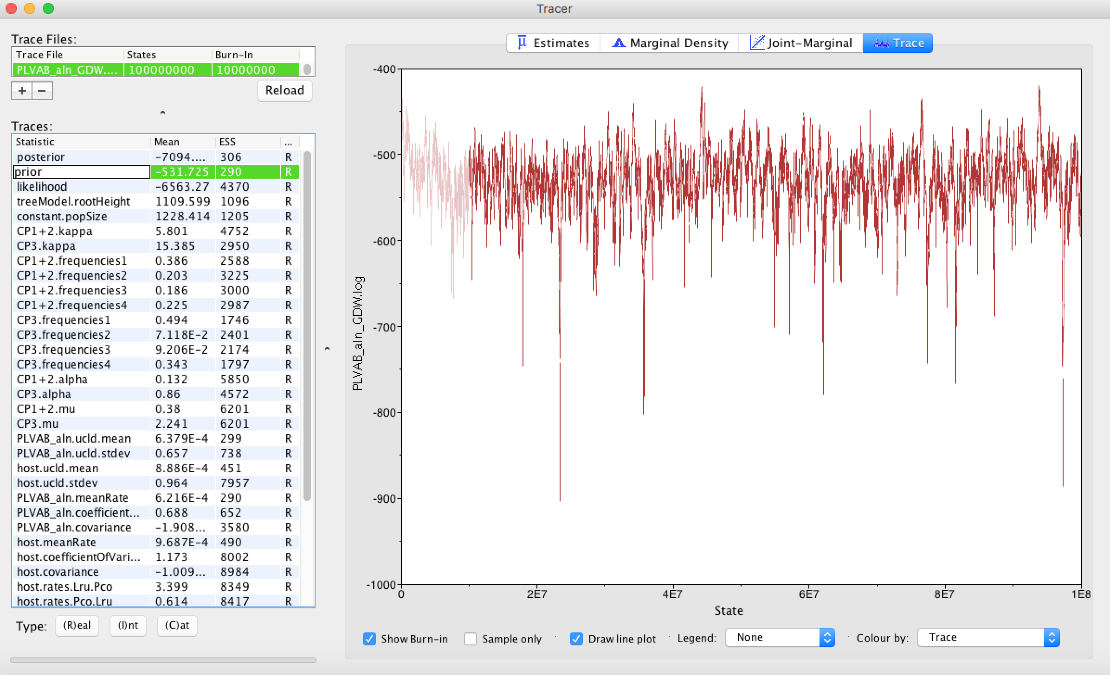
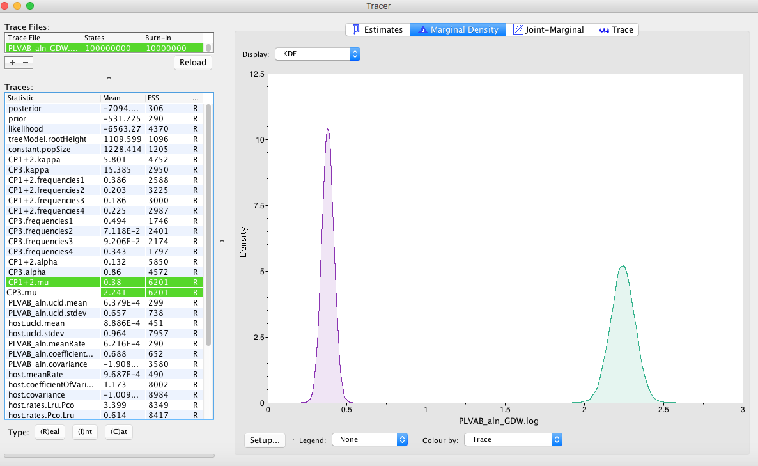

Slide 10
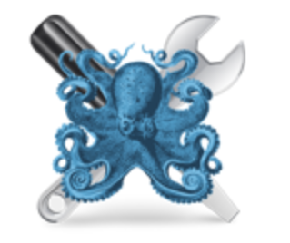
More of a package than a single software…
BEAUTi
Tracer
Tree Annotator
Produces a consensus tree
from BEAST output

Slide 11
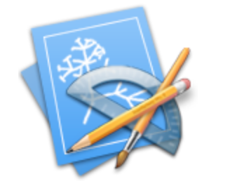
More of a package than a single software…
BEAUTi
Tracer
Tree Annotator
Fig Tree
View consensus tree
and parameter estimates

Slide 12
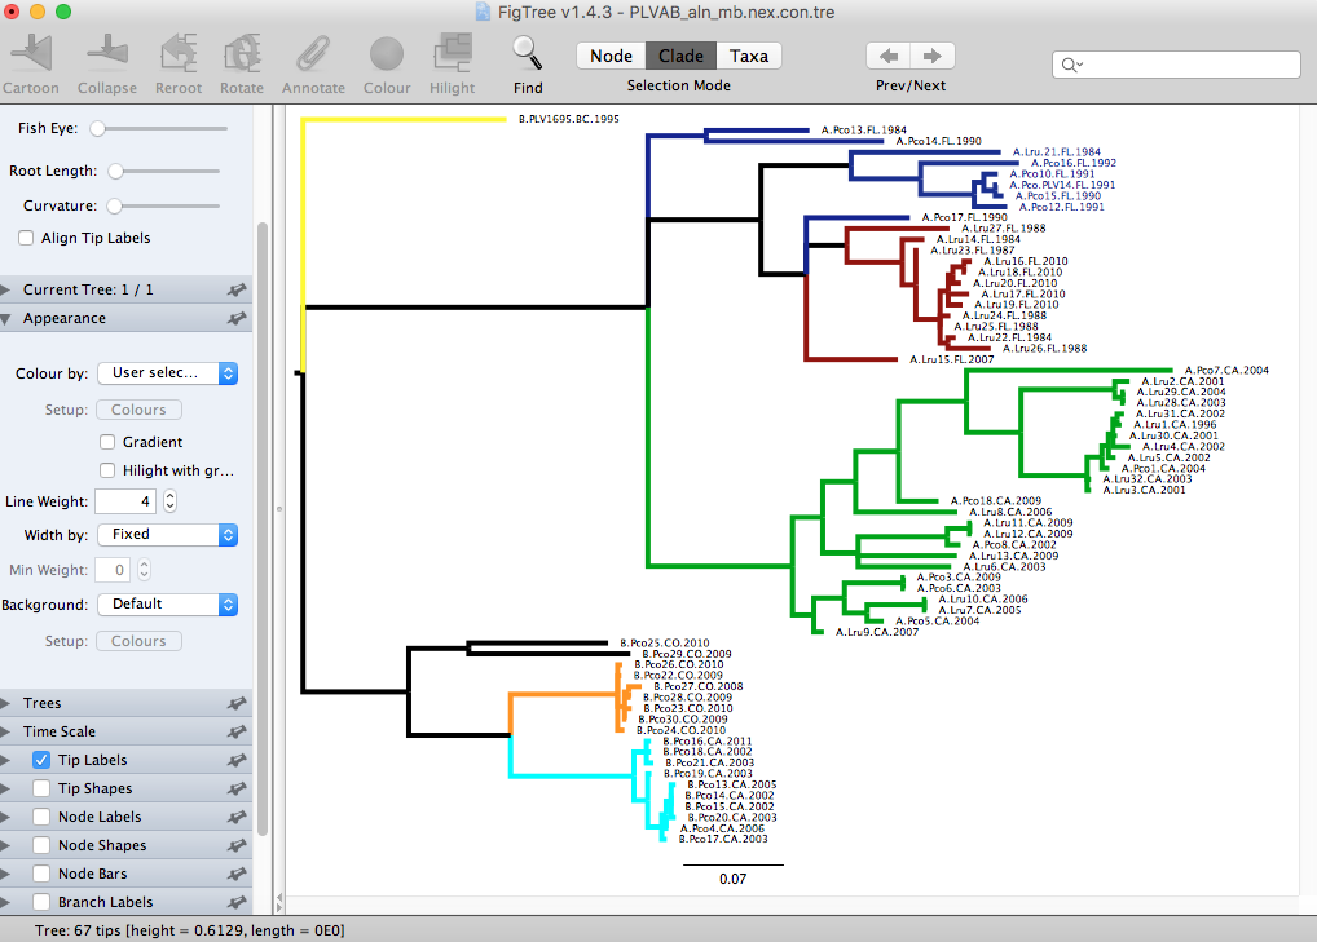
More of a package than a single software…
BEAUTi
Tracer
Tree Annotator
Fig Tree
View/edit consensus tree
and parameter estimates

Slide 13
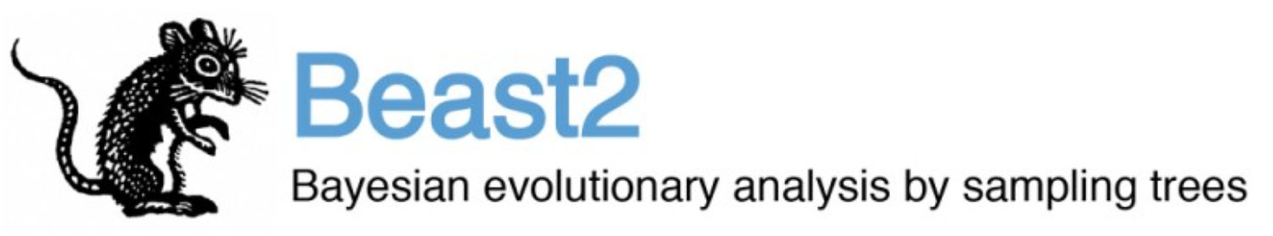
Wait…there’s more!

