Slide 1
Logistic Regression

Slide 2
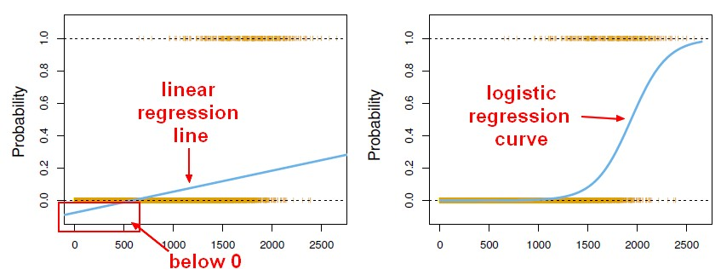
Logistic Regression
Logistic Regression
Logistic regression model predicts the probability associated with each dependent variable category
How does it do this?
It finds the linear relationship between independent and the link function of this probabilities. Then the link function that provides the best goodness of fit for the given data is chosen
Notes:
But why shouldn't we use linear regression here.
Whenever we use linear regression you can get values which might be negative and we know for a fact
that probability values can never be negative so that is a problem associated with linear regression.
When we do this particular exercise using our we will understand why we should not imply linear regression
at the same time.
If we use logistic regression your values will range from zero to one you will not become negative.
Right.
So let us understand this.
Say you have probability values which are of course from zero to 1 on y axis and say you have 0 Salary in (inr)

Slide 3
Types of logistic regression
Logistic regression
Simple
Multiple
A single independent variable model is called as simple logistic regression
A Multiple independent variable model is called as Multiple logistic regression

Slide 4
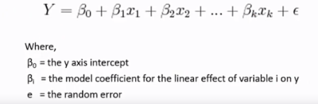
Logistic Regression
Multiple Logistic regression
Multiple Logistic regression is quite similar to multiple linear regression

Slide 5

Logistic Regression
Probability:
The probability in a logistic regression curve
where :
e is the real number constant the basic of natural logarithm and equal to 2.7183
y is the response value of the observation

Slide 6
Methods
There are three methods of the logistic regression based on nature of the attribute data
-- Binary
-- Nominal
-- Ordinal
Binary LR:
Binary logistic regression performed on the binary responsive variables. It has only two categories.
Nominal LR:
Nominal logistic regression performed on the Nominal variables. These are categorical variables that have three or more possible categories with no natural ordering
Ordinal LR:
Ordinal logistic regression performed on the Ordinal responsive variables. These are categorical variables that have three or more possible categories with natural ordering

Slide 7
Assumptions and steps:
Logistic Regression Assumptions
Only one outcome per event like yes or no
The outcomes are statistically independent
All relevant predictors are in the model
One category at a time means mutually exclusive and collectively exhaustive
Sample sizes are larger than for linear regression.
Steps Involved in Logistic Regression
Step 1: Collect and organize sample data
Step 2: Formulate Logistic Regression model
Step 3: Check the model validity.
Step 4:Determine Probabilities using probability equation
Step 5:Compile the results

