Slide 1

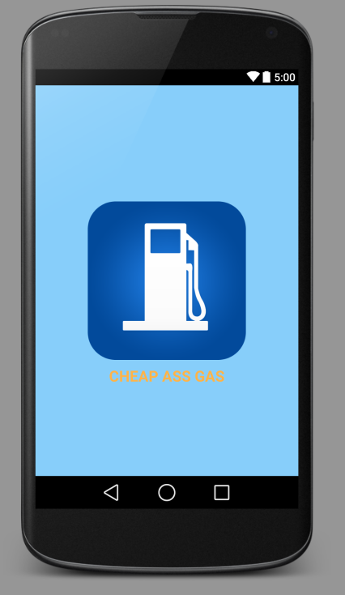
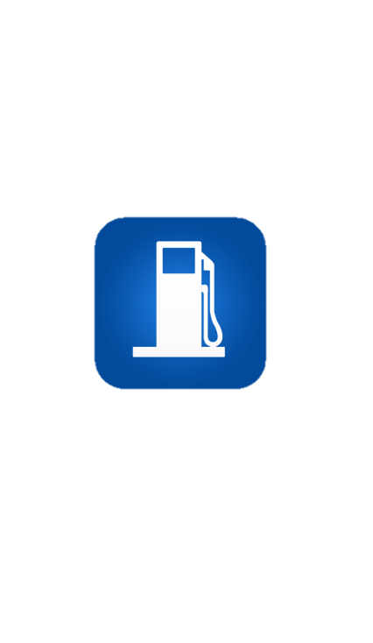
Presents
Cheap Ass Gas

Slide 2
Cheap Ass Gas
The easy to use app that answers that burning question on every frugal persons mind…
Is it worth it?

Slide 3
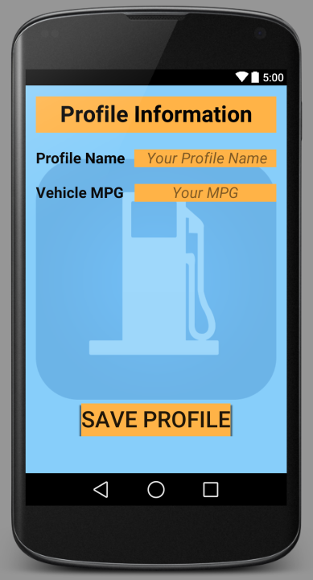
Customize
Your
information

Slide 4
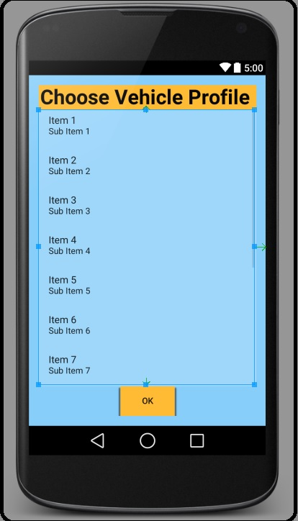
Choose
Your
information

Slide 5
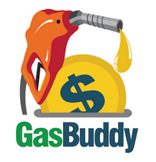

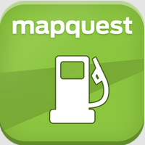
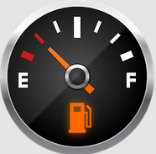
What do we have that
these guys don’t?
GasBuddy
Gas Stations
Mapquest
Gas Prices
Gas Guru

Slide 6
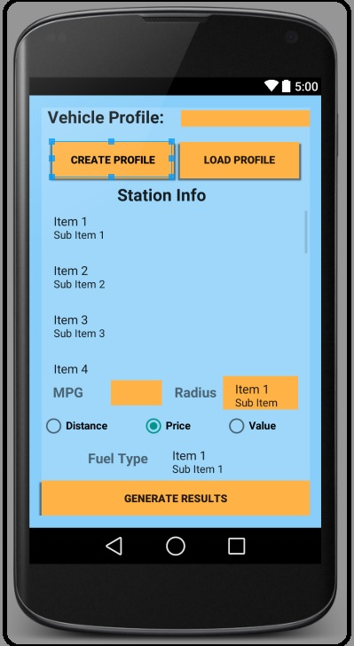
Calculate
Your
savings

Slide 7
Thank you.
Find us on Google Play

