Slide 1


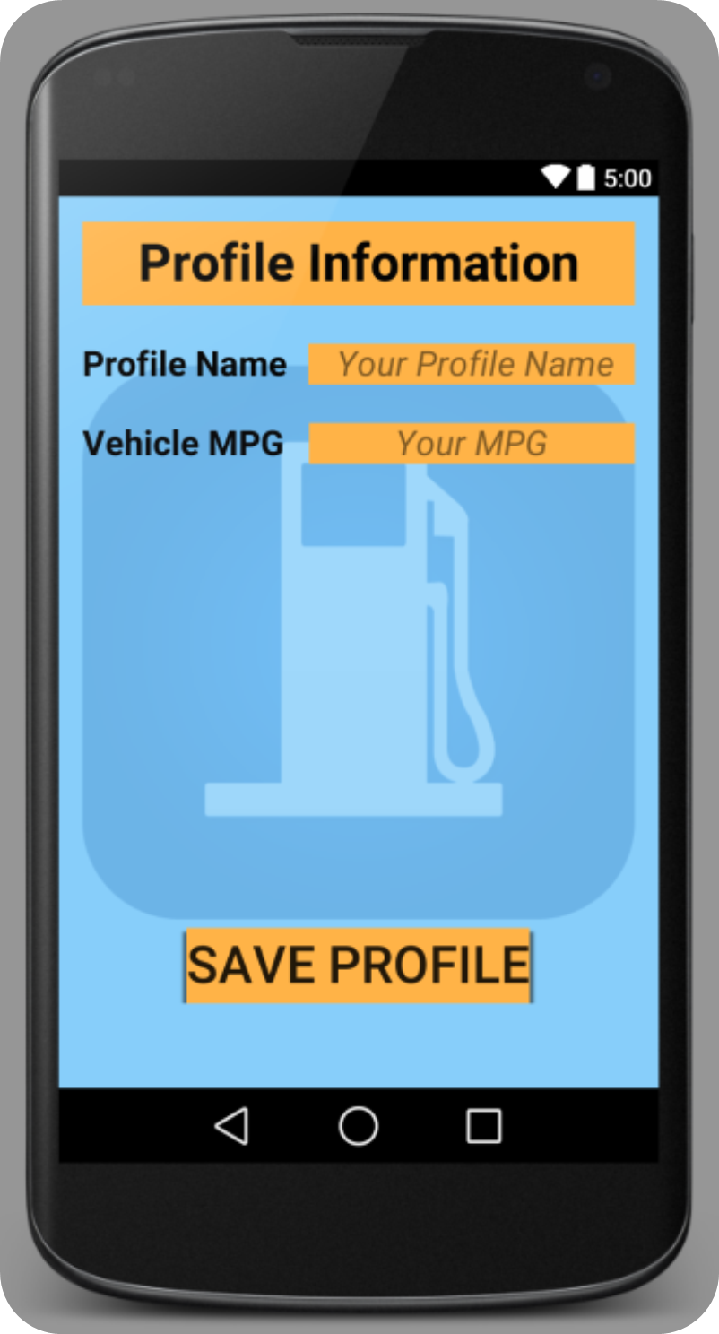
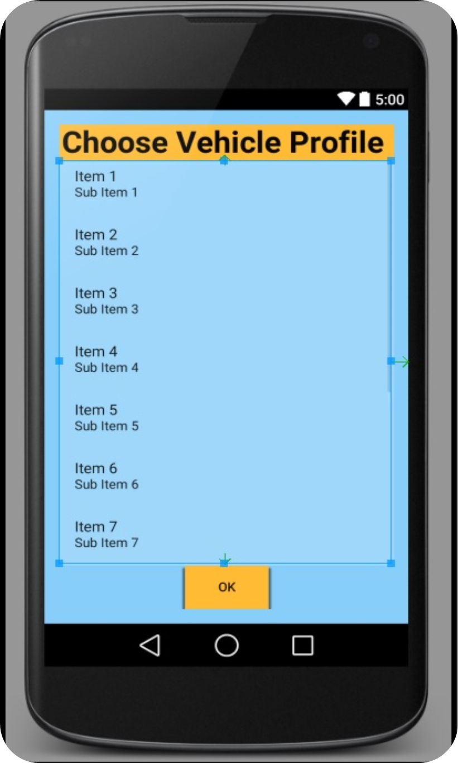
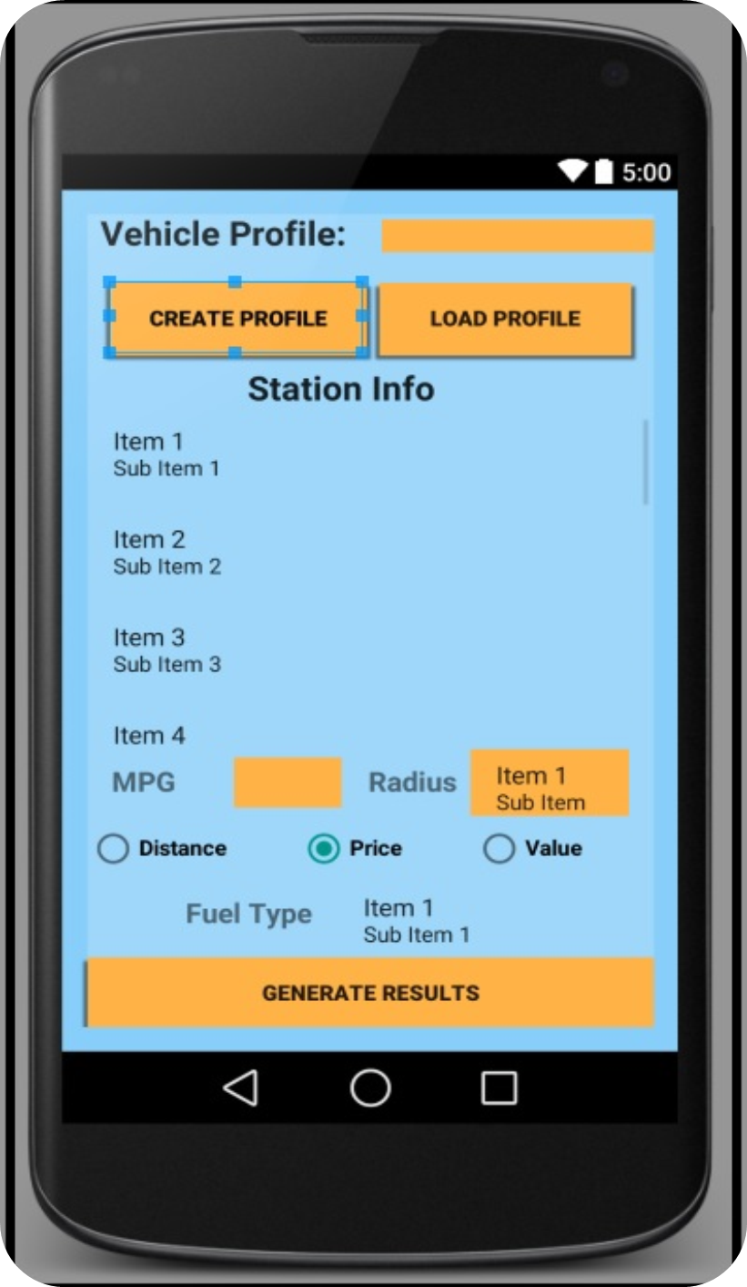
Developing a Fuel Finder App for Android
Jonathan Collins, Charlotte Rose Hamilton, Justin Roberts, (Phil Gunter, Britt Strother)
Software Engineering, Concord University, Athens, WV.
  Abstract
  Using Android Studio, Google’s integrated development environment (IDE), our team created an app that filters fuel stations based on user defined search options. Using this IDE, our team successfully designed a Graphical User Interface (GUI) capable of market deployment. The app was created in an environment mirroring industry standards for Software Development. In this system a client team employed us to build an app for their business.
  To facilitate this our team constructed a timely feedback loop with the client via use of the Agile Development method. Additionally we used an open standard data format called JavaScript Object Notation (JSON). The JSON information retrieves data via the Hypertext Transfer Protocol (HTTP) and is the crux of our app functionality. Jointly the use of studio and data retrieval tools can produce quality, competitive products with potential to promote business platforms.
Procedures
Our team created several individual activities within the program that together satisfied the client’s requirements. The needs of the app were classified into these distinct functions: Getting the information, Saving a user’s information, Calculating a “best” value based on user criterion, and retrieving user information that has been saved within the app. Three activities ( Main Activity, loadProfile and profileScreen ) provided the framework for navigation and human use while our java files GPSTracker, MainActivity, ListClassComparator, ServiceHandler, LoadProfile, and ProfileScreen all provided the core information needed to make the app run.
GPSTracker.java – This file uses LocationListener to gather information about your current location. Behind the scenes information is being exchanged between the app, your device, and an external information system.
MainActivity.java – This activity served as the controller component of the system. All interaction is governed by the sequencing of information and instructions located in this file.
ListComparator.java – Inside of this class we gathered the information received from our query and sorts the listings.
ServiceHandler.java – Manages connections to external information via HTTP.
LoadProfile.java – Looks inside of the apps memory and brings up all previously saved profiles .
ProfileScreen.java – Serves to provide users the ability to create and save profiles for convenient future use.
Results
What we developed
  Due to the nature of the course our project is still in progress and will reach it’s final development stage once submitted to Google Play store. To be precise there are two components to a finished state product. Submission to the store will stand as a landmark signifying the completion of one while maintenance will stand as another. The immediate quantifier remains submission to the Play Store, this shall server as the benchmark for our studies. A proper analysis and observation of the other component requires time and empirical data this study cannot ascertain.
Estimated level of difficulty for maintenance
  We feel confident that future use of our app was taken into full consideration while in the development stages. The desire to provide a functional piece of software that can remain usable with future devices and technologies remains an important aspect of this project. While we cannot predict the machine changes that will be unveiled in the years to come our team believes that the applications basic framework can remain intact and adapt where necessary in order to remain in operation for future users.
Compare list of client expectations
  As a preliminary to the submission stage approval from the client team is needed. Its purpose is to endorse the product in its final state or to inform us of any changes needed before submitting the app.
What we ended up using in terms of resources
  Our team feels that the agile development method along with Android Studio provided an exemplary environment for development. The success of our project in the timeframe given was made possible by the structural tools included in studio.
Introduction
A Contextual Overview : Software Engineering is an incredibly dynamic and demanding field of study that can often times be overwhelming. Rapid growth in the technology sector creates a constant need for companies to reexamine their systems and consider new frontiers. The need to remain relevant and accessible forces most business to integrate or risk failure. Within these confines lives Software Engineering. The purpose of a development team is to not only create an application or program. They are solely responsible for ensuring that the final product is exactly what the client expected. This is the environmental conditions assumed for this course. Our assignment was to create a fully functioning Android app for an assigned team that served the role of employer. We met with the client group on a periodic basis to discuss the progress of the app as well as determine future direction and priorities. Through these meetings and conversations, our “employer” would provide to us a set of requirements for each phase. They provided us with regular feedback regarding opinions on the product and were able to use an up to date version of the product on their personal device.
Within this model our team members took on various roles in order to yield a balanced understanding in regards to software development. The roles were as follows: Project Manager (PM), Lead Programmer and Team Programmer. Each member of the team was required to fulfill the role of PM for at least one phase during the development cycle. Our Lead Programmer for the project, Jonathan Collins, served as a sort of resource liaison, helping the team understand the technical ambiguities in tutorials or resource sites.
Technological Overview: Our team spent hours researching and filtering through sites such as Stack Overflow to find pertinent information regarding android development in studio. Given the brevity of Android Studio’s history, locating information relative to our project proved unusually challenging for certain aspects of the program.
Resources
Android Studio was the development environment we used to design, code and test our app. With it comes an emulator that allows the developers to use the program on an Android device.. Within this program we were able to combine the functionality of multiple resources, such as JSON strings, Java code and XML files.
JSON Strings were used inside of our primary class, Main Activity to deliver to the app the crucial information needed to calculate savings. When received they provide the location information, fuel selections available and pricing information.
Agile Programming tutorials and information pages gave us an understanding of planning options as well as insight into the processes used in the industry.
What We Learned
Throughout this project each member of our team served in varying roles and positions. Each position exposed us to realistic demands as well and the level of responsibility associated with a group dynamic. The entire process reinforced the design principles we have been learning about and gave us the opportunity to work in an environment that fostered appreciation and insight for the theories behind the principles. Having to research solutions for unique elements of our app helped paint a more realistic picture of personal responsibility in an industry setting. Additionally the rotating role of Project Manager (PM) afforded each of us a way to view the development process in a new light. We believe that the success of our project was due in part to the group model (PM, Lead Programmer, Team Programmers) we were assigned to follow. The need for strong organization and understanding is critical because without it team efforts would have become disjoint, sometimes even counter productive. The presence of a Client team also gave our project an elemental challenge that was needed and appreciated. Overall, we were able to see that even with the most sophisticated technology available a team is only as successful as it’s members. As nontechnical as it may be, attitude was a key player as well.
References
http://velmuruganandroidcoding.blogspot.com/2013/08/how-to-get-current-latitude-and.html
Developer.android.com
Deitel Developer Series: Android for Programmers
https://developer.android.com/training/location/retrieve-current.html
http://stackoverflow.com/questions/5155952/sorting-a-list-of-mapstring-string
https://www.youtube.com/watch?v=aJ4Q8Y9Zb7E
http://developer.android.com/reference/android/app/Activity.html#onCreateOptionsMenu(android.view.Menu)
http://developer.android.com/training/basics/firstapp/starting-activity.html
https://www.youtube.com/watch?v=NcVKzRBqNBo

