Slide 1

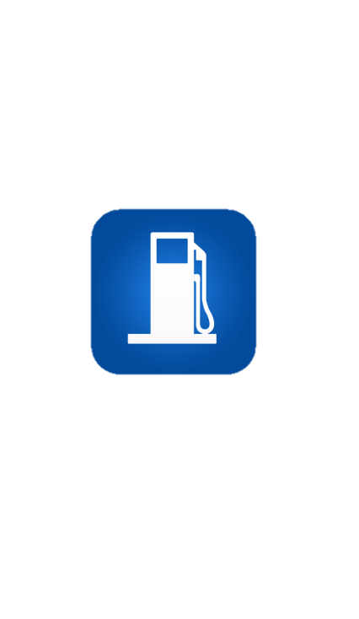
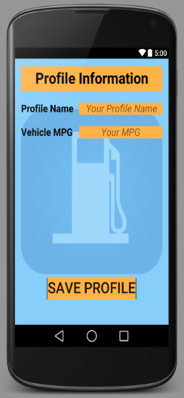
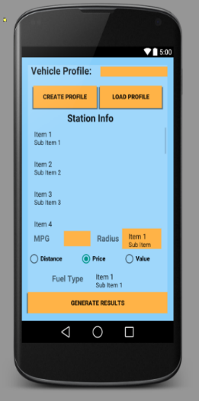
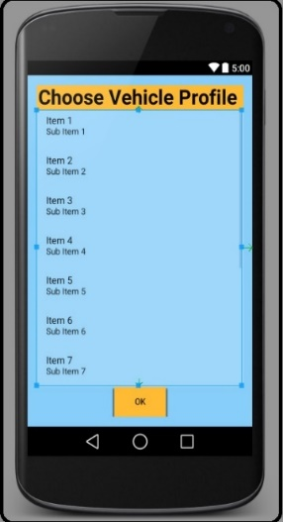

Personal savings
Cheap Ass Gas
Personalized vehicle profile let you easily transition between vehicles so that you can always get your savings down to the dime.
Traveling with a friend? We got you covered there too. You can save up to 10 profiles, or just use a one time search.
Then whenever you’re ready, hit generate results to start saving.
Team 4 Enterprises realizes that you may find your inner skeptic questioning the validity of our claims, and who could blame you? How often is this much awesome packed up and delivered to your device for less than the cost of a Snickers bar? Sound amazing? That’s because it is. Just imagine your Snickers bar not only yielding to you its yummy gooey goodness but then being there to roll out as your personal money saving sidekick whenever you need. Because that is exactly what owning this app is like. We can’t promise that it will take you to Trump status, be we do guarantee that the savings are sweet.
Cheap Ass Gas

