Slide 1











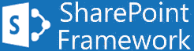
SPFx Learning Path

