Slide 1


Real-Time Data Streaming and NLP Analysis using Kafka, Transformers, and BERTopic
Jean Paul Saba & Caren Dib

Slide 2
Table Of Contents
01
03
02
04
Problematic
Sentiment Analysis Consumers
Architecture Implemented
Topic Extraction Consumers

Slide 3
01 Problematic
Real-time processing
Reddit
Crucial in the era of big data
Generate vast amounts of data
Apache Kafka
Advanced NLP techniques
Distributed event-streaming plat form
Sentiment analysis
Transformers pipeline
Real-time categorization
BERTopic model
Implementation language: Python

Slide 4
02 Architecture
Version 1: Single Topic with Partitioned Consumers
Consumers Group 1:
reddit-sentiment-group
Kafka topic:
Reddit_stream
Consumer 1
Producer
Reddit streamer
Consumer 2
Partition 0
Partition 1
Consumers Group 2:
reddit-topic-group
Consumer 1
Consumer 2
* Using BERTopic Model: Trained Separately

Slide 5
02 Architecture
Version 1: Single Topic with Partitioned Consumers
Pros | Cons
Efficient Partitioning: Parallel processing improves performance. | Coupling: Sentiment analysis and topic extraction are tightly linked.
Reduced Overhead: Managing one Kafka topic saves resources. | Single Dependency: Issues in reddit_stream affect all consumers.
Direct Processing: Data flows directly from the producer to the consumers, reducing latency. | Monitoring Challenges: Overlapping logs make debugging harder.

Slide 6
02 Architecture
Version 2 (Implemented): Multi-Topic Pipeline with Sentiment-Analyzed Data
Kafka topic:
Reddit_stream
Kafka topic:
sentiment_analyzed
Consumers Grp 1:
reddit-sentiment-group
Produces to
Consumers Grp 2:
reddit-topic-group
Produces to
Producer
Reddit streamer
Partition 0
Consumer 1
Partition 0
Consumer 1
Partition 1
Consumer 2
Partition 1
Consumer 2
* Using BERTopic Model: Trained Separately

Slide 7
02 Architecture
Version 2 (Implemented): Multi-Topic Pipeline with Sentiment-Analyzed Data
Pros | Cons
Modularity: sentiment_analyzed decouples components, adding flexibility. | Increased Complexity: More topics and producer-consumer chains add complexity.
Scalability: Sentiment analysis and topic extraction scale independently.
Data Reusability: Processed sentiment data can be reused without reprocessing. | Higher Resource Usage: Additional topics require more Kafka resources.
Fault Isolation: Errors in one stage don’t affect others, improving fault tolerance.

Slide 8




Reddit Streamer Implementation
Reddit API Integration
Kafka Producer
Real-Time Execution
Fetching and Streaming Data to Kafka
Uses PRAW to fetch posts, including title, author and score
Sends posts to Kafka with JSON serialization and partitioning.
Execution Control
Streams posts from multiple subreddits with error handling.
Stops after reaching a post limit or manual interruption.

Slide 9

03 Sentiment Analysis Consumers
Kafka Integration
Sentiment Analysis Model
Data Flow
Message Processing
Subscribes to reddit_stream topic and processes messages in real-time
Reads messages from Kafka, extracts the title, cleans text, and applies sentiment analysis
Hugging Face’s RoBERTa-based model trained on social media data
Analyzed results are sent to the sentiment_analyzed topic

Slide 10
03 Sentiment Analysis Consumers
Key Features and Benefits
Partition Awareness: The code will be run twice, and each instance will read from a different partition given by kafka.
Real-Time Sentiment Analysis: Sentiments are analyzed in real time, providing immediate insights into the tone of Reddit posts.

Slide 11
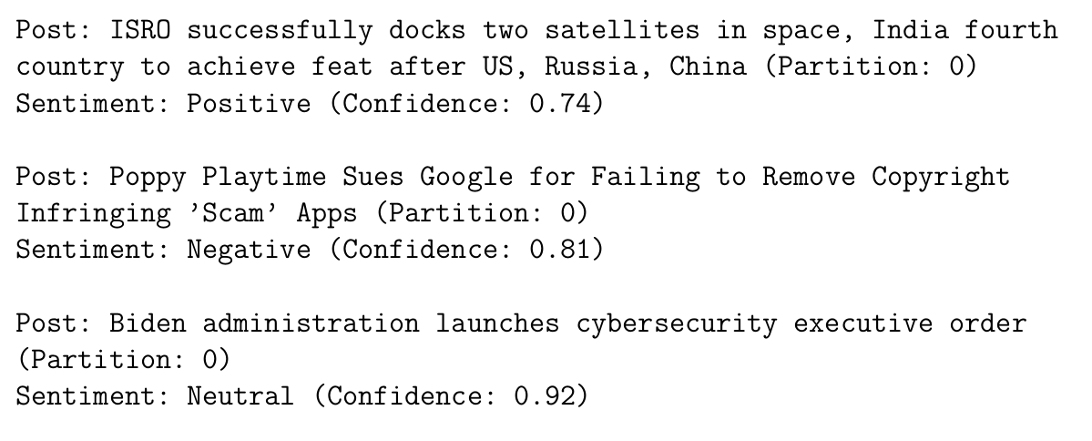
03 Sentiment Analysis Consumers
Example Outputs

Slide 12




04 Topic Extraction
Training and Saving the BERTopic Model
Collecting Titles: Extracts post titles from reddit_stream topic in Kafka.
Text Preprocessing: Removes URLs, special characters, and stopwords for clean input.
Dimensionality Reduction: Uses UMAP to reduce embedding size while preserving structure.
Topic Modeling: Applies BERTopic to cluster and identify recurring themes.

Slide 13
04 Topic Extraction
Kafka Integration
Topic Modeling
Storage
Message Processing
Topic Extraction Consumers
Subscribes to sentiment_analyzed topic and processes messages in real-time
Reads, extracts, and cleans titles from the sentiment_analyzed topic
Loads the pre-trained BERTopic model to categorize posts based on textual content.
Outputs structured data to a CSV file and generates a word cloud.

Slide 14
04 Topic Extraction
Key Features and Benefits
Partition Awareness: The code will be run twice, and each instance will read from a different partition given by kafka.
Real-Time Topic Extraction: Topics are assigned in real-time based
on the latest Reddit posts.
Data Categorization: Posts are categorized into meaningful topics,
enabling structured analysis.
Visualization: Word cloud provides an intuitive summary of the most discussed topics.

Slide 15
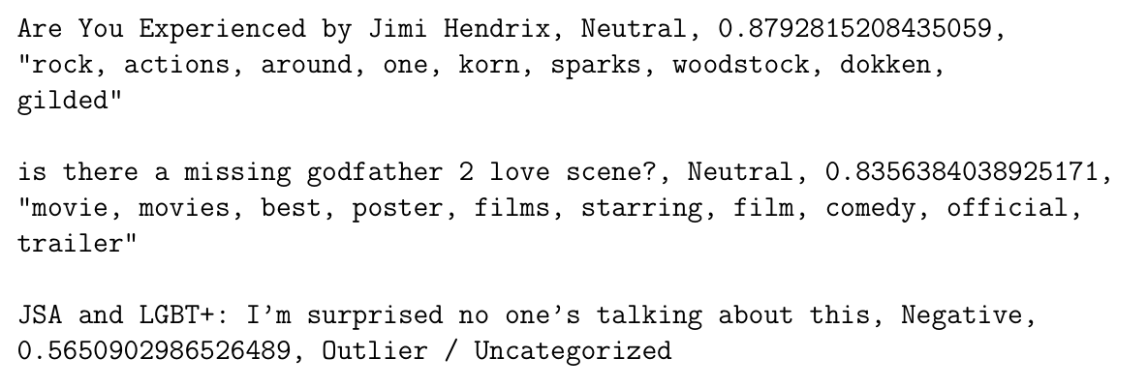

04 Topic Extraction
Example Outputs
Example Word Cloud Generated from Extracted Topics
Example outputs generated by the topic extraction consumer

Slide 16




Conclusion
Scalability
Modularity
Kafka partitions enable parallel processing.
Independent stages improve flexibility.
Real-time Insights
Fault Tolerance
Dynamic analysis of Reddit posts.
Kafka ensures reliable message flow.
A robust, scalable, and real-time NLP pipeline for dynamic text analysis.

Slide 17
Demo

