Slide 1
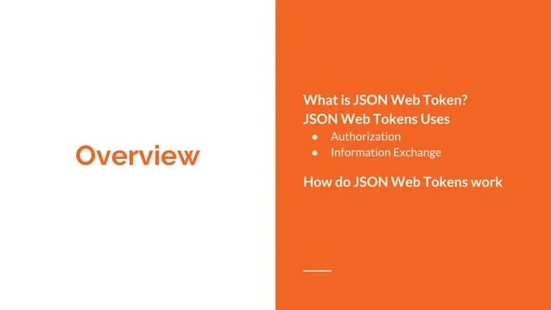

Slide 2
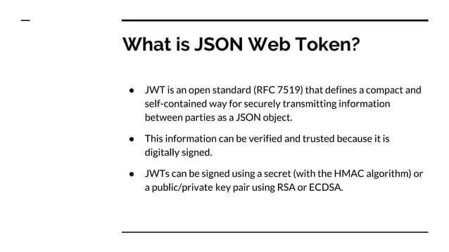

Slide 3
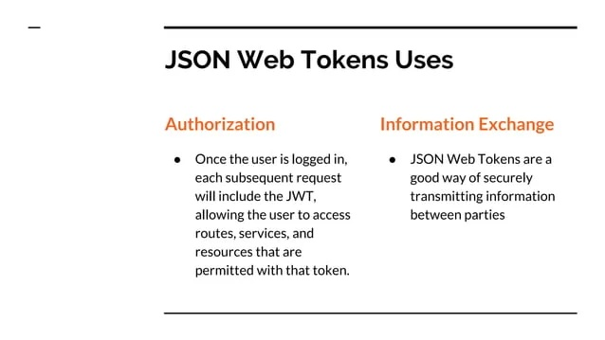

Slide 4
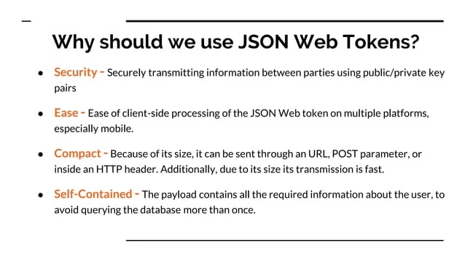

Slide 5


Slide 6
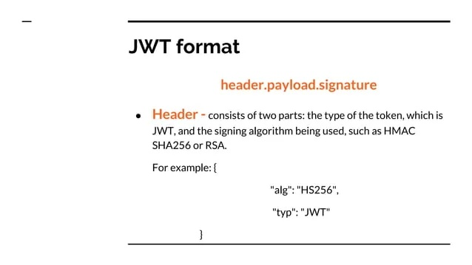

Slide 7
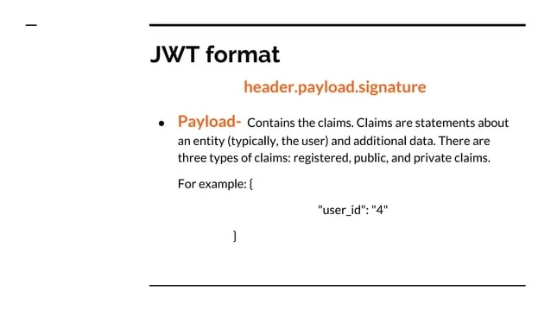

Slide 8
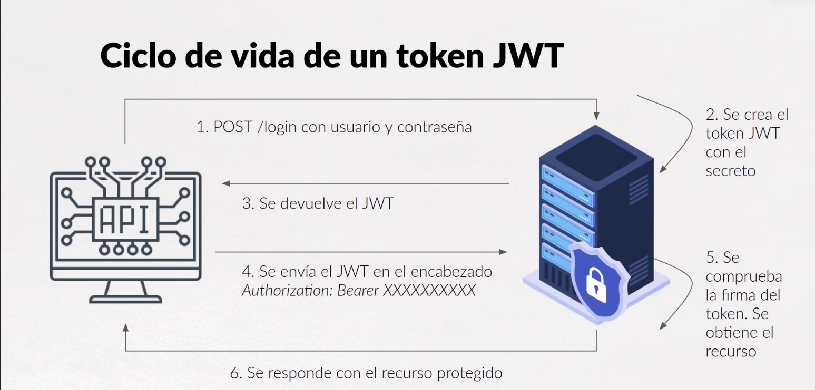
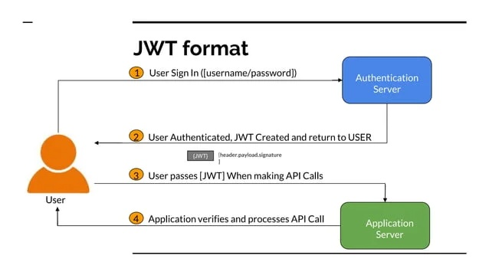

Slide 9
Express-OAuth-Server
OAuth2orize
Passport-OAuth2
Node-OAuth2-Server
Simple-OAuth2
Passport.js
Satellizer
Devise
OAuth2orize
Laravel Passport

