Slide 1


Slide 2
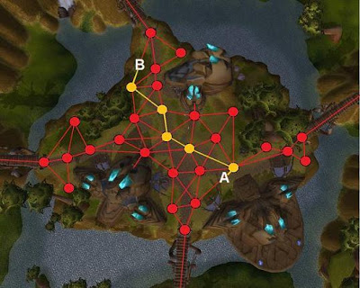
Punto 1

Slide 3
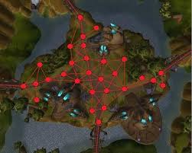
Punto 1

Slide 4
Punto 1

Slide 5
Punto 1
{ (1,1), (1,2), (1,3), (2,1), (2,2), (2,3),
(3,1), (3,2), (3,3)
}
Simulators: https://www.cs.usfca.edu/~galles/visualization/DFS.html
https://visualgo.net/en/graphds
Notes:
http://latex2png.com/
g=(V,E),E\subseteq V\times V
g=(V,E),E = V\times V
|V\times V|

Slide 6
Punto 1: Problema
A
B
A, B, A, B, A, B...
Simulators: https://www.cs.usfca.edu/~galles/visualization/DFS.html
https://visualgo.net/en/graphds
Notes:
http://latex2png.com/
g=(V,E),E\subseteq V\times V
g=(V,E),E = V\times V
|V\times V|

Slide 7
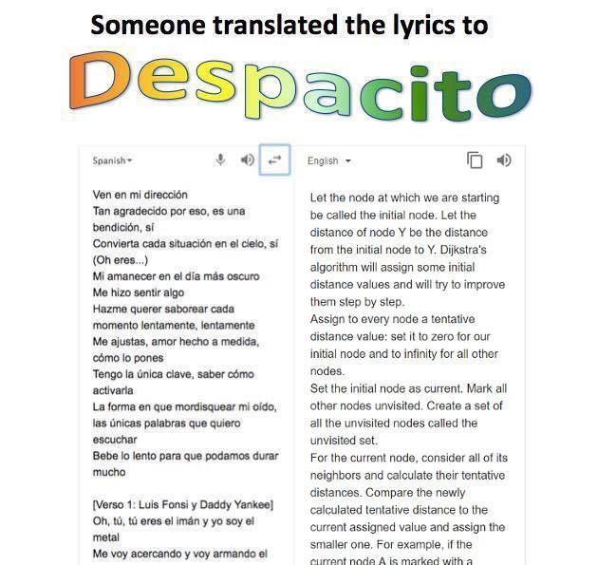
Punto 2: No es Dijkstra
Simulators: https://www.cs.usfca.edu/~galles/visualization/DFS.html
https://visualgo.net/en/graphds
Notes:
http://latex2png.com/
g=(V,E),E\subseteq V\times V
g=(V,E),E = V\times V
|V\times V|

Slide 8
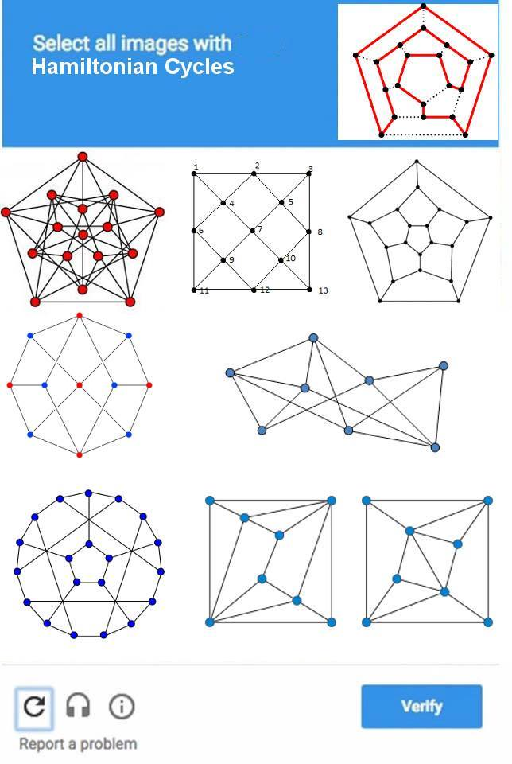
Punto 3: Diferente a camino hamiltoniano
Notes:
http://latex2png.com/
g=(V,E),E\subseteq V\times V
g=(V,E),E = V\times V
|V\times V|

Slide 9

Punto 3: Es TSP
Notes:
http://latex2png.com/
g=(V,E),E\subseteq V\times V
g=(V,E),E = V\times V
|V\times V|

Slide 10
Videos y Tutoriales de DFS
https://www.youtube.com/watch?v=zaBhtODEL0w
https://www.hackerearth.com/practice/algorithms/graphs/depth-first-search/tutorial/
https://www.hackerearth.com/practice/algorithms/graphs/depth-first-search/visualize/
https://www.hackerearth.com/practice/notes/graph-theory-part-i/
https://www.cs.usfca.edu/~galles/visualization/DFS.html
https://www.youtube.com/watch?v=bIA8HEEUxZI
Notes:
http://latex2png.com/
g=(V,E),E\subseteq V\times V
g=(V,E),E = V\times V
|V\times V|

