Slide 1
Computer Science Group 2
Justin
John
Lateef

Slide 2
Pseudocode
Insertion-sort:
Input: Array A[1...n], of elements in arbitrary order; array size n
Output: Array A[1...n] of the same elements, but in the non-decreasing order
Algorithm:
for i= 2 to n do
// insert i'th element A[i] into the already sorted A[1...i-1]
// keep swapping the value in A[i] with previous element
// till it "bubbles" down the right place
// (i.e. keep swapping till the previos element is smaller)
j <-- i
while j>1 AND A[j-1]>A[j] do // when i=1 there is no prev element
swap( A[j], A[j-1] )
j <-- j-1

Slide 3
Pseudocode
Merge-sort:
It is easier to view this algorithm as sorting separate sections of the array A. Thus the generic input of algorithms above is slightly modified by adding two parameters first and last.
Input: Array A[1...n], of elements in arbitrary order; also first and last positions 1 < first < last < n
Output: Array A[1...n] of the same elements, but the elements between first and last (i.e. A[first...last]) are in the non-decreasing order. All elements before first and after last are unchanged (and so the set of elements between first and last is not changed - only sorted).
Algorithm:
if (last < first) then RETURN //there's nothing between first & last: 1 element is always sorted
else
middle <-- |_ (first+last)/2 _|
merge_sort( A, first, middle )
merge_sort( A, middle+1, last )
merge( A[first...middle], A[middle+1...last]; A[first...last] )

Slide 4
Pseudocode
Selection-sort:
Input: Array A[1...n], of elements in arbitrary order; array size n
Output: Array A[1...n] of the same elements, but in the increasIng order (more precisely in non-decreasing order - in case some elements are equal)
Algorithm:
for i= 1 to n do
// find min element in A[i...n]
// and put it in the i'th position (i.e. at A[i])
min_index <-- I //locate min
for j= i+1 to n do
if A[j] < A[min_index] then min_index < -- j
//put the min where it belongs
swap( A[i], A[min_index] )

Slide 5
Pseudocode
Interpolation Search
A → Array list
N → Size of A
X → Target Value
Algorithm:
Set Lo → 0
Set Mid → -1
Set Hi → N-1
While X does not match
if Lo equals to Hi OR A[Lo] equals to A[Hi]
EXIT: Failure, Target not found
end if
Set Mid = Lo + ((Hi - Lo) / (A[Hi] - A[Lo])) * (X - A[Lo])
if A[Mid] = X
EXIT: Success, Target found at Mid
else
if A[Mid] < X
Set Lo to Mid+1
else if A[Mid] > X
Set Hi to Mid-1
end if
end if
End While
End Procedure

Slide 6
Pseudocode
Binary Search of an Array:
set Element-found to false
set low-element to 1
set high-element to max-num-elements
DOWHILE (Element-found = false AND
low-element < = high-element)
index = (low-element + high-element) / 2
IF input value = array (index) THEN
set Element-found to true
ELSE
IF input value < array (index) THEN
high-element = index - 1
ELSE
low-element = index + 1
END IF
END DO
END

Slide 7
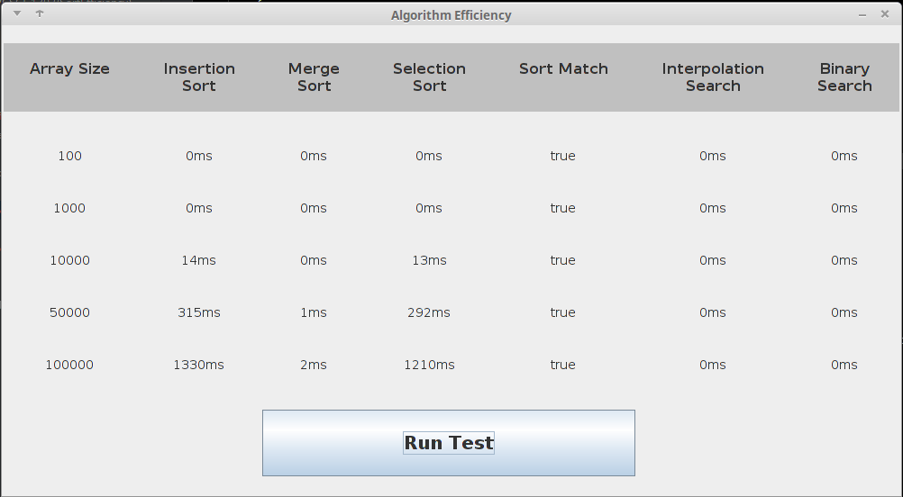
GUI

Slide 8
Conclusion
The Merge sort algorithm performed the best and the search algorithms are situational

