Slide 1
3D / 2D Dynamic Text
Jay Hunt
AR COE
Version 2.0 4/14/2021

Slide 2
3D Text Display with 2D Canvas Support
Display Text with more control in either the 3DCanvas or the 2DCanvas.
Supports concepts of Paragraphs and Line wrapping
To use:
Load the arcoe3DText.js lib
Populate configuration value (Optional)
Call doText function with the text to display
the doText function takes a JSON parameter
There are lots of potential configuration parameters available
The Library uses the concept of a “Page”, “Paragraph”, and “sentences”
The message parameter is the text to display and considered the “page”
The “page” can be divided into “paragraphs” by using the default carriage return / line feed value of “\n”. Or optionally this value can be set via a parameter.
A “default” pageDisplay JSON can be used and then adjust other values as needed in an experience
Requires an IMAGE Widget to render the Text. This is set in the “imageWidget” parameter.

Slide 3
Known Issues
Text Alignment: Currently only supports “LEFT”

Slide 4
Rendering Space
Initially designed for use in the HoloLens, this version has been adjusted to also work in the 2D Canvas
To support the use of the 2D Canvas a new configuration parameter “widgetsrc” has been added.
This parameter will hold the property value of the Image Widget in which the text will be rendered
Note in the 3D Canvas this value should be “src”
Note in the 2D Canvas this value should be “imgsrc”
widgetsrc: The Image Widget SOURCE Property
Sample: “widgetsrc": “imgsrc"
Default: none
Required: YES
Possible Values: imgsrc, src
imageWidget: The name of the Image Widget to render the text in.
Sample: “imageWidget": “image-1 "
Default: none
Required: YES
Possible Values: valid name of Image Widget

Slide 5
Text Position / Size
Sample:
Text Parameters
textAlign
FontColor
message
paragraphSplit
betweenParagraphs
widthMeters
heightMeters
canvasFont
lineheightratio
fontSize
textStartX
textStartY
{
"textAlign": "left",
"FontColor": "rgba(255, 255, 255, 1.0);",
"message": "",
"paragraphSplit": "\n",
"betweenParagraphs": 0.35,
"widthMeters": 0.089,
"heightMeters": 0.039,
"canvasFont": "Arial",
"lineheightratio": 0.9,
"fontSize": 25,
"textStartX": 10,
"textStartY": 25
}
message: The text to be display goes here and can contain paragraph marks
Sample: “message": “Please Display this text”
Default: EMPTY
Required: ideally ☺
Possible Values: Valid text

Slide 6
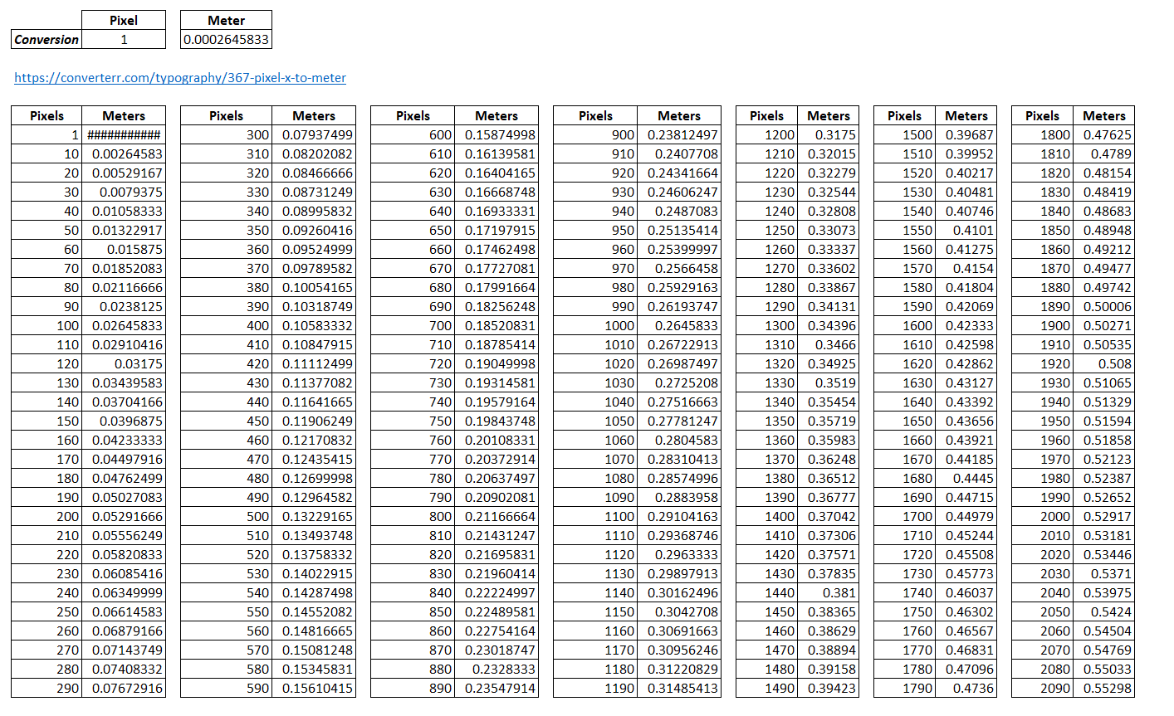
Canvas Sizing
Canvas sizing is set by DISTANCE in terms of meters. NOT PIXELS
Canvas width is set by the “widthMeters” and “heightMeters”
Roughly in the 2D Canvas a space of 360px would equal a widthMeters setting of 0.089
https://converterr.com/typography/meter-to-pixel-x

Slide 7
Image & Background
Assumption: Image Scaled to fit in Canvas
Properties:
imageSrc
imgAlignH
imgAlignV
imageScale
backingcolor
Canvas = 100 x 100
Image 10x10
imageSrc: Path and image source from Resources
Sample: "imageSrc": "app/resources/Uploaded/FAD_LOGO.png"
Default: “”
Possible Values: Any valid Path
,
imgAlignH: The HORIZONTAL Alignment for the Image
Sample: "imgAlignH": “right"
Default: “center”
Required: No
Possible Values: leftleft, left, center, right, rightright
imgAlignV: The VERTICAL Alignment for the Image
Sample: "imgAlignV": “bottom"
Default: “center”
Required: No
Possible Values: toptop, top, center, bottom, bottom
backingcolor: The background color for the text display.
Sample: "backingcolor": "rgba(120, 255, 100, 0.5)"
Default: none
Required: YES
Possible Values: Valid rgba
imageScale: The Scale Factor to apply to the image
Sample: "imageScale": 0.3
Default: 0.7
Required: No
Possible Values: Valid Integer

Slide 8


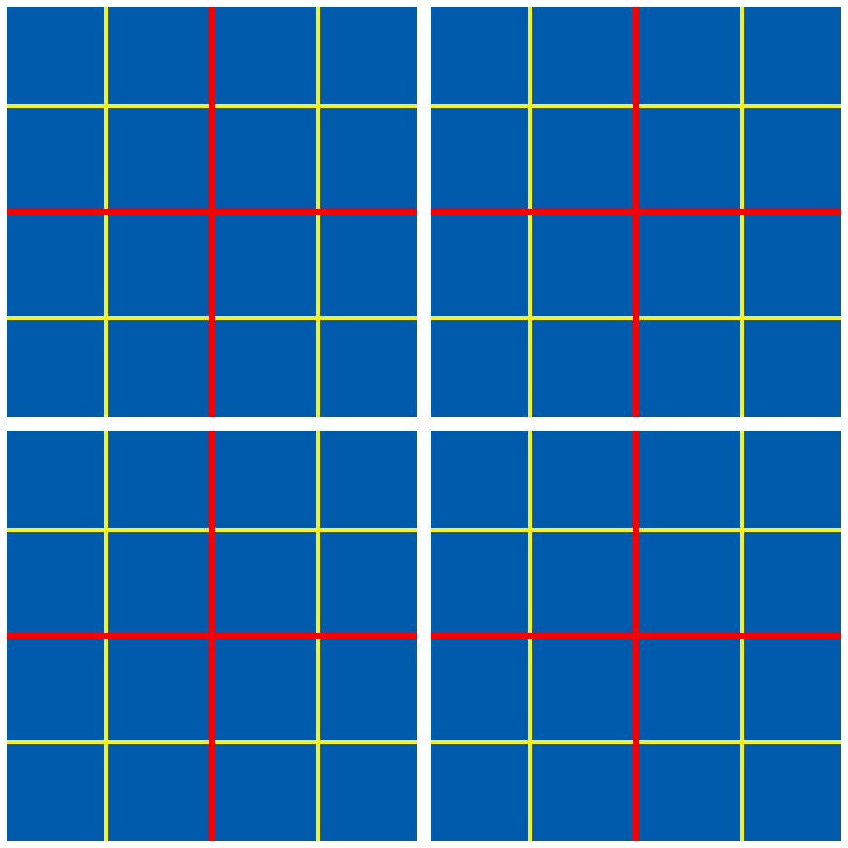
Image Background Sample Placements
Image Horizontal: Center
Image Vertical: Center
{"imgAlignH":“center", "imgAlignV":“center”}
Image Horizontal: left
Image Vertical: top
{"imgAlignH":“left", "imgAlignV":“top”}
Image Horizontal: leftleft
Image Vertical: toptop
{"imgAlignH":“leftleft", "imgAlignV":“toptop”}

Slide 9
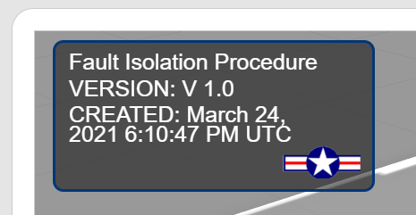
Image Display w/ Text
{"imgAlignH":"rightright",
"imgAlignV":"bottombottom",
"imageSrc": "app/resources/Uploaded/FAD_LOGO.png",
"imageScale": 0.3}
TIP: Leave ImageSrc populated but set Scale to 0 to not show an image

Slide 10
Setup
Add arcoe3DText.js to the Experience Recources
Setup the External Library
NOTE: tmlRenderer is needed but not available in external Libs and needs to be passed in.
The initialization of the lib is wrapped in a timeout to ensure proper loading has completed.
Setup Code Sample:
//Setup External Library
var head = document.getElementsByTagName('head')[0];
var script = document.createElement('script');
script.type = 'text/javascript';
script.src = './app/resources/Uploaded/arcoe3DText.js';
head.appendChild(script);
$timeout(function(){
arcoe3DText($scope, $element, $attrs, $timeout, tml3dRenderer);
},1000);

Slide 11
Usage
Sample Configuration
The Text display requires a JSON parameter. The usage of this parameter can vary by need
This parameter can be configured as a JS variable or as part of another configuration file.
Using as part of another configuration file seems to provide good flexibility
Once the JSON parameter has been initialized, add the text and call the fuction “doText()” passing the json parameter.
See next Slides for samples
"3DText": {
"debug":false,
"widgetsrc":"imgsrc",
"textRightMargin": 23,
"imageWidget": "InfoPanelLabel",
"textAlign": "left",
"FontColor": "rgba(255, 255, 255, 1.0);",
"imgAlignH":"rightright",
"imgAlignV":"bottombottom",
"imageSrc": "app/resources/Uploaded/FAD_LOGO.png",
"imageScale": 0.3,
"message": "",
"paragraphSplit": "\n",
"betweenParagraphs": 0.35,
"widthMeters": 0.089,
"heightMeters": 0.039,
"backingcolor": "rgba(120, 255, 100, 0.5)",
"canvasFont": "Arial",
"lineheightratio": 0.9,
"fontSize": 25,
"textStartX": 10,
"textStartY": 25
},

Slide 12
Sample
//Read External Configuration file Complete $scope.readComplete = function(data){
$scope.DataProperties = data;
pageProps = $scope.DataProperties['3DText'];
}
//Display the Text as needed:
about = $scope.DataProperties['Name'] + "\nVERSION: " + $scope.DataProperties['Version'] + "\nCREATED: " + $scope.DataProperties['Created’];
pageProps.message = about;
$scope.doText(pageProps);
Sample Configuration
"3DText": {
"debug":false,
"widgetsrc":"imgsrc",
"textRightMargin": 23,
"imageWidget": "InfoPanelLabel",
"textAlign": "left",
"FontColor": "rgba(255, 255, 255, 1.0);",
"imgAlignH":"rightright",
"imgAlignV":"bottombottom",
"imageSrc": "app/resources/Uploaded/FAD_LOGO.png",
"imageScale": 0.3,
"message": "",
"paragraphSplit": "\n",
"betweenParagraphs": 0.35,
"widthMeters": 0.089,
"heightMeters": 0.039,
"backingcolor": "rgba(120, 255, 100, 0.5)",
"canvasFont": "Arial",
"lineheightratio": 0.9,
"fontSize": 25,
"textStartX": 10,
"textStartY": 25
}

