Slide 1
Group Messenger
Underachievers

Slide 2
Requirement Specs
1. SendMessage
- The system shall allow the user to reply the message
- The system shall allow the user to be able to edit a draft message (backspace, insert etc.)
- The system give a confirmation that the message has been sent
2. DeleteMessage
- The system shall allow the user to delete select messages, including multiple deletion
- Deleted messages will be deleted from forum and (in)visible to all users, not just deletor

Slide 3
Requirement Specs
3. Forward
- Ability to forward select messages to other users in different group chats
- Forwarded info includes original sender and their message
4. Draft
- Saves current message to clipboard constantly, if app is closed/exited, it will keep it saved in that chat until user makes a change
5. GroupMessage
- Ability to have a message sent to all recipients in that group

Slide 4
Requirement Specs
6. SearchMessage
- Ability to take input from user and find all exact matches from any message in selected conversation
- Successful matches will return a highlighted match in the conversation
- Unsuccessful matches will return a ‘no matches found’ error message
7. AddContacts
- User ability to create a contact based on a phone number
- User will be able edit contacts first and last names
8. DeleteContacts
- Ability to remove contacts from saved contact list
- Will keep messages with deleted contact in tact until you delete the message

Slide 5
Requirement Specs
9. ViewContacts
- Ability to view a list of contacts from user’s saved contact list
- Prompt will be given to start a group message with any of your contacts
10. ViewCategorized Conversations
- Ability to categorize conversations from contacts based on time (most recent conversations will be at the top of the feed)
- Will be able to display conversations/messages from this list
11. ViewMessages
- Ability to view all (saved) messages in a given conversation based on time (most recent messages will be displayed on the bottom of the feed)

Slide 6
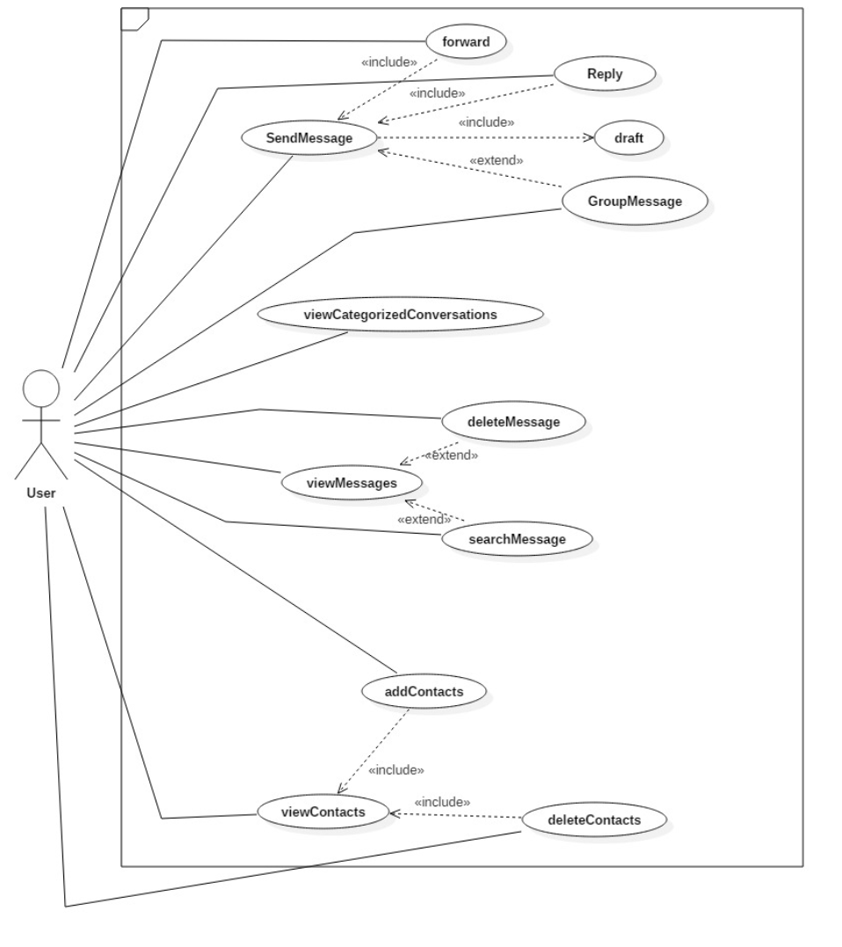
Use Case Diagram

Slide 7
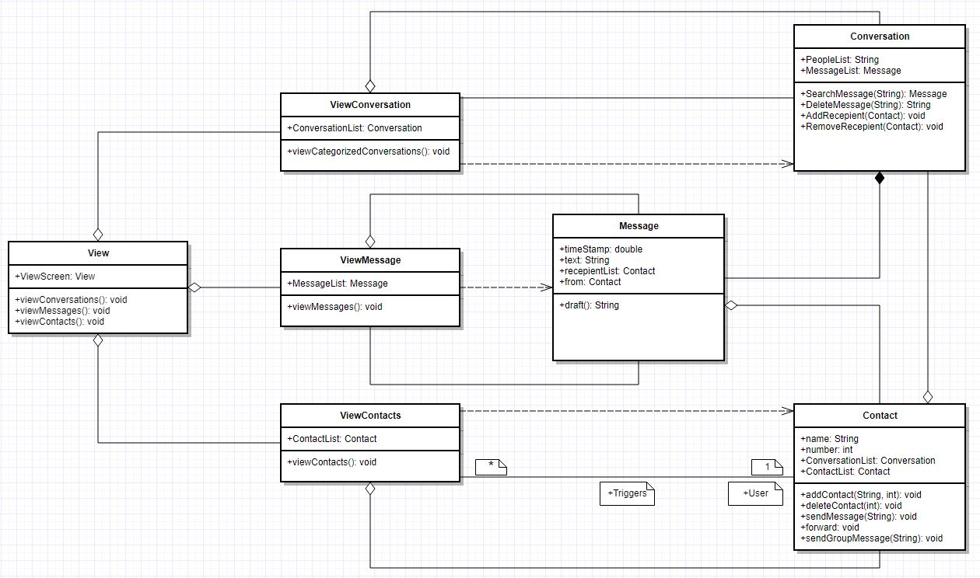
UML Class Diagram

Slide 8
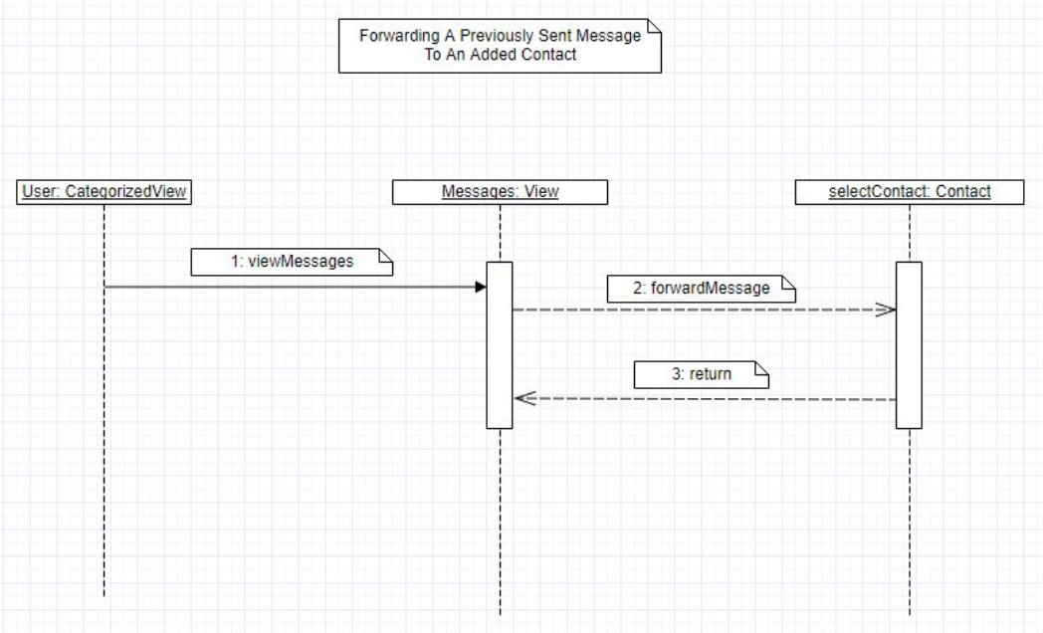
Sequence Diagram

Slide 9
Q+A

