Slide 1
Lab 2: Booleans
Anahita Memar

Slide 2
Lab conduct
Do not use any unauthorized aid, such sites like rentacoder or chegg to obtain answers
Do not use code provided by another student
Do not reuse code (by you or anyone) from prior semesters
If you need help, seek it from:
Your lab TA.
Me, Dr. Gibbons, my email is jwgibbo@ku.edu / jwgibbo@gmail.com
If equipment you don't own (e.g. cycle servers) needs attention or you're having account issues put in a ticket!

Slide 3
Learning Objectives
Use if statements
Learn and use the // and % operators

Slide 4
Numeric Operators
PEMDAS
() Parentheses
** Exponents
* Multiplication
/ Division
+ Addition
- Subtraction

Slide 5
New Operators
// Integer division
7//3 = 2
Will only keep the integer portion from division
% Modulus
7%3 = 1
Returns the remainder of integer division

Slide 6
Boolean Operators
< less than
> greater than
<= less than or equal to
>= greater than or eqaul to
== equal
!= not equal

Slide 7
Boolean Operators
And
Operates on two logical expressions
Results in True only if both its arguments are True
Or
Operates on two logical expressions
Results in True only if either of its arguments are True

Slide 8
Not
Operates on two logical expressions
Results in True only if either of its arguments are True

Slide 9
Example:
3<7
7<3
5!=5
'a'=='A'
5.5>=(10.5+3.1)

Slide 10
Control Flow
Sequential Program
Non Sequential Program
Code
Code
Code
Code
Code

Slide 11
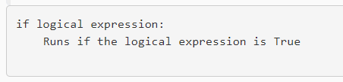
If Statements
A stand-alone if:
if logical expression :
<code>
if child_in_front_of_car :
stop()

Slide 12
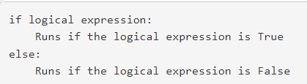
If Else Statements
if logical expression :
<code>
else:
<code>
if person_in_crosswalk:
stop()
else:
go_speed_limit()

Slide 13
If Elif Statements
if logical expression 1:
Runs if the logical expression 1 is True
elif logical expression 2:
Runs if the logical expression 1 is False and logical expression 2 is True
elif logical expression 3:
Runs if the logical expressions 1 & 2 are False and logical expression 3 is True
else:
Runs if all logical expressions are False
if light_red:
stop()
elif light_yellow:
slow_to_stop()
elif light_green:
go()
else:
stop_4way()

Slide 14
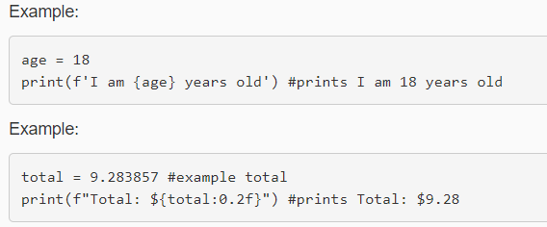
Formatted Strings
Python offers standard strings, just stuff under quotes, and there are also formatted string which allow you to inject variables directly into strings and format numeric output if you wish. All you have to do is...:
put a lower-case f in front of the opening quote
put any variables you want embedded in the string inside curly braces, {}

Slide 15
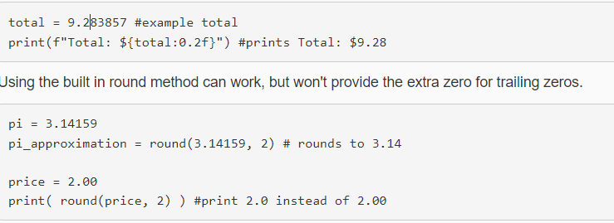
Formatted Strings
NOTE: There is a built in round() function, but it can do some undesirable stuff when it comes to formatting. See below.

Slide 16
Exercise 1: Football Spreads
It's football season! Time to learn about weird terms like "spreads" and "favored".
In the NFL, two teams play each other and almost always one team is "favored", meaning they are more likely to win the game. If you hear something like "Kansas City is favored by 3 points" that means that they are expected to when by 3 or more points.
The "spread" is the amount of points a team is favored by (e.g. the chiefs are expected to win by at least 3pts) or, alternatively, the points the losing team is expected to lose by (e.g. the Bengals are expected to lose by at least 3 points.
To "cover the spread" a team has to win by at least that expected total. So if the Chiefs are favored by 3pts but only win by 1pt they didn't "cover the spread." From a sports betting perspective that would mean the people would bet on the Bengals would actually win their money because the Bengals lost by fewer than 3pts.

Slide 17
All that being said, gambling is by definition a risky proposition; if you gamble at all, make sure you're setting limits, sticking to them, and are never doing it for anything other than low stakes entertainment.
Now, what will you do in lab? You will create a program to help the user decide if a certain team is a "good bet" or not (remember all bets carry risk, gamble responsibly if at all).
Here's what to do:
Ask the user how many points their team is favored by (float)
Ask them if they are at home by entering 'h' or 'H' (all other input indicate an away game)
Ask them if they are picking the Bengals by entering 'y' or 'Y' (all other input is not the Bengals)
Display the appropriate output based on the table below

Slide 18
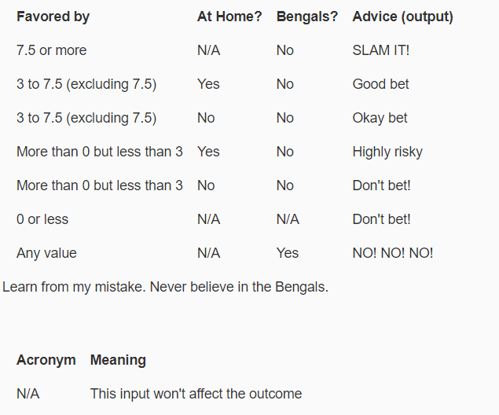
Exercise 1: Football Spreads

Slide 19
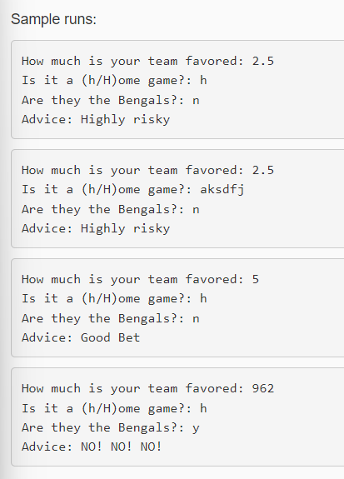
Exercise 1: Football Spreads

Slide 20
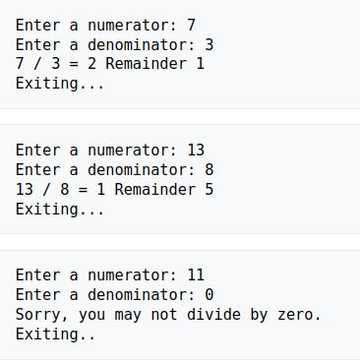
Exercise 2: Long Division Printer
Obtain a numerator and a denominator from the user.
Display the result of long division from the user.
You may assume integers as input, but you must prevent the user from crashing the if they want to divide by zero!

Slide 21
Exercise 3: Soda Packing
Create a program (without using if statements or loops) that takes a number of sodas and then tells the user how many Fridge Cubes, six packs, and single sodas it will be packages as.
Fridge Cubes hold 24 sodas
Six packs hold 6 sodas
Singles hold 1 soda

Slide 22
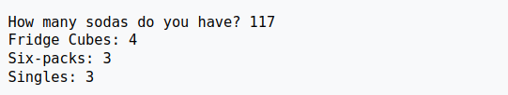
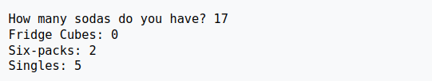
Exercise 4: Soda Packing

Slide 23
EECS 169 Exercise 4: Restaurant
You will open a restaurant that sells three items: Cold Pasta, Grilled Cheese, and Pie. Your restaurant will do the following:
Ask the user if they want Cold Pasta, Grilled Cheese, and Pie
In all cases, you are prompting them for a yes/no answer. For yes they can type 'y' or 'Y', and for no they can type 'n' or 'N'
If they want an item, find out how many
The user must not be allowed to order less than zero of an item, if they do, simply set the amount they order to zero.

Slide 24
Exercise 4: Restaurant
Ask them for their age, this will affect the discount
Anyone 55 or older gets a 55% senior citizen discount off the total cost (After tax is applied)
Anyone 5 or younger gets all the pie they want for FREE (should not be in total nor taxed)!
Display a cost per item (before any discounts), a subtotal (before any discounts), a tax amount, a discount amount, and a grand total
Tax is 8%

Slide 25
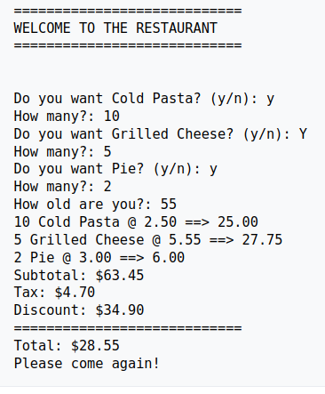
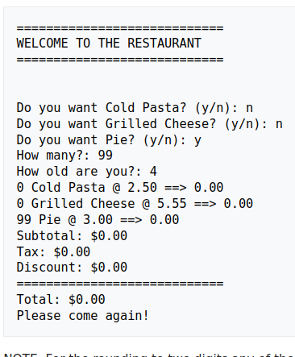
Exercise 4: Restaurant

Slide 26


Exercise 4: Restaurant
Python has multiple ways to round numbers to a significant digit
Use which ever you prefer.

Slide 27
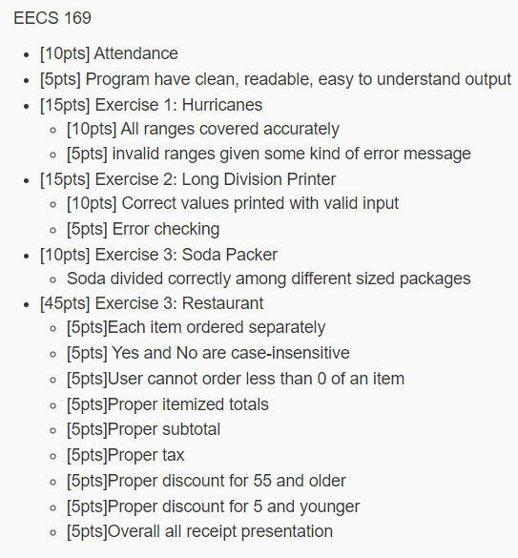
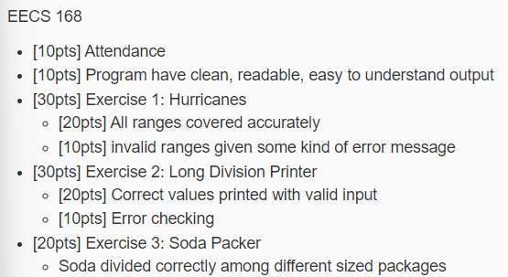
Rubric

