Slide 1
The Technology Value Stream
Juan Partida
Module 1.2 Assignment

Slide 2
Topics
Defining Lead Time vs. Processing Time
The Common Scenario: Deployment Lead Times Requiring Months
Our DevOps Ideal: Deployment Lead Times of Minutes

Slide 3
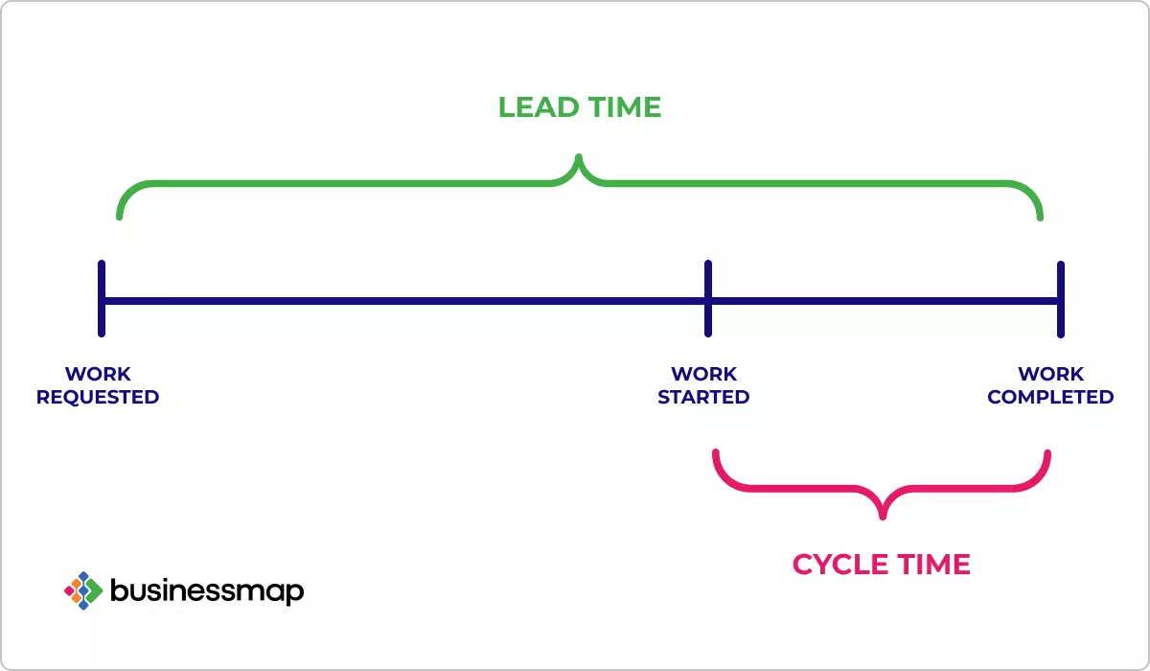
Defining Lead Time vs. Processing Time
Lead Time: The total time from the initial request to the final delivery
Processing Time/ Cycle Time: The actual time spent working on the request
By analyzing these metrics, teams can identify bottlenecks and areas for improvement. Shortening lead time and cycle time can lead to faster delivery and increased productivity.
Graphic courtesy of businessmap (Cycle Time vs. Lead Time: Differences You Need to Know)

Slide 4
The Common Scenario: Deployment Lead Times Requiring Months
In traditional IT environments, deployment lead times often span several months. This lengthy process includes multiple stages, such as development, testing, and final deployment. Each stage usually involves handoffs between teams, adding to the time taken.
Challenges associated with long deployment lead times can include the Risk of Obsolescence. When a product or feature is deployed, it might need to be updated due to the fast pace of technological advancements.

Slide 5

Graphic courtesy of Steve Smith via Investing in Continuous Delivery – Steve Smith

Slide 6

Our DevOps Ideal: Deployment Lead Times of Minutes
DevOps aims to streamline and automate the software development and deployment process. The goal is to reduce deployment lead times from months to minutes.
The benefits of achieving deployment lead time of minutes are that it allows rapid deployments for quicker delivery of new features and products, helping to capture market opportunities swiftly.

Slide 7
Sources
Cycle Time vs. Lead Time: Differences You Need to Know
Investing in Continuous Delivery – Steve Smith

