Slide 1

Establishing a Just, Learning Culture Juan Partida 12-8-24

Slide 2

What is a Just Culture?
A Just Culture is an organizational culture that promotes accountability and learning from mistakes rather than assigning blame. It encourages open communication and the reporting of errors without fear of punishment.
By fostering a Just Culture, organizations can improve safety, enhance employee morale, and create a more transparent and supportive work environment.

Slide 3
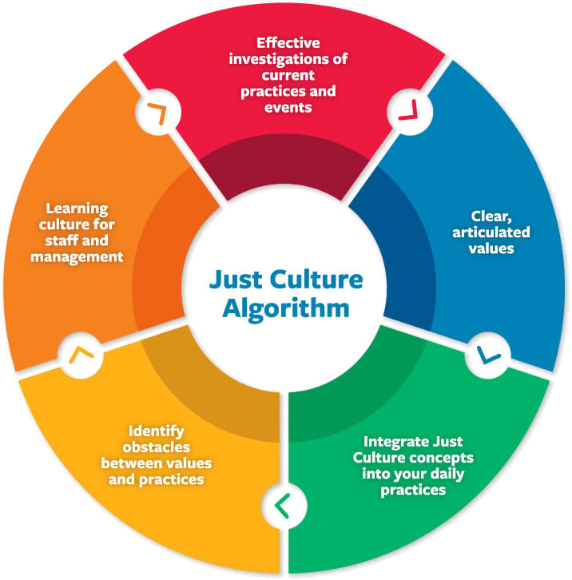
Implementation and Sustainability
Center for Patient Safety. (n.d.). Retrieved December 9, 2024, from https://www.centerforpatientsafety.org/just-accountable-culture

Slide 4


Just Culture challenges

Slide 5
Lack of Trust
When there's a lack of trust, employees may fear repercussions or believe that management won't act fairly
Employees might worry that reporting errors won't remain confidential, leading to potential blame or punishment

Slide 6
Lack of Trust
If employees don't trust that they'll be protected, they're less likely to report mistakes, which can prevent the organization from learning and improving.
A lack of trust creates a barrier to honest and open dialogue, which is crucial for identifying and addressing issues effectively.

Slide 7
Resistance to Change
Employees often prefer familiar routines and processes, making them resistant to new approaches.
Changes can bring uncertainty, and employees may worry about how these changes will affect their roles and responsibilities.

Slide 8
Resistance to Change
Resistance can delay the adoption of new practices and processes, hindering progress.
Employees may not understand the benefits of the approach and focus on the negative.

Slide 9
Inconsistent Leadership
Leaders do not consistently promote just cultural values.
Mixed messages from management.
Undermines the credibility of the initiative.
Creates confusion among staff.

Slide 10
Sources
Center for Patient Safety. (n.d.). Just accountable culture. Retrieved from https://www.centerforpatientsafety.org/just-accountable-culture
Ingram, C. (2023, January 18). Breaking down barriers: Realizing a just culture in healthcare organizations. LinkedIn. https://www.linkedin.com/pulse/breaking-down-barriers-realising-just-culture-chris-ingram

