Slide 1

DrawTablet
- Jeel Patel

Slide 2

DrawTablet
A simple drawing app
Easy to use
Included features:
Color Changer
Width Changer
Eraser
Delete all
Save

Slide 3

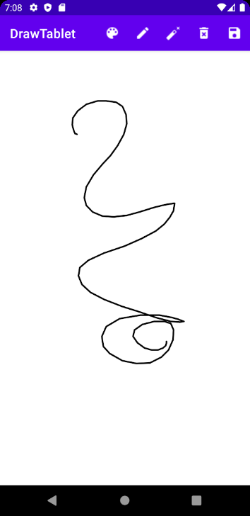

DrawTablet
Menu Items
(from left to right):
Color Changer
Width Changer
Eraser
Delete all
Save
UI:

Slide 4

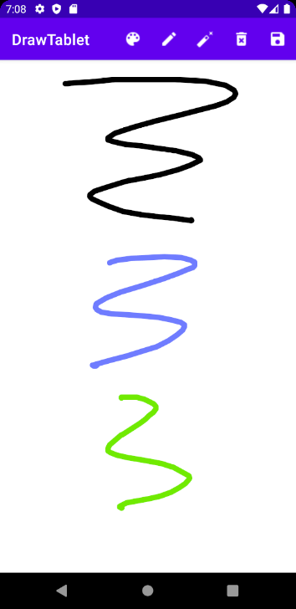

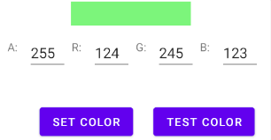
Color Changer

Slide 5
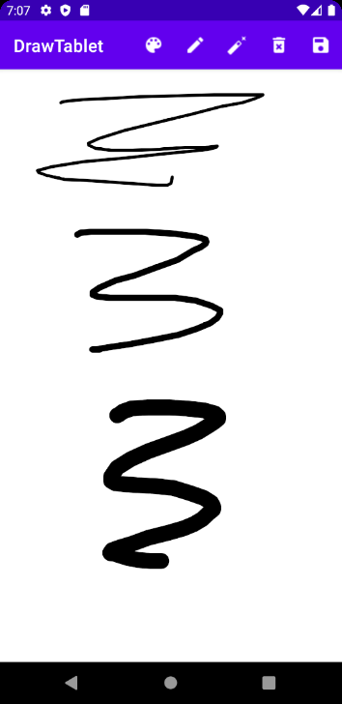
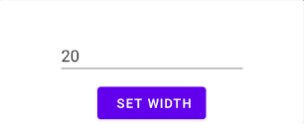
Width Changer

Slide 6
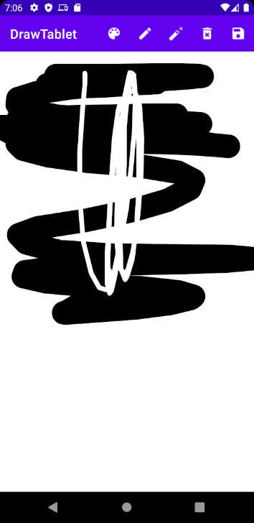
Eraser

Slide 7
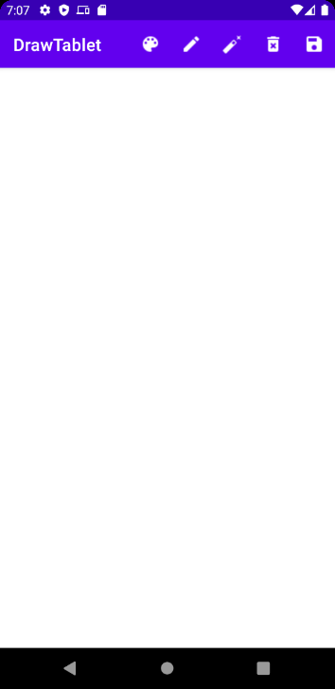
Delete

Slide 8
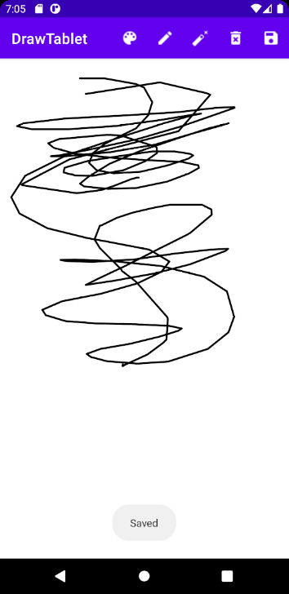
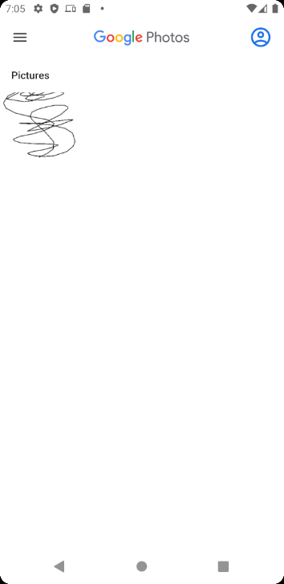
Save

