Slide 1

Iwacu
Jean Paul Tuyikunde
March 2022

Slide 2
Contents
Problem Statement
Solutions
Data Approach
Business Modal

Slide 3
Problem statement
Restoring cultural identity of Africa through communication platform.

Slide 4
Solution
We are providing a communication platform for sharing cultural related contents such as videos, chat with a complete freedom of your chat.

Slide 5
Data Approach
Data Preparation
Recommendation Engine
User Data
Recommendations
Businesses

Slide 6
Business Model
Business
Model
Ads
(African companies)
Business outside Africa

Slide 7
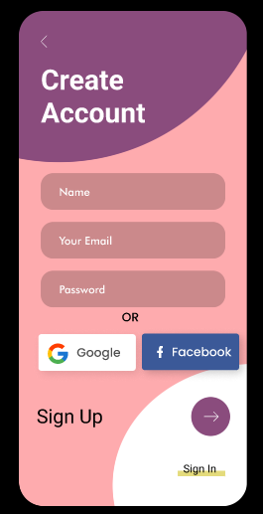
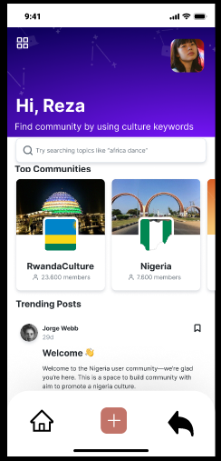
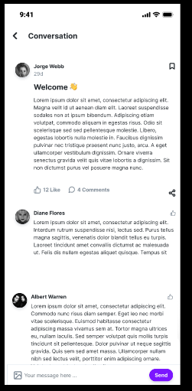
App Overview

Slide 8
Thank You.

