Slide 1
OpenTURNS UQ Software and its Graphical User interface
M. Baudin¹, A-L. Popelin¹, A. Dutfoy¹, A. Geay¹, O. Mircescu¹
A. Ladier², J. Schueller², T. Yalamas²
¹Electricité de France (EDF) - R&D, Chatou, France
²Phimeca Engineering – Paris, France
18th April 2018, SIAM-UQ 2018, California, USA
Notes:
Hi!

Slide 2
Industrial Context - interests
Exploratory study : understand a phenomena, an experimental or industrial process
Safety study : evaluate a safety margin (failure probability, rare events)
Design study : optimizing and control the performances
Uncertainties
Environmental variables
Physical parameters
Process parameters
DOE
Process: simulation code or experiments
Output distributions
Probability of failure
« Main » input parameters

Slide 3
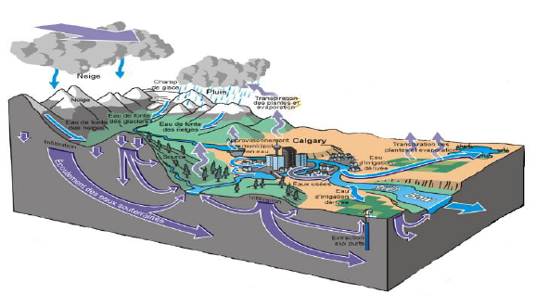
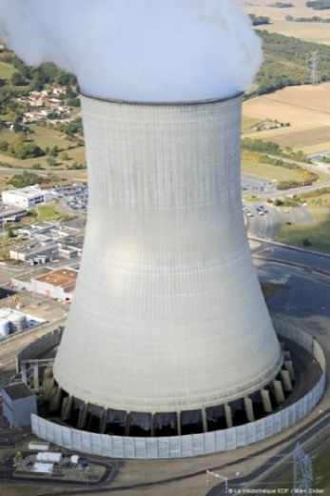
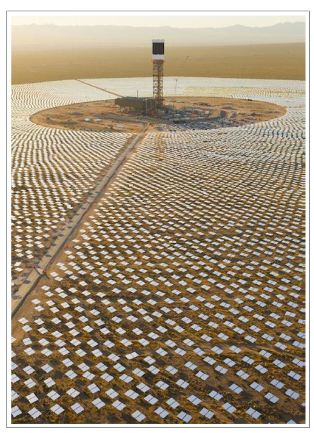
Industrial Context - interests
Exploratory study : understand a phenomena, an experimental or industrial process
Safety study : evaluate a safety margin (failure probability, rare events)
Design study : optimizing and control the performances
Hydraulic model
Nuclear lifetime studies
Renewable energy producible power

Slide 4
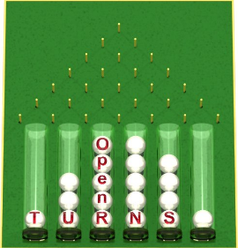



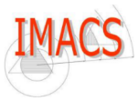
OpenTURNS : www.openturns.org
Aims at adress a global framework : Uncertainty quantification, uncertainty propagation, sensitivity analysis and metamodeling
4 Partners :
Since 2007
LGPL licence
Linux, Windows
Programming:
Python module
C++ Library

Slide 5
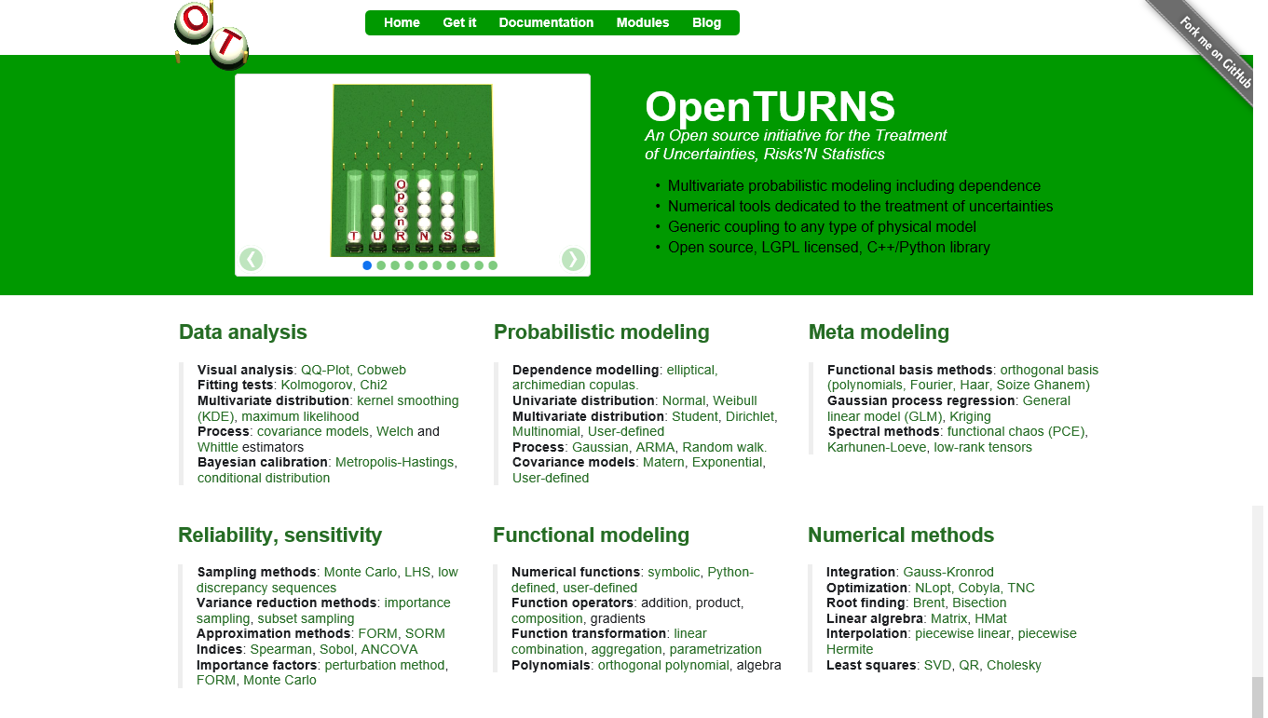
OpenTURNS : www.openturns.org
How to install it?
Conda Python package
Github
Distributed in Debian
Online documentation
> 10000 downloads in 2017
Simulator : symbolic, Python, Salome, …

Slide 6
Bring Uncertainty Methodology to Engineers
3 years ago
EDF R&D wanted to maximize the use of OpenTURNS and UQ approaches by its engineer/researcher → develop a GUI to ease the use
Phimeca has already developed an “OpenTURNS GUI” (PhimecaSoft®) which satisfy some needs of EDF R&D but not all.
EDF R&D and Phimeca decided to start a specific partnership in order to develop a new GUI based on OpenTURNS and “Salome Tools” : Paraview, Yacs, ...
This new OT GUI is now available on Salome website, in EDF Specific Salome version
http://www.salome-platform.org/contributions
Windows versions are only for partners : please contact us !

Slide 7
Some expectations regarding the GUI
As easy to use as possible : UQ approaches spreading should not be restricted due to a problem of usability
Support the methodology : guide the user
For who? Variety of physics and codes at EDF
Generic (not dedicated to a specific application)
Linux : inside simulation platform SALOME (field physics : pre and post-processing tools, HPC resources access, …)
Windows : address the system-models users (e.g. Modelica)
Trainings : symbolic formulas
Possibility to generate a Python script usable without the platform in an “expert” mode
GUI language : English, French

Slide 8
Demo time

Slide 9
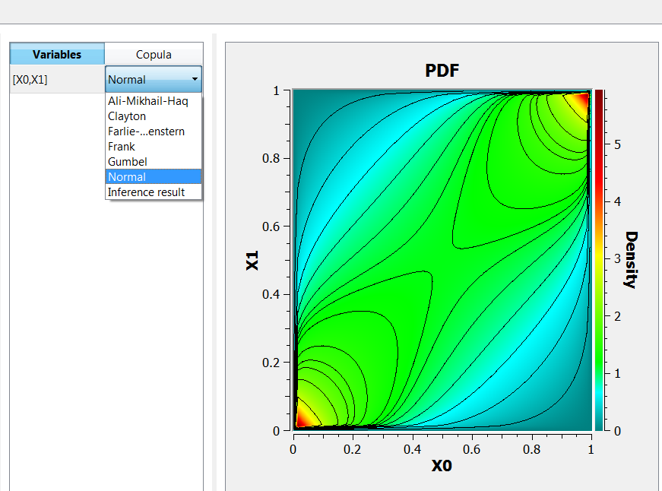
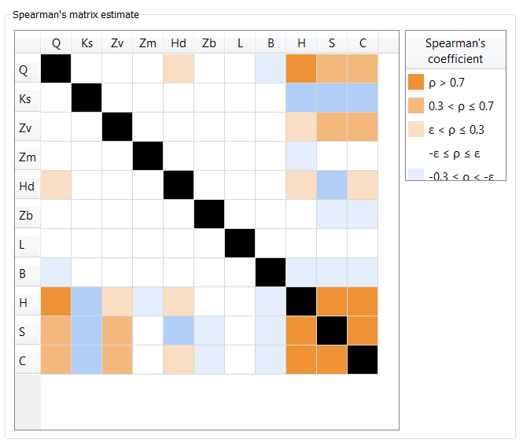
New features
Morris method to select input variables
Improved metamodel validation
Sobol’ sensitivity indices have confidence intervals
Monte Carlo analysis manages failed points
Dependence (copula) : definition and inference
Optimization
Link to the FMI models

Slide 10


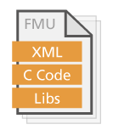
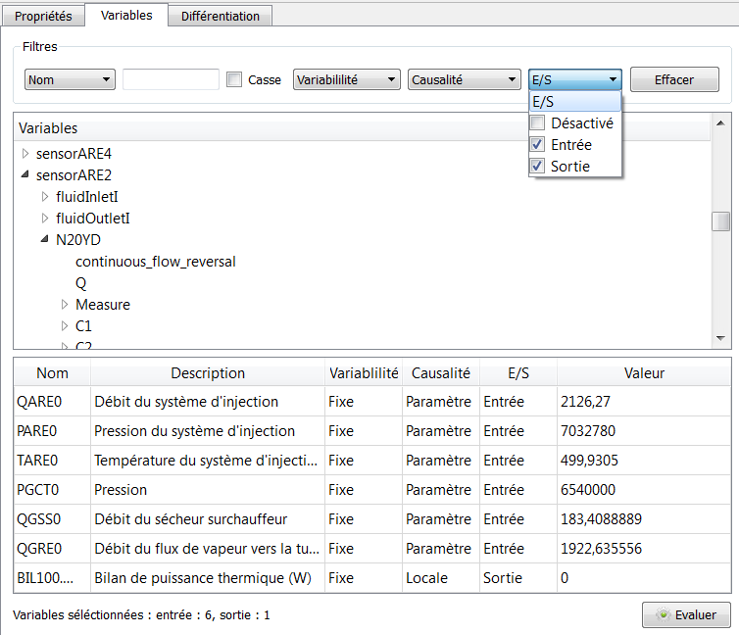
System models : link using fmi standard
Modelica is an open language for programming models based on differential algebraic systems of equations
Main tools : Dymola (Dassault Systèmes, proprietary), Open Modelica (open source Modelica Consortium)
FMI (Functionnal Mock-up Interface) is a standard for input–output data interface for numerical model.
a FMU file contains : a xml description, a binary to evaluate the model
Notes:
Main steps :
1) Open the FMU file
2) Find the input or output variables
3) Configure the input or output tag
Example : in the BIL100 test case, 6 input variables are selected from the more than 2000 variables.

Slide 11
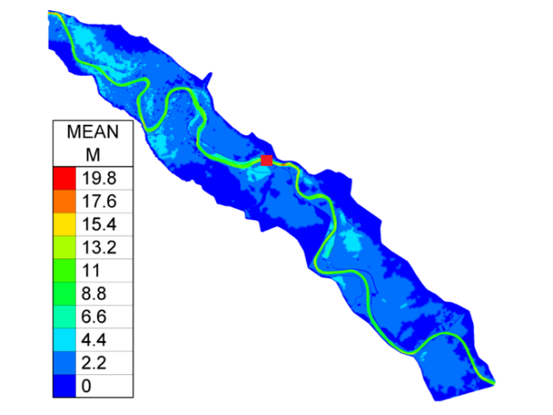
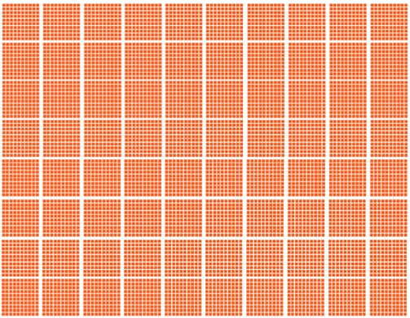




Perspectives and challenges
A new module dedicated to random fields analysis
Extend the methodology : more complex tools
Interface with codes that manage inputs and outputs as fields
Large data volume : in-situ challenge
Melissa
~ Mo
48To

Slide 12
michael.baudin@edf.fr yalamas@phimeca.com
Thank you for your attention
#11 Users Day – 15th June 2018 – Saclay, France Come and join us!

