Slide 1

Seshadri Rao Gudlavalleru Engineering College
Department of CSE (Artificial Intelligence & Machine Learning)
INTERNSHIP PROJECT Batch.No:13
Smart Currency Counterfeit Detector using CNN and ResNet50
By
B. Pavani (21481A4205)
J. Persis (21481A4223)
V. Vignesh (21481A4261)
K. Gnaneshwar (21481A4231)
Under the guidance of
Dr. Y. Adi Lakshmi
Head Of Department of CSE (Artificial Intelligence and Machine Learning)

Slide 2

The Smart Currency Counterfeit Detector is an advanced machine learning-driven system designed to identify counterfeit currency notes with precision and efficiency. Leveraging Convolutional Neural Networks (CNNs) and the ResNet50 pre-trained model, it extracts and analyzes fine-grained details such as watermarks, serial numbers, textures, and other features using robust image processing techniques. This automated, real-time detection mechanism significantly enhances financial security by reducing reliance on manual checks. The solution is scalable, seamlessly integrating into diverse platforms and industries, making it an indispensable tool for safeguarding monetary transactions globally

Slide 3
Identify Counterfeit Bills: Accurately detect and reject counterfeit currency using advanced machine learning and image processing techniques.
Enhance Security: Strengthen financial transaction security by minimizing counterfeit circulation and protecting the monetary system's integrity.
Protect Consumers: Provide an easy-to-use solution for identifying fake currency, reducing financial risks for users.
Real-Time Detection: Ensure efficient and real-time counterfeit detection to support seamless financial operations.

Slide 4

CNNs for Image Classification (Krizhevsky et al., 2012): CNNs have demonstrated outstanding performance in image classification, making them ideal for counterfeit detection by identifying intricate features on currency notes.
Counterfeit Detection with Deep Learning (Rao et al., 2020): This study used CNNs to analyze currency note patterns, achieving high accuracy in counterfeit detection across diverse datasets.
GAN-based Synthetic Data (Goodfellow et al., 2014): GANs have been employed to generate realistic counterfeit currency images, enriching training datasets and boosting model performance.

Slide 5

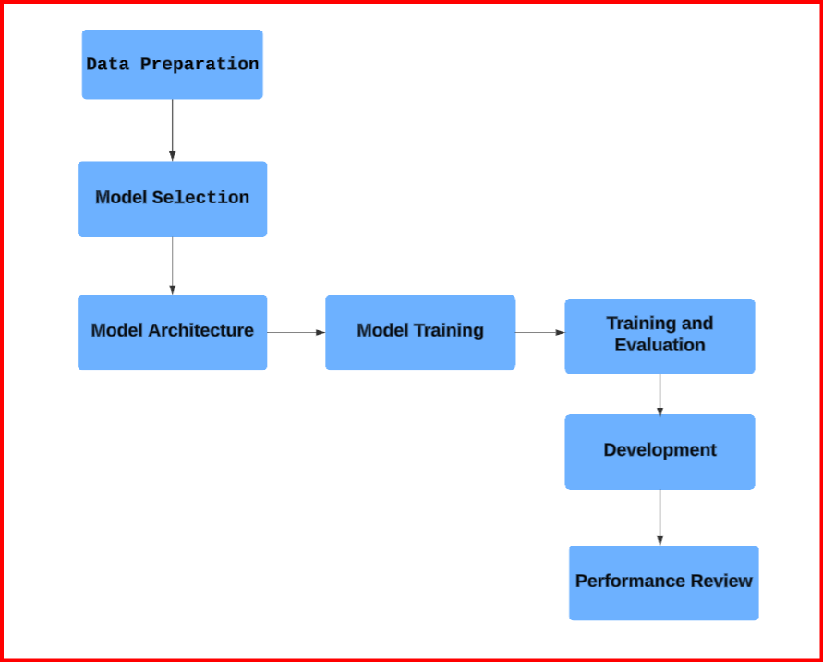

Slide 6
Data Preparation: Collect data, clean it to remove errors, and organize it for model training. Make sure the data is ready for accurate results.
Model Selection: Pick a suitable algorithm based on the problem requirements. Match the algorithm to the data and desired outcomes for optimal results.
Model Architecture: Define the model's layers and connections for effective learning. Focus on balancing complexity and performance for better results.
Model Training: Train the model using the prepared dataset to learn patterns. Adjust parameters to improve accuracy during this phase.
Training and Evaluation: Evaluate the model on unseen data to test accuracy. Use feedback to refine the model for better performance.

Slide 7
Development: Deploy the trained model into applications for real-world usage. Ensure integration aligns with user requirements and performance goals.
Performance Review: Continuously monitor model results in practical scenarios. Update and fine-tune the model to maintain effectiveness over time.

Slide 8

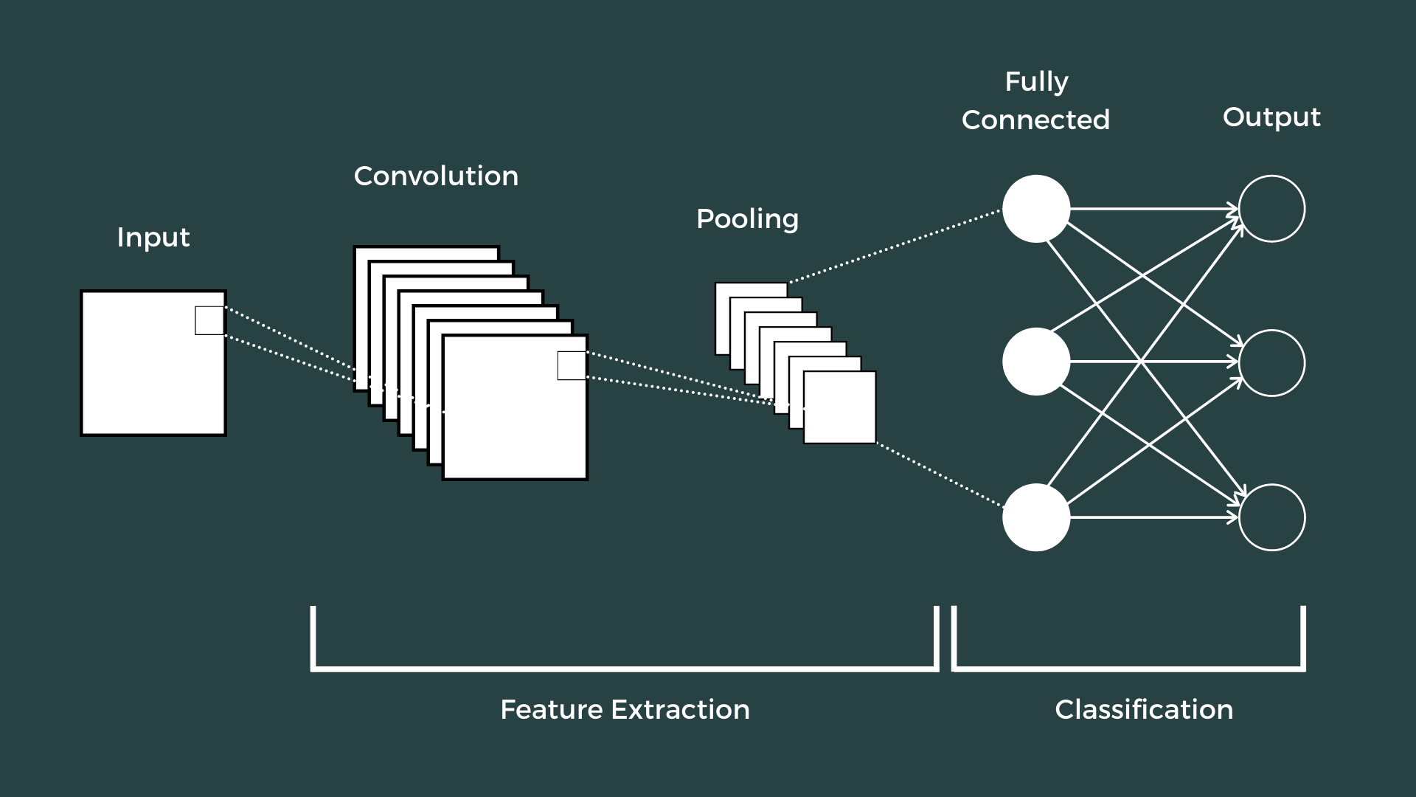

Slide 9
Input Layer: Takes raw data like images as input. Converts it into a matrix of pixel values for processing.
Convolutional Layer: Extracts features like edges or patterns using filters. Slides these filters over the input to create feature maps.
Pooling Layer: Reduces the size of feature maps while retaining important information. Helps make the model faster and prevents overfitting.
Fully Connected Layer: Combines extracted features and maps them to predictions. Acts like a traditional neural network for decision-making.
Output Layer: Provides the final classification or prediction result. Uses probabilities to identify the class of the input.

Slide 10

Software: TensorFlow, Keras, NumPy, OS, glob, and ResNet50 for model implementation, data management, and feature extraction, with the Adam optimizer for training. Visualization is done using matplotlib and seaborn.
Dataset: 153 labeled images for training and 42 labeled images for testing..
Libraries: ResNet50 for feature extraction, sklearn for model evaluation (e.g., accuracy calculation), and matplotlib and seaborn for data visualization.

Slide 11
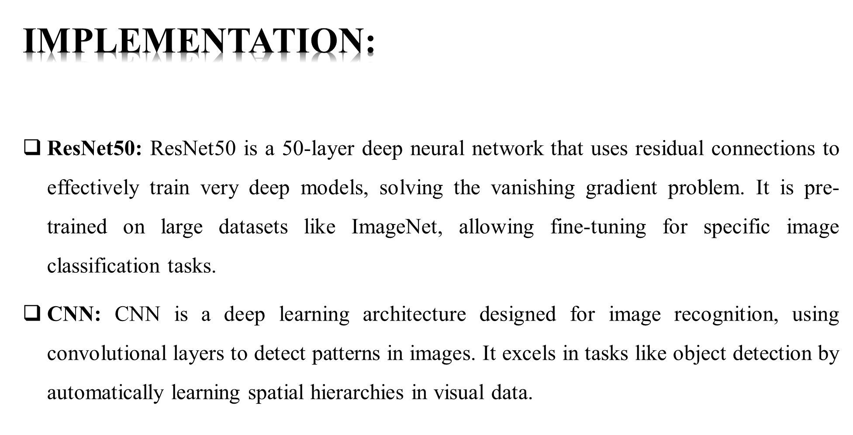

Slide 12
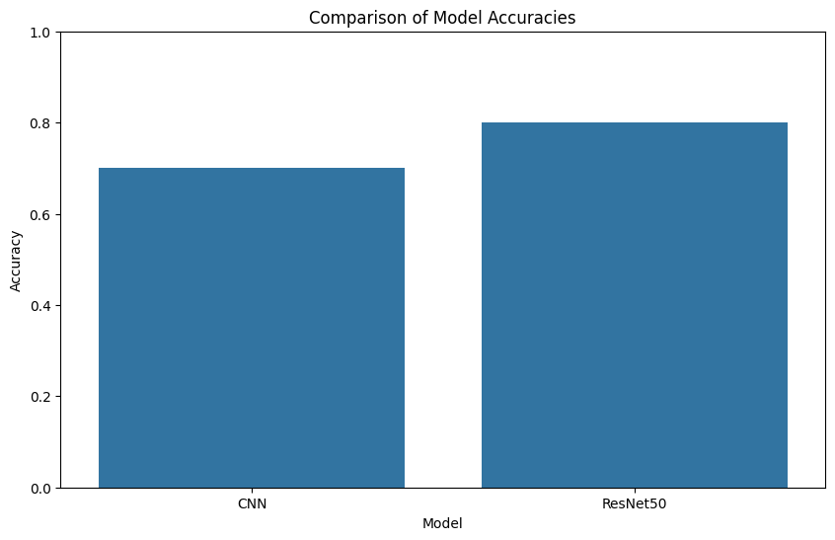
This graph shows a comparison between the accuracies of two machine learning models: CNN (Convolutional Neural Network) and ResNet50.
The y-axis represents the accuracy.The x-axis represents the names of the models.
CNN has a higher accuracy (around 0.8 or 80%).
ResNet50 has a slightly lower accuracy (around 0.7 or 70%).

Slide 13
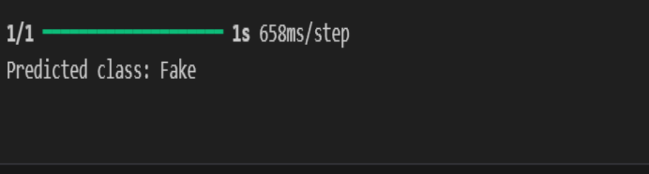
If you provide an image of a real currency note, the output will display "Real." Conversely, if the input image is of a fake note, the model will predict "Fake." The prediction is made using a deep learning model trained on a dataset of real and fake currency images. It identifies unique patterns and features to classify the notes accurately.

Slide 14

We can detect fake currency by using
Security threads: A vertical thread embedded in the currency note
Watermark: An embedded image that's visible when held against the light
Print quality: The quality of the currency note should be sharp and clear
Paper quality: The paper used for printing currency notes is a mix of 75 percent cotton and 25 percent linen.
Ultraviolet (UV) rays: Fake and forged notes can be detected using UV rays

Slide 15


