Slide 1
Application Delivery Fundamentals 2.0:
Java
Module 3: Data
Notes:
Faculty Notes:
Introduce yourself.
Introduce the module and time frame: 2 hours, 15 minutes.
Participant Notes:
N/A

Slide 2
Agenda
Comements
Operators
Blocks
Primitive data types
Strings
Identifiers
Keywords
Declaration and initialization of variables
Type casting
Arrays, array operations
Code guidelines

Slide 3
Code parts
Main task of any program is:
  Data processing
  Control flow management
Main syntax elements of program are:
  Data
  Statements, which process data
  Comments
  Whitespaces

Slide 4
Comments
/* text */
The compiler ignores everything from /* to */.
/** documentation */
This indicates a documentation comment (doc comment, for short). The compiler ignores this kind of comment, just like it ignores comments that use /* and */. The JDK javadoc tool uses doc comments when preparing automatically generated documentation.
// text
The compiler ignores everything from // to the end of the line.
http://en.wikipedia.org/wiki/Java_syntax#Comments

Slide 5
Keywords
JAVA file structure:
  package, import, class, enum, interface
For inheritance:
  extends, implements
For conditions and branching
  if, else, for, while, do, break, continue, switch, case, default, return
For exceptions:
  try, catch, finally, throw, throws
To check for conditions:
  assert
For primitive types:
  boolean, char, byte, short, int, long, float, double

Slide 6
Keywords
To construct and use objects:
  new, this, super
To check type of variable (actually operator):
  instanceof
Access modifiers:
  public, protected, private
Other modifiers:
  abstract, final, static, synchronized, transient, volatile, native, strictfp
Type of method without returned value:
  void
Reserved but actually not used keywords:
  const, goto
Full list of keywords:
  http://docs.oracle.com/javase/tutorial/java/nutsandbolts/_keywords.html

Slide 7
Goal
Goal of the course is to give theoretical knowledge and practical experience in Java language and Object-Oriented Programming (OOP):
  Using Eclipse development environment
  Using SVN and Git version control systems
  Give chance to develop applications in Java EE web, database frameworks, and Android Dalvik/ART development environment
  Familiarize new IT workers with work in a team
  Introduce new IT workers in software engineering project life cycle
Notes:
Faculty Notes:
Review the objectives for the module.
Participant Notes:
N/A

Slide 8
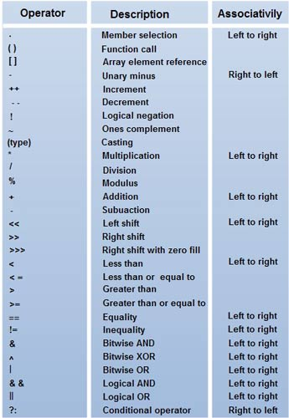
Operators

Slide 9
Statements
Statements are roughly equivalent to sentences in natural languages. A statement forms a complete unit of execution. The following types of expressions can be made into a statement by terminating the expression with a semicolon (;).
totals = a + b + c
+ d + e + f;

Slide 10
Blocks
A block is a group of zero or more statements between balanced braces and can be used anywhere a single statement is allowed.
class BlockDemo {
public static void main(String[] args) {
boolean condition = true;
if (condition) { // begin block 1
System.out.println("Condition is true.");
} // end block one
else { // begin block 2
System.out.println("Condition is false.");
} // end block 2
}
http://en.wikipedia.org/wiki/Java_syntax#Code_blocks

Slide 11
Data types
Java has primitive and complex data types
Primitive data
  Literals or constants
  Variables
  Arrays
Objects
  Built-in objects
  Custom objects

Slide 12

Identifiers
Case sensitive
Each statement finishes with ;
To begin and end a block you use { }
Space, tab, and enter characters can be used to make the code more readable
Variable declaration, constants, comments, terminology similar to C++
Identifiers can contain any combination of upper-case, lowercase, numbers and '_', '$‘
An identifier must not begin with a number
Example
  Identifier
  UserName
  user_name
  _sys_var1
  $change
http://en.wikipedia.org/wiki/Java_syntax#Identifier

Slide 13
Variables and literals
Variables at any time have some specific value. Variables are defined and referred using their type and identifiers, e.g.
int a;
Variable which value is used as a constant is defined using final keyword, e.g.:
final int b;
Literals or constants are values, which are defined inside code, e.g.
101
-22
3.14
'f'
true
"Some string"

Slide 14
Variables and constants
Variables:
  For class members and local variables use lowerCamelCase
  Example:
  int currentCustomerNo = 1;
Constants:
  It is common convention to name the constants only in uppercase. Several roots are separated by (_)
  Example:
  final int HEAD_COUNT = 10;

Slide 15
Data Types
a
Data Types
Primitive
Reference
Defined by Java
Object representation

Slide 16
Primitive data types
Primitive Data Types
Integers
Decimals (Floating Point)
Characters
True / False (Boolean)
byte (8 bits)
float (32 bits)
char (16 bits)
boolean (undefined)
short (16 bits)
double (64 bits)
int (32 bits)
long (64 bits)

Slide 17
Integer numbers: byte, short, int and long
Numbers can be initialized with three forms of literals:
  decimal,
  Octal
  Hexadecimal
Long types can be initialized using L or l at the end of number, e.g.
  2l
  077L
  0xBAACL

Slide 18
Floating point numbers float and double
By default assigned value with simple number value is double
Subtype of assigned value can be set explicitly using postfixes:
  F or f — float
  D or d — double
Exponential form can be used, using E or e
Examples
  3.14 — double
  6.02E23 — double in exponential form
  2.718F — float
  123.4E+306D — double in exponential form
http://en.wikipedia.org/wiki/Primitive_data_type

Slide 19
Program example
public class IntegerTypeSample {
public void f(long x) {
System.out.println("long argument " + x);
}
public void f(int x) {
System.out.println("int argument " + x);
}
public void f(short x) {
System.out.println("short argument " + x);
}
public void f(byte x) {
System.out.println("byte argument " + x);
}
public static void main(String[] args) {
IntegerTypeSample sample = new IntegerTypeSample();
sample.f(217L);
sample.f(217);
short x1 = (short)217;
sample.f(x1);
byte x2 = (byte)217;
sample.f(x2);
} }

Slide 20
Char
The char data type is a single 16-bit Unicode character. It has a minimum value of '\u0000' (or 0) and a maximum value of '\uffff' (or 65,535 inclusive).

Slide 21
Logical type boolean
The boolean data type has only two possible values: true and false. Use this data type for simple flags that track true/false conditions. This data type represents one bit of information, but its "size" isn't something that's precisely defined.

Slide 22
Increment and Decrement Operators
++ increments the value of its operand by 1.
-- decrements the value of its operand by 1.
Syntax:
Pre-increment: ++variable
Post-increment: variable++
Pre-decrement: --variable
Post-decrement: variable--

Slide 23
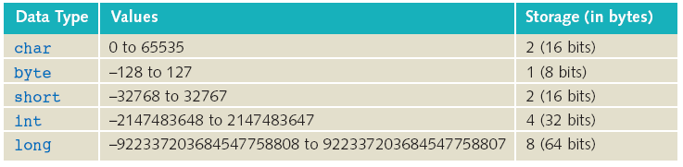
Range and size of primitive types

Slide 24
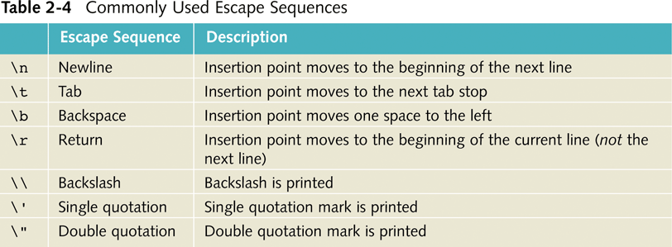
Commonly Used Escape Sequences

Slide 25
Declaration vs Initialization
Initialization - it's a special kind of assignment: the first. Before initialization objects have null value and primitive types have default values such as 0 or false. Can be done in conjunction with declaration.
Declaration - a declaration states the type of a variable, along with its name. A variable can be declared only once. It is used by the compiler to help programmers avoid mistakes such as assigning string values to integer variables. Before reading or assigning a variable, that variable must have been declared.

Slide 26
Declaration vs Initialization
Declaration
int dayOfMonth;
Initialization
dayOfMonth = 1;
First time the variable is given a value
// code
dayOfMonth = 17;
Assignment

Slide 27
Type casting
Sometimes it is necessary to assign value to variable of different data type
Java support automatic casting from "shorter" (by counting stored bytes) primitive types of the same group (integers, floats) to "longer" types
If target variable is "shorter" than type of assigned value, explicit casting using (type) operator is necessary
Examples:
  int intValue = 1954;
  long longValue = intValue; // correct, automatic casting
  long bigValue = 99L;
  int squashed = bigValue; // incorrect, need explicit casting
  int squashed = (int) bigValue; // correct
  int squashed = 99L; // incorrect, need casting
  int squashed = (int) 99L; // correct, but redundant
  int squashed = 99; // correct

Slide 28
Type casting caveats
boolean cannot be casted to any other primitive type
char can be casted to any other primitive type
In general, value can be casted, if number of bytes for value storage on left side (for variable) is equal or larger than for value at the right side
Examples:
char charval = 'x';
int intval = charval; // correct, intval will hold value
// of Unicode character
double z = 12.414F; // correct double is larger than float
int z1 = (int)z; // will work, but digits after
// decimal point will be lost
long l = 999999999999999999l;
double d = (double) l; // will work, but digits before
// decimal point will be lost

Slide 29
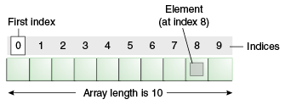
Arrays
Arrays in Java are created at runtime, just like class instances. Array length is defined at creation and cannot be changed.
Each item in an array is called an element, and each element is accessed by its numerical index. As shown in the preceding illustration, numbering begins with 0. The 9th element, for example, would therefore be accessed at index 8.

Slide 30

Array creation
public char[] createArray() {
char[] s;
s = new char[26];
for (int i = 0; i < 26; i++) {
s[i] = (char)('A'+i);
}
return s;
}

Slide 31
Value assignment into array
  Initialize array together with initialization:
  String[] names = {
"Kurzeme",
"Latgale",
"Vidzeme"
};
  Declare array, initialize its size with empty elements, and then assign values to them
  String[] names;
  names = new String[3];
  names[0] = "Kurzeme";
  names[1] = "Latgale";
  names[2] = "Vidzeme";

Slide 32
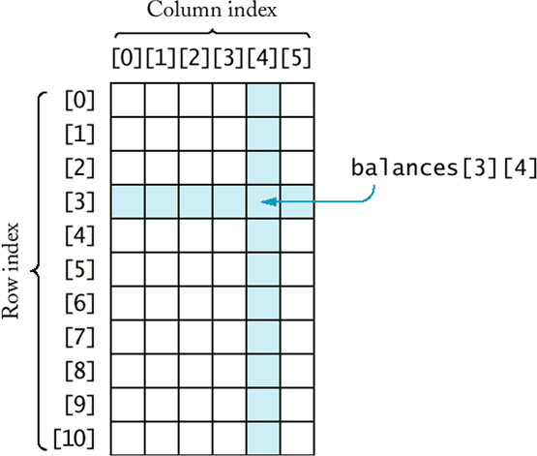
Multi-dimensional arrays
Declaration:
Int[][] array = new int[5][10]

Slide 33
Array copying
To copy arrays, you can use method:
System.arraycopy();
For example:
// first array
int elements[] = { 1, 2, 3, 4, 5, 6 };
// second, larger array
int hold[] = { 10, 9, 8, 7, 6, 5, 4, 3, 2, 1 };
// copy all elements from first array to second
System.arraycopy(elements, 0, hold, 0, elements.length);

Slide 34
Class java.lang.Math
The class Math contains methods for performing basic numeric operations such as the elementary exponential, logarithm, square root, and trigonometric functions.
Methods:
  Rounding: ceil, floor, round
  Max, min, abs: max, min, abs
  Trigonometric functions: sin, cos, tan, asin, acos,
  atan, toDegrees, toRadians
  Other: sqrt, pow, log, exp, random
  Constants: PI, E

Slide 35
Class java.lang.String
Strings are constant; their values cannot be changed after they are created. String buffers support mutable strings. Because String objects are immutable they can be shared. For example:
String str = "abc";
is equivalent to:
char data[] = {'a', 'b', 'c'};
String str = new String(data);
https://docs.oracle.com/javase/7/docs/api/java/lang/String.html

Slide 36
Other String operation methods
concat, replace, substring, toLowerCase, toUpperCase, trim;
endsWith, startsWith, indexOf, lastIndexOf;
equals, equalsIgnoreCase, compareTo;
charAt;
length

Slide 37
Class java.lang.StringBuffer
StringBuffer is mutable built-in Java object, which contains Unicode characters
new StringBuffer() — creates new stringBuffer
new StringBuffer(int size) — creates new stringBuffer with particular size
new StringBuffer(String initialString) — creates stringBuffer which contains initialString
Most used methods:
  append, insert, reverse, setCharAt, setLength

Slide 38
Class java.lang.StringBuilder
StringBuffer is mutable built-in Java object, which contains Unicode characters
Similar constructors:
  StringBuilder()
  StringBuilder(CharSequence seq)
  StringBuilder(int capacity)
  StringBuilder(String str)
Similar methods
  append(), insert(), delete(), etc.

Slide 39
StringBuffer and StringBuilder
Main difference between the StringBuffer and StringBuilder is that StringBuilder is fast, but it is not thread safe

Slide 40
Questions?

