Slide 1
Application Delivery Fundamentals 2.0:
Java
Module 7: Abstract classes and interface
Notes:
Module Duration: 1 hour
Faculty Notes:
N/A
Participant Notes:
N/A
Copyright © Accenture 2012
ADF 2.0: Java - Reuse: Procedural Programming Paradigm

Slide 2
Agenda
Keyword final
Abstract classes
Interfaces
Nested classes
3
Notes:
Faculty Notes:
Briefly review the module agenda.
Participant Notes:
N/A
Copyright © Accenture 2012
ADF 2.0: Java - Reuse: Procedural Programming Paradigm

Slide 3
Keyword final
Value to final variable can be assigned only once. It can be after declaration (then it is called blank final variable)
Value of final instance variable should be assigned in each constructor
Local uninitialized final variable should be initialized before it is used
Entity | Impact of using final keyword
Variable | The value of the variable cannot be changed.
Method | The method cannot be overridden.
Class | You cannot make a sub-class from a class that is final.

Slide 4
Constant variables (literals)
In jargon they can be called as "global constants"
public class Bank {
private static final double DEFAULT_MAX_SPEED=240.0;
...
}

Slide 5
Uninitialized final instance variable
public class Car {
private final long carID;
public Car() {
carID = createNewID();
}
public long getID() {
return carID;
}
private long createNewID() {
return ... // generate new ID }
}

Slide 6
Properties of final objects
In difference with primitive types, final objects are not immutable
Final keyword guarantees, that object is initialized/assigned only once, but objects can have properties or methods, which can change them
final List<String> modifiable = new ArrayList<>();
modifiable.add("Java");
modifiable.add("is");
final List<String> unmodifiable = Collections.unmodifiableList(modifiable);
System.out.println("Before modification: " + unmodifiable);
modifiable.add("the");
modifiable.add("best");
System.out.println("After modification: " + unmodifiable);
Will show:
Before modification: [Java, is]
After modification: [Java, is, the, best]

Slide 7

Abstract classes

Slide 8
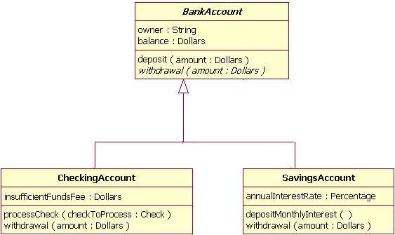
Abstract class diagram

Slide 9
Abstract class code example
public abstract class Vehicle {
public abstract double calcFuelEfficiency();
public abstract double calcTripDistance();
}
public class Truck extends Vehicle {
public Truck(double max_load) {...}
public double calcFuelEfficiency() {
/* calculate the fuel consumption of a truck at a given load */
}
public double calcTripDistrance() {
/* calculate the distance of this trip on highway */
}
}

Slide 10
Extension of an abstract class
public class RiverBarge extends Vehicle {
public RiverBarge(double max_load) {...}
public double calcFuelEfficiency() {
/* calculate the fuel efficiency of a river barge */
}
public double calcTripDistrance() {
/* calculate the distance of this trip along the river-ways */
}
}

Slide 11
Interface
Interface defines a set of methods and constants with which you can interact in a class: The methods and constants that are visible (public).
In Object-Oriented Programming:
  Classes and Interfaces capture and leverage commonalities.
  Interfaces capture only characteristics.
  Classes capture characteristics and behaviors.

Slide 12
Class Diagrams - Interface
Interface
Class

Slide 13
Support for Polymorphism
Class versus Interface
 | Method Signature | Behavior | Support for Polymorphism
Classes | Yes | Yes | Subclasses provide different behavior for characteristics specified at the parent class
Interfaces | Yes | No | Different implementations provide different behavior for characteristics represented by interfaces.
Notes:
Faculty Notes:
Review slide content and Participant Notes
Method Signature refers to its declaration.
Classes can have / dictate behaviors, interfaces cannot.
Participant Notes:
Polymorphism can be used in making systems extensible without having to change the client programs and additional changes to base classes.
Polymorphism can be implemented via Classes or Interfaces. In the previous example, classes were used. In the polymorphism module, later in this course, implementation via interfaces will be discussed.
How classes support Polymorphic behavior:
Sub-classes provide different behavior for methods specified at the parent class.
For example, consider a parent-child relationship of a Student class with 2 child classes called UnderGrad-Student and Grad-Student. All 3 classes have ‘computeTuition’ as a method. UnderGrad-Student’s and Grad-Student’s tuition calculations utilize different formulas.
How interfaces support polymorphism:
Different implementations provide different behavior for methods represented by interfaces.
For example, remember the Parent class Places which has 2 sub-classes, Park and Zoo. Park and Zoo are two different categories of Places a visitor can go, each with different kinds of rides. When a ‘rideHosting’ ticket is issued at Park, it can be used for riding a ‘Carousel’. When a ‘rideHosting’ ticket is issued at Zoo, it can be used for going on a ‘Safari’. The characteristic rideHosting is common for both classes, providing different functionality, and is thus provided as part of a common ‘Interface’ called RideHosting. This provides the method signature for the classes Park and Zoo.

Slide 14
Interfaces: Keyword and Modifiers
Interfaces are implemented using the keyword ‘implements’.
How do you implement interfaces?
Interface variables are implicitly marked as public final static.
Interface methods are implicitly marked as public abstract.
Modifiers for variables and methods
38
Notes:
Faculty Notes:
Review information on the slide and in the participant notes.
Compare interface (implement keyword) with class (extend keyword).
Animation on Slide:
Questions appear on slide launch
On Click: Response to the first question appears.
On Click: Response to the second question appears.
Participant Notes:
Interfaces are best explained as templates that define what needs to be done. They only contain method declaration. Implementation of the methods is left to the implementing classes.
The extends keyword is associated with a class.
The implements keyword is associated with interfaces.

Slide 15
Interfaces: Rules
Rules
A class can implement several interfaces.
An interface can extend several interfaces.
An interface can be declared as a reference variable.
An interface cannot be instantiated.
General syntax:
public interace <name> [extends <superclass>] {
<declarations>*
39
Notes:
Faculty Notes:
Review the rules shown on the slide.
Participant Notes:
When a class implements more than one interface, it must override all the methods of all the interfaces.
Interfaces cannot be instantiated, however they can be used as a reference variable. You will learn more about this in another module of this course.

Slide 16
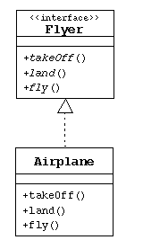
Interface example
public interface Flyer {
public void takeOff();
public void land();
public void fly();
}
public class Airplane implements Flyer {
public void takeOff() {
// accelerate until lift-off
// raise landing gear
}
public void land() {
// lower landing gear
// deccelerate and lower flaps until touch-down
// apply breaks
}
public void fly() {
// keep those engines running
}
}

Slide 17
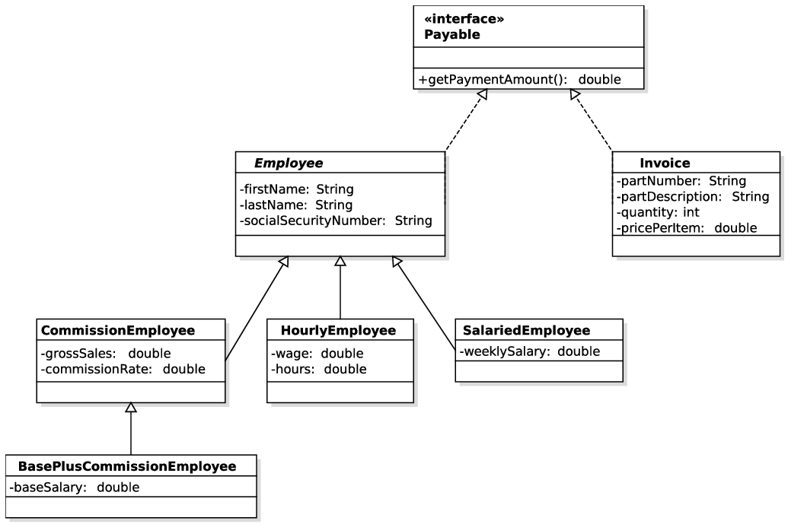
Another interface example

Slide 18
Interfaces usage
The usefulness of interfaces goes far beyond simply publishing protocols for other programmers. Any function can have parameters that are of interface type. Any object of a class that implements the interface may be passed as an argument.

Slide 19
Interfaces and abstract classes
A class can only extend a single abstract class, but it can implement as many interfaces as it wants
An abstract class can have a partial implementation, protected parts, static methods and so on, while interfaces are limited to public constants and public methods with no implementation

Slide 20

Virtual methods
Methods declared in interfaces are actually "virtual medhods" because their behavior can be implemented differently in implementing classes

Slide 21
Nested classes
Nested classes are divided into two categories: static and non-static. Nested classes that are declared static are called static nested classes. Non-static nested classes are called inner classes.
Compelling reasons for using nested classes include the following:
  It is a way of logically grouping classes that are only used in one place: If a class is useful to only one other class, then it is logical to embed it in that class and keep the two together. Nesting such "helper classes" makes their package more streamlined.
  It increases encapsulation: Consider two top-level classes, A and B, where B needs access to members of A that would otherwise be declared private. By hiding class B within class A, A's members can be declared private and B can access them. In addition, B itself can be hidden from the outside world.
  It can lead to more readable and maintainable code: Nesting small classes within top-level classes places the code closer to where it is used.

Slide 22
Inner class example
public class Outer1 {
private int size;
/* Declare an inner class called "Inner" */
public class Inner {
public void doStuff() {
// The inner class has access to 'size' from Outer
size++;
}
}
public void testTheInner() {
Inner i = new Inner();
i.doStuff();
}
}

Slide 23
Questions and Comments
36
Notes:
Faculty Notes:
Ask participants for any questions or comments they may have.
Participant Notes:
N/A

