Slide 1
Application Delivery Fundamentals 2.0:
Java
Module 11: Multi-threaded Programming
Notes:
Faculty Notes:
Introduce yourself.
Introduce the module and time frame: 2 hours, 15 minutes.
Participant Notes:
N/A

Slide 2
Agenda
What is thread
Why need concurrent programming
Thread life cycle
Thread interactions:
  Synchronizations, joining, notification
Multithreaded programming caveats
  Deadlock, starvation, livelock
Performance issues
Notes:
Faculty Notes:
Outline the topics to be covered during this module.
Participant Notes:
N/A

Slide 3
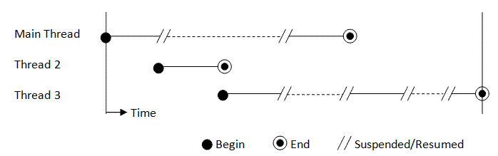
Threads
Threads is a single sequential flow of programming operations, with a definite beginning and an end. During the lifetime of the thread, there is only a single point of execution.

Slide 4
Why do we need Threads?
To maintain responsiveness of an application during a long running task
To enable cancellation of separable tasks
Some problems are intrinsically parallel
To monitor status of some resource (e.g., DB)
Some APIs and systems demand it (e.g., Swing)

Slide 5
Multithreading benefits
Benefits:
Editing a photo while recording a TV show through a digital video recorder
Downloading software while running an anti-virus program
“Anything that can be threaded today will map efficiently to multi-core”

Slide 6
Thread creation 1. approach
Implement Runnable interface:
public class HelloRunnable implements Runnable {
public void run() {
System.out.println("Hello from a thread!");
}
public static void main(String args[ {
(new Thread(new HelloRunnable()))
.start();
}
}

Slide 7
Thread creation 2. approach
Extend Thread class:
public class HelloThread extends Thread {
public void run() {
System.out.println("Hello from a thread!");
}
public static void main(String args[]) {
(new HelloThread()).start();
}
}

Slide 8
Which creation is better?
Implementing Runnable interface:
  More flexible
  You still can extend some other class
  More thread management features
Extending Thread class:
  Simpler code

Slide 9
Thread lifecycle
New: A new thread begins its life cycle in the new state. It remains in this state until the program starts the thread. It is also referred to as a born thread.
Runnable: After a newly born thread is started, the thread becomes runnable. A thread in this state is considered to be executing its task
Waiting (Runnable): Sometimes a thread transitions to the waiting state while the thread waits for another thread to perform a task. A thread transitions back to the runnable state only when another thread signals the waiting thread to continue executing.

Slide 10
Thread lifecycle
Timed waiting (Not Runnable): A runnable thread can enter the timed waiting state for a specified interval of time. A thread in this state transitions back to the runnable state when that time interval expires or when the event it is waiting for occurs.
Terminated: A runnable thread enters the terminated state when it completes its task or otherwise terminates

Slide 11
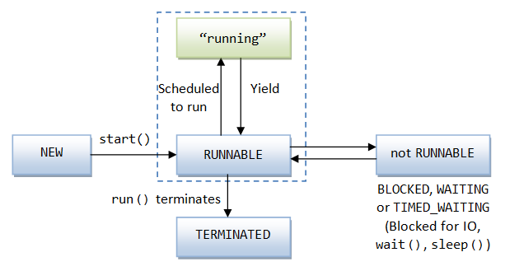
Thread lifecycle diagram

Slide 12
Thread management
 | Methods with Description
1 | public void start() Starts the thread in a separate path of execution, then invokes the run() method on this Thread object.
2 | public void run() If this Thread object was instantiated using a separate Runnable target, the run() method is invoked on that Runnable object.
3 | public final void setName(String name) Changes the name of the Thread object. There is also a getName() method for retrieving the name.
4 | public final void setPriority(int priority) Sets the priority of this Thread object. The possible values are between 1 and 10.
5 | public final void setDaemon(boolean on) A parameter of true denotes this Thread as a daemon thread.
6 | public final void join(long millisec) The current thread invokes this method on a second thread, causing the current thread to block until the second thread terminates or the specified number of milliseconds passes.
7 | public void interrupt() Interrupts this thread, causing it to continue execution if it was blocked for any reason.
8 | public final boolean isAlive() Returns true if the thread is alive, which is any time after the thread has been started but before it runs to completion.

Slide 13
Thread management Cont.
 | Methods with Description
1 | public static void yield() Causes the currently running thread to yield to any other threads of the same priority that are waiting to be scheduled.
2 | public static void sleep(long millisec) Causes the currently running thread to block for at least the specified number of milliseconds.
3 | public static boolean holdsLock(Object x) Returns true if the current thread holds the lock on the given Object.
4 | public static Thread currentThread() Returns a reference to the currently running thread, which is the thread that invokes this method.
5 | public static void dumpStack() Prints the stack trace for the currently running thread, which is useful when debugging a multithreaded application.
6 | public void wait() Causes the current thread to wait until another thread invokes the notify().
7 | public void notify() Wakes up a single thread that is waiting on this object's monitor.
8 | public void notifyAll() Wakes up all the threads that called wait( ) on the same object.

Slide 14
Thread interactions
Java has many features for thread interactions.
Main features of these are:
  Thread synchronization using synchronized blocks of code with implicit locking mechanism
  Notification mechanism between threads
  Joining, killing and other management of separate threads

Slide 15
Method join
When join is called to other thread, current thread is blocked until the second thread terminates (or the specified number of milliseconds passes).
public static void main(String[] args) {
Thread t = new Thread(new Runner());
t.start();
...
// do something in other thread
...
// wait some time and try to join
try {
t.join();
} catch (InterruptedException e) {
// if was interrupted by other thread
}
...
// continue alone
...
}

Slide 16
Synchronization
Synchronization of threads is needed for in order to control threads coordination, mainly in order to prevent simultaneous operations on data.
For simple synchronization Java provides the synchronized keyword

Slide 17
Synchronization
Example 1 – synchronizing methods:
public class SynchronizedCounter {
private int c = 0;
public synchronized void increment() { c++; } public synchronized void decrement() { c--; } public synchronized int value() { return c; }
}
The synchronized keyword on a method means that if this is already locked anywhere
(on this method or elsewhere) by another thread,
we need to wait till this is unlocked before entering the method.

Slide 18
Synchronization
Example 2 – synchronizing methods:
public void addName(String name) { synchronized(this) {
lastName = name;
nameCount++;
}
nameList.add(name);
}
When synchronizing a block, key for the locking should be supplied (usually would be this)
The advantage of not synchronizing the entire method is efficiency.

Slide 19
Synchronization
Example 3 – synchronizing using different locks:
public class TwoCounters {
private long c1 = 0, c2 = 0;
private Object lock1 = new Object();
private Object lock2 = new Object();
public void inc1() {
synchronized(lock1) {
c1++;
}
}
public void inc2() {
synchronized(lock2) {
c2++;
}
}
}
You must be absolutely sure that there is no tie between c1 and c2

Slide 20
Synchronization (Monitor)
Each object has a “monitor” that is a token used to determine which application thread has control of a particular object instance.
In execution of a synchronized method (or block), access to the object monitor must be gained before the execution.
Access to the object monitor is queued

Slide 21
Synchronization (Monitor)
Entering a monitor is also referred to as locking the monitor, or acquiring ownership of the monitor.
If a thread A tries to acquire ownership of a monitor and a different thread has already entered the monitor, the current thread (A) must wait until the other thread leaves the monitor.

Slide 22
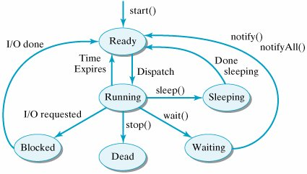
Thread lifecycle with synchronized methods

Slide 23

Deadlock
Deadlock describes a situation where two or more threads are blocked forever, waiting for each other.
Deadlocks appear when more than one resource is necessary to do operation
To prevent deadlocks
  Define global order how resources are locked
  Locks are released in reverse order as they are gathered

Slide 24

Thread interaction with locking
To avoid so called "busy waiting", threads which needs interaction with locking uses wait() and notify() methods
There are two separate
queues
  Objects waiting
  for locks
  Objects with locks

Slide 25
Proper synchronization management
Proper synchronization management ensures:
  Shared resources are in consistent state
  No deadlocks appear
  Threads which wait for different resources are waiting in different queues (thread pools)
Two approaches are used
  With pessimistic locking all resources are locked from beginning till to the end of transaction.
  With optimistic locking resources are not actually locked when it they are accessed by a transaction first time, just state of the resource is saved instead.
  At commit time state of the resource is read again and compared. If the two states are the same, transaction is commited, if differ — the transaction is rolled back.

Slide 26
Starvation and livelock
Starvation and livelock are much less common a problem than deadlock, but are still problems that every designer of concurrent software is likely to encounter.
Starvation
is situation where a thread is unable to gain regular access to shared resources and is unable to make progress. This happens when shared resources are made unavailable for long periods by "greedy" threads.
Livelock
A thread often acts in response to action from another thread, or, simply put, livelock is situation when all processing power goes to just lock management.
E.g. two people in narrow coridor: Alphonse moves to his left to let Gaston pass, while Gaston moves to his right to let Alphonse pass. Seeing that they are still blocking each other, Alphone moves to his right, while Gaston moves to his left. They're still blocking each other, so...

Slide 27

Performance and synchronization
Amdahl's law predicts maximum expected improvement to an overall system when only part of the system is improved
http://en.wikipedia.org/wiki/Amdahl%27s_law

Slide 28
Questions and Comments
Notes:
Faculty Notes:
Ask participants if they have any questions or comments so far.
Participant Notes:
N/A

