Slide 1
Accenture Delivery Fundamentals 2.0: Java
Module 13: JDBC
Notes:
Module Duration: 4 hours
Faculty Notes:
N/A
Participant Notes:
N/A

Slide 2
Agenda
What is JDBC
JDBC components
JDBC interface (API)
Mai classes of java.sql package:
  Driver
  Connection
  Statement
  ResultSet
  PreparedStatement
Briefly about SQL
SQL injections
Transactions
Notes:
Faculty Notes:
Review the agenda with the participants.
Participant Notes:
N/A

Slide 3
JDBC Overview
JDBC is the Java industry standard for database-independent connectivity between the Java language and databases.
JDBC provides an API that gives the application the ability to:
Connect to databases
Send SQL statements
Process results
JDBC technology allows you to use the Java programming language to exploit ‘write once, run anywhere’ capabilities for applications that require access to enterprise data.
6
Notes:
Faculty Notes:
Review the slide content with the participants.
Participant Notes:
N/A

Slide 4
Purpose
Database drivers or JDBC drivers are required to connect to different databases.
JDBC drivers:
  Provide the connection to the database.
  Implement the protocol necessary for sending queries and retrieving results.
Application
JDBC API
JDBC Driver
Database
7
Notes:
JDBC consists of following components:
JDBC API — provides programmatic access from Java o database
JDBC Driver Manager — defines objects which can connect Java applications to a JDBC driver.
JDBC Test Suite — helps to determine that JDBC drivers will run your program.
JDBC-ODBC Bridge — provides JDBC access via ODBC (ODBC (Open Database Connectivity developed by Microsoft) drivers

Slide 5
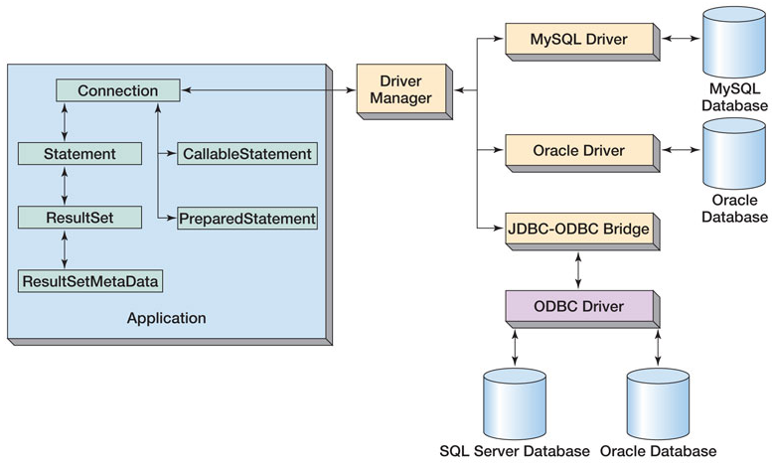
JDBC Components

Slide 6
JDBC interface
JDBC (Java Database Connectivity) interface (API) provides:
  Connection to the database
  Creation of SQL statements
  Invocation of SQL statements, actual execution is performed by database
  Retrieval of returned results

Slide 7
JDBC example
import java.sql.*;
public class JDBCSample {
public static void main( String args[]) {
String connectionURL = ;
try {
Class.forName("com.mysql.jdbc.Driver"); // Load the driver class.
Connection con = DriverManager.getConnection(
"jdbc:mysql://localhost:3306/test","user", "password"); //Create connection
Statement stmt = con.createStatement(); //Create a Statement
//Execute the statement and store results in ResultSet object
ResultSet rs = stmt.executeQuery("select moviename, releasedate from movies");
while (rs.next())
System.out.println("Name= " + rs.getString("name")); // Iterate through ResultSet
} catch (Exception e) {
System.err.println(e);
} finally {
con.close(); // Close the connection
}
}
}

Slide 8
Creation of JDBC driver instance
Before connection to database it is necessary to load appropriate driver
It is static class which is loaded on first invocation, passing its name as string:
Class.forName("com.mysql.jdbc.Driver")
There is no need to assign returned value to variable

Slide 9
Creation of JDBC connection
Class.forName("com.mysql.jdbc.Driver");
Connection conn = null;
conn = DriverManager.getConnection("jdbc:mysql://hostname:port/dbname","username", "password");
conn.close();

Slide 10
SQL statement
Database operations are performed using Statement object:
Statement satement = connection.createStatement("SQL statement");
As Java is strongly typed language, it has three methods with different names and returned types:
  boolean execute() — is used to update one record
  ResultSet executeQuery() — is used when Select operation is perormed
  int executeUpdate() — is used when insert, update or delete actions are performed on several records

Slide 11
SELECT Statements
SELECT statement:
Used to retrieve data from the table
Can be used to retrieve selected rows and columns from a table
Syntax:
SELECT <Column1>, <Column2> FROM <table name>
or
SELECT * FROM <table name>
Example:
SELECT Dept_name FROM Department;
or
SELECT * FROM Department;
32
Notes:
Faculty Notes:
Review the slide content with the participants.
Ask the participants to use a Select statement to retrieve all of the records from the Department table they created earlier. The table will currently not have any records and should return an empty set.
Participant Notes:
Use a Select statement to retrieve all of the rows from the Department table you created earlier.

Slide 12
INSERT Statements
INSERT statement:
Allows users to add records into a table
Sequence of the values being inserted follows the sequence of columns in the INSERT statement
Enclose Character and Date data column values within single quotes (‘) while inserting a record
Syntax:
INSERT INTO <table> [ (<column(s)> ) ] VALUES (<value(s)>)
Example:
int res = st.executeUpdate("insert into mytable values (1,'aa')");
36
Notes:
Faculty Notes:
Review the slide content with the participants.
Participant Notes:
N/A

Slide 13
Update statement
UPDATE statement is used to update values of columns in existing rows of the table
To execute Update statement executeUpdate() should be used
Syntax:
UPDATE <table name>
SET <column> = <value>
[, <column> = <value>, …]
[WHERE <condition>]
Example:
UPDATE Department
SET name = ‘Information Technology’
WHERE Dept_id = ‘D002’;

Slide 14
Delete statement
Delete statement is used to delete records from the table
To execute Delete statement executeUpdate() method should be used
Syntax:
DELETE FROM <table name>
[WHERE <condition>];
Example:
DELETE FROM Department WHERE Dept_id = ‘D001’;

Slide 15
Result handling
Results which return more than 1 object are stored in ResultSet object
ResultSet has internal iterator, which points to non-existing record before first record
ResultSet.next() move iterator to next record, and if there is no any, ir returns false. Otherwise it points to first record
Different getXxx() methods allow to get values from fields of one record
Example:
Syntax:
while (rs.next()) {
System.out.println("Customer: " + rs.getString(2));
System.out.println("Id: " + rs.getString(1));
System.out.println("");
}

Slide 16
getXxx() methods of ResultSet
Method | Returned type
getBinaryStream() | java.io.InputStream
getBoolean() | boolean
getByte() | byte
getBytes() | Byte [ ]
getDate() | java.sql.Date
getDouble() | double
getFloat() | float
getInt() | int
getLong() | long
getShort() | short
getString() | java.lang.String
getTime() | java.sql.Time

Slide 17
SQL injections
As the name implies, SQL injection vulnerabilities allow an attacker to inject (or execute) SQL commands within an application. It is one of the most wide spread and dangerous application vulnerability. The CLASP project provides a good overview of SQL injection.

Slide 18
Example of SQL injection
The following Java servlet code, used to perform a login function, illustrates the vulnerability by accepting user input without performing adequate input validation or escaping meta-characters.
conn = pool.getConnection( );
String sql = "select * from user where username='" + username +"' and password='" + password + "'";
stmt = conn.createStatement();
rs = stmt.executeQuery(sql);
if (rs.next()) {
loggedIn = true;
out.println("Successfully logged in");
} else {
out.println("Username and/or password not recognized");
}

Slide 19
Prepared statements
Prepared statements are used to:
  Improve performance by converting string to pre-processed bytecode form
  Avoid SQL injections by allowing to pass only valid type of parameters
  Preview (hint: you can copy and paste the preview into Microsoft Word):
// create SQL statement with parameters
PreparedStatement st = conn.prepareStatement(
“UPDATE account “ +
“SET balance = ? “ +
“WHERE id = ?”);
// bind the parameters
st.setFloat(1, accounts[i].getBalance());
st.setInt(2, accounts[i].getId());
st.execute();
st.clearParameters();

Slide 20
setXxx() methods of PreparedStatement
Method | Converted SQL type
setBinaryStream() | LONGVARBINARY
setBoolean() | BIT
setByte() | TINYINT
setBytes() | VARBINARY vai LONGVARBINARY
setDate() | DATE
setDouble() | DOUBLE
setFloat() | FLOAT
setInt() | INTEGER
setLong() | BIGINT
setShort() | SMALLINT
setString() | VARCHAR vai LONGVARCHAR
setTIME() | TIME

Slide 21

Transaction
A transaction is a set of one or more SQL statements that make up a logical unit of work
It is ether fully executed or not executed at all
How you "not execute" partially executed task?

Slide 22
Transaction example
try {
con.setAutoCommit(false);
updateSales = con.prepareStatement(statementString);
con.commit(); // commit successful
} catch (SQLException e ) {
con.rollback(); // rollback
} finally {
con.setAutoCommit(true);
}

Slide 23
Questions and Comments
Notes:
Faculty Notes:
Ask the participants if they have any questions or comments.
Participant Notes:
N/A

